Slide 1
Chapter 5
Input and Output

Slide 2
Objectives Overview
Differentiate among various types of keyboards: standard, compact, on-screen, virtual, ergonomic, gaming, and wireless
Describe characteristics of various pointing devices: mouse, touchpad, pointing stick, and trackball
Describe various uses of touch screens
Describe various types of pen input: stylus, digital pen, and graphics tablet
Describe various uses of motion input, voice input, and video input
See Page 288
for Detailed Objectives

Slide 3
Objectives Overview
Differentiate among various scanners and reading devices
Explain the characteristics of various displays
Summarize the various types of printers
Identify various assistive technology input and output methods
Identify the purpose and features of speakers, headphones and earbuds, data projectors, interactive whiteboards, and force-feedback game controllers and tactile output
See Page 288
for Detailed Objectives

Slide 4
What Is Input?
Input is any data and instructions entered into the memory of a computer
Pages 288– 289
Figure 7-1

Slide 5
What Is Input?
Commonly used input methods include:
Keyboard
Pointing devices
Touch screens
Pen input
Motion input
Voice input
Video input
Scanners and reading devices
Page 288

Slide 6
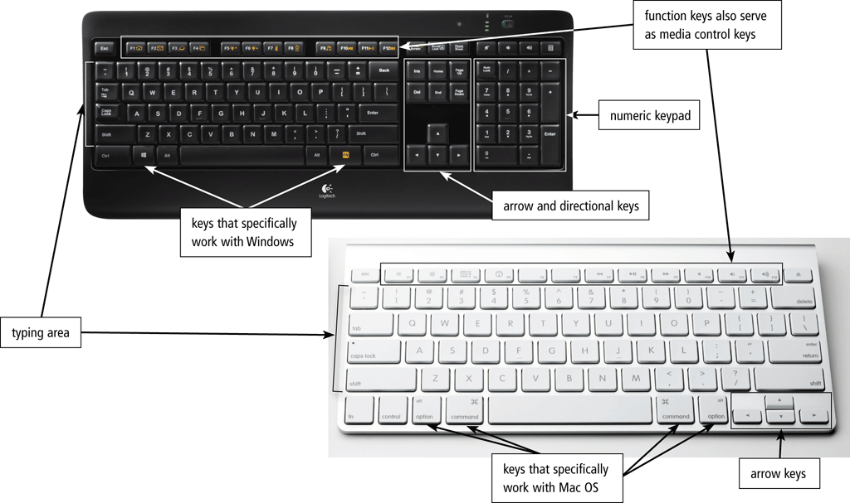
Keyboards
A keyboard is an input device that contains keys users press to enter data and instructions into a computer or mobile device
Page 290
Figure 7-2

Slide 7
Keyboards
Most desktop computer keyboards have…
Typing area
Function keys
Toggle key
Directional keys
Media control buttons
Internet control buttons
Page 290

Slide 8
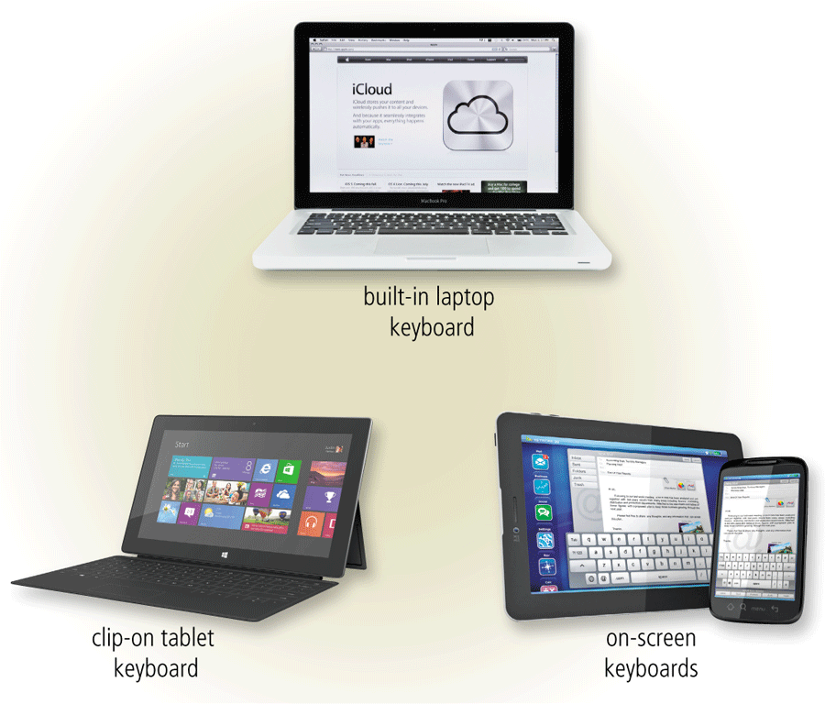
Keyboards
There are various types of keyboards in addition to standard keyboards found on desktops
Page 291
Figure 7-3

Slide 9
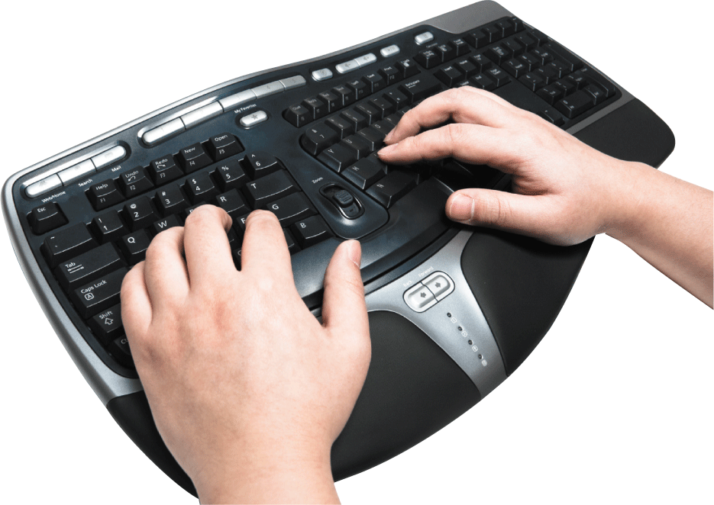
Keyboards
An ergonomic keyboard has a design that reduces the chance of repetitive strain injuries
Ergonomics incorporates comfort, efficiency, and safety into the design of the workplace
Page 292
Figure 7-4

Slide 10
Pointing Devices
A pointer is a small symbol on the screen whose location and shape change as a user moves a pointing device
Page 292

Slide 11
Pointing Devices
A mouse is a pointing device that fits under the palm of your hand comfortably
Optical mouse, laser mouse, and touch mouse
Page 292
Figure 7-5

Slide 12
Pointing Devices
Touchpad
A touchpad is a small, flat, rectangular pointing device that is sensitive to pressure and motion
Pointing Stick
A pointing stick is a pressure-sensitive pointing device shaped like a pencil eraser that is positioned between keys on a mobile computer keyboard
Trackball
A trackball is a stationary pointing device with a ball on its top or side
Pages 293 - 294
Figures 7-6 – 7-8

Slide 13
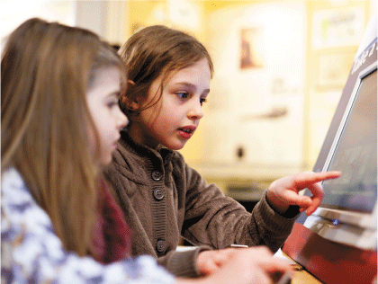
Touch Screens
A touch screen is a touch-sensitive display device
Page 294

Slide 14
Pen Input
With pen input, you touch a stylus or digital pen on a flat surface to write, draw, or make selections
Page 297
Figure 7-10

Slide 15
Pen Input
A graphics tablet, also called a digitizer, is an electronic plastic board that detects and converts movements of a style or digital pen into signals that are sent to the computer
Page 298
Figure 7-12

Slide 16
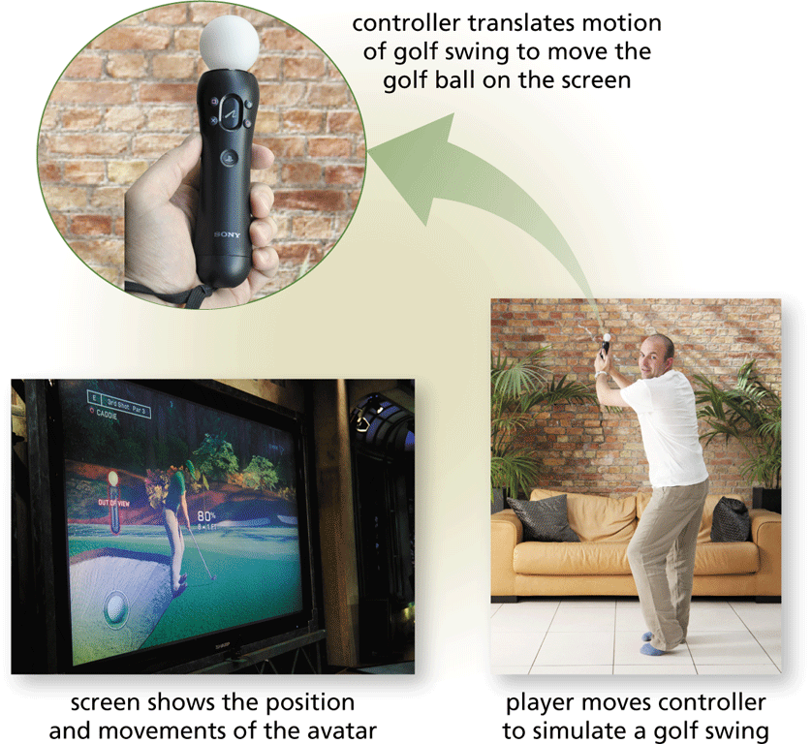
Motion Input
With motion input, sometimes called gesture recognition, users can guide on-screen elements using air gestures
Pages 298 - 299

Slide 17
Voice Input
Voice input is the process of entering input by speaking into a microphone
Voice recognition, also called speech recognition, is the computer or mobile device’s capability of distinguishing spoken words
Pages 299 – 300
Figure 7-13

Slide 18
Audio Input
Audio input is the process of entering any sound into the computer such as speech, music, and sound effects
Music production software allows users to record, compose, mix, and edit music and sounds
Page 300
Figure 7-14

Slide 19
Video Input
Video input is the process of capturing full-motion images and storing them on a computer or mobile device’s storage medium
Record video on a digital video (DV) camera
Transfer video to a computer or mobile device
Page 300

Slide 20
Video Input
A webcam is a type of DV camera that enables a user to:
Capture video and still images
Send email messages with video attachments
Add live images to instant messages
Broadcast live images over the Internet
Conduct videoconferences
Make video calls
Page 302

Slide 21
Video Input
A videoconference is a meeting between two or more geographically separated people
Page 303
Figure 7-16

Slide 22
Scanners and Reading Devices
A scanner is a light-sensing input device that reads printed text and graphics and then translates the results into a form the computer can process
A flatbed scanner works in a manner similar to a copy machine except it creates a file of the document in memory instead of a paper copy
Page 304

Slide 23
Scanners and Reading Devices
Page 304
Figure 7-17

Slide 24
Scanners and Reading Devices
An optical reader is a device that uses a light source to read characters, marks, and codes and then converts them into digital data that a computer can process
Optical character recognition (OCR)
Optical mark recognition (OMR)
Page 304

Slide 25
Scanners and Reading Devices
A bar code reader, also called a bar code scanner uses laser beams to read bar codes
A QR code stores information in both a vertical and horizontal direction
Page 305
Figure 7-18

Slide 26
Scanners and Reading Devices
RFID (radio frequency identification) uses radio signals to communicate with a tag placed in or attached to an object
An RFID reader reads information on the tag via radio waves
RFID can track:
Tracking times of runners in a marathon
Tracking location of people and other items
Checking lift tickets of skiers
Managing inventory
Gauging temperature and pressure of tires on a vehicle
Checking out library books
Providing access to rooms or buildings
Page 306

Slide 27
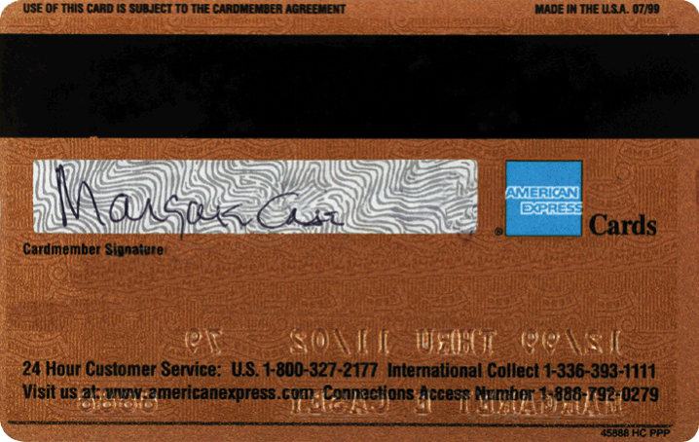
Scanners and Reading Devices
Magstripe readers read the magnetic stripe on the back of cards such as:
Credit cards
Entertainment cards
Bank cards
Other similar cards
Identification cards
Page 306
Figure 7-20

Slide 28
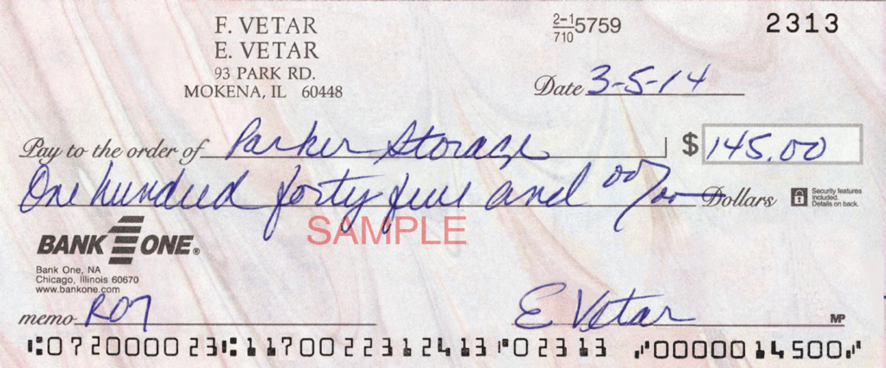
Scanners and Reading Devices
MICR (magnetic ink character recognition) devices read text printed with magnetized ink
An MICR reader converts MICR characters into a form the computer can process
Banking industry uses MICR for check processing
Page 307
Figure 7-21

Slide 29
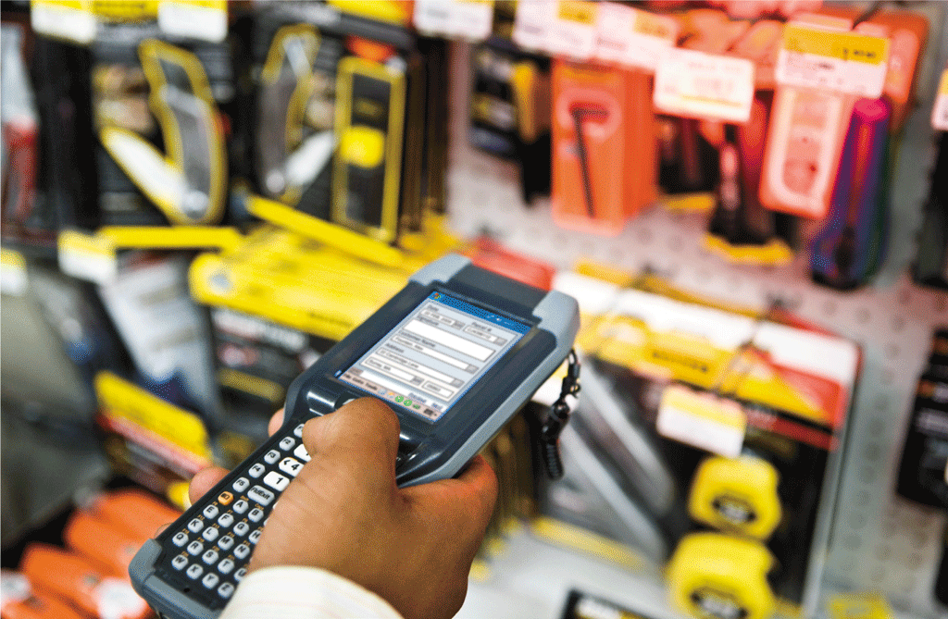
Scanners and Reading Devices
A data collection device obtains data directly at the location where the transaction or event takes place
Page 307
Figure 7-22

Slide 30
What Is Output?
Output is data that has been processed into a useful form
Page 308
Figure 7-23

Slide 31
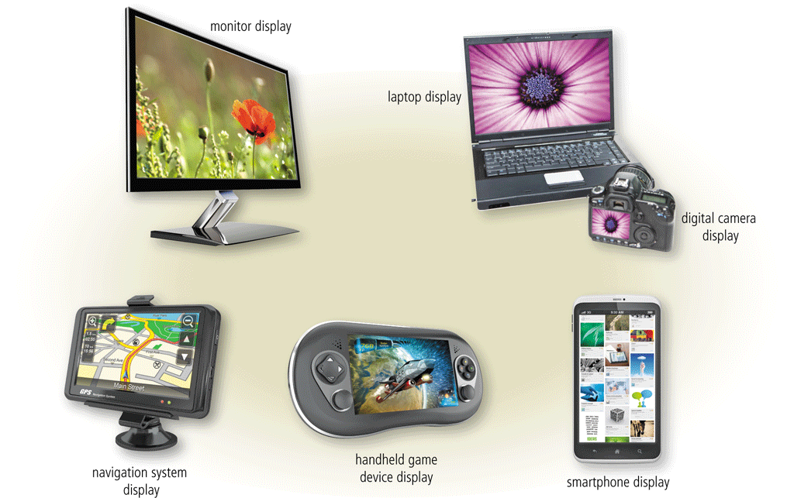
Displays
A display visually conveys text, graphics, and video information
A monitor is a display that is packaged as a separate peripheral device
LCD monitor
Pages 309 - 310
Figure 7-24

Slide 32
Displays
The quality of a display depends primarily on its:
Resolution
Response time
Brightness
Dot pitch
Contrast ratio
Pages 310 - 311

Slide 33
Displays
Today’s monitors use a digital signal to produce a picture
To display the highest quality images, the monitor should plug into:
A DVI port
An HDMI port
A DisplayPort
Page 311

Slide 34
Displays
Home users sometimes use a digital television (DTV) as a display
HDTV is the most advanced form of digital television
A Smart TV is an Internet-enabled HDTV
Page 311
Figure 7-25

Slide 35
Printers
A printer produces text and graphics on a physical medium
Before purchasing a printer, ask yourself a series of questions
Pages 312 - 313
Figure 7-26

Slide 36
Printers
A nonimpact printer forms characters and graphics on a piece of paper without actually contacting the paper
Ink-jet printers
Photo printers
Laser printers
Thermal printers
Mobile printers
Plotters
Large-format printers
All-in-one printers
Page 313

Slide 37
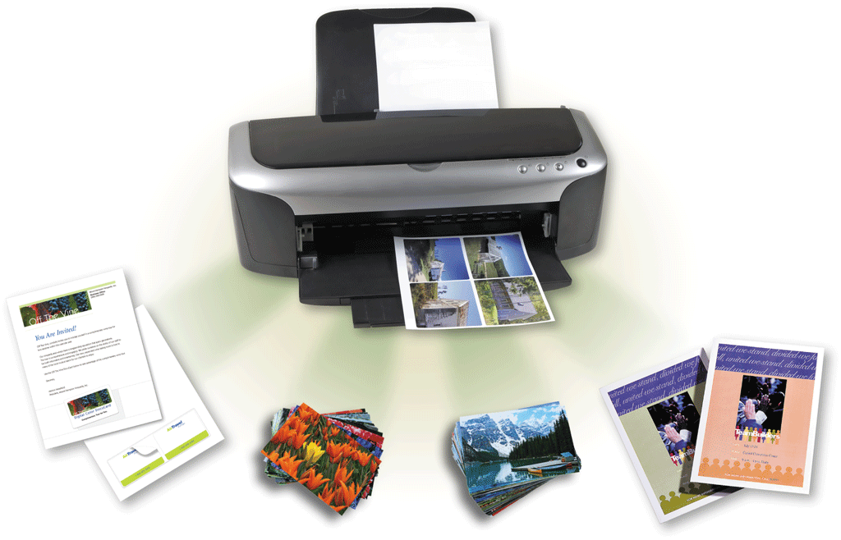
Printers
An ink-jet printer forms characters and graphics by spraying tiny drops of liquid ink onto a piece of paper
Color or black-and-white
Speed is measured by the number of pages per minute (ppm) it can print
Pages 313 - 314
Figure 7-27

Slide 38
Printers
A photo printer produces lab-quality pictures
Many use ink-jet technology
PictBridge allows you to print photos directly from a digital camera
Print from a memory card
Page 315

Slide 39
Printers
Page 315
Figure 7-29

Slide 40
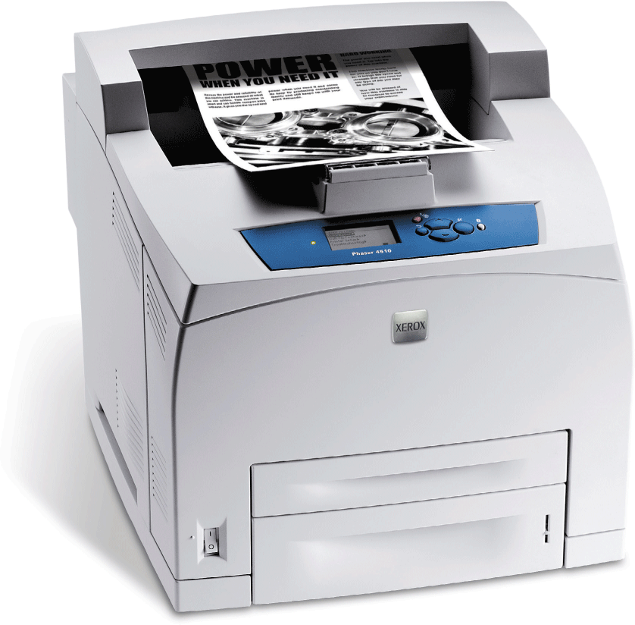
Printers
Laser printer
High-speed
High-quality
Color
Black-and-white
Page 316
Figure 7-30

Slide 41
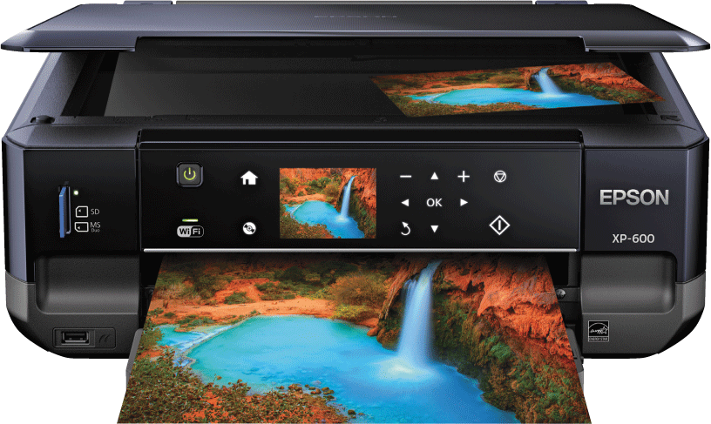
Printers
An all-in-one printer is a single device that prints, scans, copies, and in some cases, faxes
Sometimes called a multifunction printer
Page 318
Figure 7-32

Slide 42
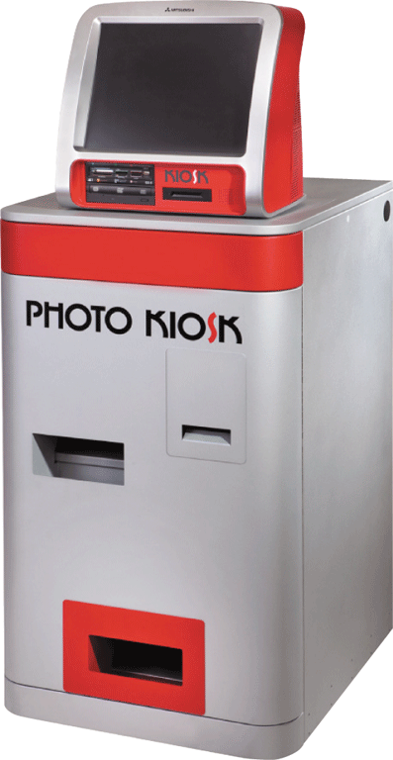
Printers
A thermal printer generates images by pushing electrically heated pins against the heat-sensitive paper
Dye-sublimation printer
Page 318
Figure 7-33

Slide 43
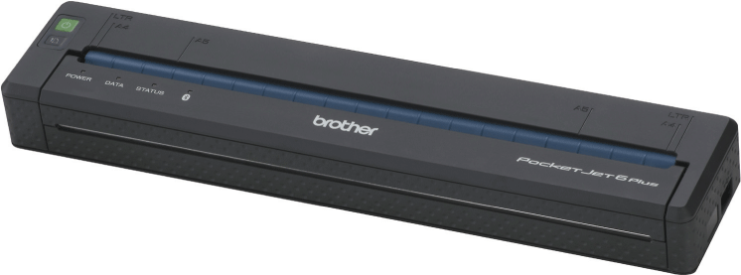
Printers
A mobile printer is a small, lightweight, battery-powered printer that allows a mobile user to print from a mobile device
Page 318
Figure 7-34

Slide 44
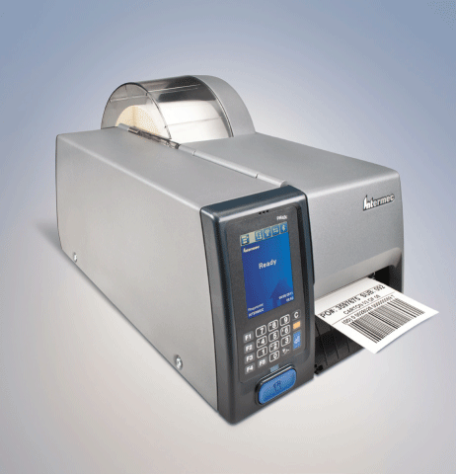
Printers
A label printer is a small printer that prints on an adhesive-type material that can be placed on a variety of items
Page 318
Figure 7-35

Slide 45
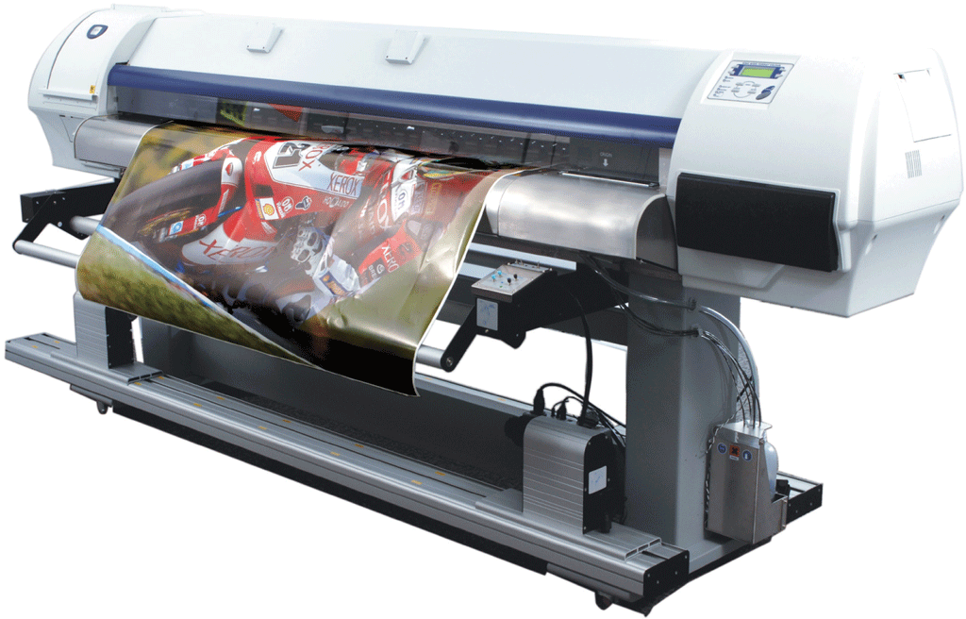
Printers
Plotters are used to produce high-quality drawings
Large-format printers create photo-realistic quality color prints
Pages 318 - 319
Figure 7-36

Slide 46
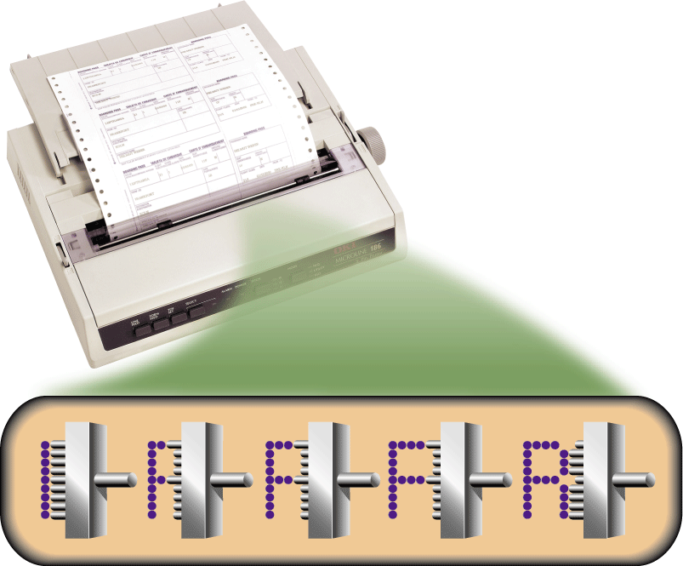
Printers
Impact printers form characters and graphics on a piece of paper by striking a mechanism against an inked ribbon that physically contacts the paper
Page 319
Figure 7-37

Slide 47
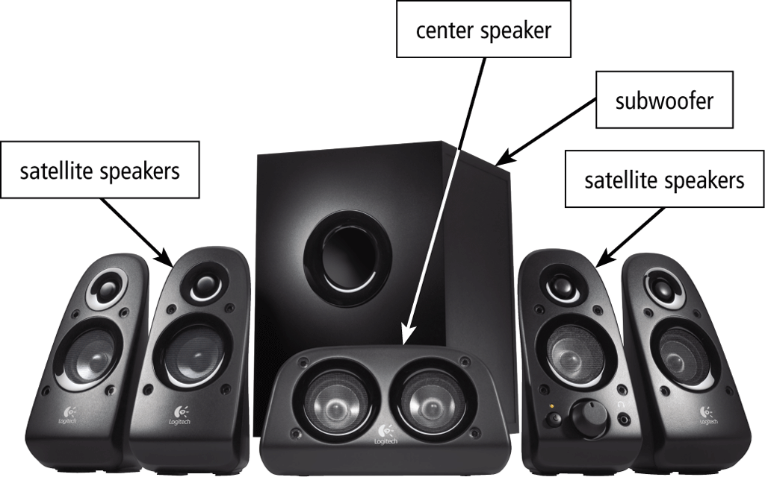
Other Output Devices
Many users attach surround sound speakers or speaker systems to their computers, game consoles, and mobile devices to generate higher-quality sounds
Page 319
Figure 7-38

Slide 48
Other Output Devices
Headphones are speakers that cover or are placed outside of the ear
Earbuds (also called earphones) rest inside the ear canal
Page 320
Figure 7-39

Slide 49
Other Output Devices
A data projector is a device that takes the text and images displaying on a computer or mobile device screen and projects them on a larger screen
Page 320
Figure 7-40

Slide 50
Other Output Devices
An interactive whiteboard is a touch-sensitive device, resembling a dry-erase board, that displays the image on a connected computer screen
Page 321
Figure 7-41

Slide 51
Other Output Devices
Joysticks, wheels, gamepads, and motion-sensing game controllers can be considered output devices when they include force feedback
Technology that sends resistance to the device in response to actions of the user
Page 321
Figure 7-42

Slide 52
Assistive Technology Input and Output
Head-mounted pointer
Braille printer
Pages 321 - 322
Figures 7-44

Slide 53
Summary
Variety of options for input and output
Several assistive technology options for input and output
Page 323

