Slide 1
Chapter 8
Communication and Network

Slide 2
Objectives Overview
Discuss the purpose of the components required for successful communications and identify various sending and receiving devices
Differentiate between client/server and peer-to-peer networks
Differentiate among a star network, bus network, and ring network
Describe the various network communications standards and protocols
Differentiate among LANs, MANs, WANs, and PANs
Explain the purpose of communications software
See Page 416
for Detailed Objectives

Slide 3
Objectives Overview
Describe various types of communications lines
Differentiate among wireless transmission media
Describe commonly used communications devices
Discuss different ways to set up and configure a home network
Differentiate among physical transmission media
See Page 416
for Detailed Objectives

Slide 4
Communications
Digital communications describes a process in which two or more computers or devices transfer data, instructions, and information
Sending device
Communications channel
Receiving device
Page 416

Slide 5
Communications
Page 417
Figure 10-1

Slide 6
Networks
A network is a collection of computers and devices connected together via communications devices and transmission media
Advantages of a network include:
Facilitating communications
Sharing hardware
Sharing data and information
Sharing software
Transferring funds
Pages 418 - 419

Slide 7
Networks
Page 418
Figure 10-2

Slide 8
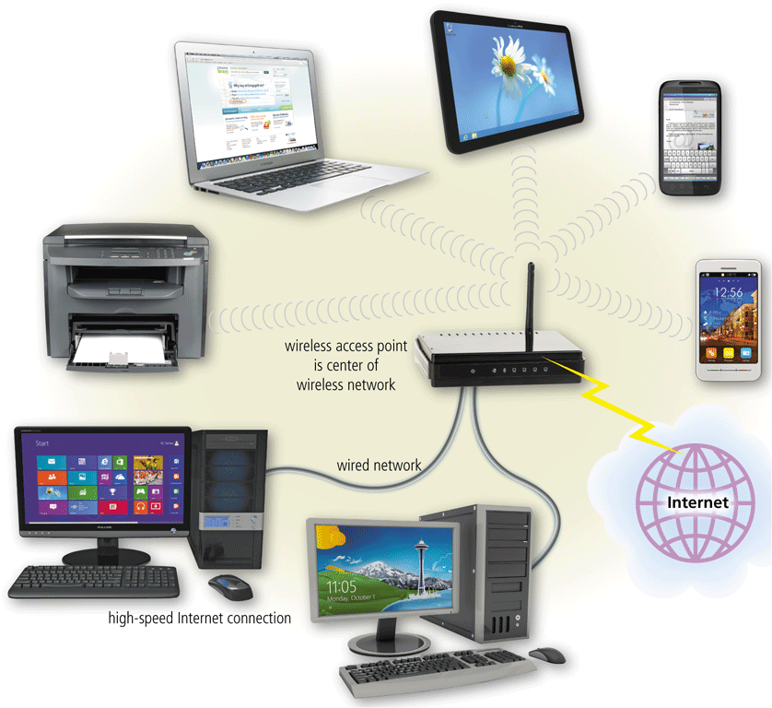
Networks
A local area network (LAN) is a network that connects computers and devices in a limited geographical area
A wireless LAN (WLAN) is a LAN that uses no physical wires
Pages 419 - 420
Figures 10-3 – 10-4

Slide 9
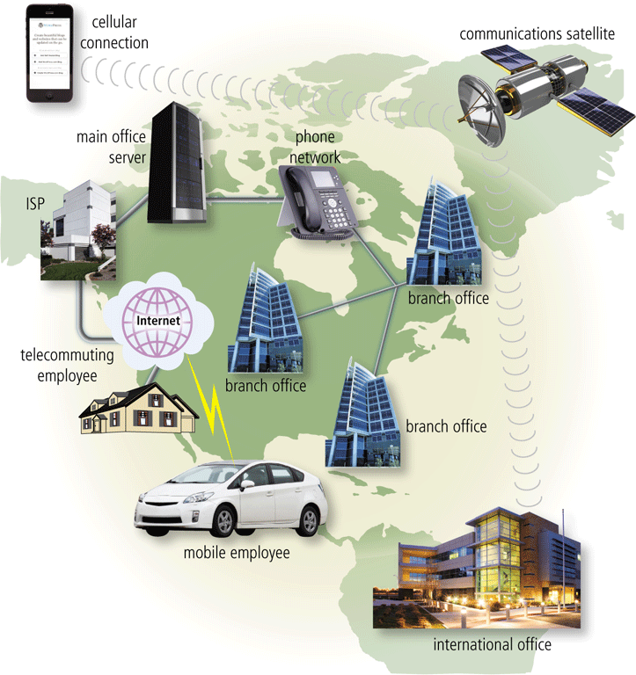
Networks
A metropolitan area network (MAN) connects LANs in a metropolitan area
A wide area network (WAN) is a network that covers a large geographic area
A personal area network (PAN) is a network that connects computers and devices in an individual’s workspace with wired and wireless technology
Page 421
Figure 10-5

Slide 10
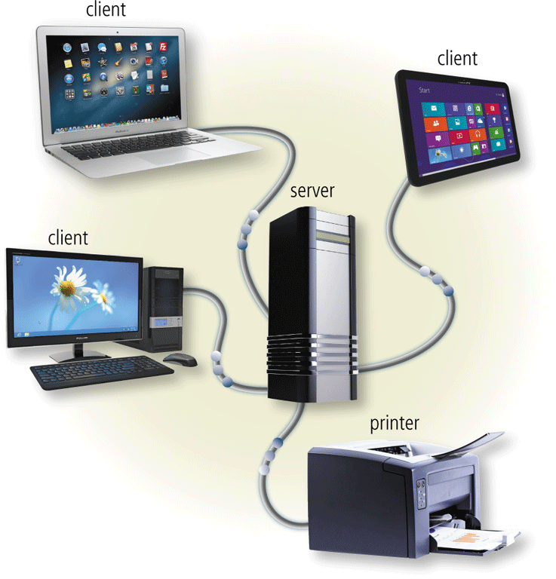
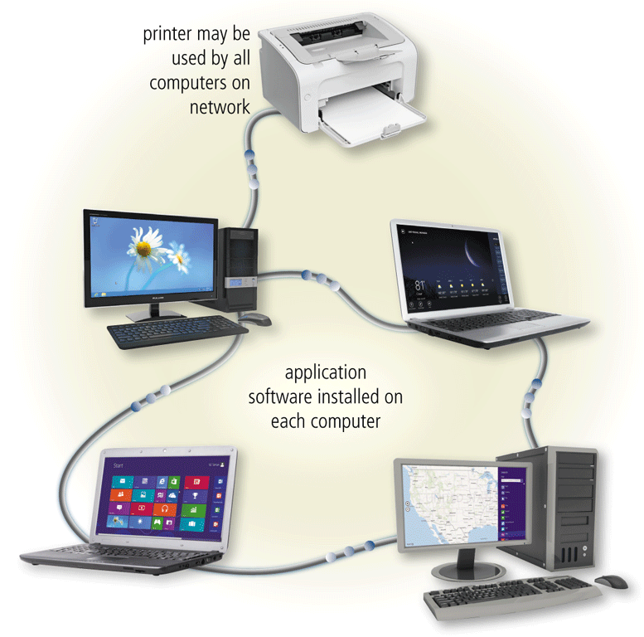
Networks
The configuration of computers, devices, and media on a network is sometimes called the network architecture
http://www.youtube.com/watch?v=uliny6fWbvs
Client/server network
Peer-to-peer network
Pages 421 - 422
Figures 10-6 – 10-7

Slide 11
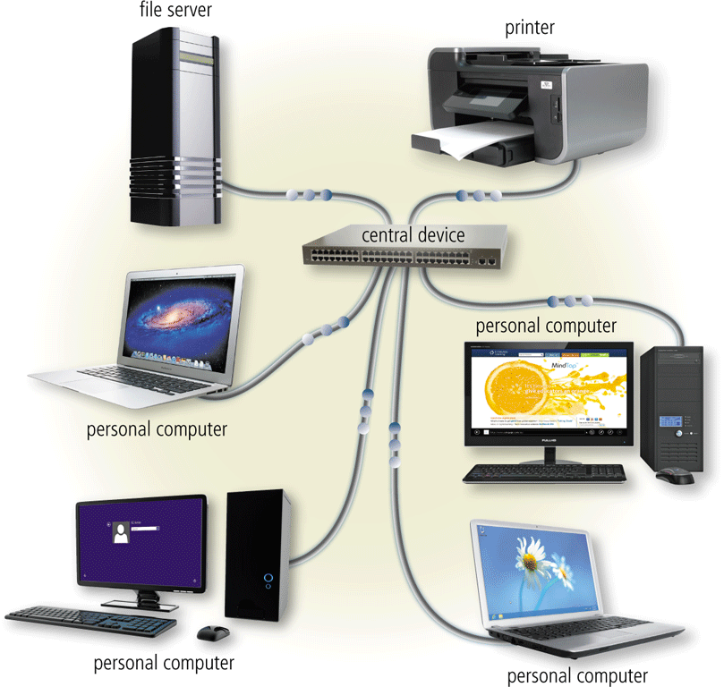
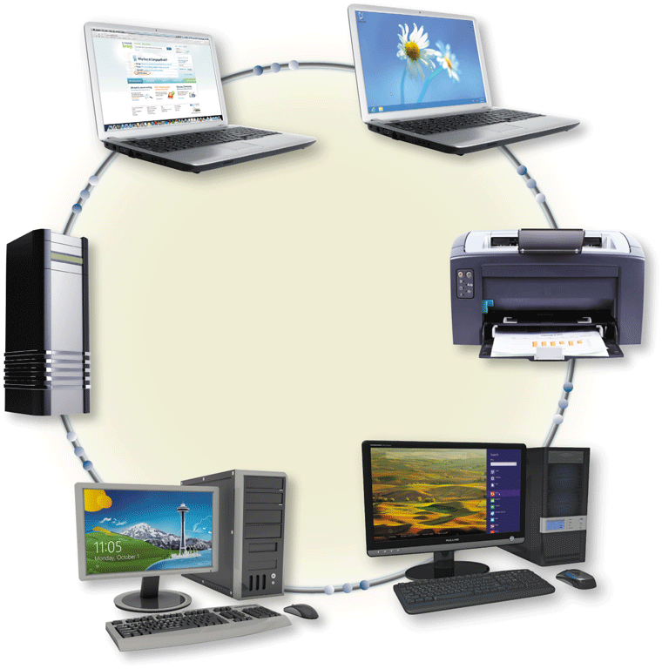
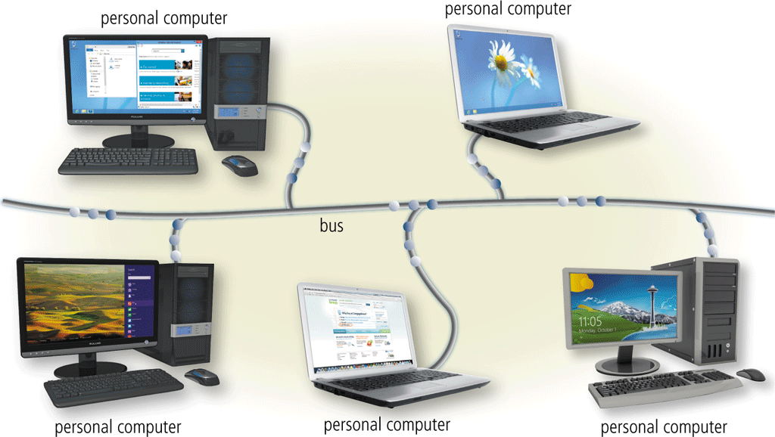
Networks
A network topology refers to the layout of the computers and devices in a communications network
http://www.youtube.com/watch?v=RdN06rhKtqA
Star network
Ring network
Bus network
Pages 423– 424
Figures 10-8 – 10-10

Slide 12
Network Communications Standards and Protocols
Ethernet
Token ring
TCP/IP
Wi-Fi
Bluetooth
UWB
IrDA
RFID
WiMAX
NFC
Page 425

Slide 13
Network Communications Standards and Protocols
Ethernet is a network standard that specifies no central computer or device on the network (nodes) should control when data can be transmitted
The token ring standard specifies that computers and devices on the network share or pass a special signal (token)
TCP/IP is a network protocol that defines how messages (data) are routed from one end of a network to another
Pages 425 - 426

Slide 14
Network Communications Standards and Protocols
Wi-Fi identifies any network based on the 802.11 standard that specifies how two wireless devices communicate over the air with each other
Bluetooth is a network protocol that defines how two Bluetooth devices use short-range radio waves to transmit data
UWB (ultra-wideband) is a network standard that specifies how two UWB devices use short-range radio waves to communicate at high speeds with each other
IrDA transmits data wirelessly via infrared (IR) light waves
RFID is a protocol that defines how a network uses radio signals to communicate with a tag placed in or attached to an object, an animal, or a person
Pages 427 - 429

Slide 15
Network Communications Standards and Protocols
Page 430
Figure 10-12

Slide 16
Communications Software
Communications software consists of programs and apps that:
Help users establish a connection to another computer, mobile device, or network
Manage the transmission of data, instructions, and information
Provide an interface for users to communicate with one another
Page 431

Slide 17
Communications Lines
Dedicated line
Cable
DSL
ISDN
FTTP
T-Carrier
ATM
Pages 432 - 434

Slide 18
Communications Lines
Page 433
Table 10-2

Slide 19
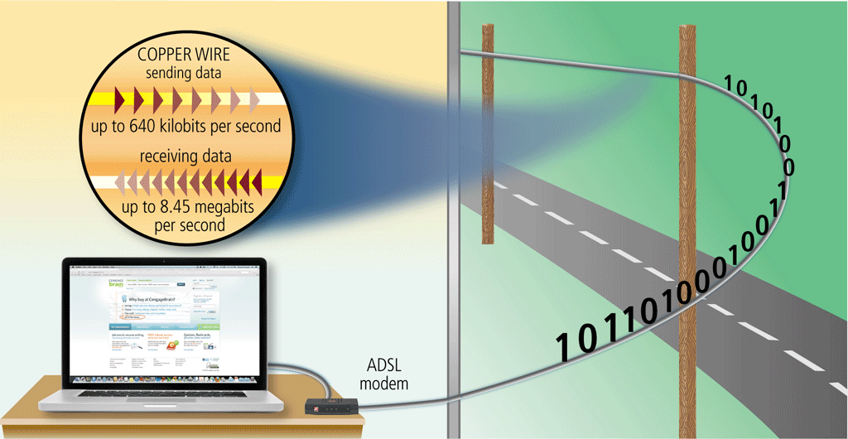
Communications Lines
ADSL is a type of DSL that supports faster transfer rates when receiving data
Page 433
Figure 10-14

Slide 20
Communications Devices
A communications device is any type of hardware capable of transmitting data, instructions, and information between a sending device and a receiving device
Page 434

Slide 21
Communications Devices
A broadband modem sends and receives data and information to and from a digital line
DSL modem
Cable modem
Page 435

Slide 22
Communications Devices
Page 435
Figure 10-15

Slide 23
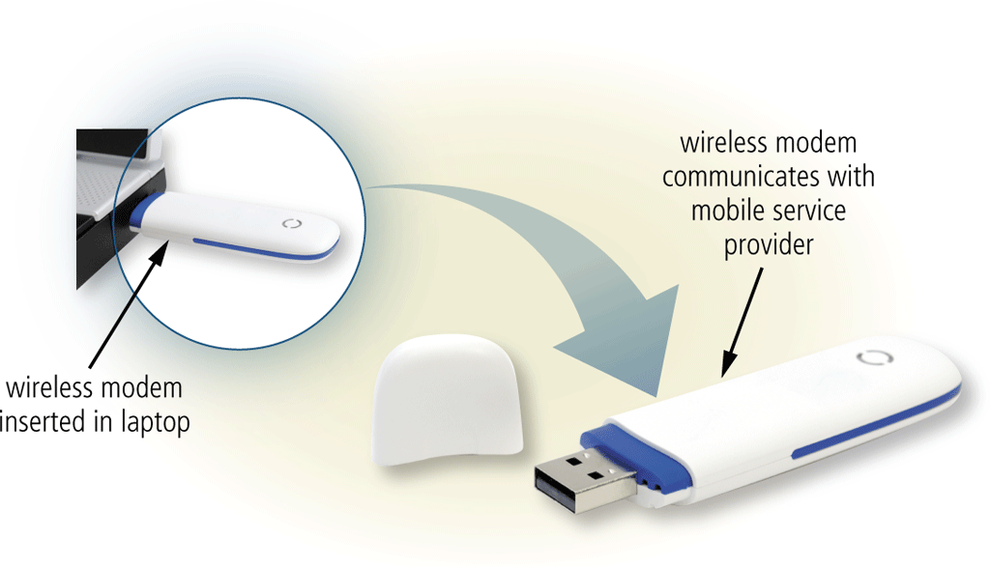
Communications Devices
A wireless modem uses a mobile phone provider’s network to connect to the Internet wirelessly from a computer or mobile device
Page 436
Figure 10-16

Slide 24
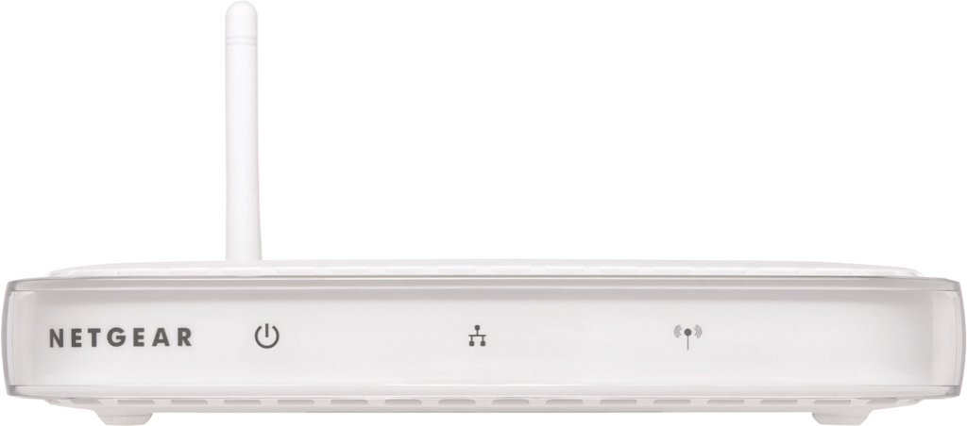
Communications Devices
A wireless access point is a central communications device that allows computers and devices to transfer data wirelessly among themselves or to a wired network
Page 436
Figure 10-17

Slide 25
Communications Devices
A router connects multiple computers or other routers together and transmits data to its correct destination on a network
Page 437
Figure 10-18

Slide 26
Communications Devices
A network card enables a computer or device that does not have built-in networking capability to access a network
Available in a variety of styles
Page 439
Figure 10-20

Slide 27
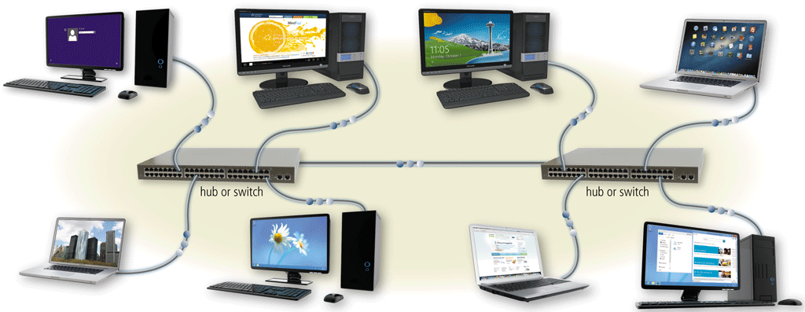
Communications Devices
A hub or switch is a device that provides a central point for cables in a network
http://www.youtube.com/watch?v=Ofjsh_E4HFY
Page 439
Figure 10-21

Slide 28
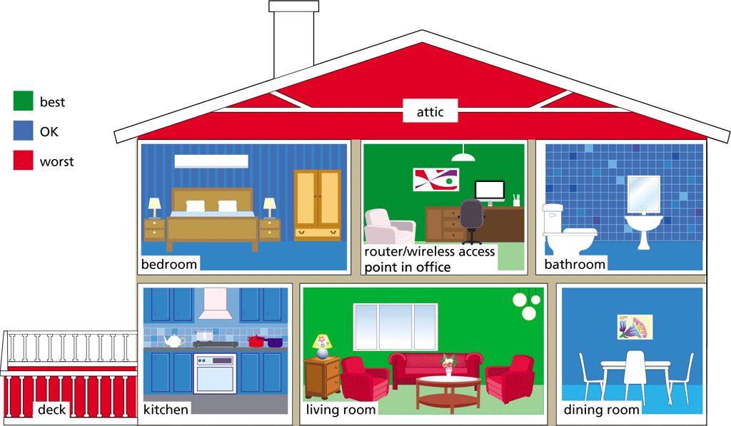
Home Networks
Many home users connect multiple computers and devices together in a home network
Pages 440 - 441

Slide 29
Transmission Media
Transmission media carries one or more communications signals
Broadband media transmit multiple signals simultaneously
The amount of data, instructions, and information that can travel over transmission media sometimes is called the bandwidth
Latency is the time it takes a signal to travel from one location to another on a network
Page 442
Figure 10-22

Slide 30
Physical Transmission Media
Page 443
Table 10-3

Slide 31
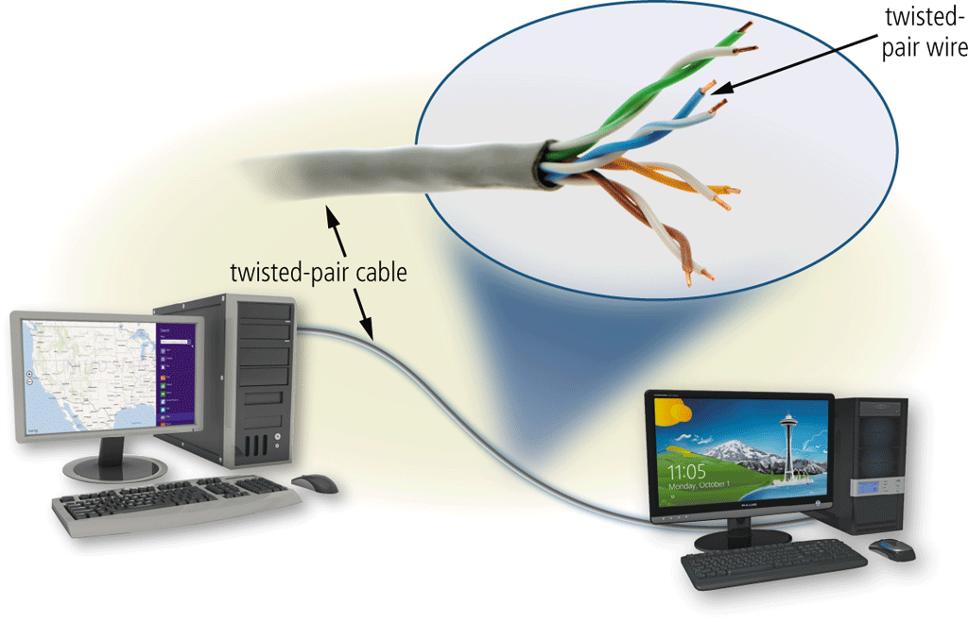
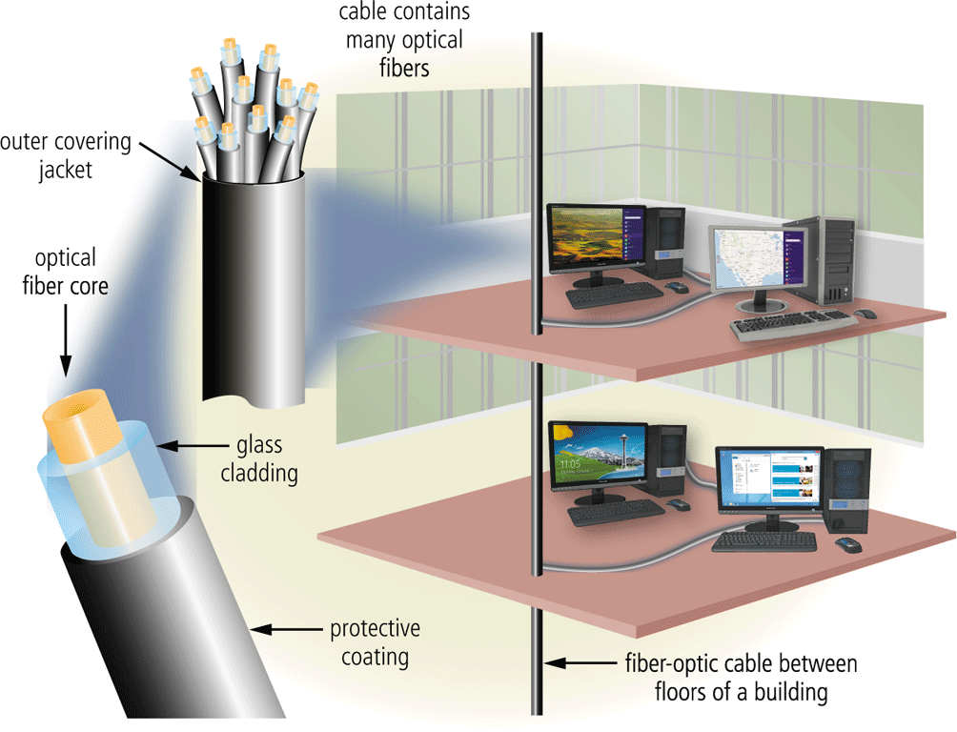
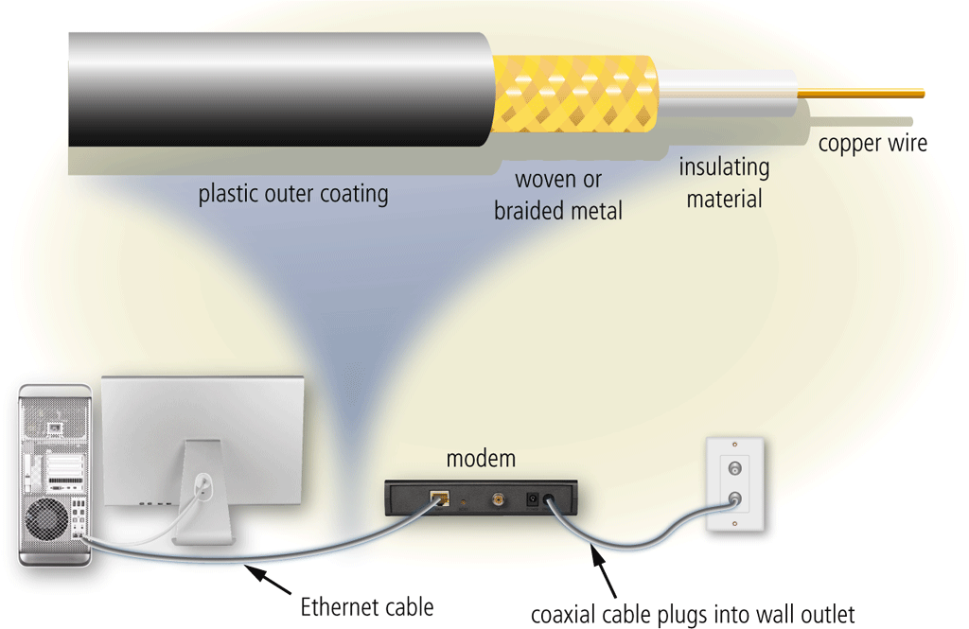
Physical Transmission Media
Twisted-pair cable
Fiber-optic cable
Coaxial cable
Pages 443 - 444
Figures 10-23 – 10-25

Slide 32
Wireless Transmission Media
Page 445
Table 10-4

Slide 33
Wireless Transmission Media
Broadcast radio is a wireless transmission medium that distributes radio signals through the air over long distances
Cellular radio is a form of broadcast radio that is used widely for mobile communications
Pages 445 - 446
Figure 10-26

Slide 34
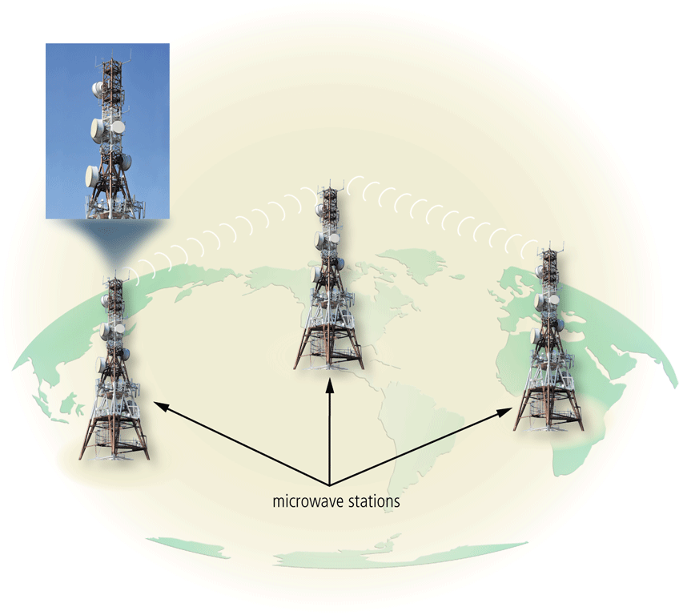
Wireless Transmission Media
Microwaves are radio waves that provide a high-speed signal transmission
Page 447
Figure 10-27

Slide 35
Wireless Transmission Media
A communications satellite is a space station that receives microwave signals from an earth-based station, amplifies it, and broadcasts the signal over a wide area
Page 448
Figure 10-28

Slide 36
Wireless Transmission Media
A global positioning system (GPS) is a navigation system that consists of one or more earth-based receivers that accept and analyze signals sent by satellites in order to determine the receiver’s geographical location
Page 449

Slide 37
Wireless Transmission Media
Page 449
Figure 10-29

Slide 38
Summary
Various types of network architectures, topologies, and standards and protocols
Communications software
Communications lines and communications devices
How to create a home network
Physical transmission media and wireless transmission media
Page 451

