Slide 1
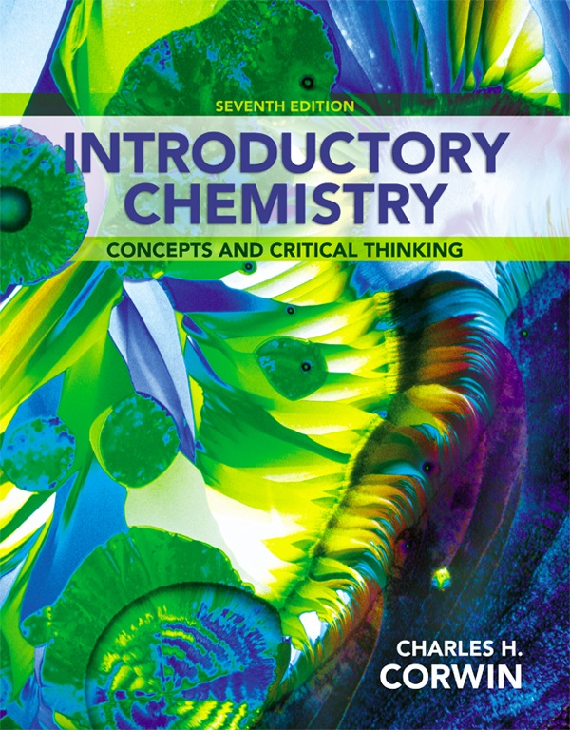
Chapter 7
Chemical
Reactions
by Christopher G. Hamaker
Illinois State University
© 2014 Pearson Education, Inc.

Slide 2
Chemical and Physical Changes
In a physical change, the chemical composition of the substance remains constant.
Examples of physical changes are the melting of ice or the boiling of water.
In a chemical change, the chemical composition of the substance changes; a chemical reaction occurs.
During a chemical reaction, a new substance is formed.

Slide 3

Chemistry Connection: Fireworks
The bright colors seen in a fireworks display are caused by chemical in a rocket shell; gunpowder ignites and shoots chemicals into the sky.
Each metal produces a different color.
  Na compounds are orange-yellow.
  Ba compounds are yellow-green.
  Ca compounds are red-orange.
  Sr compounds are bright red.
  Li compounds are scarlet red.
  Cu compounds are blue-green.
  Al or Mg metals are white sparks.

Slide 4
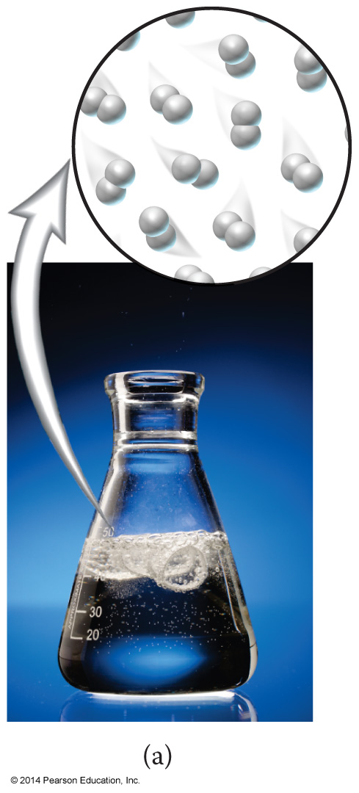
Evidence for Chemical Reactions
There are four observations that indicate a chemical reaction is taking place.
  A gas is produced.
    Gas may be observed in many ways in a reaction from light fizzing to heavy bubbling.
    The release of hydrogen gas from the reaction of magnesium metal with acid is shown here.

Slide 5
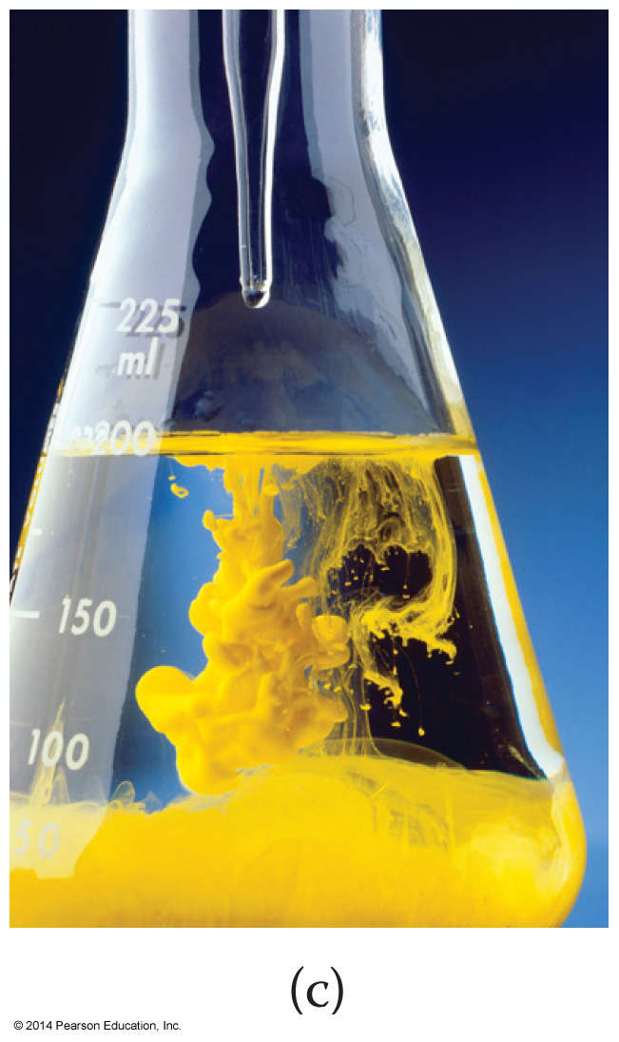
Evidence for Chemical Reactions, Continued
  A substance dissolves in water to give an aqueous solution.
  If we add two aqueous solutions together, we may observe the production of a solid substance.
  The insoluble solid formed is called a precipitate.
An insoluble solid is produced in a solution.

Slide 6
Evidence for Chemical Reactions, Continued
A permanent color change
is observed.
  Many chemical reactions
  involve a permanent color
  change.
  A change in color indicates that a new substance has been formed.

Slide 7
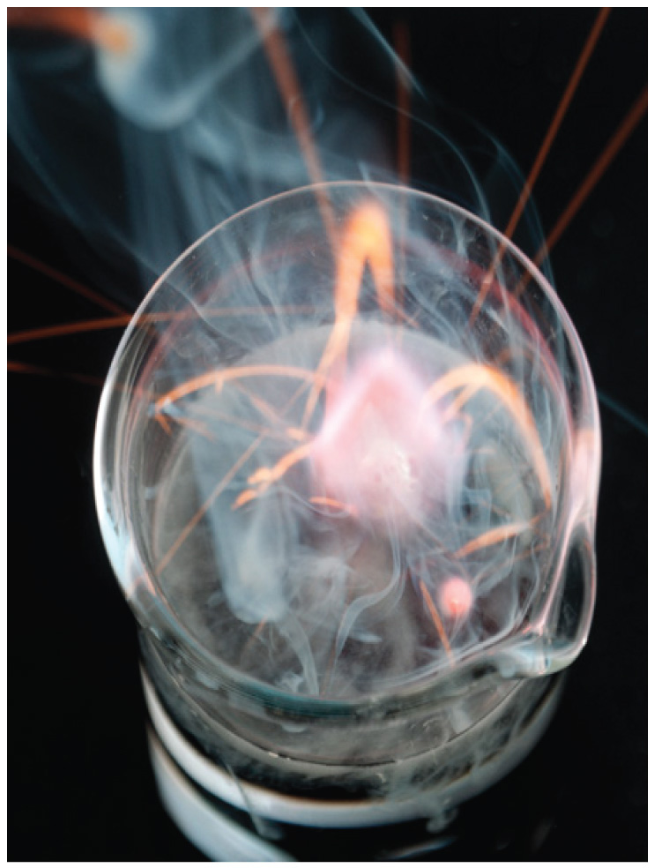
Evidence for Chemical Reactions, Continued
  A reaction that releases heat is an exothermic reaction.
  A reaction that absorbs heat is an endothermic reaction.
  Examples of a heat energy change in a chemical reaction are heat and light being given off.
An energy change is observed.

Slide 8
Writing Chemical Equations
A chemical equation describes a chemical reaction using formulas and symbols. A general chemical equation is as follows:
A + B → C + D
In this equation, A and B are reactants and C and D are products.
We can also add a catalyst to a reaction. A catalyst is written above the arrow and speeds up the reaction without being consumed.

Slide 9
States of Matter in Equations
When writing chemical equations, we usually specify the physical state of the reactants and products.
A(g) + B(l) → C(s) + D(aq)
In this equation, reactant A is in the gaseous state and reactant B is in the liquid state.
Also, product C is in the solid state and product D is in the aqueous state.

Slide 10
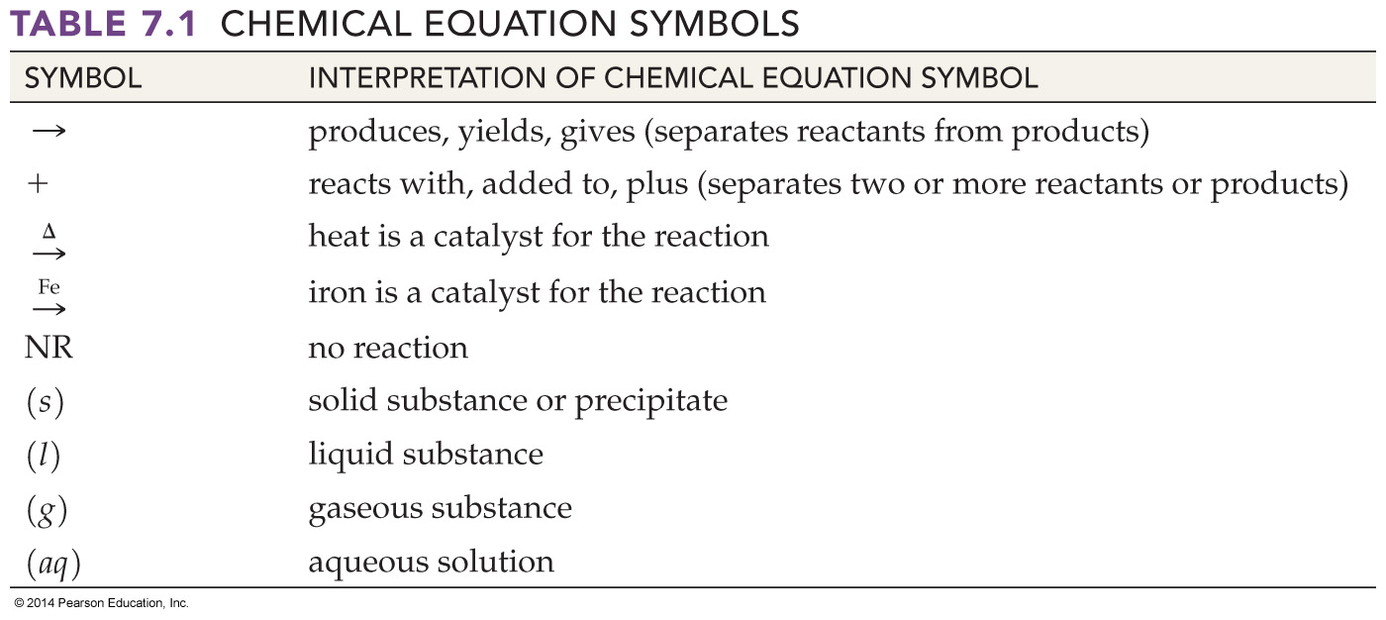
Chemical Equation Symbols
Here are several symbols used in chemical equations:

Slide 11
A Chemical Reaction
Let’s look at a chemical reaction:
HC₂H₃O₂(aq) + NaHCO₃(s) → NaC₂H₃O₂(aq) + H₂O(l) + CO₂(g)
The equation can be read as follows:
  Aqueous acetic acid is added to solid sodium carbonate and yields aqueous sodium acetate, liquid water, and carbon dioxide gas.

Slide 12
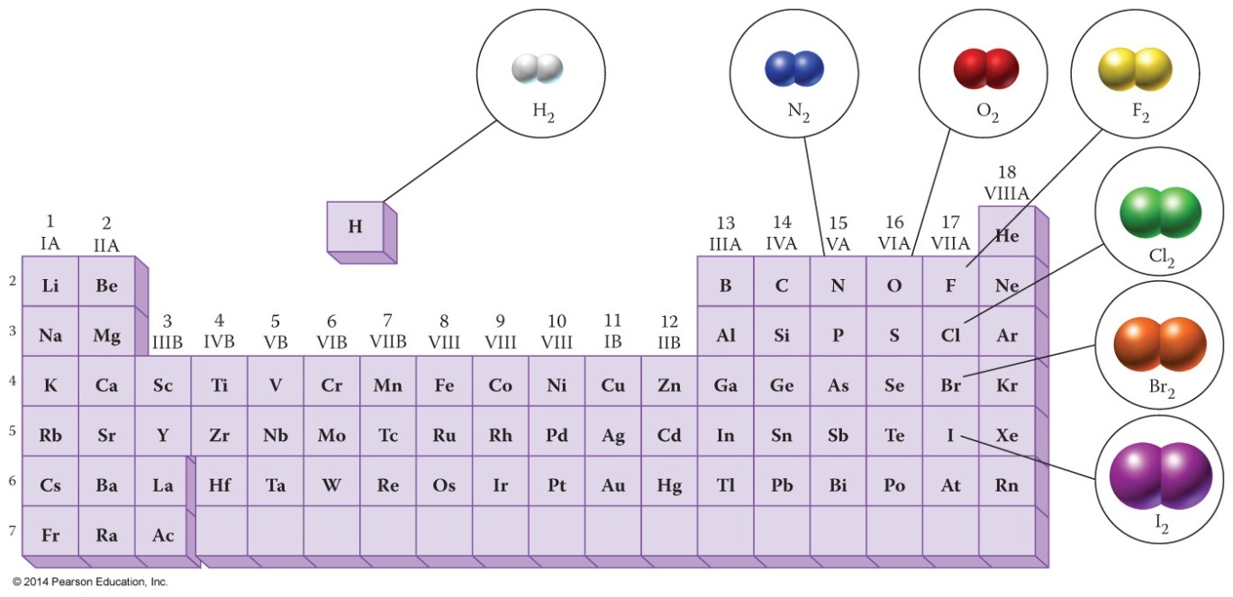
Diatomic Molecules
Seven nonmetals occur naturally as diatomic molecules:
    Hydrogen (H₂)
    Nitrogen (N₂)
    Oxygen (O₂)
    Halogen (F₂)
    Halogen (Cl₂)
    Halogen (Br₂)
    Halogen (I₂)
These elements are written as diatomic molecules when they appear in chemical reactions.

Slide 13
Balancing Chemical Equations
When we write a chemical equation, the number of atoms of each element must be the same on both sides of the arrow.
This is called a balanced chemical equation.
We balance chemical reactions by placing a whole number coefficient in front of each substance.
A coefficient multiplies all subscripts in a chemical formula:
  3 H₂O has 6 hydrogen atoms and 3 oxygen atoms.

Slide 14
Guidelines for Balancing Equations
Before placing coefficients in an equation, check that the formulas are correct.
Never change the subscripts in a chemical formula to balance a chemical equation.
Balance each element in the equation starting with the most complex formula.
Balance polyatomic ions as a single unit if it appears on both sides of the equation.

Slide 15
Guidelines for Balancing Equations, Continued
The coefficients must be whole numbers. If you get a fraction, multiply the whole equation by the denominator to get whole numbers.
[H₂(g) + ½ O₂(g) → H₂O(l)] x 2
2 H₂(g) + O₂(g) → 2 H₂O(l)
After balancing the equation, check that there are the same number of atoms of each element (or polyatomic ion) on both sides of the equation.
2(2) = 4 H; 2 O → 2(2) = 4 H; 2 O

Slide 16
Guidelines for Balancing Equations, Continued
Finally, check that you have the smallest whole number ratio of coefficients. If you can divide all the coefficients by a common factor, do so to complete your balancing of the reaction.
[2 H₂(g) + 2 Br₂(g) → 4 HBr(g)] ÷ 2
H₂(g) + Br₂(g) → 2 HBr(g)
2 H; 2 Br → 2(1) = 2 H; 2(1) = 2 Br

Slide 17
Balancing a Chemical Equation
2 Al, 3 SO₄, 3 Ba, 6 NO₃ → 2 Al, 6 NO₃, 3 Ba, 3 SO₄
Balance the following chemical equation:
__Al₂(SO₄)₃(aq) + __Ba(NO₃)₂(aq) → __Al(NO₃)₃(aq) + __BaSO₄(s)
There is one SO₄ on the right and three on the left. Place a 3 in front of BaSO₄. There are two Al on the left, and one on the right. Place a 2 in front of Al(NO₃)₃.
Al₂(SO₄)₃(aq) + __Ba(NO₃)₂(aq) → 2 Al(NO₃)₃(aq) + 3 BaSO₄(s)
There are three Ba on the right and one on the left. Place a 3 in front of Ba(NO₃)₂.
Al₂(SO₄)₃(aq) + 3 Ba(NO₃)₂(aq) → 2 Al(NO₃)₃(aq) + 3 BaSO₄(s)

Slide 18
Classifying Chemical Reactions
We can place chemical reactions into five categories:
    Combination reactions
    Decomposition reactions
    Single-replacement reactions
    Double-replacement reactions
    Neutralization reactions

Slide 19
Combination Reactions
A combination reaction is a reaction in which simpler substances are combined into a more complex compound.
Combination reactions are also called synthesis reactions.
We will look at three combination reactions:
    The reaction of a metal with oxygen
    The reaction of a nonmetal with oxygen
    The reaction of a metal and a nonmetal

Slide 20
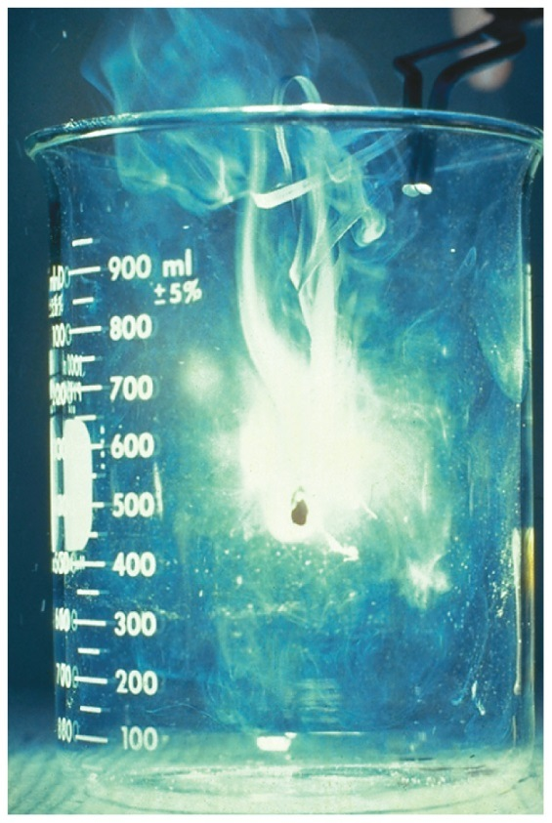
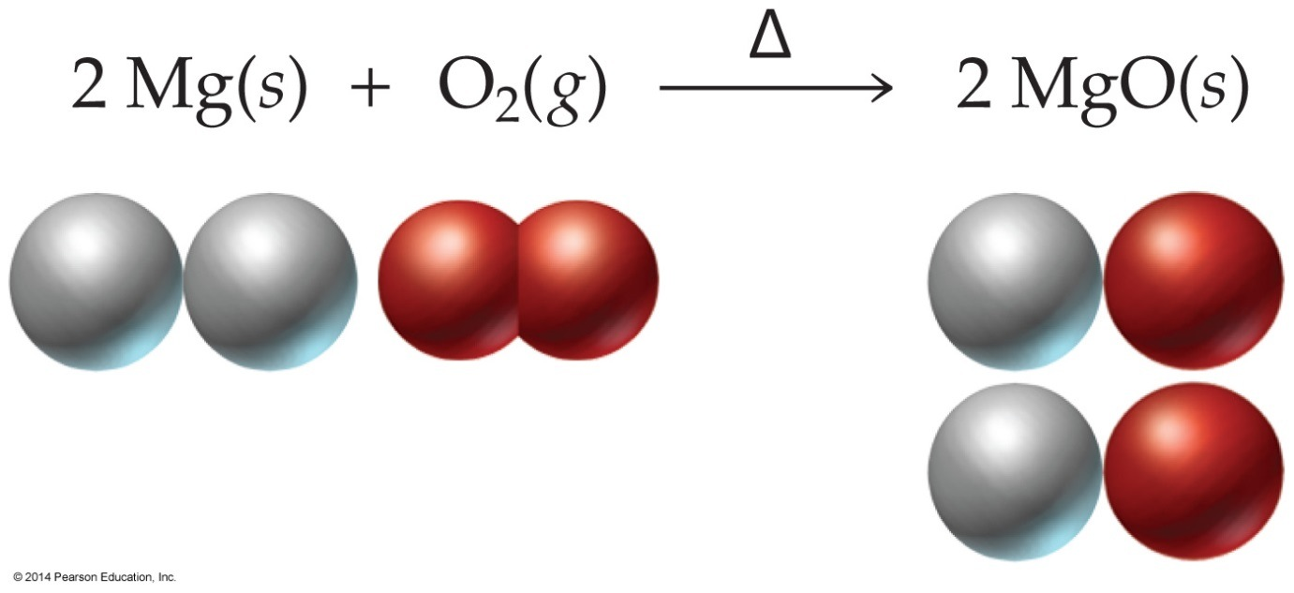
Reactions of Metals with Oxygen
When a metal is heated with oxygen gas, a metal oxide is produced.
metal + oxygen gas → metal oxide
For example, magnesium metal produces magnesium oxide.

Slide 21
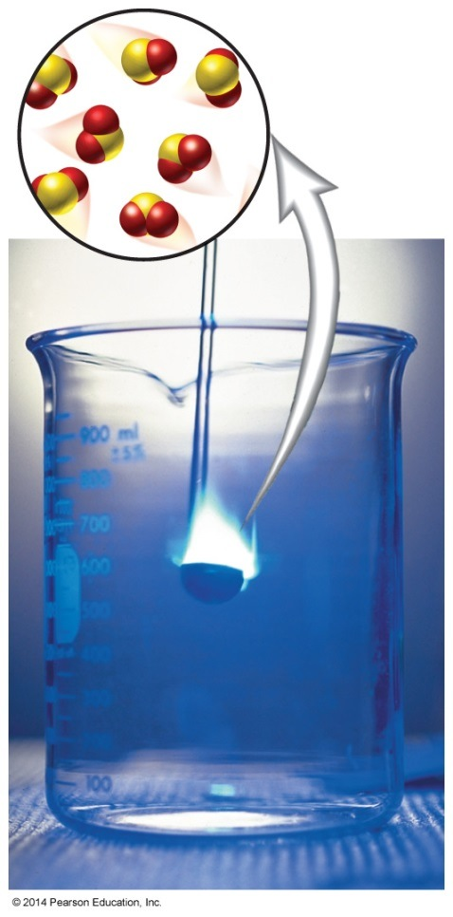
Reactions of Nonmetals with Oxygen
∆
Oxygen and a nonmetal react to produce a nonmetal oxide.
nonmetal + oxygen gas → nonmetal oxide
Sulfur reacts with oxygen to produce sulfur dioxide gas.
S(s) + O₂(g) → SO₂(g)

Slide 22
Metal and Nonmetal Reactions
∆
A metal and a nonmetal react in a combination reaction to give an ionic compound.
metal + nonmetal → ionic compound
Lithium reacts with bromine gas to produce lithium bromide.
2 Li(s) + Br₂(g) → 2 LiBr(s)
When a main group metal reacts with a nonmetal, the formula of the ionic compound is predictable. If the compound contains a transition metal, the formula is not predictable.

Slide 23
Decomposition Reactions
In a decomposition reaction, a single compound is broken down into two or more simpler substances.
Heat is usually required to start a decomposition reaction. Ionic compounds containing oxygen often decompose into a metal and oxygen gas.
For example, heating solid mercury(II) oxide produces mercury metal and oxygen gas.
2 HgO(s) → 2 Hg(l) + O₂(g)

Slide 24
Carbonate Decompositions
∆
∆
Metal hydrogen carbonates decompose to give a metal carbonate, water, and carbon dioxide.
For example, nickel(II) hydrogen carbonate decomposes as follows:
Ni(HCO₃)₂(s) → NiCO₃(s) + H₂O(l) + CO₂(g)
Metal carbonates decompose to give a metal oxide and carbon dioxide gas.
For example, calcium carbonate decomposes as follows:
CaCO₃(s) → CaO(s) + CO₂(g)

Slide 25
Activity Series Concept
When a metal undergoes a single replacement reaction, it displaces another metal from a compound or aqueous solution.
The metal that displaces the other metal does so because it is more active.
The activity of a metal is a measure of its ability to compete in a replacement reaction.
In an activity series, a sequence of metals is arranged according to its ability to undergo a reaction.

Slide 26
Activity Series
Metals that are most reactive appear first in the activity series.
Metals that are least reactive appear last in the activity series.
The relative activity series is:
Li > K > Ba > Sr > Ca > Na > Mg >
Al > Mn > Zn > Fe > Cd > Co > Ni >
Sn > Pb > (H) > Cu > Ag > Hg > Au

Slide 27
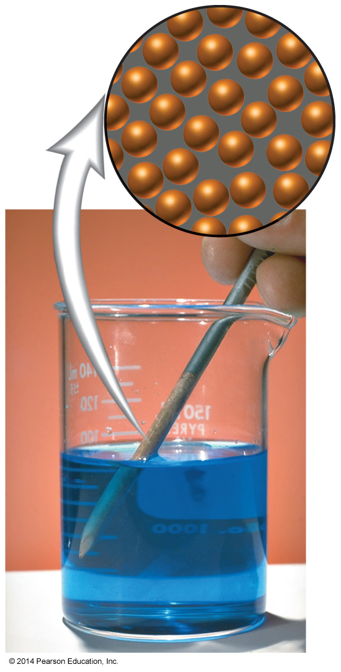
Single-Replacement Reactions
A single-replacement reaction is a reaction in which a more active metal displaces another less active metal in a compound.
If a metal precedes another in the activity series, it will undergo a single-replacement reaction.
Fe(s) + CuSO₄(aq) →
FeSO₄(aq) + Cu(s)

Slide 28
Aqueous Acid Displacements
Metals that precede (H) in the activity series react with acids, and those that follow (H) do not react with acids.
More active metals react with acid to produce hydrogen gas and an ionic compound.
Fe(s) + 2 HCl(aq) → FeCl₂(aq) + H₂(g)
Metals less active than (H) show no reaction.
Au(s) + H₂SO₄(aq) → NR

Slide 29
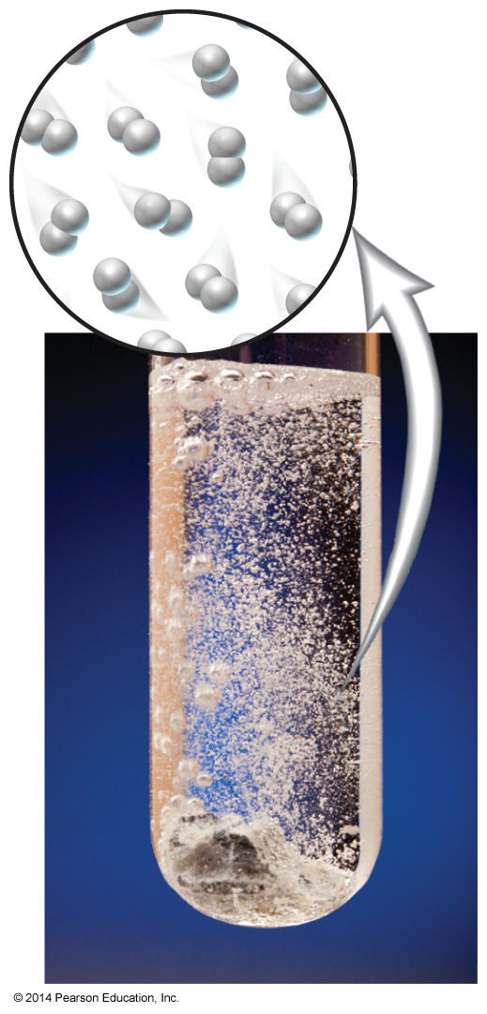
Active Metals and Water
A few metals are active enough to react directly with water. These are called active metals.
They react with water to produce a metal hydroxide and hydrogen gas.
2 Na(s) + 2 H₂O(l) → 2 NaOH(aq) + H₂(g)
Ca(s) + 2 H₂O(l) → Ca(OH)₂(aq) + H₂(g)

Slide 30
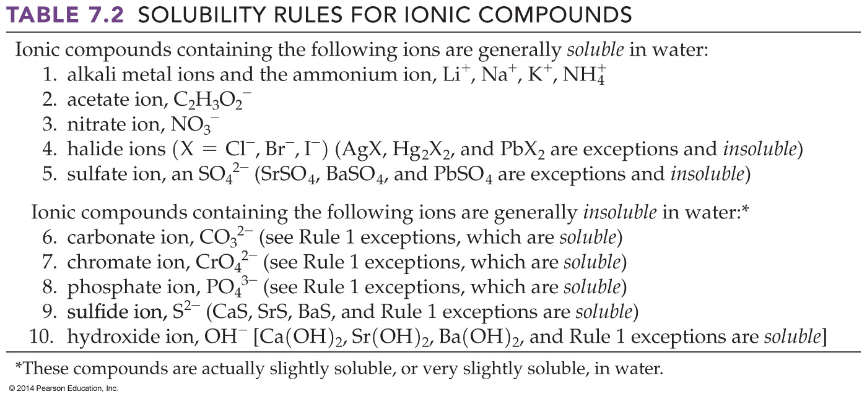
Solubility Rules
Not all ionic compounds are soluble in water. We can use the solubility rules to predict if a compound will be soluble in water.

Slide 31
Double-Replacement Reactions
In a double-replacement reaction, two ionic compounds in aqueous solution switch anions and produce an insoluble substance.
AX + BZ → AZ + BX
If either AZ or BX is an insoluble compound, a precipitate will appear and there is a chemical reaction.
If no precipitate is formed, there is no reaction.

Slide 32
Double-Replacement Reactions, Continued
Aqueous barium chloride reacts with aqueous potassium chromate as follows:
BaCl₂(aq) + K₂CrO₄(aq) → BaCrO₄(s) + 2 KCl(aq)
From the solubility rules, BaCrO₄ is insoluble, so there is a double-replacement reaction.
Aqueous sodium chloride reacts with aqueous lithium nitrate as follows:
NaCl(aq) + LiNO₃(aq) → NaNO₃(aq) + LiCl(aq)
Both NaNO₃ and LiCl are soluble, so there is no reaction.

Slide 33
Neutralization Reactions
A neutralization reaction is the reaction of an acid and a base.
HX + BOH → BX + HOH
A neutralization reaction produces a salt and water.
H₂SO₄(aq) + 2 KOH(aq) → K₂SO₄(aq) + 2 H₂O(l)

Slide 34
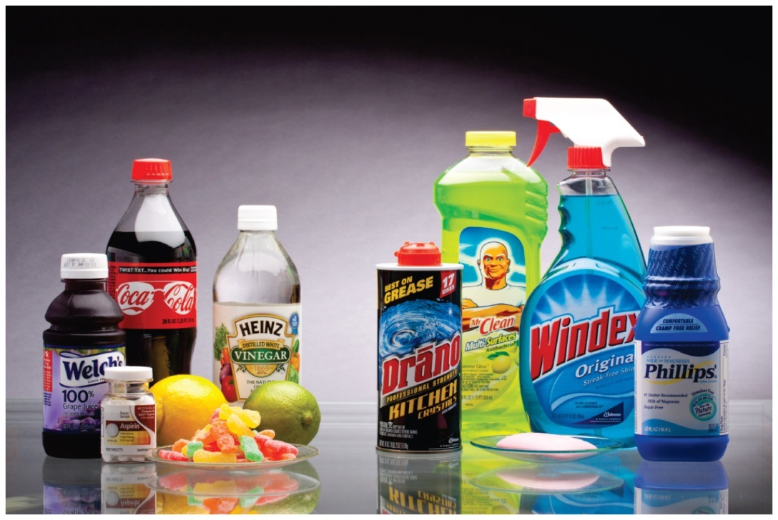
Critical Thinking: Household Chemicals
Many common household items contain familiar chemicals
  Vinegar is a solution of acetic acid.
  Swimming pools use hydrochloric acid.
  Drain and oven cleaners contain sodium hydroxide.

Slide 35
Chapter Summary
There are four ways to tell if a chemical reaction has occurred:
    A gas is produced.
    An insoluble solid is produced.
    A permanent color change is observed.
    An energy change is observed.
An exothermic reaction gives off heat and an endothermic reaction absorbs heat.

Slide 36
Chapter Summary, Continued
There are seven elements that exist as diatomic molecules:
    H₂
    N₂
    O₂
    F₂
    Cl₂
    Br₂
    I₂

Slide 37
Chapter Summary, Continued
When we balance a chemical equation, the number of each type of atom must be the same on both the product and reactant sides of the equation.
We use coefficients in front of compounds to balance chemical reactions.

Slide 38
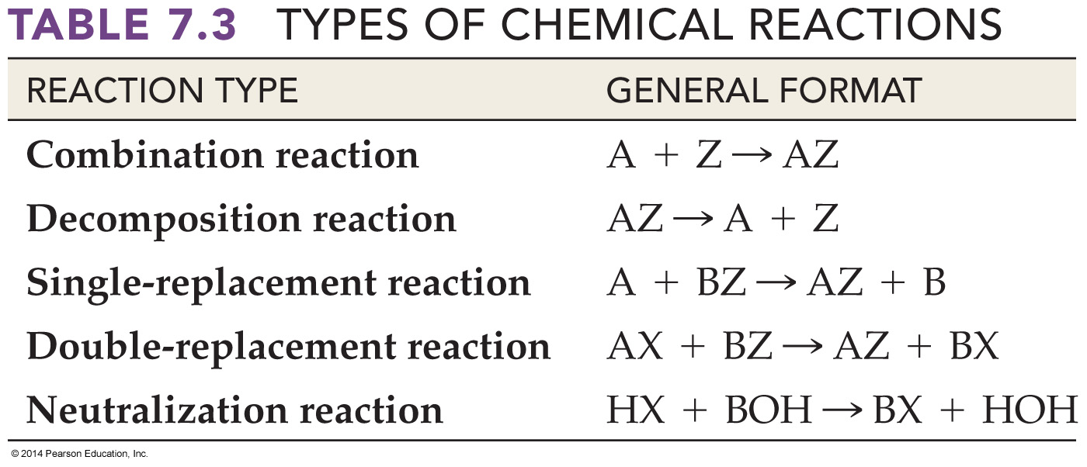
Chapter Summary, Continued
There are five basic types of chemical reactions.

Slide 39
Chapter Summary, Continued
In combination reactions, two or more smaller molecules are combined into a more complex molecule.
In a decomposition reaction, a molecule breaks apart into two or more simpler molecules.
In a single-replacement reaction, a more active metal displaces a less active metal according to the activity series.

Slide 40
Chapter Summary, Continued
In a double-replacement reaction, two aqueous solutions produce a precipitate of an insoluble compound.
The insoluble compound can be predicted based on the solubility rules.
In a neutralization reaction, an acid and a base react to produce a salt and water.

