Slide 1
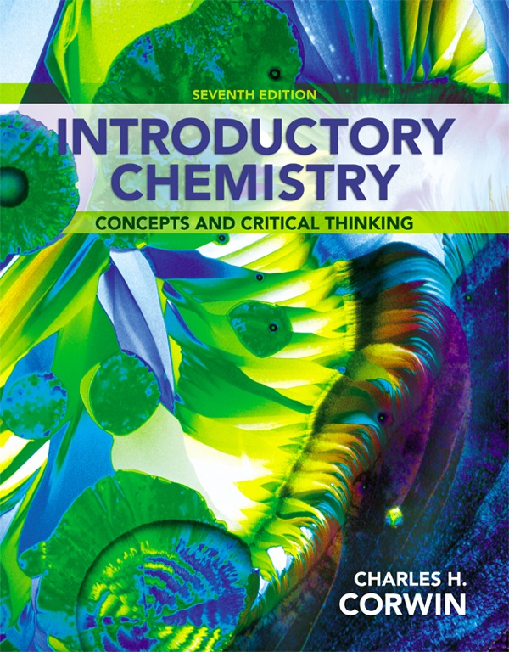
Chapter 10
Gases
by Christopher G. Hamaker
Illinois State University
© 2014 Pearson Education, Inc.

Slide 2
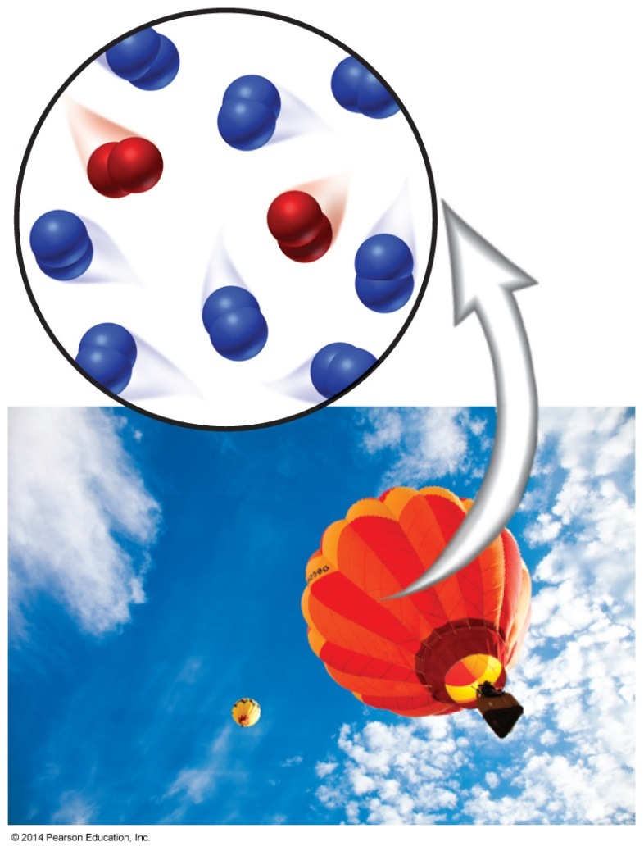
Properties of Gases
There are five important properties of gases:
    Gases have a variable shape and volume.
    Gases expand uniformly.
    Gases compress uniformly.
    Gases have a low density.
    Gases mix uniformly with other gases in the same container.
Let’s take a closer look at
these properties.

Slide 3
Detailed Gas Properties
Gases have a variable shape and volume.
    A gas takes the shape of its container, filling it completely. If the container changes shape, the gas also changes shape.
Gases expand uniformly.
    The volume of a gas decreases when the volume of its
    container decreases. If the volume is reduced enough, the
    gas will liquefy.

Slide 4
Detailed Gas Properties, Continued
3. Gases compress uniformly.
    A gas constantly expands to fill a sealed container. The volume of a gas increases if there is an increase in the volume of the container.
4. Gases have a low density.
    The density of air is about 0.001 g/mL compared to a density
    of 1.0 g/mL for water. Air is about 1000 times less dense
    than water.

Slide 5
Detailed Gas Properties, Continued
5. Gases mix uniformly with other gases in the same container.
    Air is an example of a mixture of gases. When automobiles emit nitrogen oxide gases into the atmosphere, they mix with the other atmospheric gases.
    A mixture of gases in a sealed container will mix to form a homogeneous mixture.

Slide 6
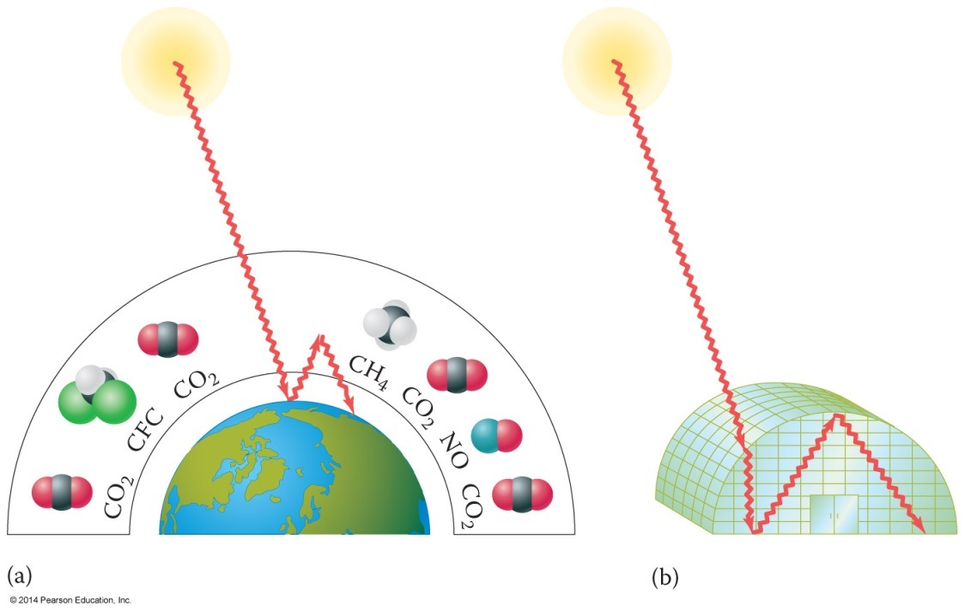
Chemistry Connection:
The Greenhouse Effect
Several gases contribute to the greenhouse effect.
High energy radiation strikes Earth’s surface, and is converted to heat.
This heat is radiated from the surface as infrared radiation.
This infrared radiation
is absorbed by the
gases, and released
as heat in all
directions, heating
the atmosphere.

Slide 7
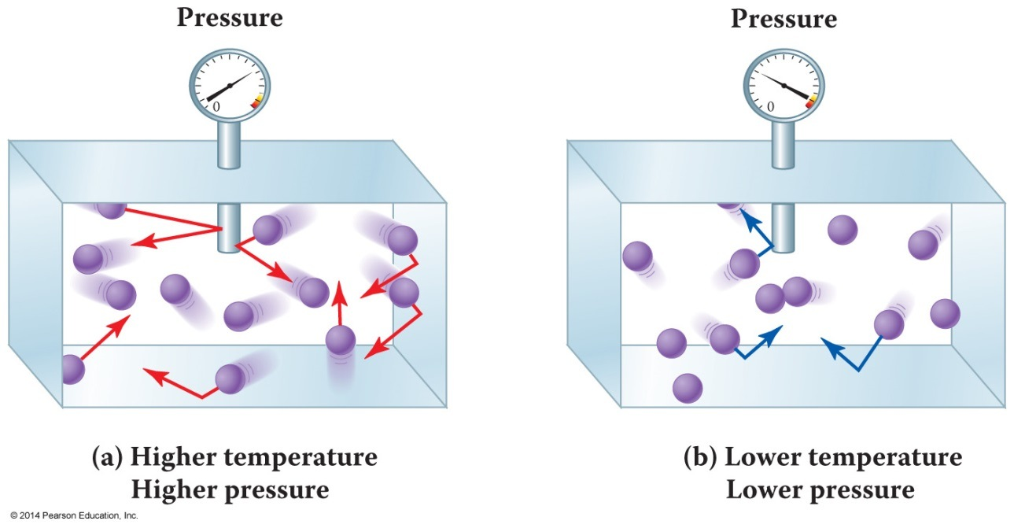
Atmospheric Pressure
Gas pressure is the result of constantly moving gas molecules striking the inside surface of their container.
  The more often the molecules collide with the sides of the container, the higher the pressure.
  The higher the
  temperature, the
  faster the gas
  molecules move.

Slide 8
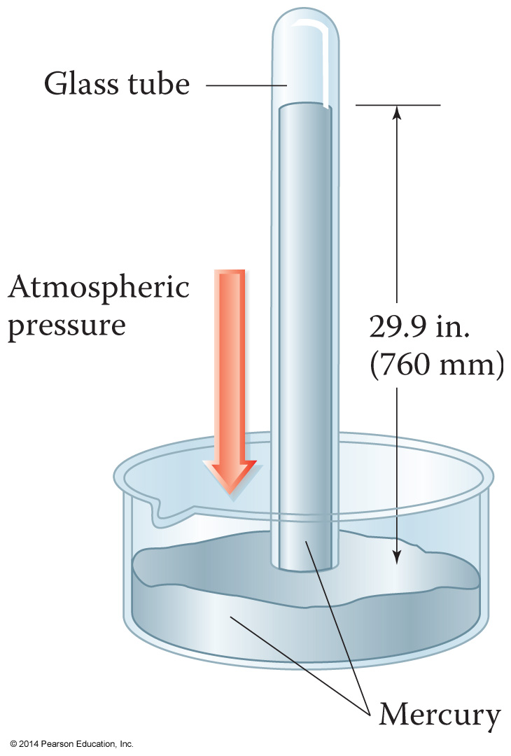
Atmospheric Pressure
Atmospheric pressure is a result of the air molecules in the environment.
Evangelista Torricelli invented
the barometer in 1643 to
measure atmospheric pressure.
Atmospheric pressure is
29.9 inches of mercury or
760 torr at sea level.

Slide 9
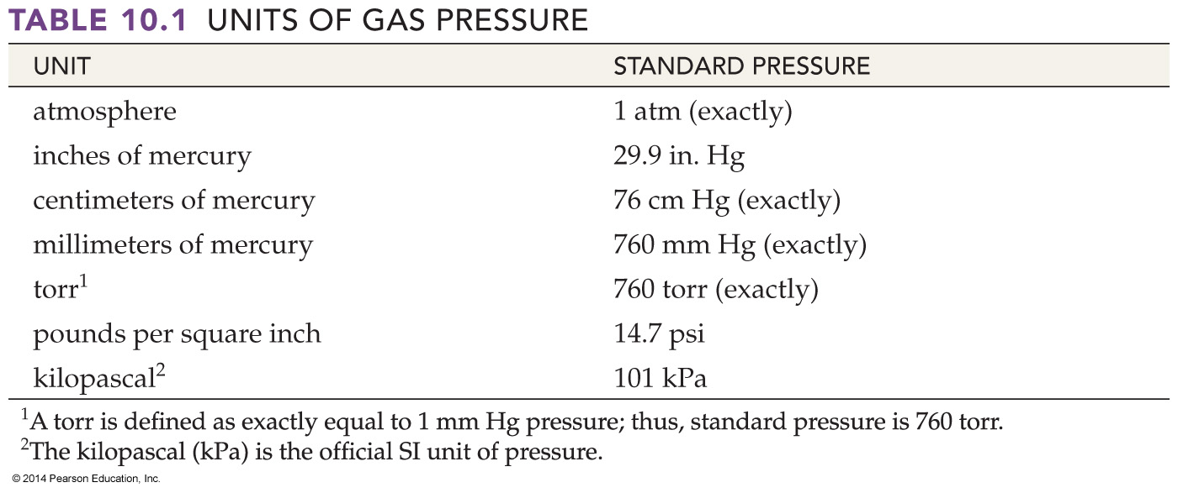
Units of Pressure
Standard pressure is the atmospheric pressure at sea level, 29.9 inches of mercury.
  Here is standard pressure expressed in other units.

Slide 10
Gas Pressure Conversions
1 atm
26.2 in. Hg x
= 0.876 atm
29.9 in Hg
The barometric pressure is 26.2 in. Hg. What is the barometric pressure in atmospheres?
We want atm; we have in. Hg.
Use 1 atm = 29.9 in. Hg:

Slide 11
Variables Affecting Gas Pressure
There are three variables that affect gas pressure:
    The volume of the container.
    The temperature of the gas.
    The number of molecules of gas in the container.

Slide 12
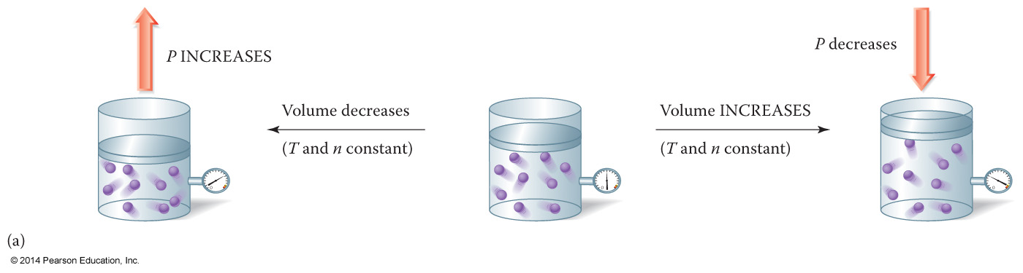
Volume Versus Pressure
When volume decreases, the gas molecules collide with the container more often, so pressure increases.
When volume increases, the gas molecules collide with the container less often, so pressure decreases.

Slide 13
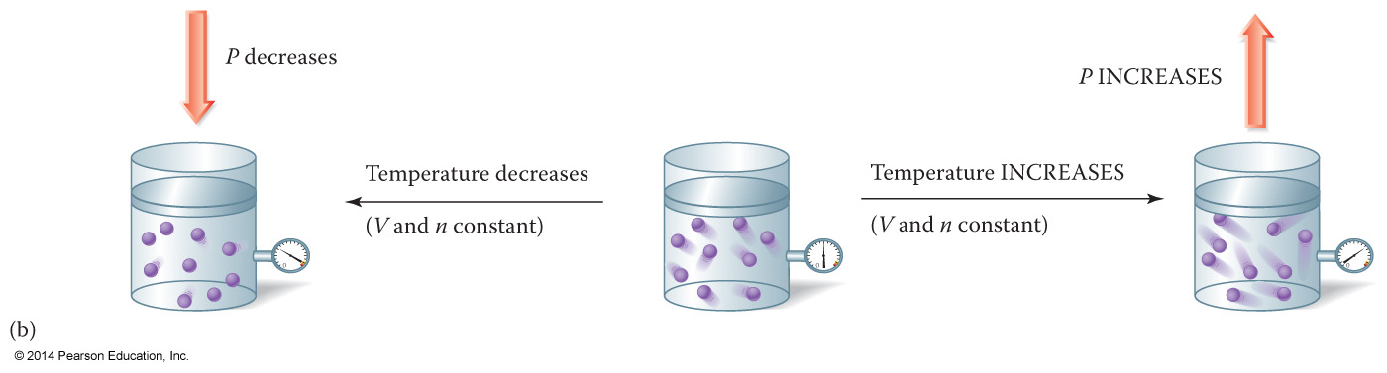
Temperature Versus Pressure
When temperature decreases, the gas molecules move slower and collide with the container less often, so pressure decreases.
When temperature increases, the gas molecules move faster and collide with the container more often, so pressure increases.

Slide 14
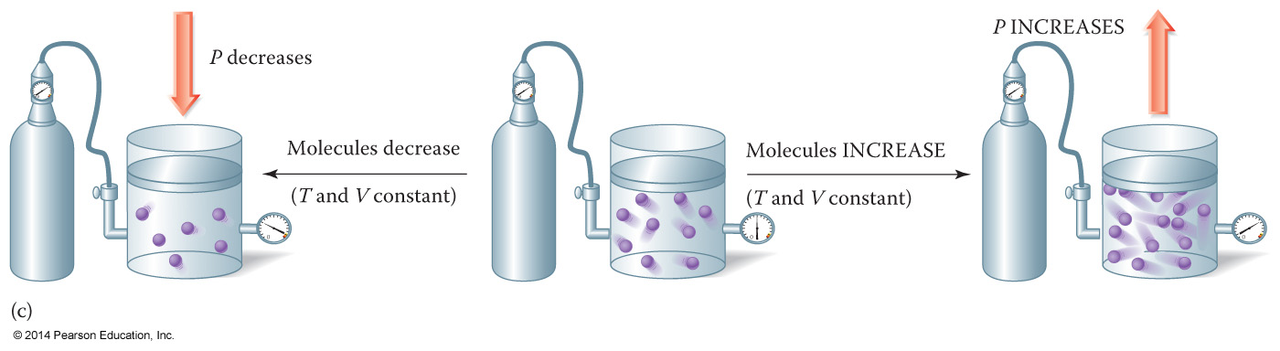
Molecules Versus Pressure
When the number of molecules decreases, there are fewer gas molecules colliding with the side of the container, so pressure decreases.
When the number of molecules increases, there are more gas molecules colliding with the side of the container, so pressure increases.

Slide 15
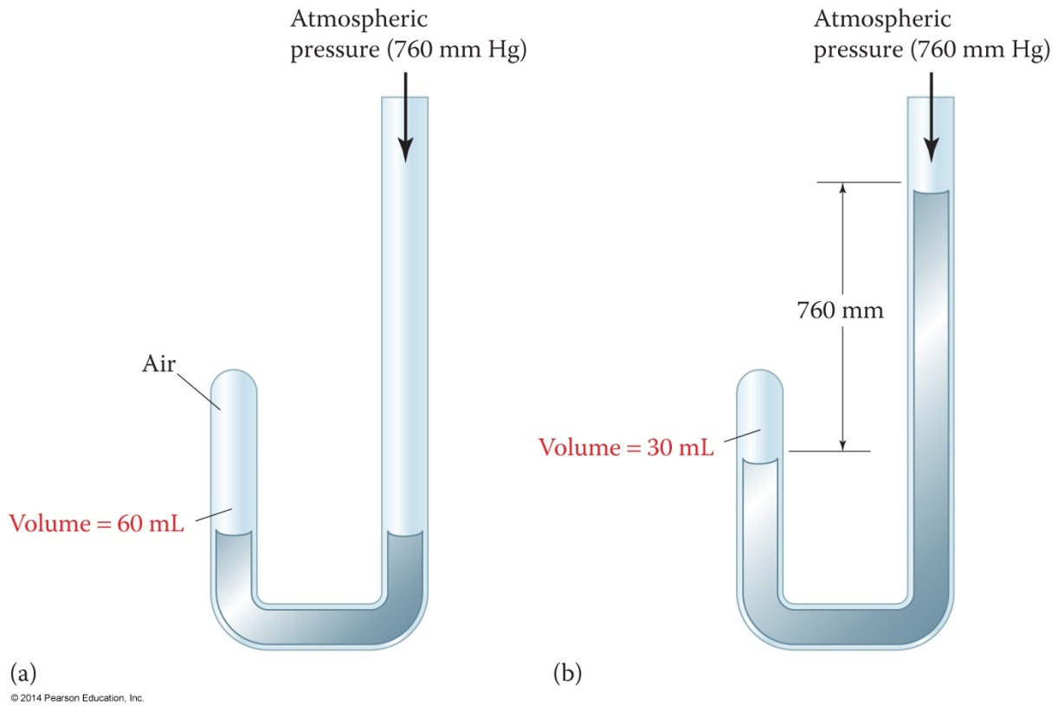
Boyle’s Gas Experiment
Robert Boyle trapped air in a J-tube using liquid mercury.
He found that the volume of air decreased as he added more mercury.
When he halved the
volume, the pressure
doubled.

Slide 16
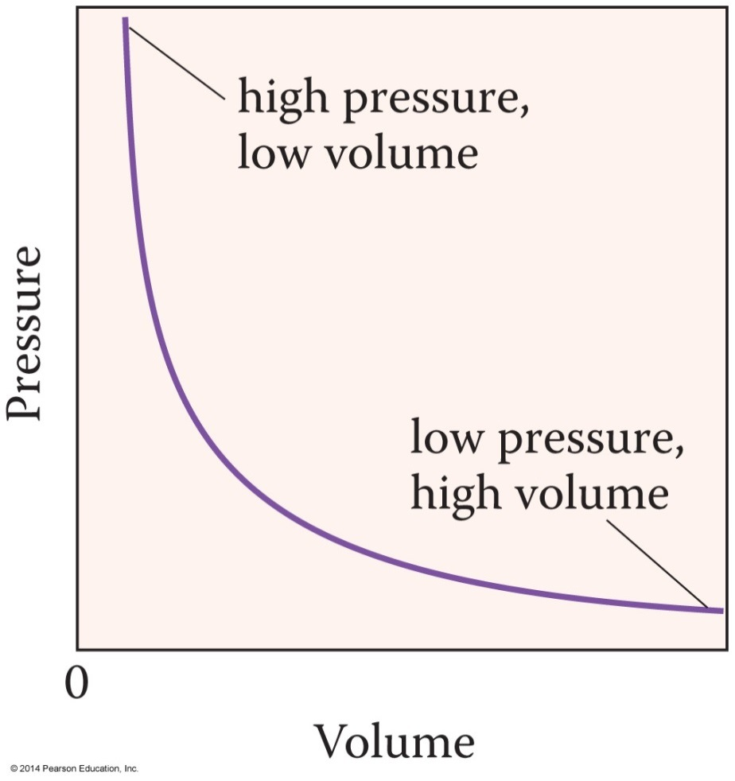
Boyle’s Law
1 .
V ∝
P
Boyle’s law states that the volume of a gas is inversely proportional to the pressure at constant temperature.
Inversely proportional
means two variables have
a reciprocal relationship.
Mathematically, we write:

Slide 17
Boyle’s Law, Continued
If we introduce a proportionality constant, k, we can write Boyle’s law as follows:
We can also rearrange it to PV = k.
Let’s take a sample of gas at P₁ and V₁, and change the conditions to P₂ and V₂. Because the product of pressure and volume is constant, we can write:
  P₁V₁ = k = P₂V₂
1 .
V = k x
P

Slide 18
Applying Boyle’s Law
P₁
V₁ x
= V₂
P₂
P_{factor}
V₁
P₁ x
= P₂
V₂
V_{factor}
To find the new pressure after a change in volume:
To find the new volume after a change in pressure:

Slide 19
Boyle’s Law Problem
V₁
P₁ x
= P₂
V₂
3.50 L
1550 mm Hg x
= 775 mm Hg
7.00 L
A 3.50 L sample of methane gas exerts a pressure of 1550 mm Hg. What is the final pressure if the volume changes to 7.00 L?
The volume increased and the pressure decreased as we expected.

Slide 20
Chemistry Connection: Robert Boyle
Robert Boyle spoke Latin and Greek by the age
of eight.
Enrolled at Oxford University at age 27.
Designed a vacuum pump in 1657 and used it to prove sound does not travel in the absence of air.
Published The Sceptical Chymist in 1661, arguing that theories were only as good that the experiments they were based on.

Slide 21
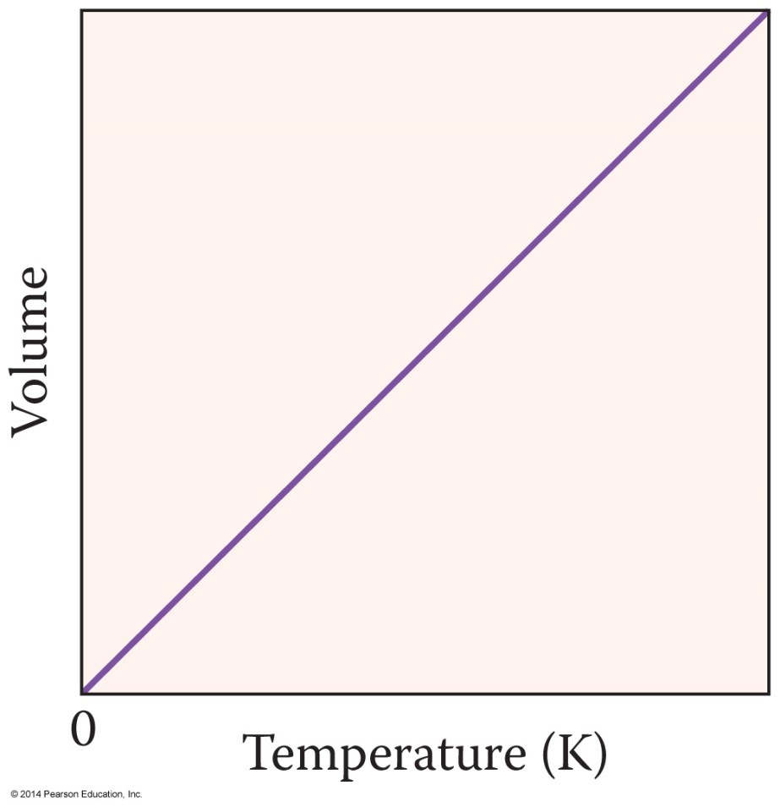
Charles’s Law
In 1783, Jacques Charles discovered that the volume of a gas is directly proportional to the temperature in Kelvin. This is Charles’s law.
V ∝ T at constant
pressure.
Notice that Charles’s
law gives a straight
line graph.

Slide 22
Charles’s Law, Continued
V
T
V₁
V₂
= k =
T₁
T₂
We can write Charles’s law as an equation using a proportionality constant, k.
  V = k T or = k
Again, let’s consider a sample of gas at V₁ and T₁, and change the volume and temperature to V₂ and T₂. Because the ratio of volume to temperature is constant, we can write:

Slide 23
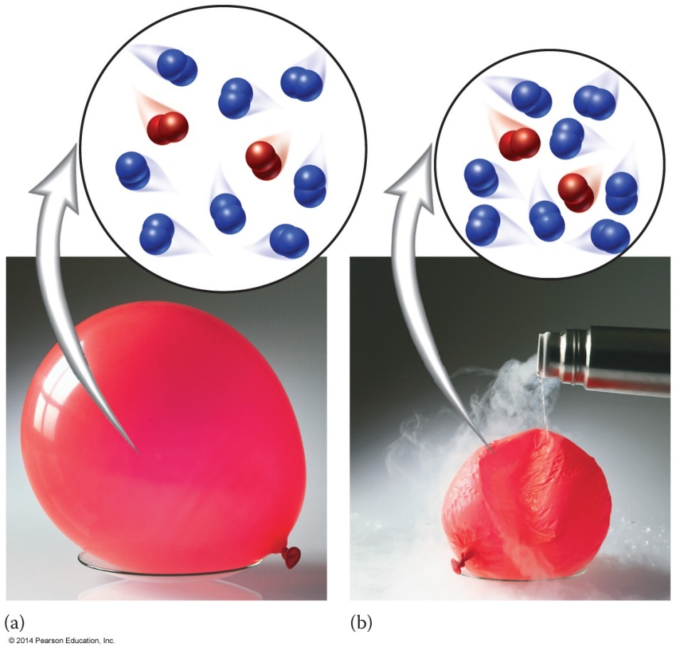
Illustration of Charles’s Law
Below is an illustration of Charles’s law.
As a balloon is cooled from room temperature with liquid nitrogen (–196 °C), its volume decreases.

Slide 24
Applying Charles’s Law
T₂
V₁ x
= V₂
T₁
T_{factor}
V₂
T₁ x
= T₂
V₁
V_{factor}
To find the new volume after a change in temperature:
To find the new temperature after a change in volume:

Slide 25
Charles’s Law Problem
A 132 L helium balloon is heated from 20 °C to 40 °C. What is the final volume at constant P?
We first have to convert the temp from °C to K:
  20 °C + 273 = 293 K
  40 °C + 273 = 313 K
T₂
V₁ x
= V₂
T₁
313 K
132 L x
= 141 L
293 K

Slide 26
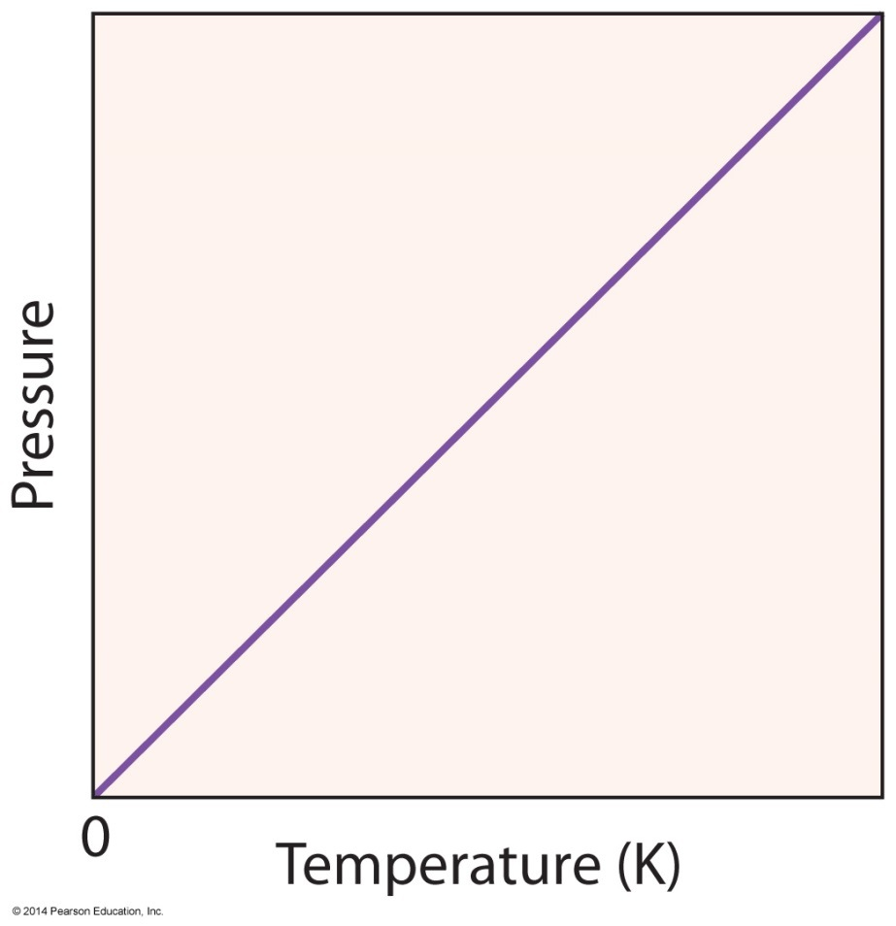
Gay-Lussac’s Law
In 1802, Joseph Gay-Lussac discovered that the pressure of a gas is directly proportional to the temperature in Kelvin. This is Gay-Lussac’s Law.
P ∝ T at constant
temperature.
Notice that Gay-Lussac’s
law gives a straight-
line graph.

Slide 27
Gay-Lussac’s Law, Continued
P
T
P₁
P₂
= k =
T₁
T₂
We can write Gay-Lussac’s law as an equation using a proportionality constant, k.
  P = k T or = k
Let’s consider a sample of gas at P₁ and T₁, and change the volume and temperature to P₂ and T₂. Because the ratio of pressure to temperature is constant, we can write:

Slide 28
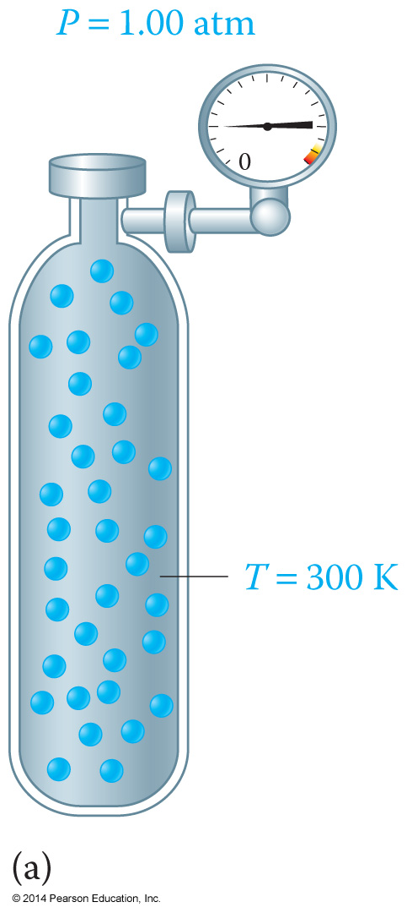
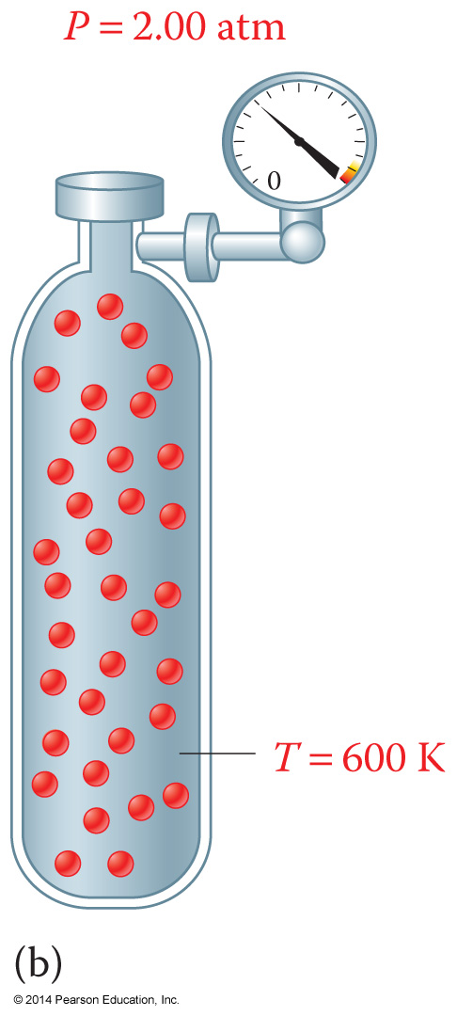
Illustration of Gay-Lussac’s Law
Here is an illustration of Gay-Lussac’s law.
As the temperature of a gas in a steel cylinder increases, the pressure increases.

Slide 29
Applying Gay-Lussac’s Law
T₂
P₁ ×
= P₂
T₁
T_{factor}
P₂
T₁ ×
= T₂
P₁
P_{factor}
To find the new volume after a change in temperature:
To find the new temperature after a change in volume:

Slide 30
Gay-Lussac’s Law Problem
A steel container of nitrous oxide at 10.4 atm is cooled from 33 °C to –28 °C. What is the final volume at constant V?
We first have to convert the temp from °C to K:
  33 °C + 273 = 306 K
  –28 °C + 273 = 245 K
T₂
P₁ x
= P₂
T₁
306 K
10.4 atm x
= 13.0 atm
245 K

Slide 31
Combined Gas Law
P₁V₁
P₂V₂
=
T₁
T₂
When we introduced Boyle’s, Charles’s, and Gay-Lussac’s laws, we assumed that one of the variables remained constant.
Experimentally, all three (temperature, pressure, and volume) usually change.
By combining all three laws, we obtain the combined gas law:

Slide 32
Applying the Combined Gas Law
P₁
T₂
V₂ = V₁ x
x
P₂
T₁
P_{factor}
T_{factor}
V₁
T₂
P₂ = P₁ x
x
V₂
T₁
V_{factor}
T_{factor}
P₂
V₂
T₂ = T₁ x
x
P₁
V₁
P_{factor}
V_{factor}
To find a new volume when P and T change:
To find a new pressure when V and T change:
To find a new temperature when P and V change:

Slide 33
Combined Gas Law Problem
Conditions | P | V | T
initial | 1.00 atm | 10.0 L | 300 K
final | P₂ | 20.0 L | 600 K
In a combined gas law problem, there are three variables: P, V, and T.
Let’s apply the combined gas law to 10.0 L of carbon dioxide gas at 300 K and 1.00 atm. If the volume and Kelvin temperature double, what is the new pressure?

Slide 34
Combined Gas Law Problem, Continued
V₁
T₂
P₂ = P₁ x
x
V₂
T₁
10.0 L
600 K
P₂ = 1.00 atm x
x
20.0 L
300 K
P₂ = 1.00 atm

Slide 35
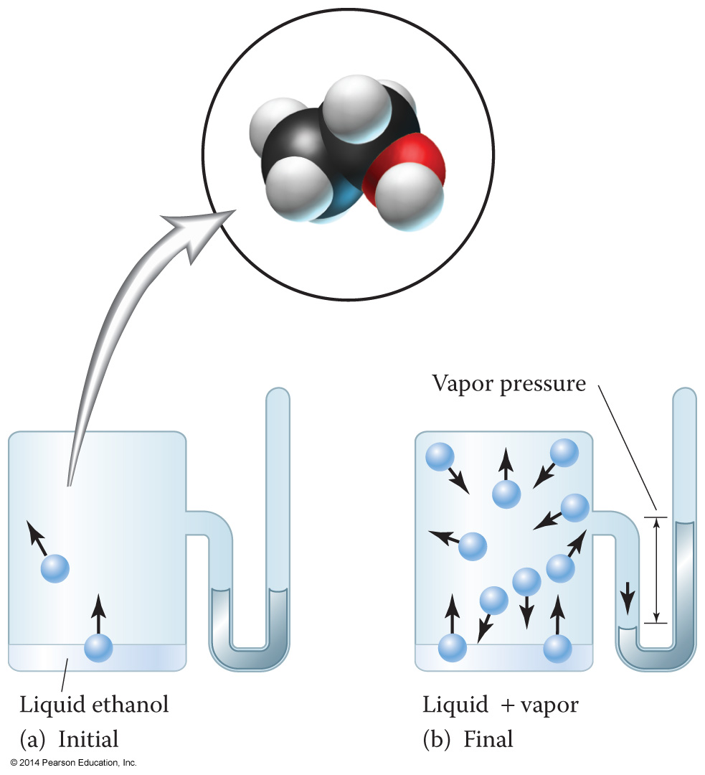
The Vapor Pressure Concept
Vapor pressure is the pressure exerted by the gaseous vapor above a liquid when the rates of evaporation and condensation are equal.
Vapor pressure increases as temperature increases.

Slide 36
Dalton’s Law of Partial Pressures
Dalton’s law of partial pressures states that the total pressure of a gaseous mixture is equal to the sum of the individual pressures of each gas.
  P₁ + P₂ + P₃ + … = P_{total}
The pressure exerted by each gas in a mixture is its partial pressure.

Slide 37
Dalton’s Law Calculation
A sample of noble gases contains helium, neon, argon, and krypton. If the partial pressure of helium is 125 mm Hg; neon is 45 mm Hg; argon is 158 mm Hg; and krypton is 17 mm Hg, what is the total pressure of the sample?
  P_{total} = P_{He} + P_{Ne} + P_{Ar} + P_{Kr}
P_{total} = 125 mm Hg + 45 mm Hg + 158 mm Hg + 17 mm Hg
P_{total} = 345 mm Hg

Slide 38
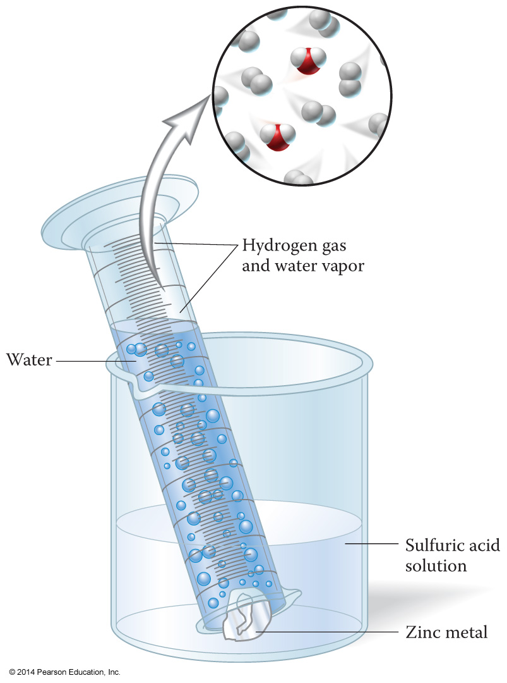
Collecting a Gas over Water
We can measure the volume of a gas by displacement.
By collecting the gas in a graduated cylinder, we can measure the amount of gas produced.
The gas collected is referred to as “wet” gas since it also contains water vapor.

Slide 39
Ideal Gas Behavior
An ideal gas is a gas that behaves in a predictable and consistent manner.
Ideal gases have the following properties:
  Gases are made up of tiny molecules.
  Gas molecules demonstrate rapid, motion in straight lines, and travel in random directions.
  Gas molecules have no attraction for one another.
  Gas molecules collide without losing energy.
  The average kinetic energy of gas molecules is proportional to the Kelvin temperature that is KE ∝ T.

Slide 40
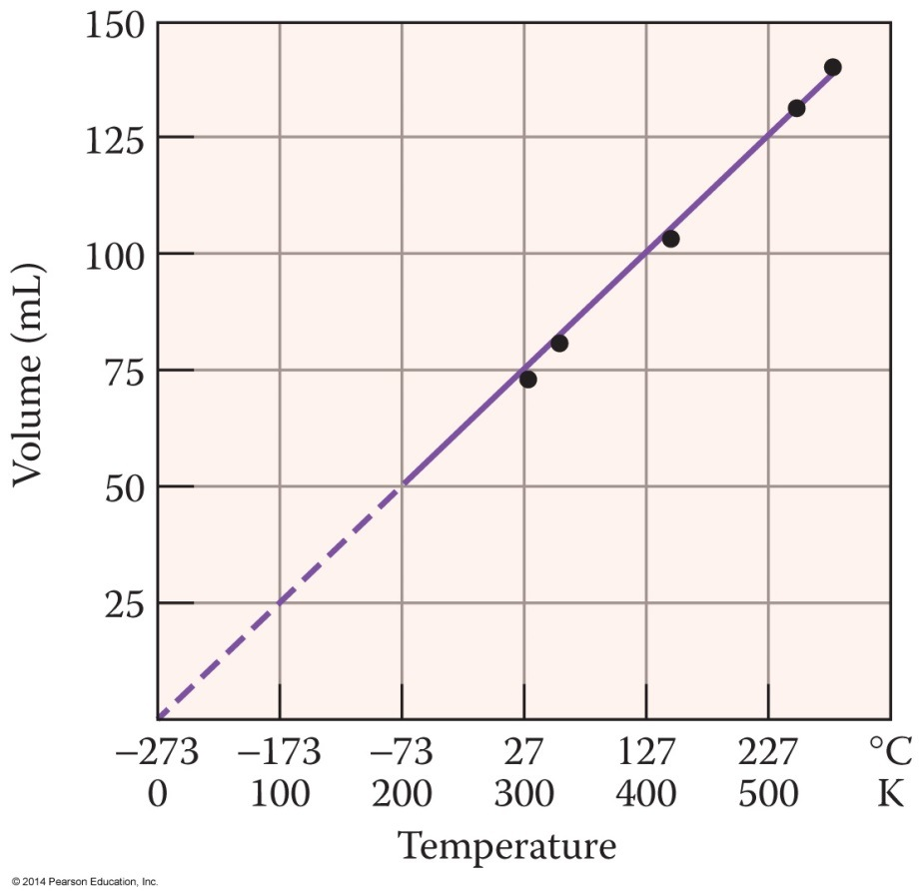
Absolute Zero
The temperature where the pressure and volume of a gas theoretically reaches zero is absolute zero.
If we extrapolate T versus P or T versus V graphs to zero pressure or volume, the temperature is 0 Kelvin, or –273 °C.

Slide 41
Ideal Gas Law
nT .
P ∝
V
RnT .
P =
V
Recall that the pressure of a gas is inversely proportional to volume and directly proportional to temperature and the number of molecules (or moles):
If we introduce a proportionality constant, R, we can write the equation:

Slide 42
Ideal Gas Law, Continued
We can rearrange the equation to read:
  PV = nRT
This is the ideal gas law.
The constant R is the ideal gas constant, and has a value of 0.0821 L ⋅ atm/mol ⋅ K.

Slide 43
Ideal Gas Law Problem
PV .
n =
RT
(1.00 atm)(2.34 L)
n =
(0.0821 atm⋅L/mol⋅K)(273K)
n = 0.104 mol
How many moles of neon gas occupy 2.34 L
at STP?
At STP, T = 273K and P = 1.00 atm. Rearrange the ideal gas equation to solve for moles:

Slide 44
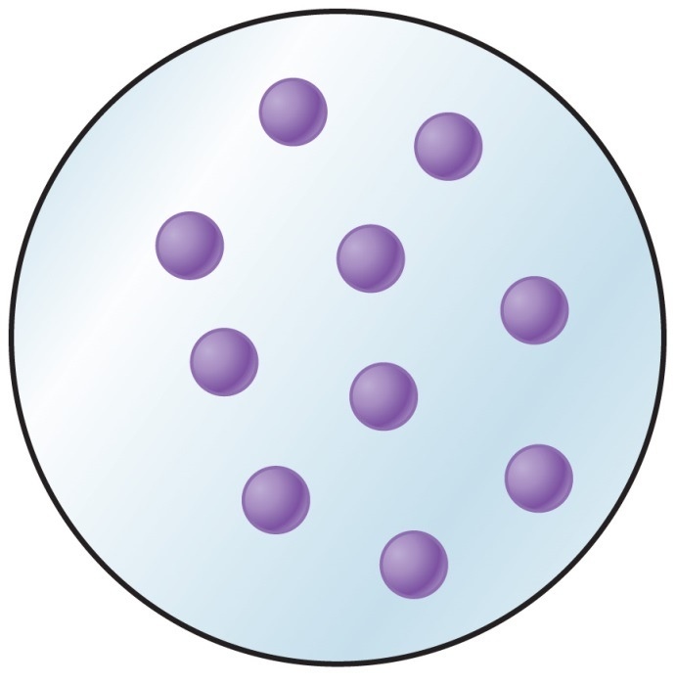
Critical Thinking: Conceptualizing Gases
Regardless of temperature, all gases are randomly distributed in their container; however, the average speed of the gas molecules changes with temperature.
This is true for all gases.

Slide 45
Chapter Summary
Gases have variable shape and volume.
The pressure of a gas is directly proportional to the temperature and the number of moles present.
The pressure of a gas is inversely proportional to the volume it occupies.
Standard temperature and pressure are exactly
1 atmosphere and 0 °C (273 K).

Slide 46
Chapter Summary, Continued
V₁
V₂
=
.
T₁
T₂
P₁
P₂
=
.
T₁
T₂
P₁V₁
P₂V₂
=
.
T₁
T₂
Boyle’s law is: P₁V₁ = P₂V₂.
Charles’s law is:
Gay-Lussac’s law is:
The combined gas law is:

Slide 47
Chapter Summary, Continued
Dalton’s law of partial pressures is:
P₁ + P₂ + P₃ + … = P_{total}.
The ideal gas law is: PV = nRT.
R is the ideal gas constant:
0.0821 L ⋅ atm/mol ⋅ K.

