Slide 1
Module 52: Sociological Perspectives on Health and Illness
Sociology in Modules
Richard T. Schaefer
3rd edition

Slide 2
Sociological Perspectives on Health and Illness
Health: “state of complete physical, mental, and social well-being, and not merely the absence of disease and infirmity” (Leavell and Clark)

Slide 3
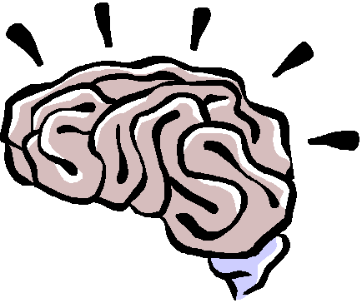
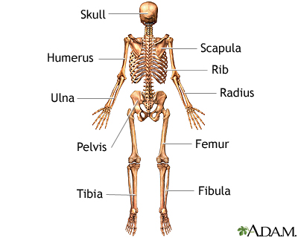

Slide 4
Quiz
Health is directly correlated with
1. Healthy life style with regular exercise
2. Income
3. Food consumption in accordance with the food pyramid

Slide 5
Social determinates of health
Health and illness are socially constructed
Important to consider how health varies in different situations or cultures

Slide 6
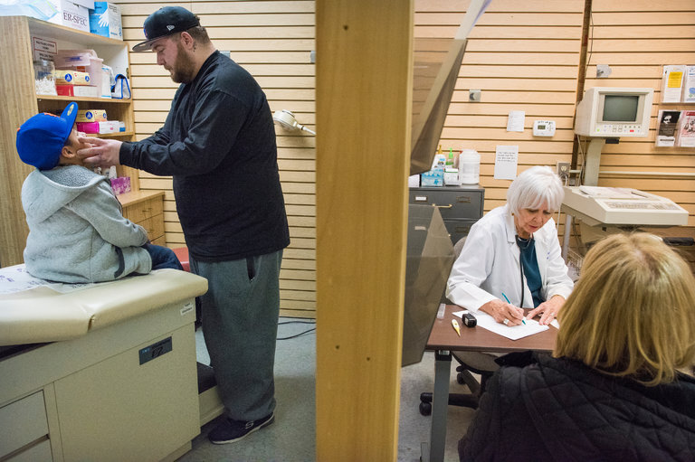
Disparity in Life Spans of the Rich and the Poor Is Growing
By SABRINA TAVERNISEFEB. 12, 2016 New York Times

Slide 7
The Association Between Income and Life Expectancy in the United States, 2001-2014
Raj Chetty, PhD¹; Michael Stepner, BA²; Sarah Abraham, BA²; et al Shelby Lin, MPhil³; Benjamin Scuderi, BA⁴; Nicholas Turner, PhD⁵; Augustin Bergeron, MA⁴; David Cutler, PhD⁴
JAMA. 2016;315(16):1750-1766. doi:10.1001/jama.2016.4226
This study published in the Journal of the American Medical Association (JAMA) provides more evidence that life expectancy in the United States is chiefly determined by economic class. Higher income is the most critical factor in longevity, the study found, with the gap between the richest one percent and poorest one percent of individuals averaging 14.6 years for men and 10.1 years for women.
The study was based on income data derived from 1.4 billion tax records between 1999 and 2014 of individuals aged 40 to 76, and death records obtained from the Social Security Administration. It found that men in the top one percent had an expected age of death of 87.3, compared to 72.7 years for the poorest one percent. The richest women on average lived 88.9 years, while the poorest lived only 78.8 years.

Slide 8
Gender matters: Heart disease risk in women
Risk still underappreciated: many women say their physicians never talk to them about coronary risk and sometimes don't even recognize the symptoms, mistaking them instead for signs of panic disorder and stress

Slide 9
WHAT ACCOUNTS FOR HEALTH DISPARITIES?FINDINGS FROM THE HOUSTON SURVEYS (2001-2013) by Stephen L. Klineberg, Kinder Institute for Urban Research, Rice University, Houston
“In general, would you say that your overall state of physical health these days is excellent, very good, good, fair, or poor?” (remarkably reliable indicator of a person’s actual state of health).

Slide 14
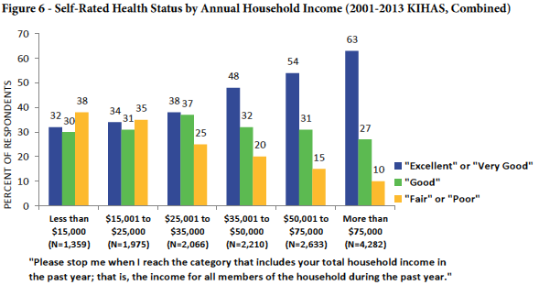

Slide 15
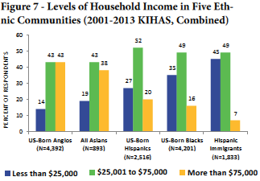

Slide 16
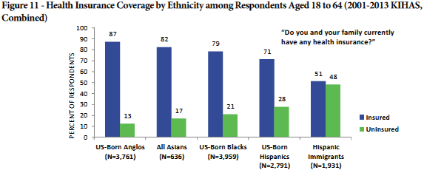

Slide 18
Functionalist Perspective
“Being sick” must be controlled so that not too many people are released from societal responsibilities
Sick role: societal expectations about attitudes and behavior of a person viewed as being ill
Physicians function as “gatekeepers” for the sick role

Slide 19
Functionalist Perspective on illness
functionalist model: Talcott Parsons (1951)
Parsons argued that the best way to understand illness sociologically is to view it as a form of deviance that disturbs the social function of the society.
Ill health impairs our ability to perform our roles in society, and if too many people are unhealthy, society’s functioning and stability suffer. This was especially true for premature death, said Parsons, because it prevents individuals from fully carrying out all their social roles and thus represents a “poor return” to society for the various costs of pregnancy, birth, child care, and socialization of the individual who ends up dying early

Slide 20
Functionalist Perspective on illness – “Sick Role”
Expectations regarding the sick role.
Sick people should not be perceived as having caused their own health problem.
sick people must want to get well. If they do not want to get well or, worse yet, are perceived as faking their illness or malingering after becoming healthier, they are no longer considered legitimately ill by the people who know them or, more generally, by society itself.
Sick people are expected to have their illness confirmed by a physician or other health-care professional and to follow the professional’s instructions in order to become well. If a sick person fails to do so, she or he again loses the right to perform the sick role.

Slide 21
Functionalist Perspective
Physicians function as “gatekeepers” for the sick role
According to Parson, Physicians also have a role to perform. First and foremost, they have to diagnose the person’s illness, decide how to treat it, and help the person become well.
To do so, they need the cooperation of the patient, who must answer the physician’s questions accurately and follow the physician’s instructions.
Parsons thus viewed the physician-patient relationship as hierarchical: the physician gives the orders (or, more accurately, provides advice and instructions), and the patient follows them.

Slide 22
Problem with “Sick role”
What about individual judgement of health? - for example age is associated with perception about health
Sick role may be more applicable to short term illness? What about long term illness?
How different occupational groups define “sick role” – for example, athletes learn to define ailments as “Sport injury”

Slide 23
Conflict Perspective
Growing role of medicine as major institution of social control
Medicalization of Society
Greatly expanded domain of expertise – sexuality, anxiety, child development, substance abuse
Problems viewed using a medical model- some of this problem have socio-cultural origins – not considered
Retains jurisdiction over health care – growth of C-sections and distrust of nurse-midwives

Slide 25
Inequality in Healthcare - Conflict Perspective
People who are socially disadvantaged by income, employment status, education and place of residence, also have a higher risk of chronic diseases, such as diabetes, heart disease and cancers, and depression.
Inequities in Health Care
Obvious inequities exist
Brain drain: immigration to U.S. and other industrialized nations of skilled workers, professionals, and technicians
Dramatic differences in infant morality rate: number of deaths of infants under one year old per 1,000 live births in given year

Slide 26
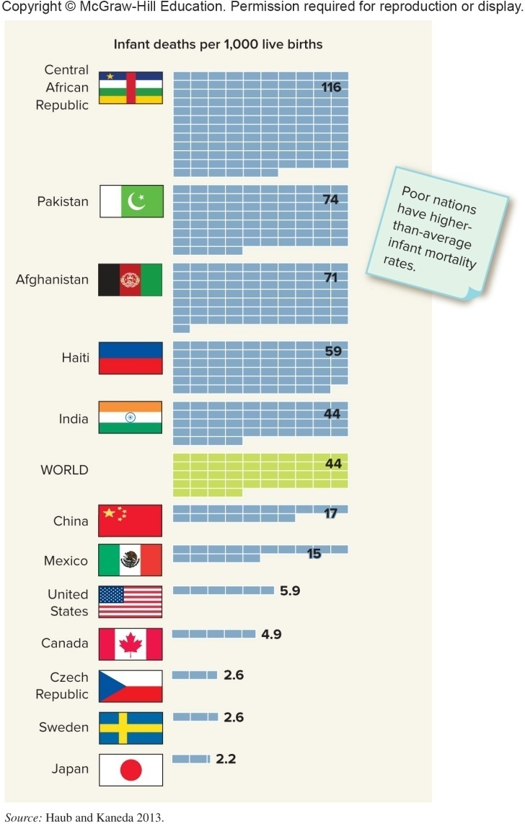
Figure 52-1: Infant Mortality Rates in Selected Countries
Notes:
26

Slide 27
Interactionist Perspective
Examines roles played by health care professionals and patients
Asserts patients may play an active role in positive or negative health

Slide 28
Labeling Perspective
Labeling theory attempts to explain why certain people viewed one way while others engaged in same behavior are not
Example – racial disparities in healthcare
The designations healthy and ill generally involve social definition
Professionals have power to define who is sick – non conformity with that label may lead to backlash.
Homosexuality – 1974 APA dropped homosexuality as mental disorder

Slide 29
Module 53: Social Epidemiology and Health Care in the United States
Sociology in Modules
Richard T. Schaefer
3rd edition

Slide 30
Social Epidemiology and Health Care in the United States
Social epidemiology: study of distribution of disease, impairment, and general health status across a population
Morbidity rates: disease incidence figures presented as rates or number of reports per 100,000 people
Mortality rate: incidence of death in a given population

Slide 31
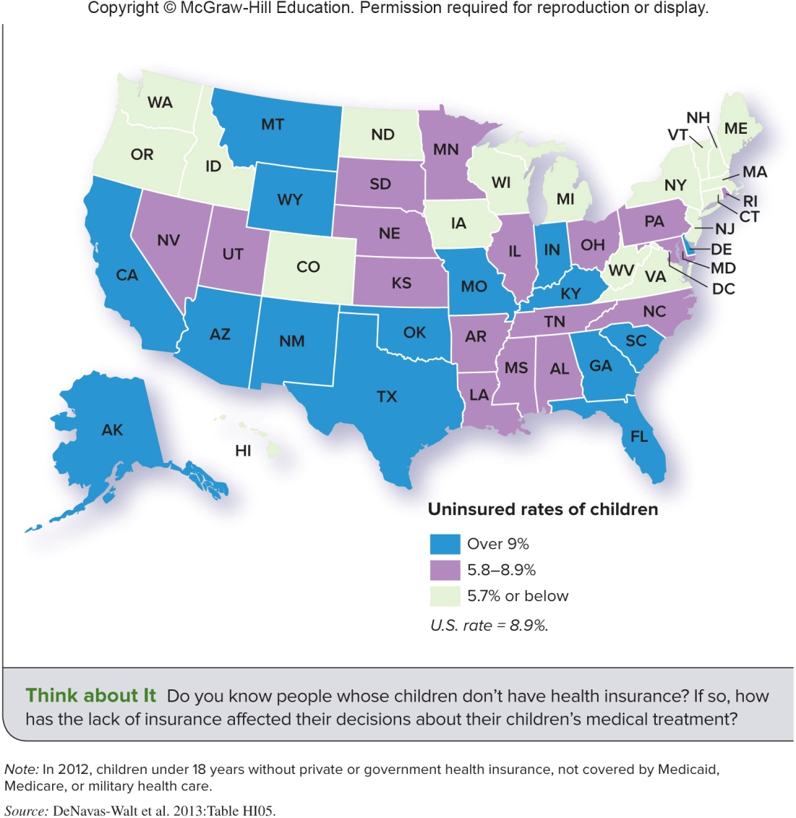
Figure 53-2: Percentage of Children without Health Insurance
Notes:
31

Slide 32
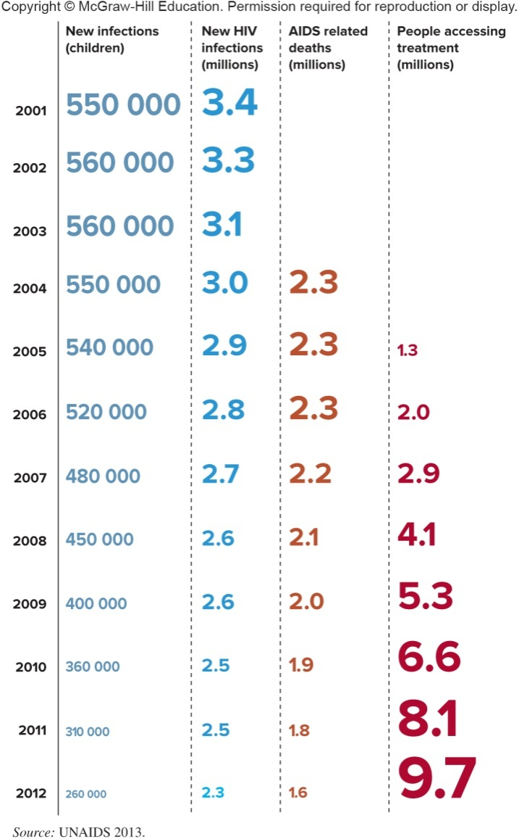
Figure 53-1: AIDS by the Numbers Worldwide
Notes:
32

Slide 33
Social Class
People in lower classes have higher rates of mortality and disability
Effects appear to be cumulative
Poor are less able to afford quality medical care
Conflict theorists: capitalist societies care more about maximizing profits than they do about the health and safety of industrial workers
Example: Duke medical center, 900 bed hospital
How many billing specialists???
Ottawa and Pennsylvania – same population
Ottawa has 11 hospitals that can do heart surgeries
Pennsylvania – How many ??

Slide 34
Race and Ethnicity
Health profiles of racial and ethnic groups reflect social inequality in U.S.
Poor economic and environmental conditions manifested in high morbidity and mortality
African Americans have higher infant mortality rates when compared to Whites
Mexican Americans may use curanderismo: form of holistic health care and healing

Slide 35
Gender
Women experience higher prevalence of many illnesses but tend to live longer
Theorized reasons for longevity:
Lower rate of cigarette smoking
Lower alcohol consumption
Lower rate of employment in dangerous occupations
More likely to seek treatment

Slide 36
Healthcare in United states
How much do we spend ?
What can we expect in future?
2020 – 4.6 trillion (estimate)
Healthcare
Education, Defense, Farm subsidies, Food stamps and Foreign Aid

Slide 37
“Bitter Pill: Why Medical Bills Are Killing Us,” by Steven Brill (TIME report Source:Patricia Dubrava (summary of the report)
62% of personal bankruptcy filings each year are related to medical bills
The lowest paid CEO on the list of 10 largest nonprofit hospitals earns $2,080,779
Of the countries that spend most on health care, we spend by far the highest per person and yet our life expectancy is the lowest in that group.
Our infant mortality rank is 50th in the world, nine spots below Cuba
One Nexium pill here costs as much as eight pills in France.

Slide 38
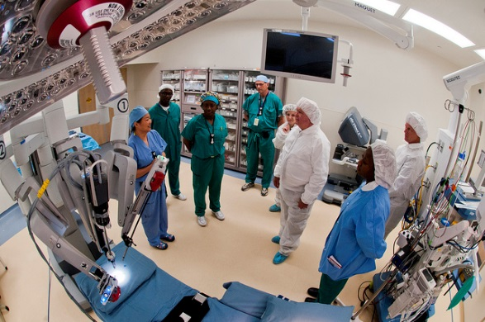
Historic view of the healthcare system
1830- 1840 – No unified medical licensing body
AMS (1948) standardization of education and licensing
Institutionalization of healthcare
By 1920 – Decentralization by allied professions and greater division of labor

Slide 39
Physician – patient relationship
Traditional models – Physicians had a role of dominance
Functionalist view – Professional socialization of physicians (Expert Vs passive learners)

Slide 40
Study of patient's perspective medical errors may have health care professional rethinking what is important to their patients
A study, published in the Annals of Family Medicine (2014), suggests that patients are more disturbed with lack of access to and relationships with their physicians than technical errors in diagnosis and treatment.
Barriers
Humanist approach part of medical training, but perceived not as important as technical skills
Patient overload
Trust – fear of malpractice

Slide 41
Inter-professional collaboration
Physician – Nurse relationship
Gender divide - 91% female nurses (2016)
34% Female doctors (Kaiser Foundation 2016)
Doctor-Nurse game ( Leonard Stein, 1967)
“Interactions between the two were carefully managed so as not to disturb the fixed hierarchy. Nurses were bold, had initiative, and were responsible for important recommendations. While being bold, however, they had to appear passive”.

Slide 42
Doctors and nurses: new game, same result Radcliffe M. BMJ. 2000 Apr 15; 320(7241): 1085.
After the 1970s nursing reconstructed itself as an independent profession which sometimes stood up to doctors. They did this in various ways, an example being the investment in university education and the social affirmation that went with it
For all the jostling for position over the past 20 years little has changed, the public may love its angels but it holds its medics in awe.

Slide 43
Complementary and alternative medicine
1992 – National center complementary and alternative medicine established (Funded by NIH)
NIH sponsored survey found that 1 in 4 adult in the US use alternate medicine
At a global level, according to WHO, 80 % people in poorest countries use some form of alternate medicine

Slide 44
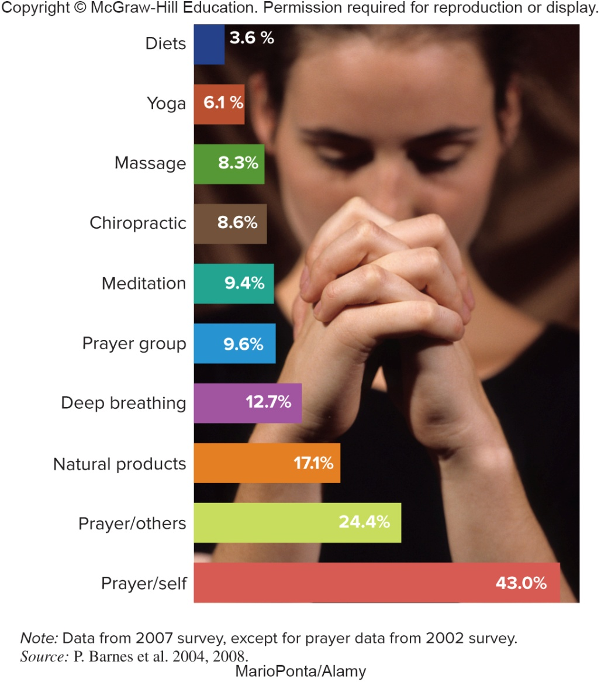
Figure 53-4: Use of Complementary and Alternative Medicine
Notes:
44

Slide 45
The Role of Government
1946 Hill-Burton Act: first subsidies for building and improving hospitals
1965: Medicare and Medicaid established
Programs greatly expanded federal involvement in health care financing
1983: government instituted cost-control program
2010: Affordable Care Act offered health insurance coverage for people of all ages

Slide 46
Module 54: What Is Mental Illness?
Sociology in Modules
Richard T. Schaefer
3rd edition

Slide 47
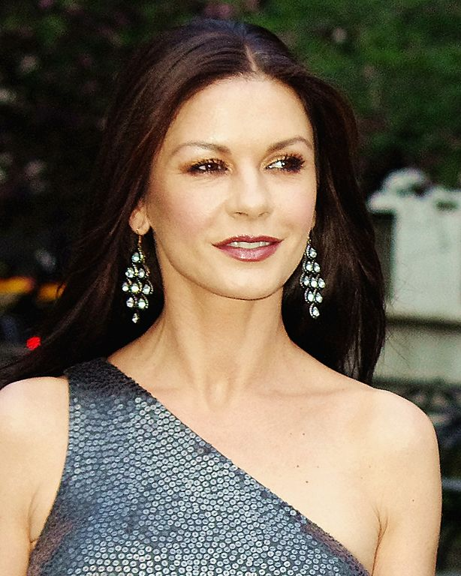
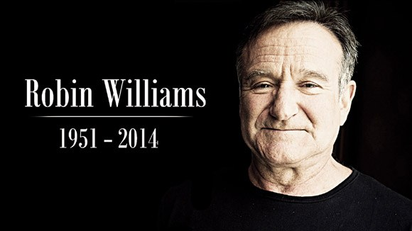

Slide 48
What Is Mental Illness?
Term mental illness should be reserved for disorder of the brain that disrupts thinking, feeling, and ability to interact with others
In the U.S., mental illness traditionally viewed with suspicion
Tragic shootings increase stigma against those with mental illness
Despite stigma, more people seeking treatment

Slide 49
Stigma and mental illness
1950
More openness about disclosure, recognition and treatment
Only 4% of violent crime committed by people with mental illness. Yet today “violence “ is more likely to be associated with mental illness

Slide 50
Theoretical Models of Mental Disorders
Medical model: mental illness is rooted in biological causes that can be treated through medical intervention
Social and cultural factors contribute to mental illness
Example - Hallucination
Controversy over publication of and reliance on DSM
1987 – dropped sexual orientation
2013 – added binge eating and some forms of hoarding
Labeling theory: some behaviors that are viewed as mental illnesses may not really be illnesses – “Myth of Mental Illness”

Slide 51
Patterns of Care
Government took early role in mental illness because of disruptions that it causes
Community Mental Health Centers Act increased government intervention and provision of care
Some states making it easier to commit mental patients to hospitals involuntarily
Like physical illness, racial disparity with mental illness

