Slide 1
Quiz on Ch. 3 and 4 –need calculators (no phones)!
Trade n Grade
Discuss Ch. 5
Homework Expectations Review
Student Resources

Slide 2
Please write the last 5 of your W number.
You have 25 minutes

Slide 3
Please use different color pen/marker if you have it.
Write your Last 5 W# on “graded by” line
Mark correct answers in the left margin
Write total correct in upper right corner (i.e. 10/10)

Slide 4
1. Consumers spend approximately the following amount of their food budget on food away from home:
a) nearly three quarters.
b) almost half.
c) almost one-third.
d) less than one-quarter.

Slide 5
2. A segment within the commercial food service industry which has declined in sales is
a) QSRs.
b) drive-through restaurants.
c) delivery restaurants.
d) employee cafeterias.

Slide 6
3. The largest growth segment (as a percentage increase) in food service has been
a) on-site food service.
b) off-premise food service.
c) motel restaurants.
d) vending food service.

Slide 7
4. The role of the server in a restaurant is principally
a) a mechanical one, that is, bringing the food.
b) to entertain the guest.
c) a combination of promptness and efficiency with anticipation of the guest’s needs.
d) to represent the dignity of the restaurant and of the service profession.

Slide 8
5. A POD is a
a) way of increasing market presence.
b) marketing term for advertising in chain restaurants.
c) management term for a computer analysis.
d) specialized type of purchasing.

Slide 9
6. If you wish to be promoted rapidly in the restaurant business, usually your best avenue is through
a) human resources.
b) accounting.
c) marketing.
d) operations.

Slide 10
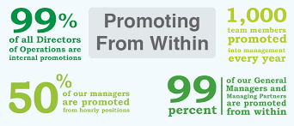

Slide 11
7. The key responsibility for the front of the house is
a) fast service.
b) excellent food presentation.
c) guest satisfaction.
d) personal charm.

Slide 12
8. Basically, the bottom line in increasing restaurant sales is
a) consumer demand.
b) employee training.
c) manager’s devotion.
d) the owner’s mandate to make a profit.

Slide 13
9. Cost of sales is
a) sales and marketing expenses.
b) fixed costs.
c) cost of product consumed by the guest.
d) bar (or beverage cost) less food cost.

Slide 14
10. A profit-and-loss statement is also called
a) a statement of income and expense.
b) an accounting statement.
c) a statement of sales, controllable expense, and capital costs.
d) a profit statement.

Slide 15
Bonus Points!!!
(+1) Define the dining market:
(+1) Define the eating market:
(+2) Typically, the three defined areas of the restaurant are:
______________________________
______________________________
______________________________
The dining market primarily serves the guest’s social needs.
The eating market primarily serves the guest’s biological needs.
Front of House (FOH)
Back of House (BOH)
Office

Slide 16
SHOW YOUR WORK!!!!
(+2) Determine the average cover:
Food sales = $831.76
Number of checks = 37
Number of patrons served = 148
The average cover is ______________
$5.62
$831.76/148

Slide 17
SHOW YOUR WORK!!!!
(+2) Determine the food cost percent:
Food cost = $ 9,520
Food sales = $32,138
Food cost % = _______________
29.62%, 29.6% or 30%
$9,520/$32,138

Slide 18
SHOW YOUR WORK!!!!
(+2) A 60 seat restaurant operating 7 days a week has an average check of $8.00 and serves 270 persons, on average, each day. Determine the total increase in sales each day if the average cover can be increased to $8.25.
daily increase in sales is _______________
increase in sales for one year ______
$67.50
$.25*270
$24,637.50
$67.50*365

Slide 19
From 15/5 to 95/5
"It is free to be nice, costly to be rude" and what he calls "the 95:5 rule. “All of us do 95% right,” he said. “Every day, we wake up but it's the 5 percent you look for in the details that separates you from everybody else, and that's what I preach.
https://www.instagram.com/tv/B26iLrFAgqX/

Slide 20
Class Group Assignment (Dojo Groups)
Do the corresponding
question on pages 165-166
2. Be prepared to share

Slide 21
Notes:
Salaries, wages, labor, inventory, etc.

Slide 22
Chapter 5
Restaurant Industry Organization: Chain, Independent, or Franchise?

Slide 23
RESTAURANT INDUSTRY ORGANIZATION
This chapter will focus on restaurant company organization—that is, how companies are organized
This is important to know because there are significant differences between chains (corporate), independents, and franchises
Currently, the industry’s growth is being driven by chains.

Slide 24
CHAINS
Chains have strengths in seven areas:
Marketing and brand recognition
Site selection
Access to capital
Purchasing economies
Centrally administered control and information systems
New product development and
Human resource development

Slide 25
Marketing and Brand Recognition
Chains achieve a high level of brand recognition by:
keeping their messages simple,
large marketing budgets
the additive effect (repeating the message)
The large cost of marketing a national company is spread among a large number of units (franchisees)

Slide 27
Who are the most recognized public figures for kids?

Slide 28
Ronald McDonald is more popular than Mickey Mouse, Donald Duck and the Easter Bunny…
why?!?!?!

Slide 29
Name that tagline!!
Just Do It!
Good to the last drop
Break me off a piece of that ….
You’re not you when you’re hungry
Pizza, Pizza
Eatin’ good in the neighborhood.
Have it your way!
Table 5.1 p 137
Marketing Expenditures

Slide 30
Site Selection Expertise
Much of a restaurant’s success is owed to choosing the proper site
It has become much more competitive to identify suitable sites
Choices are based upon a thorough examination of the feasibility of the site

Slide 31
Access to Capital
Challenging with the rising costs of opening a restaurant and lenders’ view that the restaurant business is risky
Options include loans from
Banks
friends and family
personal savings
limited investors
“going public”
IPO, Angel Investors Crowdfunding

Slide 32
Purchasing Economies
The power of purchasing large quantities for distribution among different locations or entering into a contract with a company for multiple individual purchases
Considering that food is a primary expense, the savings of 1% – 2% can be significant

Slide 33
Control and information systems
Chains spend a lot of money to develop procedures for collecting and analyzing accounting and marketing information.
Daily reports from the POS are sent to the central office computer for analysis and problem solving before being sent back to the unit for follow-up.
This cost is also spread across the multiple units.

Slide 34
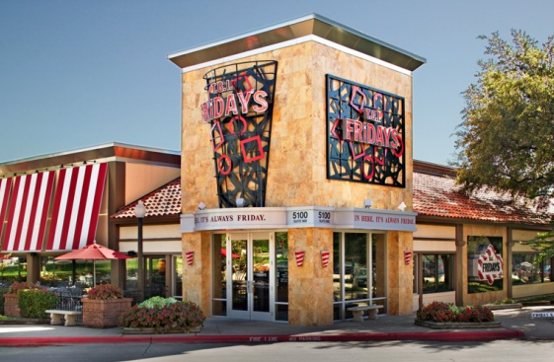
Control and Information Systems
Chains can also afford to purchase expensive systems with the justification that the cost will be spread across multiple units
Contrast this with
the challenge of an
individual operator
purchasing a system
beyond their means

Slide 35
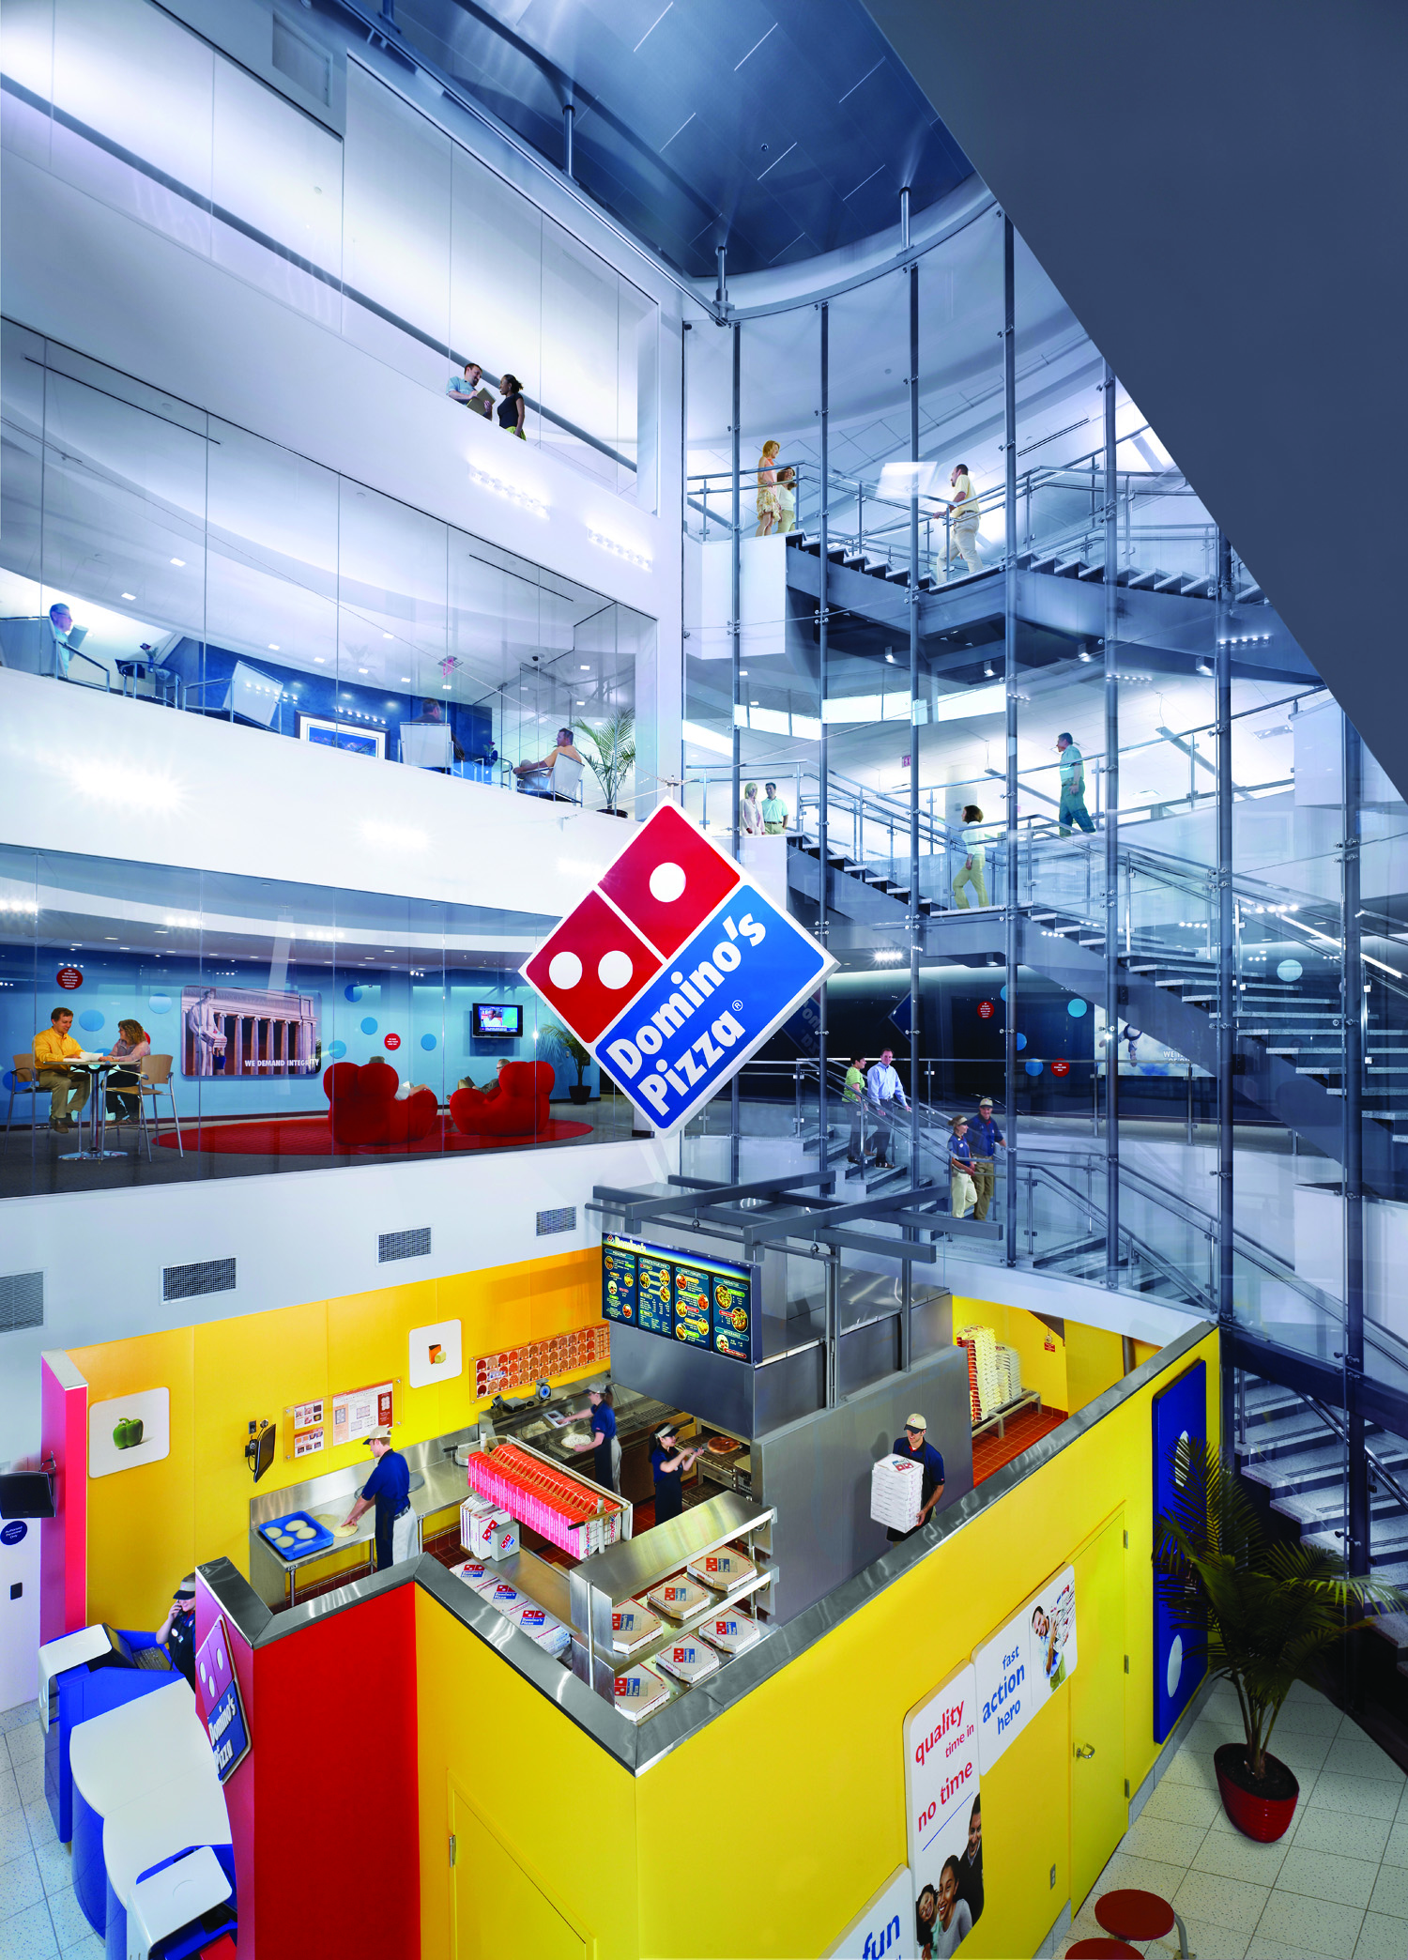
New Product Development
This is becoming more important as competition increases
Large chains can afford to staff and equip development kitchens

Slide 36
The Independents
HR develops close personal ties with employees, thus reducing turnover
Flexibility in decision making
Differentiation
Hands on multiple units
They can franchise as well

Slide 37
Human Resource Program Development
Again, the cost of recruiting, hiring, training, and developing is spread across multiple units
Also, human resource expertise can be centralized
There can also be disadvantages

Slide 39
what are some disadvantages of a centralized hr?
Notes:
Salaries, wages, labor, inventory, etc.

Slide 40
https://youtu.be/g9nehPueARc

Slide 41
CHAIN domination
Largely as a result these strengths, chain domination (as measured by market share) has grown over the last several years
The top 100 chains alone generate over 50% of all restaurant sales
This domination has increased from just 33% in 1975
Table 5.2 p 142-10 Fastest Growing Chains

Slide 42
product/trade name vs. Business format
Product or Tradename Franchising allows use of the brand and sell of products
Business Format allows use of product, service and all systems and standards/

Slide 43
The new franchise-pre-opening
In the beginning:
Screening
Financing
Site Selection and Planning
Pre-opening training
Operation Manuals

Slide 44
The new franchise post-opening
Continued Support
Operating and Control Procedures
Info Management
QA
Training
Field Support
Purchasing
Marketing
Advertising
New Products
New Concepts (Co-branding)

Slide 45
10 minutes
1. List advantages &
disadvantages for:
a) franchisees
b) franchisors
2. Be prepared to share
3. If you were to open a business, would you be an independent or franchisee?

Slide 46
Click the pic for video

Slide 47
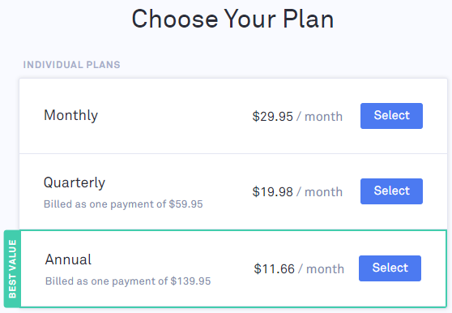
Grammerly is FREE!!!!!
IF you choose to upgrade:

Slide 48
DUE: 11/13/2019

Slide 49
Homework
Chapter 6
Begin studying for midterm
-you will need pencil & Scantron!
Begin working on class projects
-Project and rubric on LW

