Slide 1
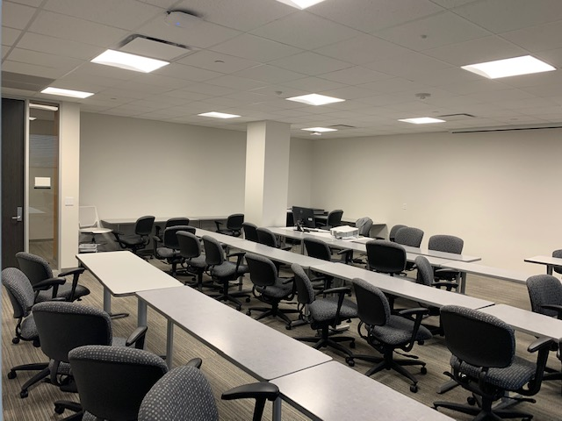
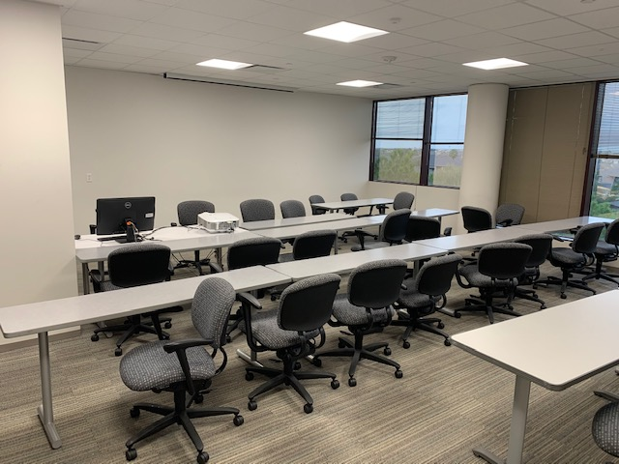
Alief-Hayes room A430 pictures Thanks Elias Lytton

