Slide 1
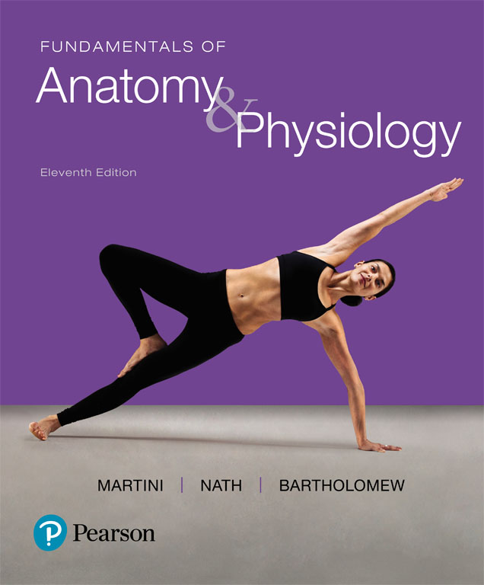
Fundamentals of Anatomy & Physiology
Eleventh Edition
Chapter 29
Development and Inheritance
Lecture Presentation by
Deborah A. Hutchinson
Seattle University

Slide 2
29-1 Development
Prenatal development
Embryonic and fetal developmental stages
Postnatal development
Begins at birth
Continues to maturity
State of full development or completed growth

Slide 3
29-1 Development
Pre-embryonic development
Processes that occur in first 2 weeks after fertilization
Produces embryo
Embryonic development
Occurs during third through eighth weeks
Embryology—study of these events
Fetal development
Development of fetus
Begins at start of ninth week, continues until birth

Slide 4
29-1 Development VERY IMPORTANT DEFINTIONS
Differentiation
Creation of different cell types during development
Occurs through selective changes in genetic activity
Some genes are turned off, others are turned on
Inheritance (heredity)
Transfer of genetically determined characteristics from generation to generation
Genetics
Study of mechanisms responsible for inheritance

Slide 5
29-2 Fertilization
Fertilization
Fusion of two haploid gametes, each containing 23 chromosomes
Produces zygote containing 46 chromosomes
Sperm
Delivers paternal chromosomes to fertilization site
Small, efficient, and highly streamlined
Oocyte
Contains everything needed to support development of embryo for nearly a week

Slide 6
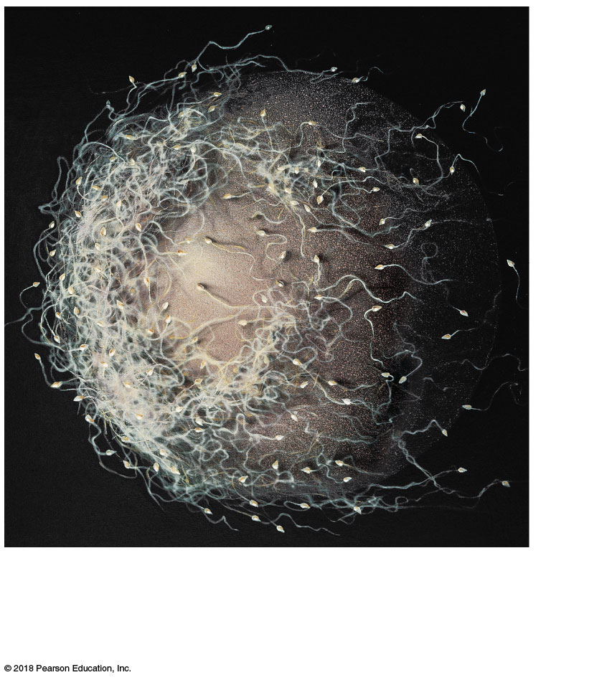
Figure 29–1a Fertilization.
× 300
a
A secondary oocyte and numerous sperm at
the time of fertilization. Notice the difference
in size between the gametes.

Slide 7
29-2 Fertilization
Fertilization
Occurs in uterine tube within a day after ovulation
Secondary oocyte travels a few centimeters
Sperm must cover distance between vagina and ampulla of uterine tube
Oocyte activation
Triggered by fusion of sperm and oocyte membranes
Completion of meiosis II and formation of second polar body

Slide 8
29-2 Fertilization
After oocyte completes meiosis II, it becomes mature ovum
Amphimixis
Fusion of female pronucleus and male pronucleus
“Moment of conception”
Cell becomes a zygote with 46 chromosomes
Fertilization is complete
First cleavage
Produces two daughter cells (blastomeres)

Slide 9
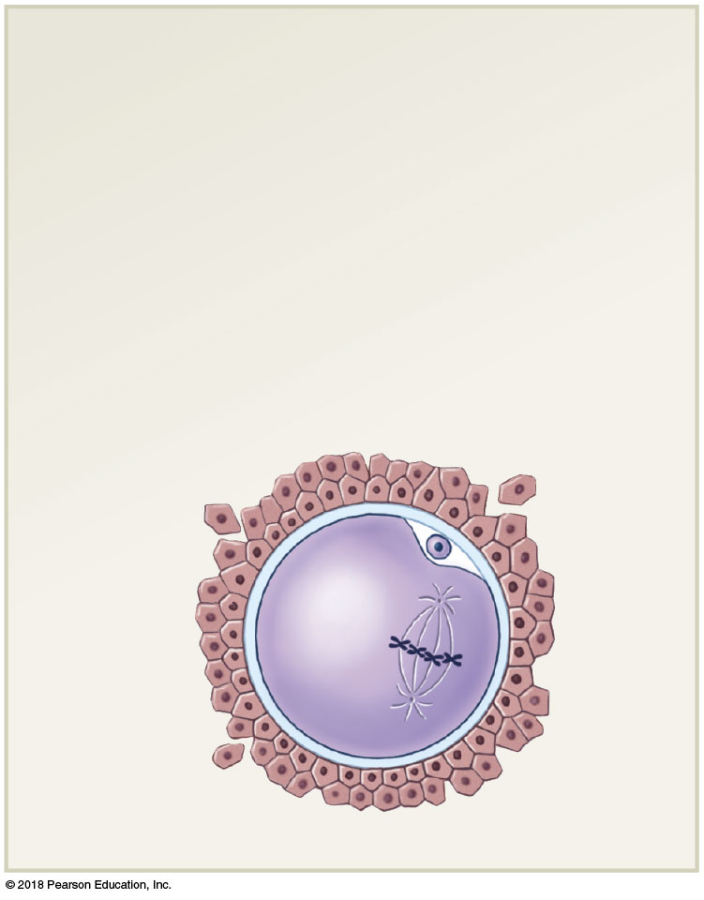
Figure 29–1b Fertilization (Part 1 of 6).
Oocyte at Ovulation
Ovulation releases a secondary oocyte
and the first polar body; both are
surrounded by the corona radiata. The
oocyte is suspended in metaphase of
meiosis II.
Corona
radiata
First polar
body
Zona
pellucida

Slide 10
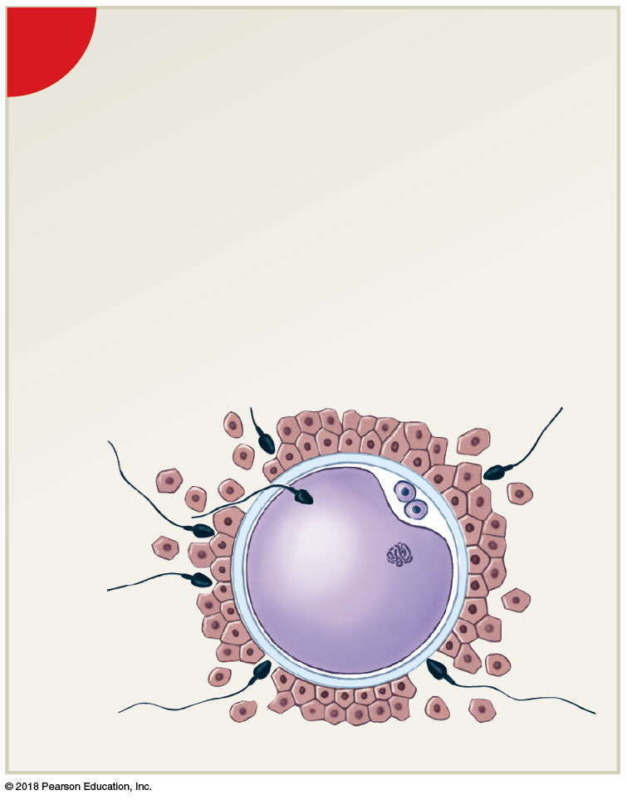
Figure 29–1b Fertilization (Part 2 of 6).
1
Fertilization and Oocyte Activation
Acrosomal enzymes from multiple
sperm create gaps in the corona
radiata. A single sperm then makes
contact with the oocyte membrane,
and membrane fusion occurs,
triggering oocyte activation and
the completion of meiosis.
Fertilizing
sperm
Second polar
body

Slide 11
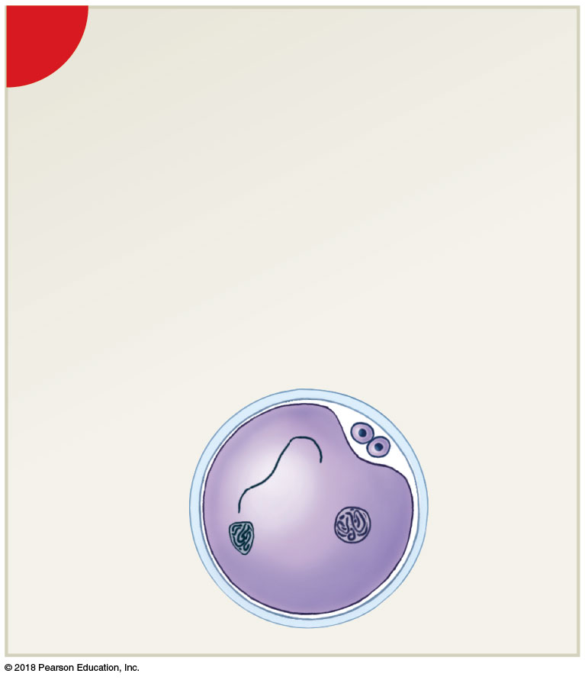
Figure 29–1b Fertilization (Part 3 of 6).
2
Pronuclei Develop and
DNA Synthesis Occurs
The sperm is absorbed into
the cytoplasm, and the female
pronucleus develops. As the
male pronucleus develops,
most remaining sperm break
down.
Nucleus of
fertilizing
sperm
Female
pronucleus

Slide 12
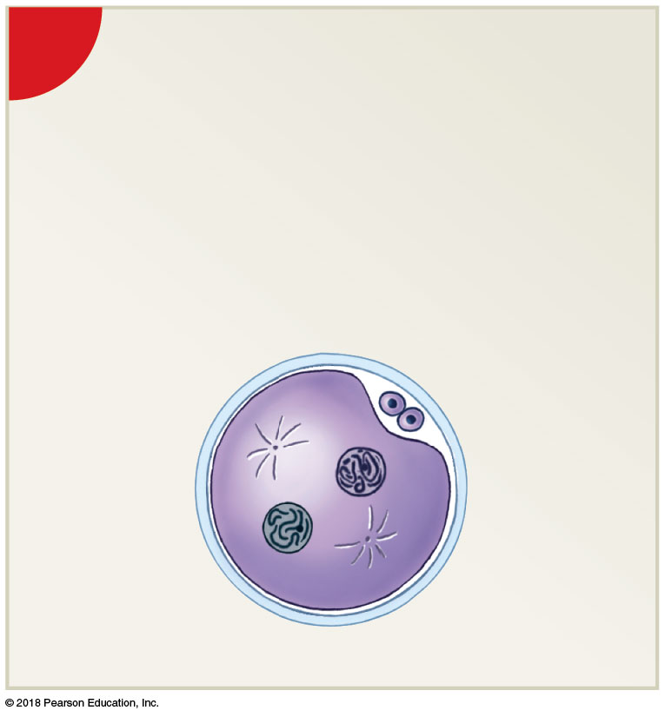
Figure 29–1b Fertilization (Part 4 of 6).
3
Spindle Formation Begins
Pronuclei chromatin condenses
into chromosomes, and spindle
fibers appear in preparation for the
first cell division.
Centrioles
Female
pronucleus
Male
pronucleus

Slide 13
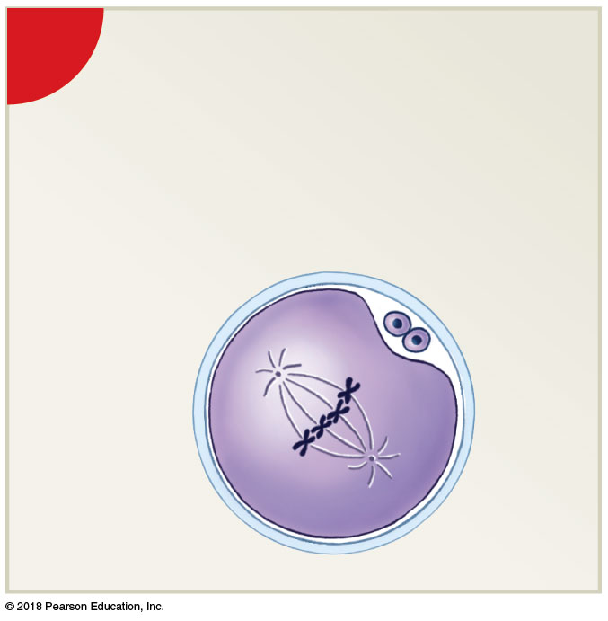
Figure 29–1b Fertilization (Part 5 of 6).
4
Amphimixis Occurs and
Cleavage Begins
Maternal and paternal
chromosomes align
on metaphase plate

Slide 14
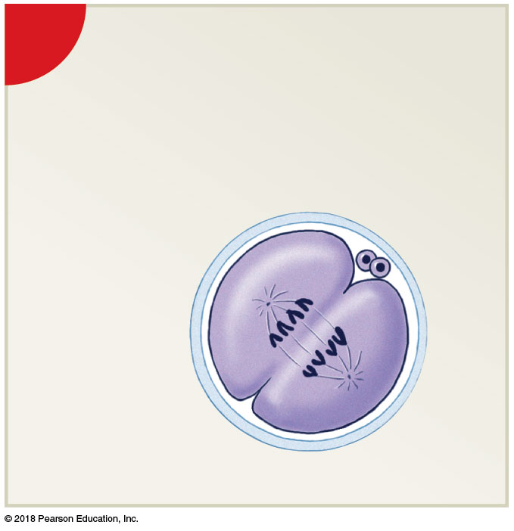
Figure 29–1b Fertilization (Part 6 of 6).
5
First Cleavage Forms
Two Blastomeres
The first cleavage division nears
completion about 30 hours after
fertilization.
Blastomeres

Slide 15
29-3 Gestation
Gestation
Time spent in prenatal development
Consists of three integrated trimesters, each 3 months long

Slide 16
29-3 Gestation IMPORTANT TIMELINES
First trimester
Pre-embryonic through early fetal development
Rudiments of all major organ systems appear
Second trimester
Development of organs and organ systems
Body shape and proportions change
Third trimester
Rapid fetal growth and deposition of adipose tissue or fat
Most major organ systems are fully functional

Slide 17
29-4 The First Trimester
First trimester **** Know Sequence or order of events
Involves four general processes
1) Cleavage
2) Implantation
3) Placentation
4) Embryogenesis

Slide 18
29-4 The First Trimester
Cleavage
Sequence of cell divisions that begins immediately after fertilization
Zygote becomes a pre-embryo, which develops into multicellular blastocyst
Ends when blastocyst contacts uterine wall
Implantation
Begins with attachment of blastocyst to endometrium of uterus
Sets stage for formation of embryonic structures

Slide 19
29-4 The First Trimester
Placentation
Occurs as blood vessels form around periphery of blastocyst
Placenta develops to permit exchange between maternal and embryonic blood
Embryogenesis
Formation of viable embryo
Establishes foundations for all major organ systems

Slide 20
29-4 The First Trimester
First trimester
Most dangerous prenatal stage
Only about 40 percent of conceptions produce embryos that survive first trimester (spontaneous abortion)

Slide 21
29-4 The First Trimester
Cleavage and blastocyst formation
Blastomeres
Identical cells produced by cleavage
Morula
Stage after 3 days of cleavage
Pre-embryo is a solid ball of cells resembling mulberry
Reaches uterus on day 4 or 5
cleavage and blastocyst formation
Blastocyst
Forms from morula
Hollow ball

Slide 22
29-4 The First Trimester
Cleavage and blastocyst formation
Inner cell mass
Will form embryo

Slide 23
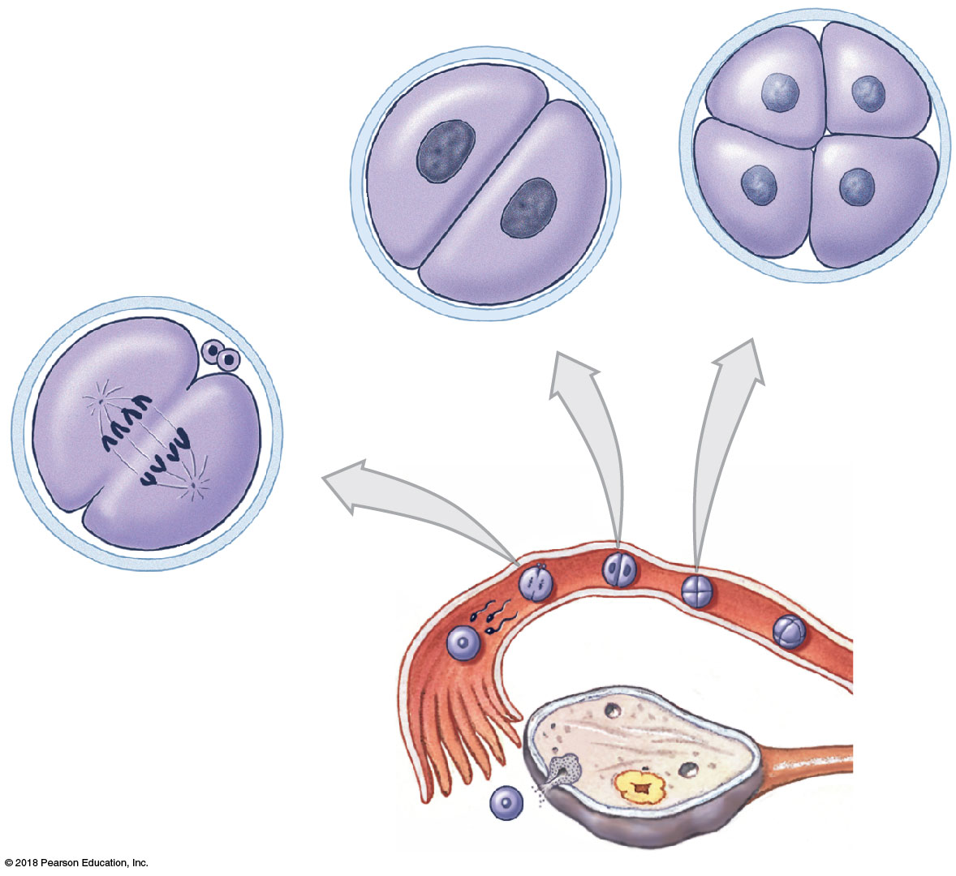
Figure 29–2 Cleavage and Blastocyst Formation (Part 1 of 2).
Blastomeres
Don’t memorize time of stages
But fertilized egg (zygote) dividing
as it moves along Fallopian
or uterine tubes.
Polar bodies
4-cell stage
2-cell stage
DAY 1
DAY 2
First cleavage
division
DAY 0:
Fertilization

Slide 24
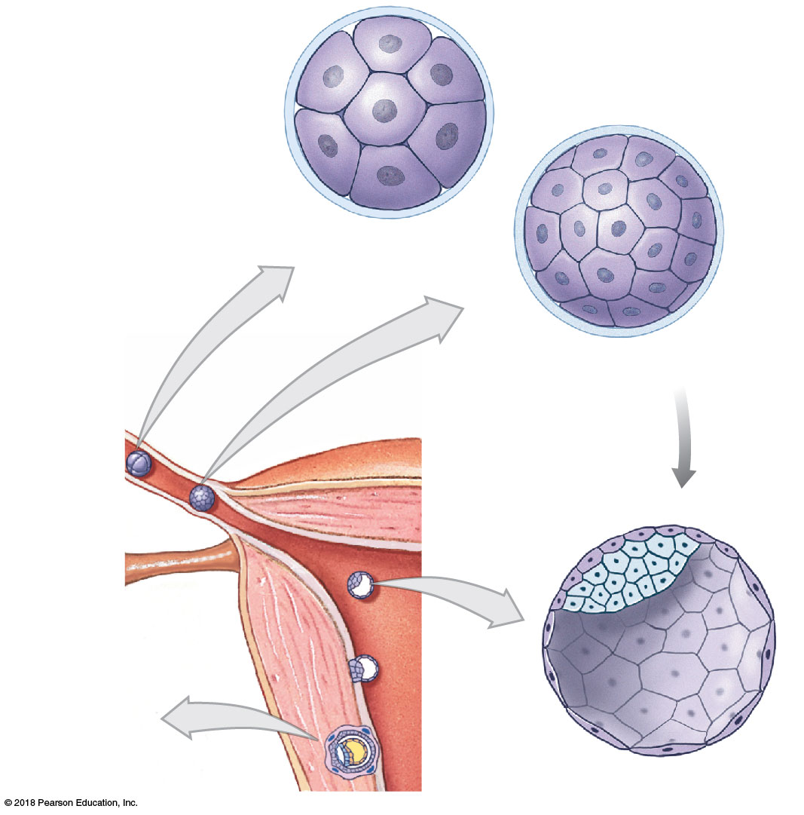
Figure 29–2 Cleavage and Blastocyst Formation (Part 2 of 2).
NOTE: early morula goes to
blastocyst stage as it attaches
to the uterine wall.
Zona pellucida
Early morula
DAY 3
Advanced
morula
DAY 4
Hatching
Inner cell
mass
DAY 6
Blastocoele
Days 7–10:
Implantation in
uterine wall
Trophoblast
Blastocyst

Slide 25
29-4 The First Trimester
Implantation
Occurs 7–10 days after fertilization
Blastocyst adheres to uterine lining
Amniotic cavity
Fluid-filled chamber created as inner cell mass separates from trophoblast
Next to superficial layer of inner cell mass
Deeper layer is exposed to blastocoele

Slide 26
29-4 The First Trimester
Ectopic pregnancy
Implantation occurs somewhere other than within uterus
0.6 percent of pregnancies
Does not produce viable embryo
Can be life threatening to the mother

Slide 27
29-4 The First Trimester
Embryonic period
Implantation to week 9
Differentiation
Involves changes in genetic activity of some cells but not others

Slide 28
29-4 The First Trimester Essent
Early embryogenesis called
Gastrulation
Forms 3 layers of cells in embryo
Through cell migration
Three germ layers
Ectoderm
Mesoderm
Endoderm
****You need to know all 3 germ layers and what they produce (later slides)

Slide 29
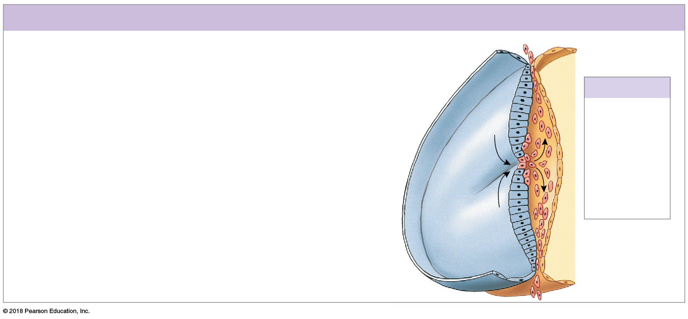
Figure 29–4 The Inner Cell Mass and Gastrulation (Part 2 of 2).
Figure only shown so that you observe 3 germ layers, at DAY 15 of GASTRULATION
Do not memorize, observe formation of germ layers.
Day 15: Gastrulation
By day 15, superficial cells of the two-layered embryonic
disc have begun to migrate toward a central line known as
the primitive streak. Here, the migrating cells leave the
surface and move between the two existing layers. This
movement creates three distinct embryonic layers: (1) the
ectoderm, consisting of superficial cells that did not
migrate into the interior of the embryonic disc; (2) the
endoderm, consisting of the cells that face the yolk sac;
and (3) the mesoderm, consisting of the poorly
organized layer of migrating cells between the
ectoderm and the endoderm. Collectively, these
three embryonic layers are called germ layers,
and the migration process is called gastrulation.
Through gastrulation, the embryonic disc becomes an
oval, three-layered sheet. This disc will form the body of
the embryo, whereas all other cells of the blastocyst will
be part of the extra-embryonic membranes.
Yolk sac
Amnion
Germ Layers
Ectoderm
Mesoderm
Primitive
streak
Endoderm
Embryonic disc

Slide 30
29-4 The First Trimester What is ECTODERM?
Ectodermal contributions
Integumentary system
Epidermis, nails, hair follicles and hairs
Glands communicating with skin (sweat, mammary, and sebaceous glands)
Nervous system
All neural tissue

Slide 31
29-4 The First Trimester
Ectodermal contributions
Endocrine system
Pituitary gland and adrenal medullae
Respiratory system
Mucous epithelium of nasal passageways

Slide 32
29-4 The First Trimester What is MESODERM?
Mesodermal contributions
Integumentary system
Dermis and hypodermis
Skeletal system
All structures except some pharyngeal derivatives
Muscular system
All structures

Slide 33
29-4 The First Trimester
Mesodermal contributions
Endocrine system
Adrenal cortex
Endocrine tissues of heart, kidneys, and gonads
Cardiovascular system
All structures
Lymphatic system
All structures

Slide 34
29-4 The First Trimester
Mesodermal contributions
Urinary system
Kidneys, including nephrons and initial portions of collecting system
Reproductive system
Gonads and adjacent portions of duct systems
Miscellaneous
Lining of pleural, pericardial, and peritoneal cavities
Connective tissues that support all organ systems

Slide 35
29-4 The First Trimester What is ENDODERM?
Endodermal contributions
Endocrine system
Thymus, thyroid gland, and pancreas
Respiratory system
Respiratory epithelium (except nasal passageways) and associated mucous glands
Digestive system
Mucous epithelium (except mouth and anus)
Exocrine glands (except salivary glands)
Liver and pancreas

Slide 36
29-4 The First Trimester
Endodermal contributions
Urinary system
Urinary bladder and distal portions of duct system
Reproductive system
Distal portions of duct system
Stem cells that produce gametes

Slide 37
29-4 The First Trimester
Extra-embryonic membranes
Support embryonic and fetal development
Yolk sac
Amnion (amnionic fluid)
Chorion

Slide 38
29-4 The First Trimester
Yolk sac
Begins as layer of cells that spreads out to form complete pouch
Primary nutrient source for early embryonic development
Becomes important site for blood cell formation
Amnion
Amniotic fluid is produced
Surrounds and cushions developing embryo or fetus

Slide 39
29-4 The First Trimester
Chorion
Blood vessels develop in chorion
First step in creation of functional placenta
By third week, chorionic villi contact maternal tissues and blood vessels
Villi enlarge and branch, forming placenta
Exchange platform between mother and fetus

Slide 40
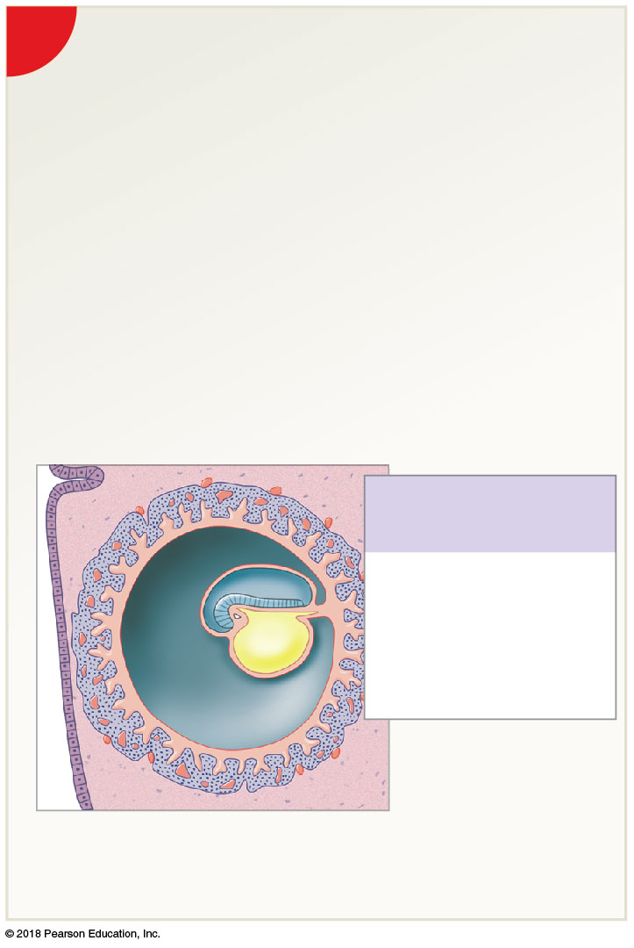
Figure 29–5 Extra-Embryonic Membranes and Placenta Formation (Part 2 of 5).
2
Week 3
The embryonic disc bulges into
the amniotic cavity at the head
fold. The allantois, an endodermal
extension surrounded by
mesoderm, extends toward
the trophoblast.
Amniotic cavity
(containing
amniotic fluid)
Head fold
of embryo
Extra-Embryonic
Membranes
Amnion
Allantois
Yolk sac
Chorion
Chorionic villi
of placenta
Syncytiotrophoblast

Slide 41
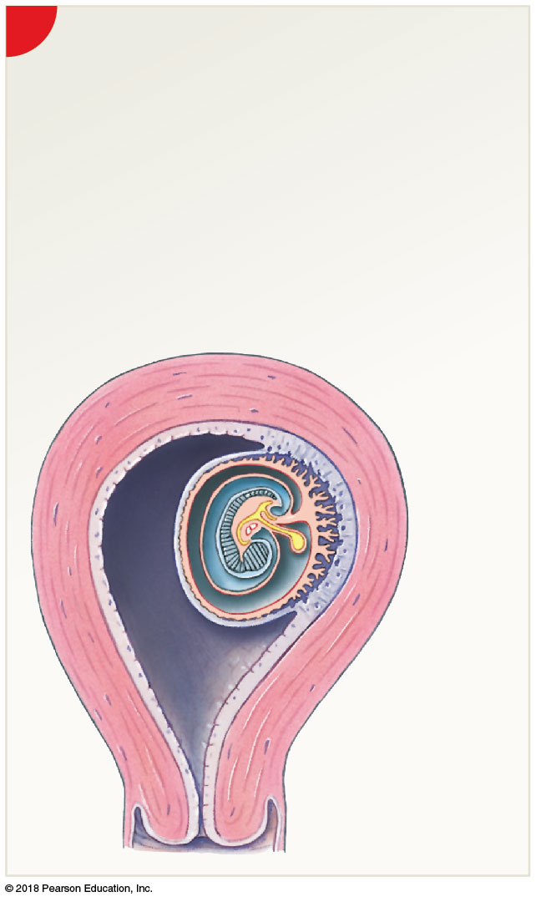
Figure 29–5 Extra-Embryonic Membranes and Placenta Formation (Part 4 of 5).
4
Week 5
The developing embryo and extra-embryonic
membranes bulge into the uterine cavity. The
cytotrophoblast pushing out into the uterine
cavity remains covered by endometrium but no
longer participates in nutrient absorption and
embryo support. The embryo moves away from
the placenta, and the body stalk and yolk stalk
fuse to form an umbilical stalk.
WEEK 5
Basal
decidua
Umbilical
stalk
Uterus
Myometrium
Placenta
Yolk sac
Chorionic
villi of
placenta
Capsular
decidua
Parietal
decidua
Uterine
cavity

Slide 42
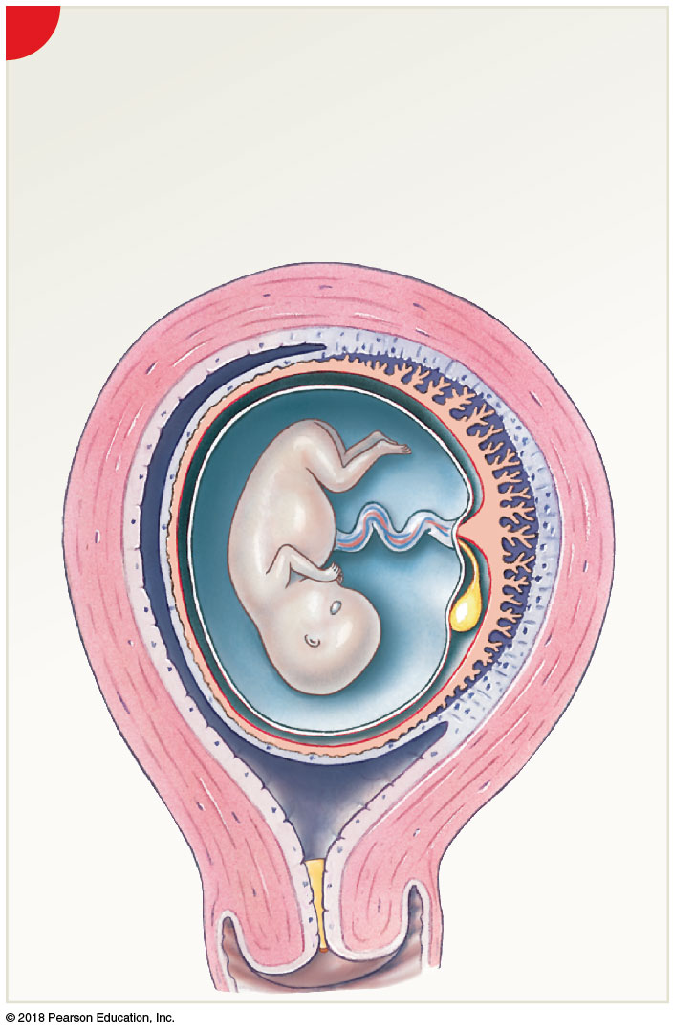
Figure 29–5 Extra-Embryonic Membranes and Placenta Formation (Part 5 of 5).
5
Week 10
The amnion has expanded greatly, filling the uterine
cavity. The fetus is connected to the placenta by an
elongated umbilical cord that contains a portion of the
allantois, blood vessels, and the remnants of the yolk
stalk. A mucus plug forms, preventing bacteria from
entering the uterus.
Parietal decidua
Umbilical cord
Basal decidua
Placenta
Amnion
Amniotic cavity
Capsular
decidua
Chorion
Mucus plug

Slide 43
29-4 The First Trimester
Umbilical cord
Connects fetus and placenta
Contains allantois, placental blood vessels, and yolk stalk

Slide 44
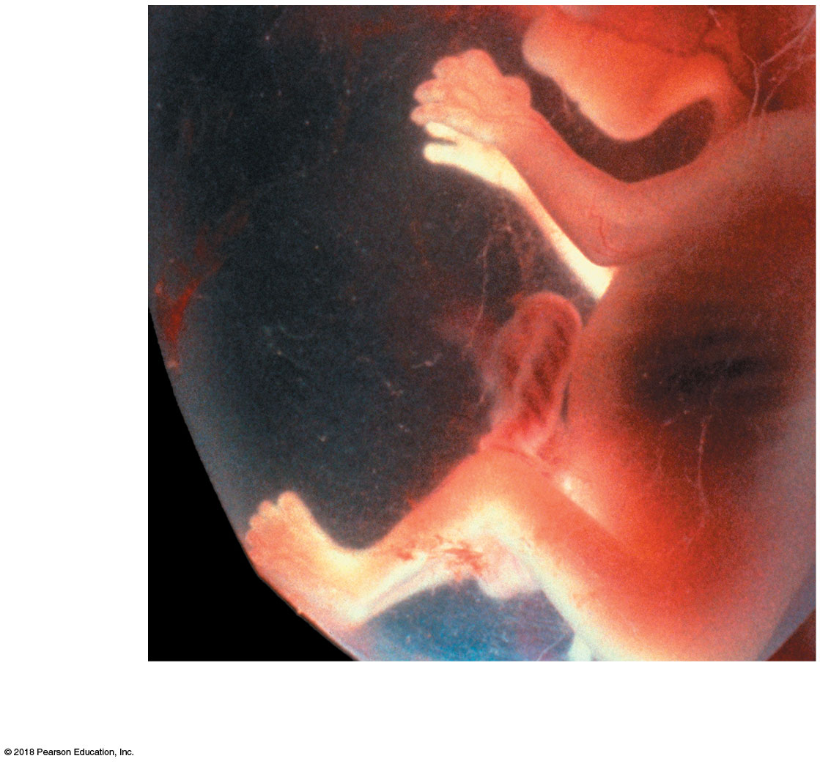
Figure 29–7d The First 12 Weeks of Development.
Amnion
Umbilical
cord
d
Week 12. Fiberoptic view of human
development at week 12 (about 5.4 cm in size).

Slide 45
29-5 The Second and Third Trimesters
Second trimester
Fetus grows faster than surrounding placenta
Amnion and chorion fuse, creating amniochorionic membrane
Third trimester
Most organ systems become able to function without maternal assistance
Growth rate slows but much weight is gained
Fetus and enlarged uterus displace many of mother’s abdominal organs

Slide 46
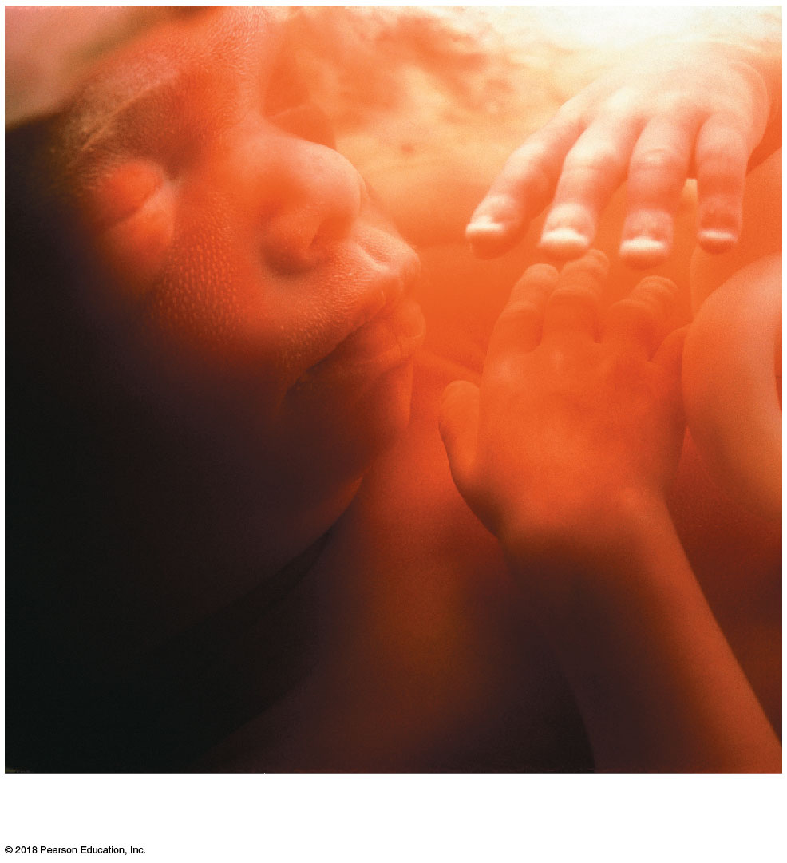
Figure 29–8a Fetal Development in the Second and Third Trimesters.
a
A 4-month-old fetus, seen through a fiberoptic endoscope
(about 13.3 cm in size)

Slide 47
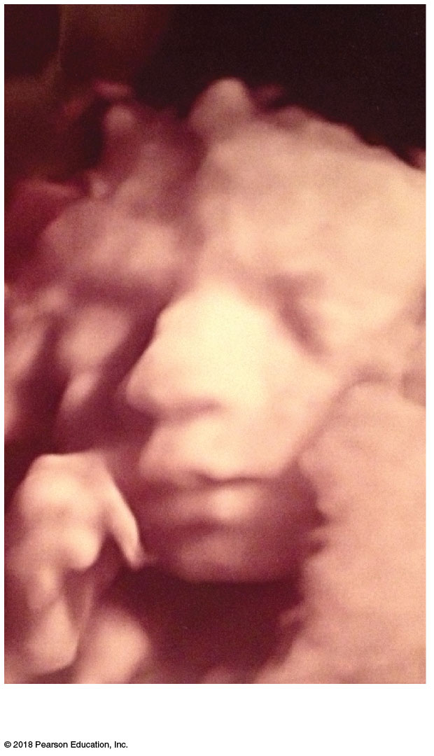
Figure 29–8b Fetal Development in the Second and Third Trimesters.
b
Head of a 6-month-old fetus, revealed
through ultrasound (about 30 cm in size)

Slide 48
29-6 Maternal Organ Support of Development
Placental hormones
Human chorionic gonadotropin
Human placental lactogen
Placental prolactin
Relaxin
Progesterone
Estrogens
******NOTE PLACENTA produces hormones

Slide 49
29-6 Maternal Organ Support of Development
Human chorionic gonadotropin (hCG)
Appears in maternal bloodstream soon after implantation
hCG in blood or urine samples provides reliable indication of pregnancy
PREGNANCY TESTs detect hCG

Slide 50
29-6 Maternal Organ Support of Development
Human placental lactogen (hPL)
Prepares mammary glands for milk production
Placental prolactin
Helps convert mammary glands to active status
Relaxin
Causes dilation of cervix, making it easier for fetus to enter vaginal canal
Suppresses release of oxytocin by hypothalamus and delays onset of labor contractions

Slide 51
29-7 Labor and Delivery
Parturition (childbirth)
Forcible expulsion of fetus from uterus
Labor
Strong, rhythmic uterine contractions
Progesterone released by placenta
Has inhibitory effect on uterine smooth muscle
Prevents extensive, powerful contractions

Slide 52
29-7 Labor and Delivery
Braxton Hicks contractions (false labor)
Experienced by some women late in pregnancy
Occasional spasms in uterine musculature
Contractions are not regular or persistent
True labor
Initiated by placental and fetal factors
Fetal pituitary gland secretes oxytocin
Increases myometrial contractions and prostaglandin production

Slide 53
29-7 Labor and Delivery
Labor contractions
KNOW the order of these 3 stages of labor
Dilation stage
Expulsion stage
Placental stage

Slide 54
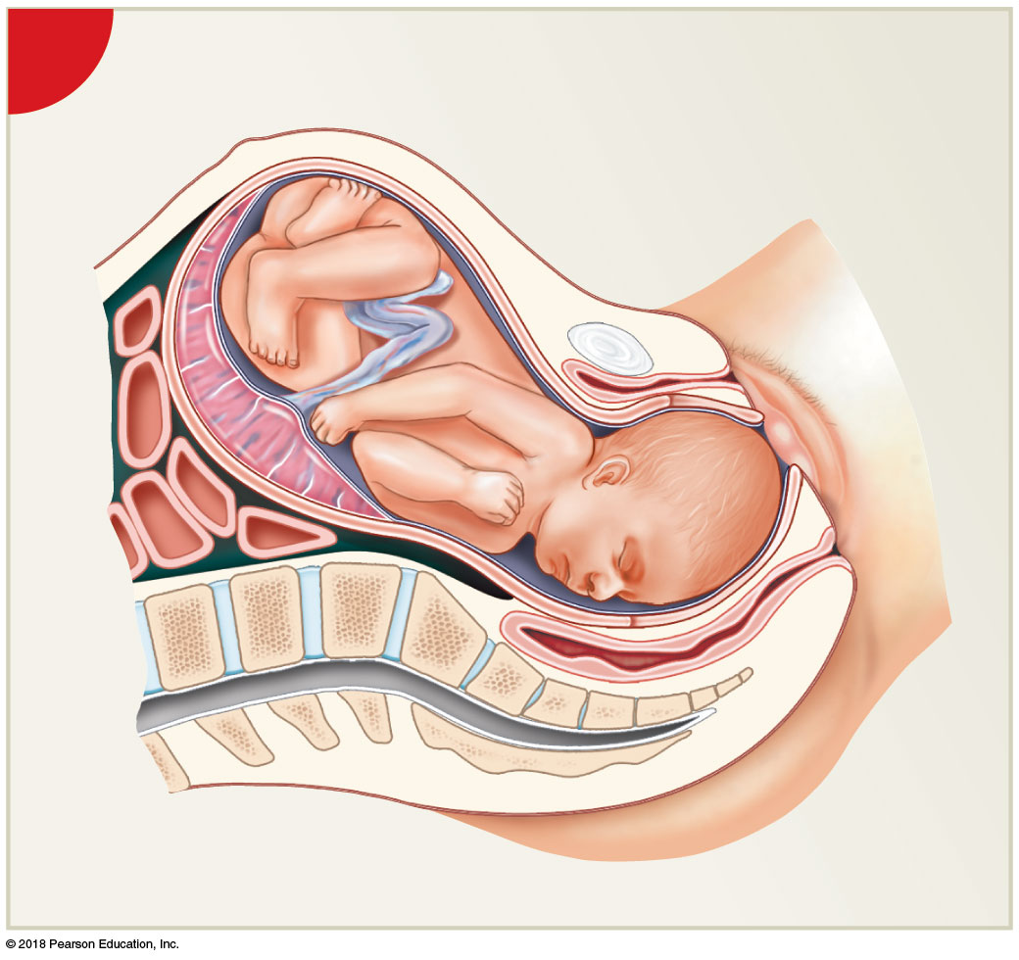
Figure 29–11 The Stages of Labor (Part 2 of 4).
1
The Dilation Stage

Slide 55
29-7 Labor and Delivery
Expulsion stage
Begins as cervix completes dilation to 10 cm
Contractions reach maximum intensity
Continues until fetus has emerged from vagina
Typically in less than 2 hours
Delivery
Arrival of newborn infant into outside world

Slide 56
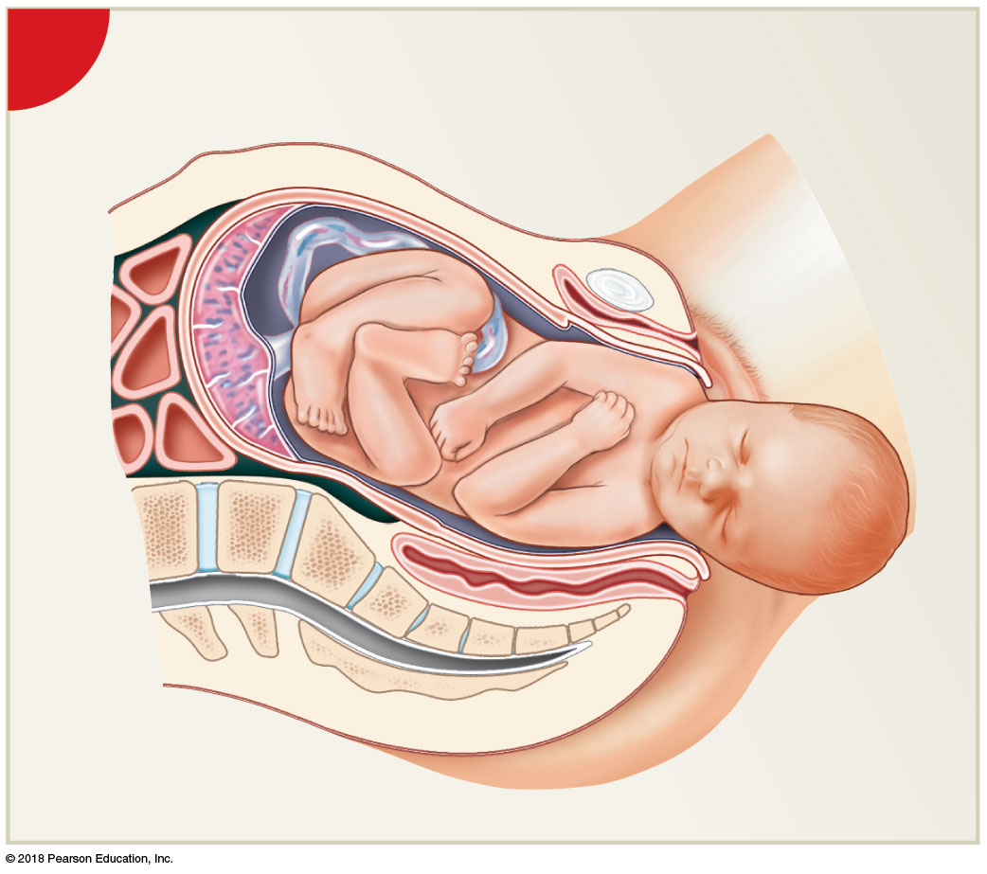
Figure 29–11 The Stages of Labor (Part 3 of 4).
2
The Expulsion Stage

Slide 57
29-7 Labor and Delivery
Apgar score
Assessment of newborn’s health in five areas
Heart rate, breathing, skin color, muscle tone, and reflex response
Each criterion receives a score from 0–2
Total of 8–10 indicates healthy baby

Slide 58
29-7 Labor and Delivery
Placental stage
Muscle tension builds in walls of partially empty uterus
Tears connections between endometrium and placenta
Ends within an hour of delivery with ejection of placenta, or afterbirth
Accompanied by loss of blood

Slide 59
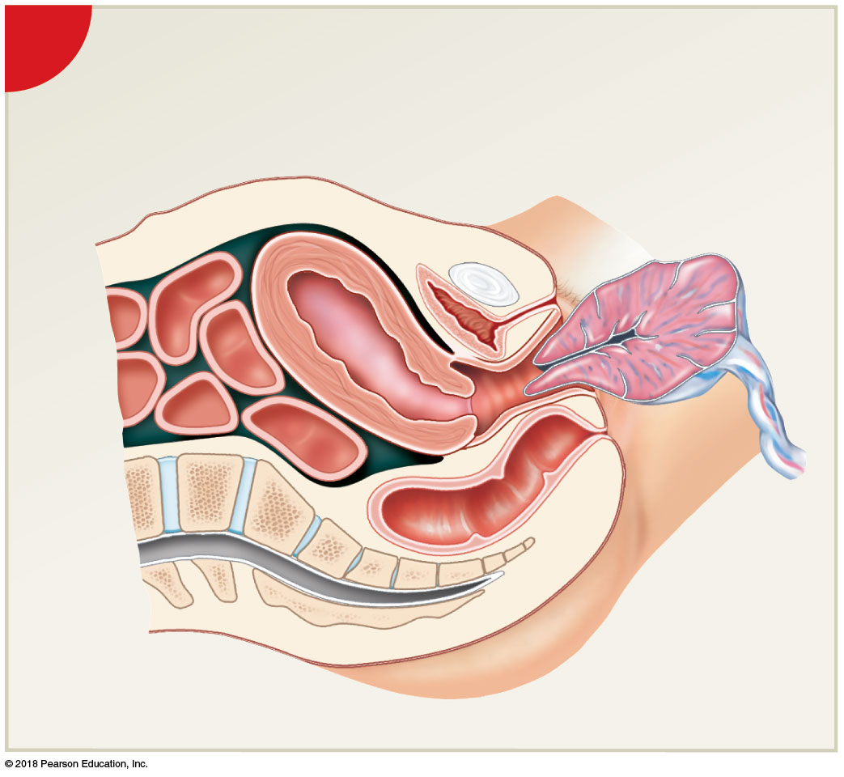
Figure 29–11 The Stages of Labor (Part 4 of 4).
3
The Placental Stage
Uterus
Ejection of the
placenta

Slide 60
29-7 Labor and Delivery
Premature delivery
Birth at 28–36 weeks
With care, newborns have a good chance of surviving and developing normally

Slide 61
29-7 Labor and Delivery
Breech birth (you don’t need to memorize examples)
Legs or buttocks of fetus, instead of head, enter vaginal canal first
Umbilical cord can become constricted, cutting off placental blood flow
Cervix may not dilate enough to pass head
Prolongs delivery
Subjects fetus to severe distress and potential injury

Slide 62
29-7 Labor and Delivery
Cesarean section (C-section)
Removal of infant by incision made through abdominal wall
One in three deliveries in United States
Due to risk factors including advanced maternal age, diabetes, obesity, and multiple births (twins)

Slide 63
29-7 Labor and Delivery
Dizygotic twins (“fraternal twins”)
Develop when two separate oocytes are ovulated and fertilized TWO DIFFERENT ZYGOTES
Genetic makeup not identical
Monozygotic twins (“identical twins”)
Result either from
Separation of blastomeres early in cleavage
Splitting of inner cell mass before gastrulation
Genetic makeup is identical
Because both formed from same pair of gametes

Slide 64
29-7 Labor and Delivery
Rates of multiple births
In the US, for 2014 the twin birth rate hit an all-time high of 33.9 twins per 1,000 births. Or 1 in every 30 births
THE TEXT BOOK statistic shown blow is incorrect
Twins in 1 of every 89 births
Triplets in 1 of every 89² (7921) births
Quadruplets in 1 of every 89³ (704,969) births
Conjoined twins
Genetically identical twins
Splitting of blastomeres or embryonic disc did not complete

Slide 65
29-8 Postnatal Stages and Senescence
Life stages
Neonatal period
Infancy
Childhood
Adolescence
Maturity
Senescence (process of aging)
Begins at maturity (end of development)
Leads ultimately to death

Slide 66
29-8 Postnatal Stages and Senescence
Duration of life stages
Neonatal period
Birth to 1 month of age
Infancy
Continues through first year of life
Childhood
Infancy until adolescence
Adolescence (puberty)
Period of sexual and physical maturation

Slide 67
29-8 Postnatal Stages and Senescence
Neonatal period, infancy, and childhood
Two major events occur
Most organ systems become fully operational
Individual grows rapidly and body proportions change significantly
Pediatrics
Medical specialty focusing on postnatal development from infancy through adolescence

Slide 68
29-8 Postnatal Stages and Senescence
Puberty
Period of sexual maturation that marks beginning of adolescence
cells become more sensitive to FSH and LH
Hormonal changes produce sex-specific differences in many systems

Slide 69
29-8 Postnatal Stages and Senescence
Senescence (aging)
Reduces functional capabilities of individual
Affects homeostatic mechanisms
Changes at the molecular level ultimately lead to death
Geriatrics
Medical specialty dealing with problems associated with aging
Geriatricians—physicians trained in geriatrics

Slide 70
29-9 Inheritance
Chromosomes
Contain DNA and proteins
Genes
Functional segments of DNA
Each gene carries information needed to direct synthesis of a specific polypeptide

Slide 71
29-9 Inheritance
Genotype genes
Chromosomes and their genes
Instructions are expressed in many ways
Determines anatomical and physiological characteristics
Phenotype study of appearance of genes
Anatomical and physiological characteristics
Results from interaction between genotype and environment

Slide 72
29-9 Inheritance
Each somatic cell has 23 pairs of chromosomes
At amphimixis, one member of each pair is contributed by ovum, the other by sperm
22 of those pairs are autosomes
Most genes affect somatic characteristics
Chromosomes of 23rd pair are sex chromosomes
Determine whether individual is male or female
HUMANS have 46 chromosomes in your body or somatic cells, 23 from your father and 23 from your mother. Therefore 23 PAIRS of chromosomes.
Your 23 chromosome is your sex chromosome

Slide 73
29-9 Inheritance
Homozygous
Both homologous chromosomes carry same allele of a particular gene
Heterozygous
Homologous chromosomes carry different alleles of a particular gene
Resulting phenotype depends on nature of interaction between alleles

Slide 74
29-9 Inheritance
Interactions between alleles
Simple inheritance
Phenotype determined by interactions between single pair of alleles
Simple inheritance
Strict dominance
Dominant allele is always expressed in phenotype
Recessive allele will be expressed only if same allele is present on both chromosomes

Slide 75
29-9 Inheritance
Simple inheritance
Strict dominance
Dominant allele is always expressed in phenotype
Recessive allele will be expressed only if same allele is present on both chromosomes

Slide 76
29-9 Inheritance
Polygenic inheritance
Phenotype determined by interactions among several genes

Slide 77
29-9 Inheritance
Sex-linked inheritance
X chromosome
Considerably larger than Y chromosome
Has more genes than does Y chromosome
Carried by all oocytes
Y chromosome
Includes a gene specifying that individual will be male
Not present in females

Slide 78
29-9 Inheritance
Sperm
Carry either X or Y chromosome
Because males have one of each, and can pass along either one
X-linked genes
Found on X chromosome but not on Y
Affect somatic structures
Inheritance does not follow pattern of alleles on autosomal chromosomes

Slide 79
29-9 Inheritance
Genetic recombination
During meiosis, various changes can occur in chromosome structure
Producing gametes with chromosomes that differ from those of each parent
Greatly increases genetic variation among gametes
Note GAMETES are Haploid. The female gamete is the egg. The male gamete is the sperm.
Sperm has 23 chromosomes. Egg has 23 chromosomes

Slide 80
29-9 Inheritance
Chromosomal abnormalities
Damaged, broken, missing, or extra copies of chromosomes
Present in 10 percent of zygotes
Most of which do not survive
Present in 0.5 percent of newborns
Produce a variety of serious clinical conditions

Slide 81
29-9 Inheritance
Mutations
Changes in nucleotide sequence of an allele
Spontaneous mutations
Result from random errors in DNA replication
Relatively common, but in most cases error is detected and repaired by enzymes
Errors that go undetected and unrepaired have potential to change phenotype
Can produce gametes that contain abnormal alleles

Slide 82
29-9 Inheritance
Carriers
Individuals who are heterozygous for abnormal allele but do not show effects of mutation

Slide 83
29-9 Inheritance
Human genome
Full set of genetic material (DNA) in our chromosomes
3.2 billion base pairs
20,000–25,000 protein-coding genes
About 10,000 different single-gene disorders have been described
Gene therapy
Inserting corrective genes into a patient’s cells
Used to treat genetic disorders or diseases

