Slide 1
19-3 Blood Types
Surface antigens
Substances on plasma membranes that identify cells to immune system
Normal cells are ignored and foreign cells are attacked
Blood type
Determined by presence or absence of surface antigens on RBCs: A, B, and Rh (or D)

Slide 2
19-3 Blood Types
Four blood types
Type A (surface antigen A)
Type B (surface antigen B)
Type AB (antigens A and B)
Type O (neither A nor B)

Slide 3
19-3 Blood Types
Rh blood group
Based on presence or absence of Rh antigen
Rh positive (Rh⁺)
Rh surface antigen is present (e.g., Type O⁺)
Rh negative (Rh⁻)
Rh antigen is absent (e.g., Type O⁻)

Slide 4
19-3 Blood Types
Agglutinogens
Surface antigens on RBCs
Screened by immune system
Agglutinins
Antibodies in plasma
Attack antigens on foreign RBCs
Causing agglutination (clumping) of foreign cells

Slide 5
19-3 Blood Types
Agglutinins
Type A blood
Anti-B antibodies
Type B blood
Anti-A antibodies
Type O blood
Both anti-A and anti-B antibodies
Type AB blood
Neither anti-A nor anti-B antibodies
Only sensitized Rh⁻ blood has anti-Rh antibodies

Slide 6
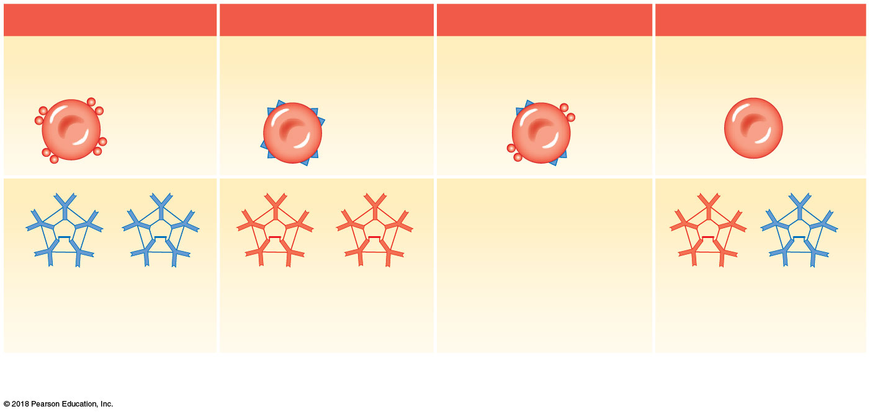
Figure 19–6a Blood Types and Cross-Reactions.
Type A
Type B
Type AB
Type O
Type A blood has RBCs with
surface antigen A only.
Type B blood has RBCs with
surface antigen B only.
Type AB blood has RBCs with
both A and B surface antigens.
Type O blood has RBCs lacking
both A and B surface antigens.
Surface
antigen A
Surface
antigen B
If you have Type A blood, your
plasma contains anti-B
antibodies, which will attack
Type B surface antigens.
If you have Type B blood, your
plasma contains anti-A
antibodies, which will attack
Type A surface antigens.
If you have Type AB blood,
your plasma has neither
anti-A nor anti-B antibodies.
If you have Type O blood, your
plasma contains both anti-A
and anti-B antibodies.
a
Blood type depends on the presence of surface antigens (agglutinogens) on RBC surfaces. The plasma contains antibodies
(agglutinins) that will react with foreign surface antigens.

Slide 7
19-3 Blood Types
Cross-reaction (transfusion reaction)
May occur in a transfusion of blood or plasma from one person to another
Occurs if donor and recipient blood types are not compatible
Plasma antibody meets its specific surface antigen
RBCs agglutinate and may hemolyze

Slide 8
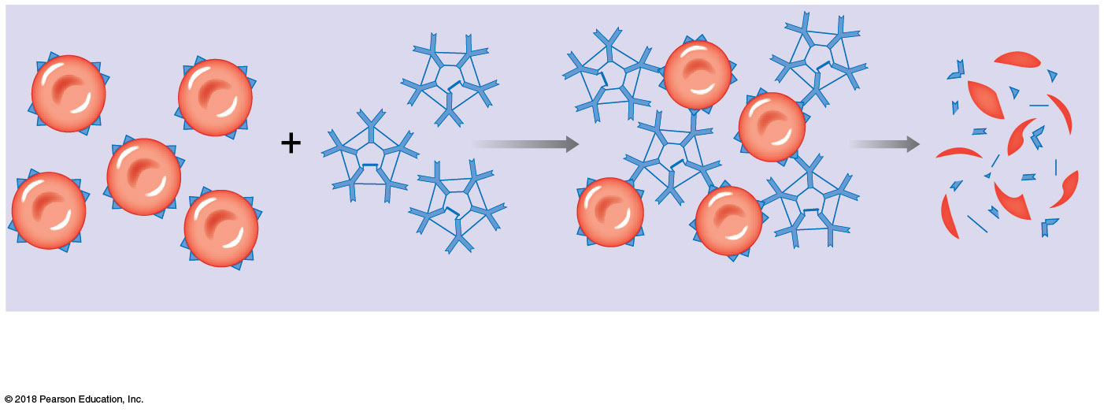
Figure 19–6b Blood Types and Cross-Reactions.
RBC
Surface antigens
Opposing antibodies
Agglutination (clumping)
Hemolysis
b
In a cross-reaction, antibodies react with their target antigens causing agglutination and hemolysis of the affected RBCs.
In this example, anti-B antibodies encounter B surface antigens, which cause the RBCs bearing the B surface antigens to
clump together and break up.

Slide 9
19-3 Blood Types
Compatibility testing
Performed in advance of transfusions
Cross-match testing
Reveals cross-reactions between donor’s RBCs and recipient’s plasma
Type O– is the universal donor
But cross-reactions can still occur
Because at least 48 surface antigens exist besides A and B

Slide 10
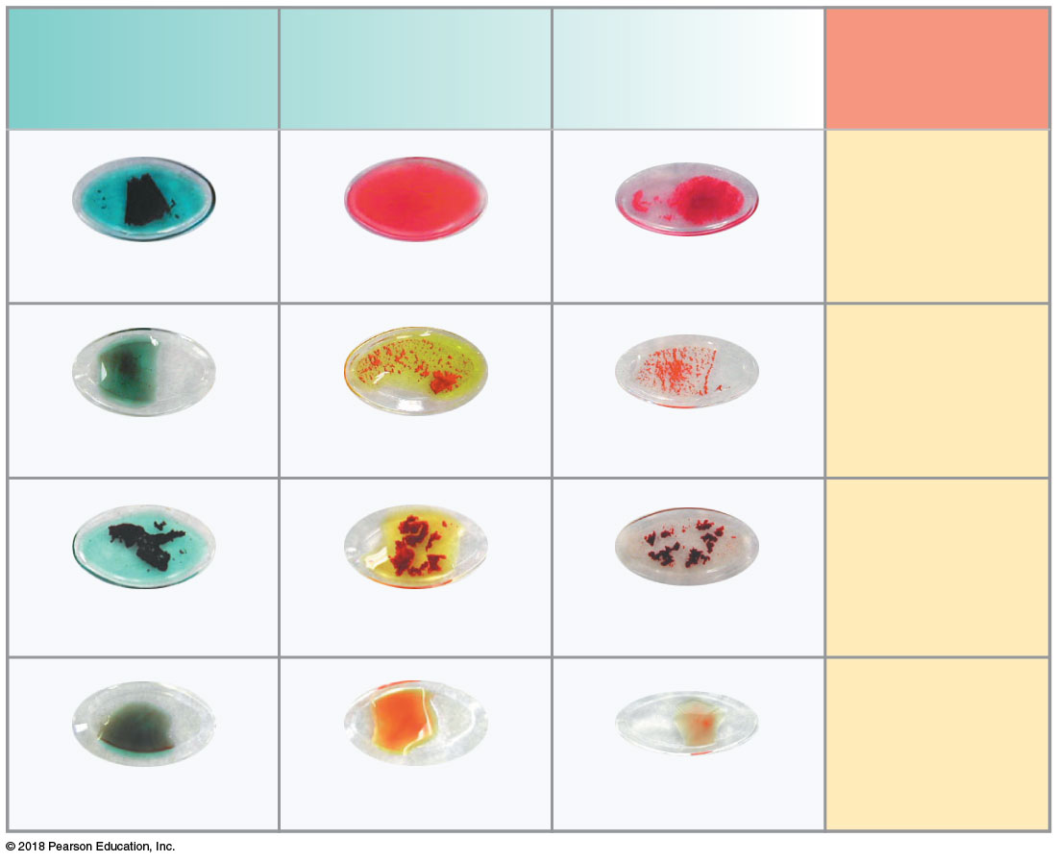
Figure 19–7 Blood Type Testing.
Anti-A
Anti-B
Anti-Rh
Blood
type
A⁺
Clumping
No clumping
Clumping
B⁺
No clumping
Clumping
Clumping
AB⁺
Clumping
Clumping
Clumping
O⁻
No clumping
No clumping
No clumping

