Slide 2
The Lymphatic System and Immunity
Learning Outcomes
22-1 Distinguish between innate (nonspecific) and adaptive (specific) defenses, and explain the role of lymphocytes in the immune response.
22-2 Identify the major components of the lymphatic system, describe the structure and functions of each component, and discuss the importance of lymphocytes.
22-3 List the body’s innate (nonspecific) defenses, and describe the components, mechanisms, and functions of each.

Slide 3
The Lymphatic System and Immunity
Learning Outcomes
22-4 Define adaptive (specific) defenses, identify the forms and properties of immunity, and distinguish between cell-mediated (cellular) immunity and antibody-mediated (humoral) immunity.
22-5 Discuss the types of T cells and their roles in the immune response, and describe the mechanisms of T cell activation and differentiation.

Slide 4
The Lymphatic System and Immunity
Learning Outcomes
22-6 Discuss the mechanisms of B cell activation and differentiation, describe the structure and function of antibodies, and explain the primary and secondary responses to antigen exposure.
22-7 Describe the development of immunocompetence, list and explain examples of immune disorders and allergies, and discuss the effects of stress on immune function.

Slide 5
The Lymphatic System and Immunity
Learning Outcomes
22-8 Describe the effects of aging on the lymphatic system and the immune response.
22-9 Give examples of interactions between the lymphatic system and other organ systems we have studied so far and explain how the nervous and endocrine systems influence the immune response.

Slide 6
An Introduction to the Lymphatic System and Immunity
Pathogens
Microscopic organisms that cause disease:
Viruses
Bacteria
Fungi
Parasites
Each attacks in a specific way

Slide 7
22-1 Overview of the Lymphatic System
The Lymphatic System
Protects us against disease
Lymphatic system cells respond to:
Environmental pathogens
Toxins
Abnormal body cells, such as cancers

Slide 8
22-1 Overview of the Lymphatic System
Specific Defenses
Lymphocytes
Part of the immune response
Identify, attack, and develop immunity
To a specific pathogen

Slide 9
22-1 Overview of the Lymphatic System
The Immune System
Immunity
The ability to resist infection and disease
All body cells and tissues involved in production of immunity
Not just lymphatic system

Slide 10
22-1 Overview of the Lymphatic System
Nonspecific Defenses
Block or attack any potential infectious organism
Cannot distinguish one attack from another

Slide 11
22-2 Structures of Body Defenses
Organization of the Lymphatic System
Lymph
A fluid similar to plasma but does not have plasma proteins
Lymphatic vessels (lymphatics)
Carry lymph from peripheral tissues to the venous system
Lymphoid tissues and lymphoid organs
Lymphocytes, phagocytes, and other immune system cells

Slide 12
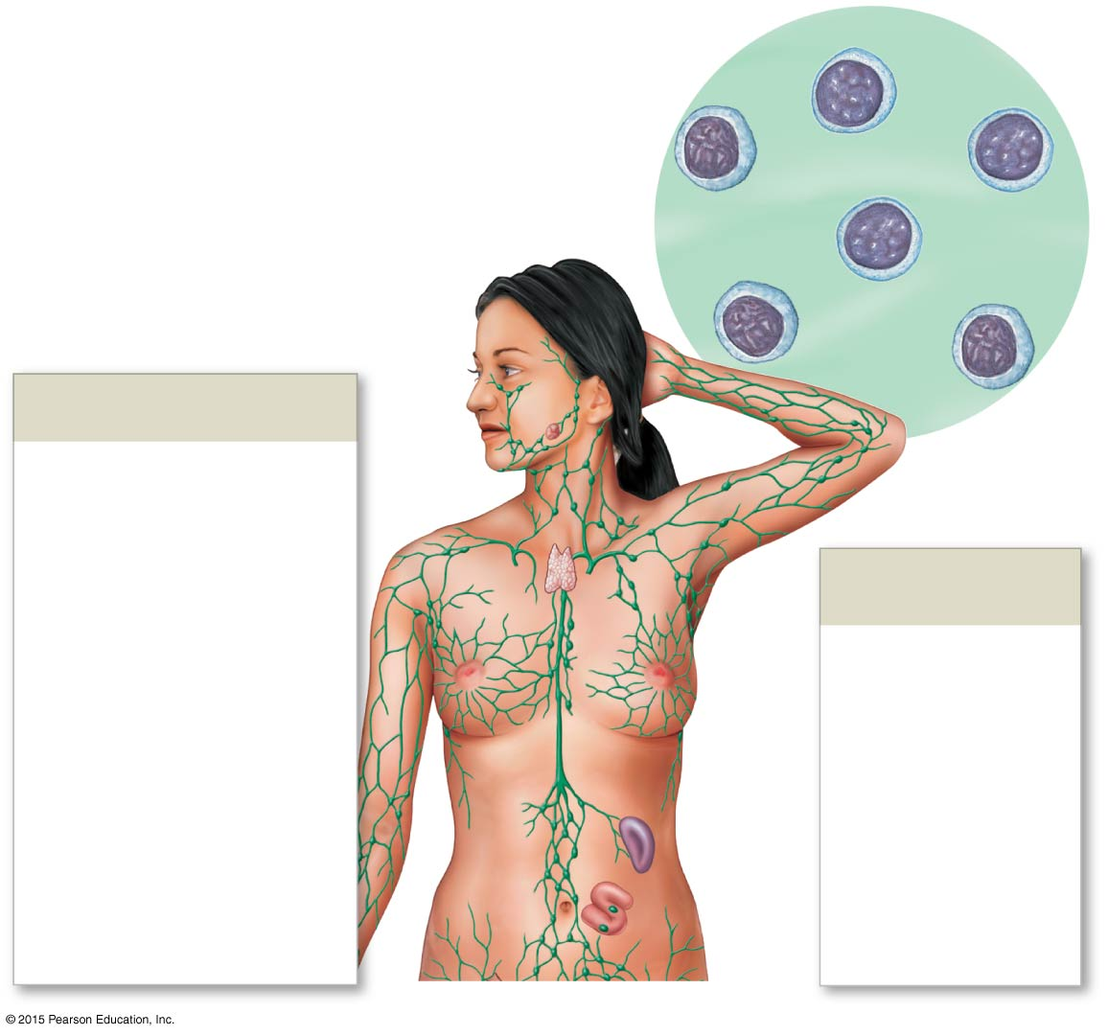
Figure 22-1 An Overview of the Lymphatic System (Part 1 of 2).
Lymph
Lymphocyte
Lymphatic Vessels and Lymph Nodes
Cervical lymph nodes
Thoracic duct
Right lymphatic duct
Lymphoid Tissues and Organs
Axillary lymph nodes
Lymphatics of mammary gland
Tonsil
Thymus
Cisterna chyli
Spleen
Lymphatics of upper limb
Mucosa-associated lymphoid tissue (MALT) in digestive, respiratory, urinary, and reproductive tracts
Lumbar lymph nodes

Slide 13
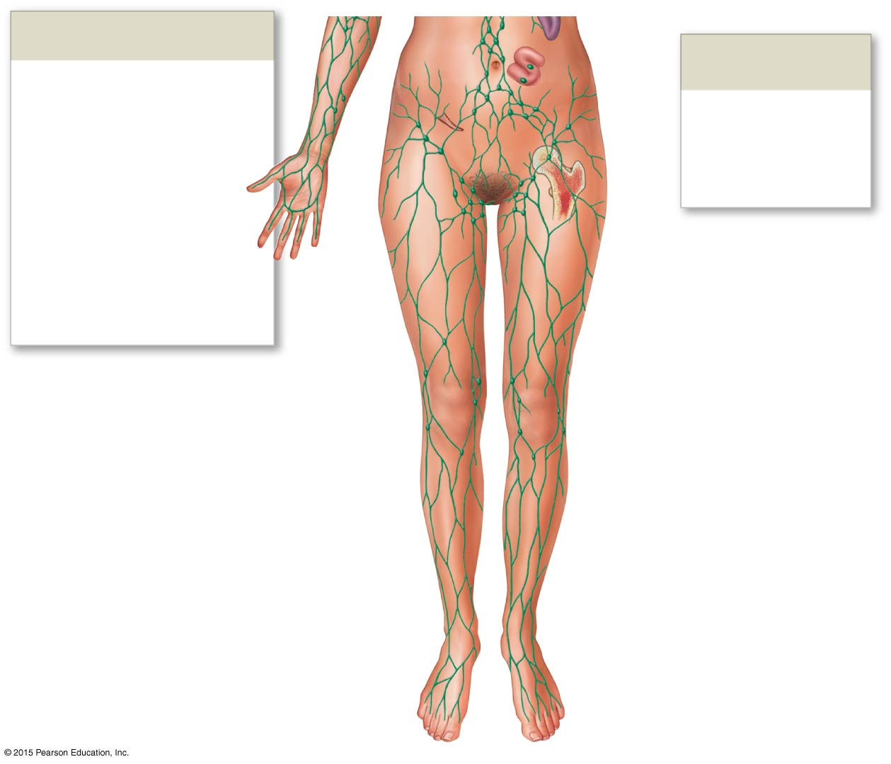
Figure 22-1 An Overview of the Lymphatic System (Part 2 of 2).
Lymphatic Vessels and Lymph Nodes
Lymphoid Tissues and Organs
Pelvic lymph nodes
Appendix
Red bone marrow
Inguinal lymph nodes
Lymphatics of lower limb

Slide 14
22-2 Structures of Body Defenses
Function of the Lymphatic System
To produce, maintain, and distribute lymphocytes
Lymphocyte Production
Lymphocytes are produced
In lymphoid tissues (e.g., tonsils)
Lymphoid organs (e.g., spleen, thymus)
In red bone marrow
Lymphocyte distribution
Detects problems
Travels into site of injury or infection

Slide 15
22-2 Structures of Body Defenses
Lymphocyte Circulation
From blood to interstitial fluid through capillaries
Returns to venous blood through lymphatic vessels
The Circulation of Fluids
From blood plasma to lymph and back to the venous system
Transports hormones, nutrients, and waste products

Slide 16
22-2 Structures of Body Defenses
Lymphatic Vessels
Are vessels that carry lymph
Lymphatic system begins with smallest vessels
Lymphatic capillaries (terminal lymphatics)

Slide 17
22-2 Structures of Body Defenses
Lymphatic Capillaries
Differ from blood capillaries in four ways
Start as pockets rather than tubes
Have larger diameters
Have thinner walls
Flat or irregular outline in sectional view

Slide 18
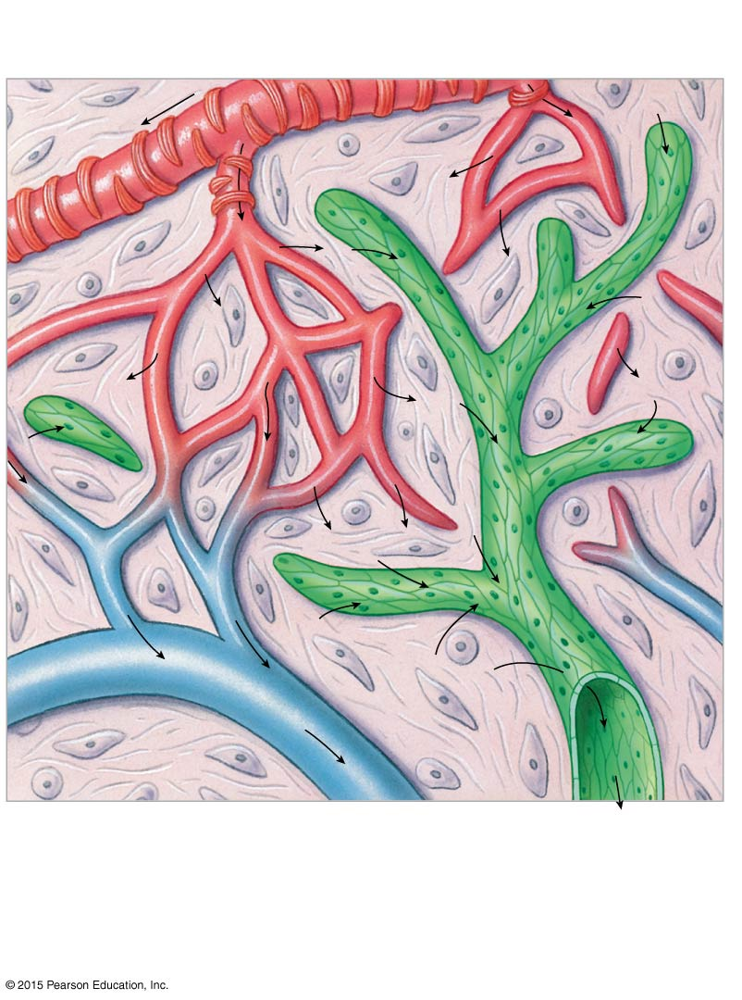
Figure 22-2a Lymphatic Capillaries.
Smooth muscle
Arteriole
Endothelial cells
Lymphatic capillary
Venule
Interstitial fluid
Lymph flow
Blood capillaries
Areolar tissue
a
The interwoven network formed by blood capillaries and lymphatic capillaries. Arrows indicate the movement of fluid out of blood capillaries and
the net flow of interstitial fluid and lymph.

Slide 19
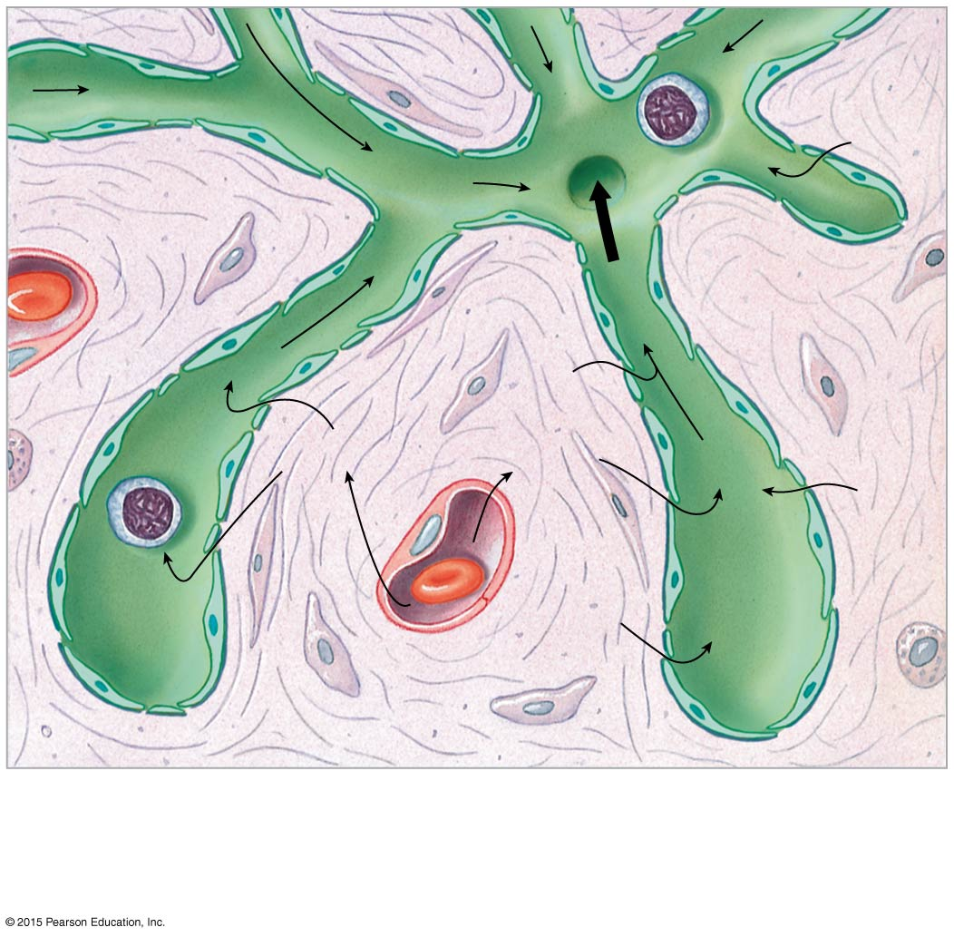
Figure 22-2b Lymphatic Capillaries.
Lymphocyte
Incomplete basement membrane
Lymph flow
Areolar tissue
To larger lymphatics
Interstitial fluid
Plasma
Lymphatic capillary
Interstitial fluid
Blood capillary
b
A sectional view indicating the movement of fluid from the plasma, through the tissues as interstitial fluid, and into the lymphatic system as lymph.

Slide 20
22-2 Structures of Body Defenses
Lymphatic Capillaries
Endothelial cells loosely bound together with overlap
Overlap acts as one-way valve
Allows fluids, solutes, viruses, and bacteria to enter
Prevents return to intercellular space

Slide 21
22-2 Structures of Body Defenses
Lymph Flow
From lymphatic capillaries to larger lymphatic vessels containing one-way valves
Lymphatic vessels travel with veins
Lacteals
Are special lymphatic capillaries in small intestine
Transport lipids from digestive tract

Slide 22
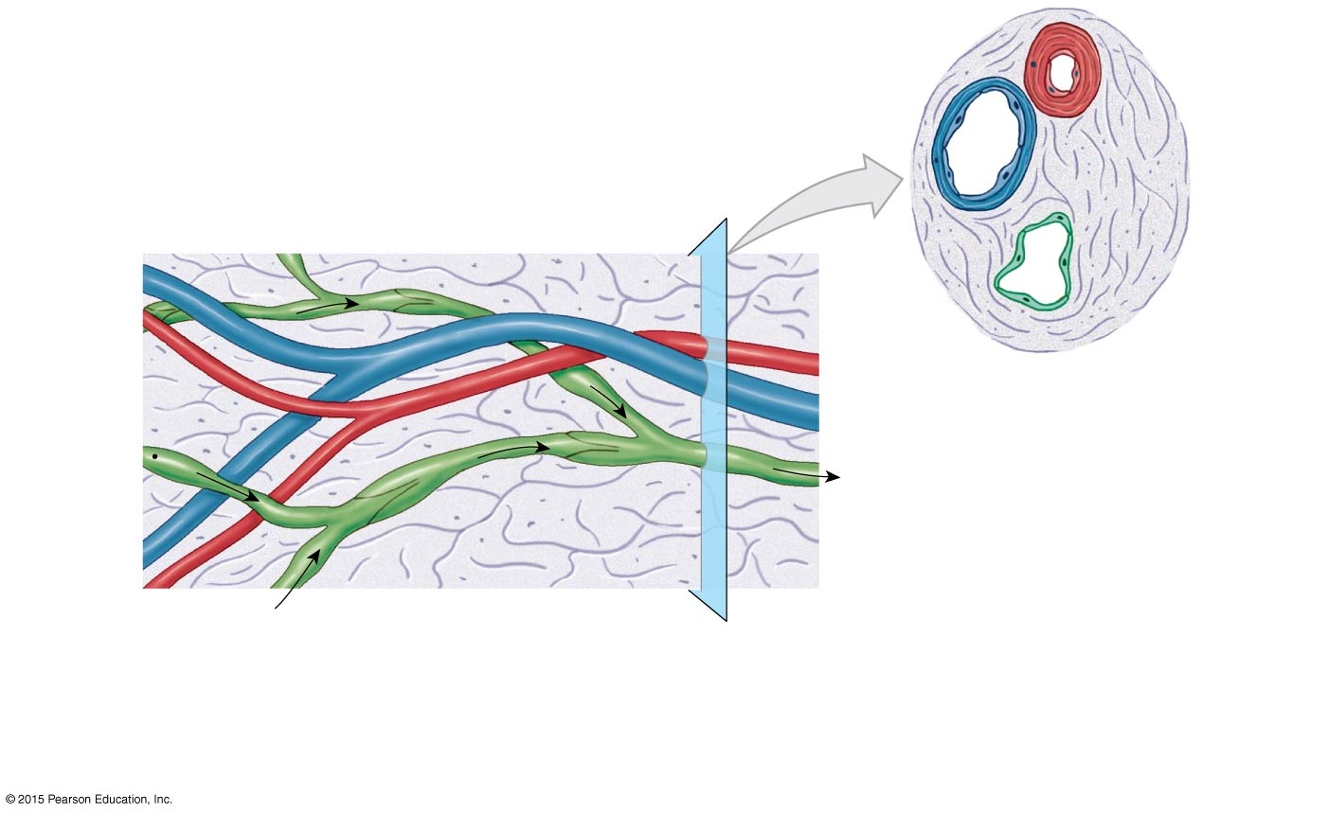
Figure 22-3a Lymphatic Vessels and Valves.
Artery
Vein
Lymphatic vessel
Vein
Artery
Lymphatic vessel
Toward venous system
Lymphatic valve
From lymphatic capillaries
a
A diagrammatic view of areolar connective tissue containing small blood vessels and a lymphatic vessel. The cross-sectional view emphasizes their structural differences.

Slide 23
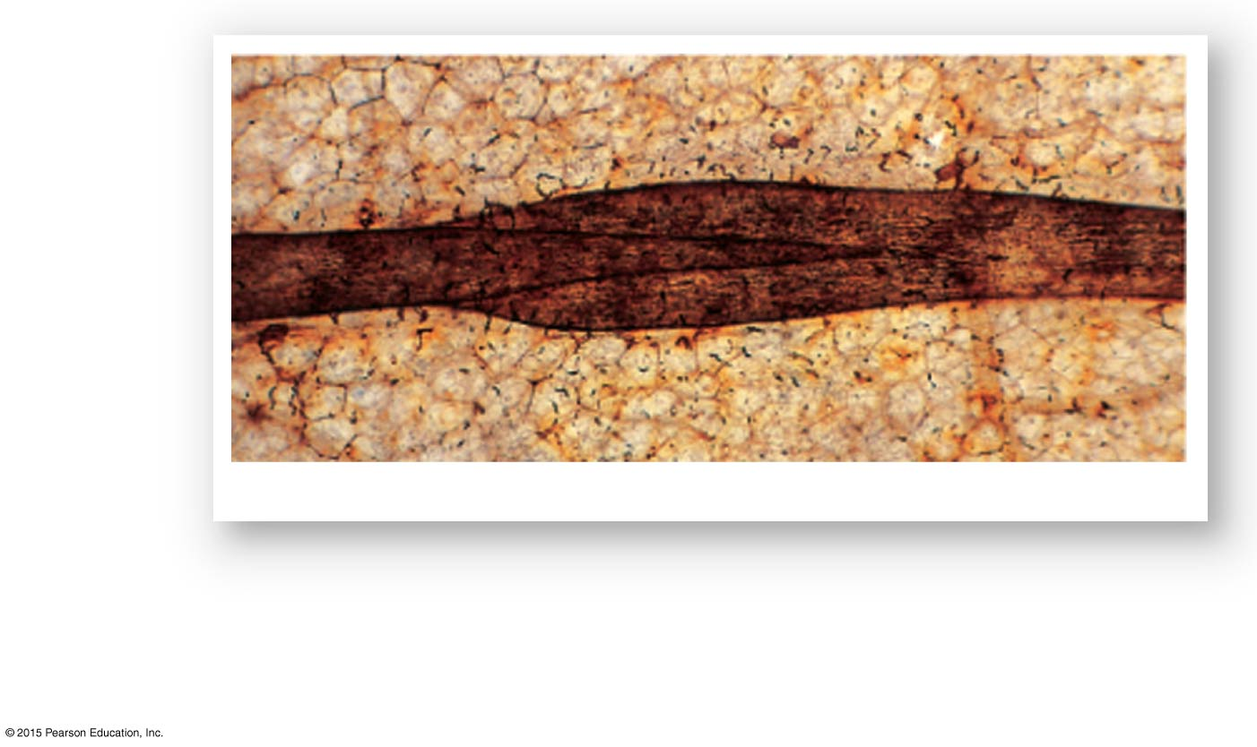
Figure 22-3b Lymphatic Vessels and Valves.
Lymphatic valve
Lymphatic vessel
Lymphatic vessel and valve
LM × 63
b
Like valves in veins, each lymphatic valve consists of a pair of flaps that permit movement of fluid in only one direction.

Slide 24
22-2 Structures of Body Defenses
Lymphatic Vessels
Superficial lymphatics
Deep lymphatics
Are located in:
Skin
Mucous membranes
Serous membranes lining body cavities

Slide 25
22-2 Structures of Body Defenses
Superficial and Deep Lymphatics
The deep lymphatics
Are larger vessels that accompany deep arteries and veins
Superficial and deep lymphatics
Join to form large lymphatic trunks
Trunks empty into two major collecting vessels
Thoracic duct
Right lymphatic duct

Slide 26
22-2 Structures of Body Defenses
Major Lymph-Collecting Vessels
The base of the thoracic duct
Expands into cisterna chyli
Cisterna chyli receives lymph from:
Right and left lumbar trunks
Intestinal trunk

Slide 27
22-2 Structures of Body Defenses
The Inferior Segment of Thoracic Duct
Collects lymph from:
Left bronchomediastinal trunk
Left subclavian trunk
Left jugular trunk
Empties into left subclavian vein

Slide 28
22-2 Structures of Body Defenses
The Right Lymphatic Duct
Collects lymph from:
Right jugular trunk
Right subclavian trunk
Right bronchomediastinal trunk
Empties into right subclavian vein

Slide 29
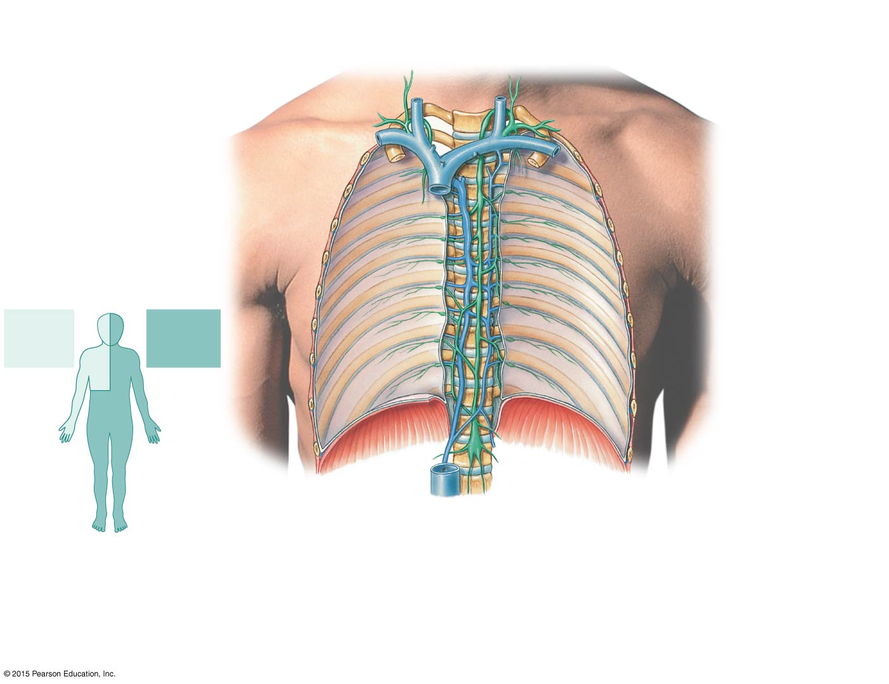
Figure 22-4 The Relationship between the Lymphatic Ducts and the Venous System.
Brachiocephalic veins
Left internal jugular vein
Right internal jugular vein
Left jugular trunk
Right jugular trunk
Thoracic duct
Right lymphatic duct
Left subclavian trunk
Right subclavian trunk
Left bronchomediastinal trunk
Right subclavian vein
Right bronchomediastinal trunk
Left subclavian vein
Superior vena cava (cut)
First rib (cut)
Azygos vein
Highest intercostal vein
Rib (cut)
Thoracic duct
Drainage
of right lymphatic duct
Drainage of thoracic duct
Thoracic lymph nodes
Hemiazygos vein
Parietal pleura (cut)
Diaphragm
Cisterna chyli
Inferior vena cava (cut)
Intestinal trunk
Right lumbar trunk
Left lumbar trunk
a
The thoracic duct carries lymph originating in tissues inferior to the diaphragm and from the left side of the upper body. The smaller right lymphatic duct carries lymph from the rest of the body.
b
The thoracic duct empties into the left subclavian vein. The right lymphatic duct empties into the right subclavian vein.

Slide 30
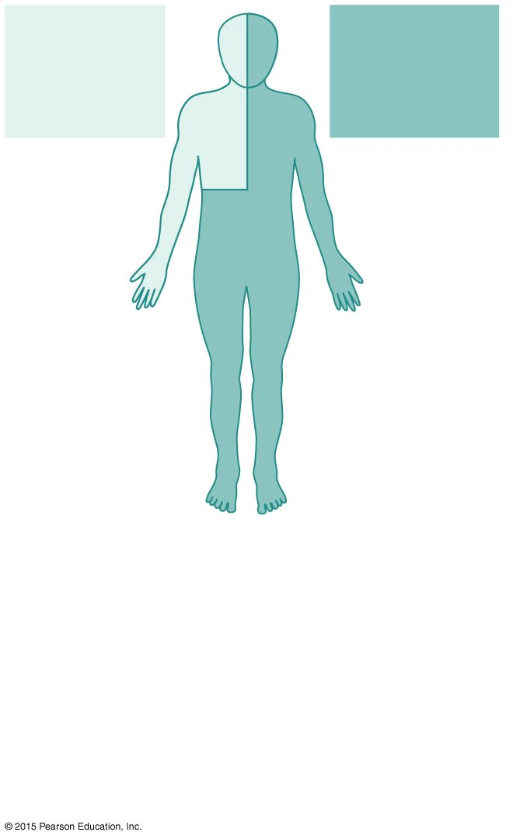
Figure 22-4a The Relationship between the Lymphatic Ducts and the Venous System.
Drainage
of right lymphatic duct
Drainage of thoracic duct
a
The thoracic duct carries lymph originating in tissues inferior to the diaphragm and from the left side of the upper body. The smaller right lymphatic duct carries lymph from the rest of the body.

Slide 31
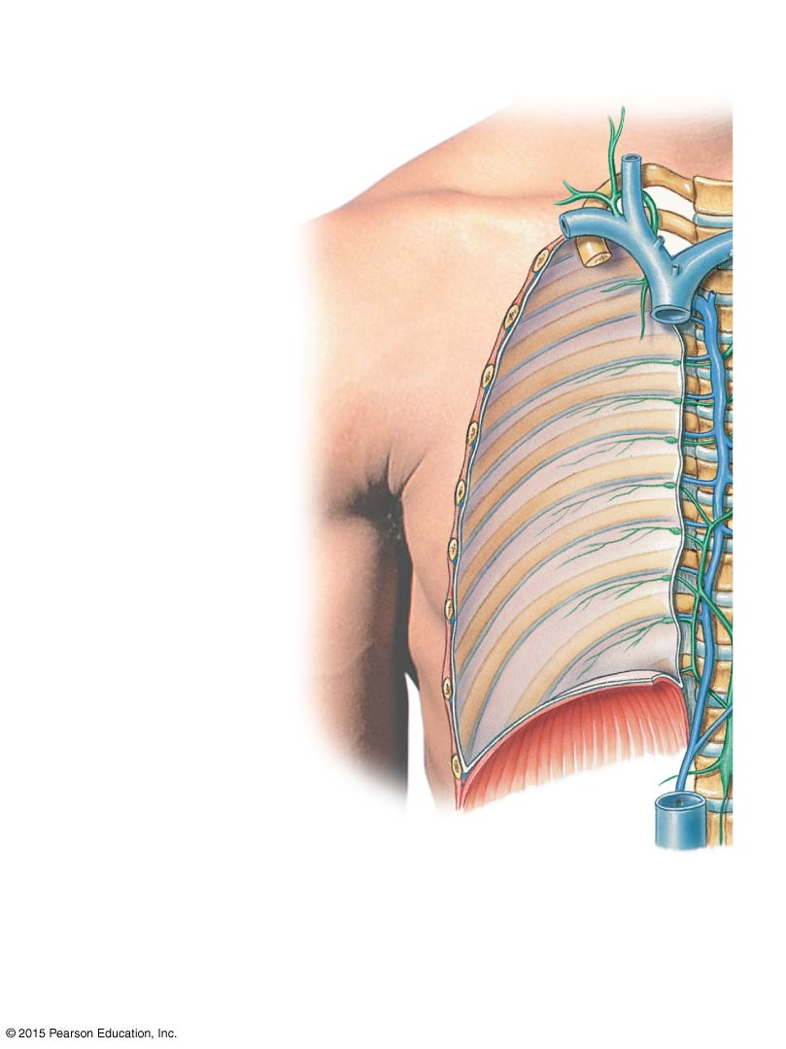
Figure 22-4b The Relationship between the Lymphatic Ducts and the Venous System (Part 1 of 2).
Brachiocephalic veins
Right internal jugular vein
Right jugular trunk
Right lymphatic duct
Right subclavian trunk
Right subclavian vein
Right bronchomediastinal trunk
Superior vena cava (cut)
Azygos vein
Rib (cut)
Inferior vena cava (cut)
Right lumbar trunk
b
The thoracic duct empties into the left subclavian vein. The right lymphatic duct empties into the right subclavian vein.

Slide 32
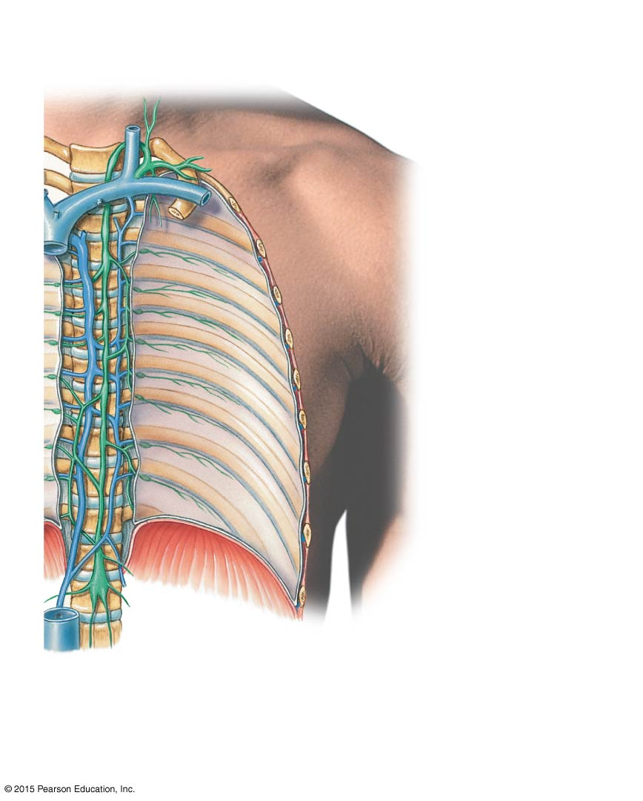
Figure 22-4b The Relationship between the Lymphatic Ducts and the Venous System (Part 2 of 2).
Brachiocephalic veins
Left internal jugular vein
Left jugular trunk
Thoracic duct
Left subclavian trunk
Left bronchomediastinal trunk
Left subclavian vein
First rib (cut)
Highest intercostal vein
Thoracic duct
Thoracic lymph nodes
Hemiazygos vein
Parietal pleura (cut)
Diaphragm
Cisterna chyli
Intestinal trunk
Left lumbar trunk
b
The thoracic duct empties into the left subclavian vein. The right lymphatic duct empties into the right subclavian vein.

Slide 33
22-2 Structures of Body Defenses
Lymphedema
Blockage of lymph drainage from a limb
Causes severe swelling
Interferes with immune system function
Lymphocytes
Make up 20–40 percent of circulating leukocytes
Most are stored, not circulating

Slide 34
22-2 Structures of Body Defenses
Types of Lymphocytes
T cells
Thymus-dependent
B cells
Bone marrow-derived
NK cells
Natural killer cells

Slide 35
22-2 Structures of Body Defenses
T Cells
Make up 80 percent of circulating lymphocytes
Main Types of T Cells
Cytotoxic T (T_{C}) cells
Memory T cells
Helper T (T_{H}) cells
Suppressor T (T_{S}) cells

Slide 36
22-2 Structures of Body Defenses
Cytotoxic T Cells
Attack cells infected by viruses
Produce cell-mediated immunity
Memory T Cells
Formed in response to foreign substance
Remain in body to give “immunity”
Helper T Cells
Stimulate function of T cells and B cells

Slide 37
22-2 Structures of Body Defenses
Suppressor T Cells
Inhibit function of T cells and B cells
Regulatory T Cells
Are helper and suppressor T cells
Control sensitivity of immune response

Slide 38
22-2 Structures of Body Defenses
Other T Cells
Inflammatory T cells
Suppressor/inducer T cells
B Cells
Make up 10–15 percent of circulating lymphocytes
Differentiate (change) into plasma cells
Plasma cells
Produce and secrete antibodies (immunoglobulin proteins)

Slide 39
22-2 Structures of Body Defenses
Antigens
Targets that identify any pathogen or foreign compound
Immunoglobulins (Antibodies)
The binding of a specific antibody to its specific target antigen initiates antibody-mediated immunity

Slide 40
22-2 Structures of Body Defenses
Antibody-Mediated Immunity
A chain of events that destroys the target compound or organism
Natural Killer (NK) Cells
Also called large granular lymphocytes
Make up 5–10 percent of circulating lymphocytes
Responsible for immunological surveillance
Attack foreign cells, virus-infected cells, and cancer cells

Slide 41
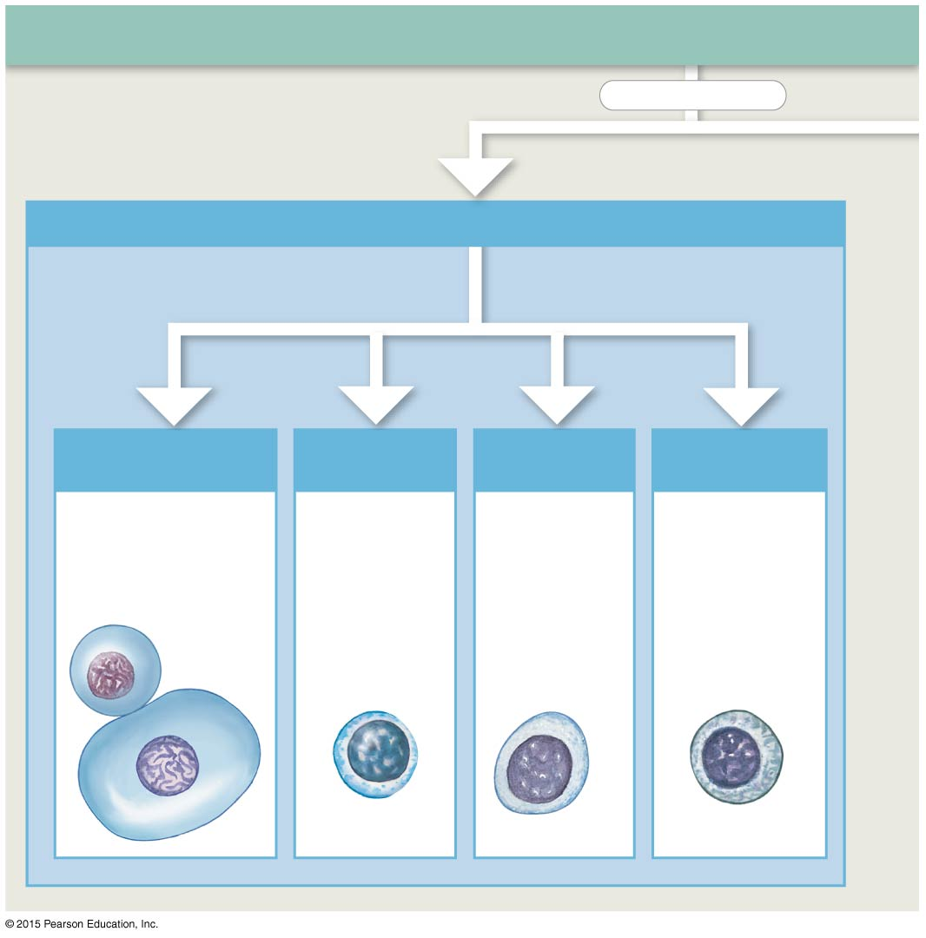
Figure 22-5 Classes of Lymphocytes (Part 1 of 2).
Classes of Lymphocytes
subdivided into
T Cells
Approximately 80% of circulating lymphocytes are classified as T cells.
differentiate into
Cytotoxic T Cells
Helper T Cells
Suppressor T Cells
Memory T Cells
Cytotoxic T cells attack foreign cells or body cells infected by viruses.
Helper T cells stimulate the activation and function of both T cells and B cells.
Suppressor T cells inhibit the activation and function of both T cells
and B cells.
Memory T cells are a subset of T cells that
respond to a previously encountered antigen.

Slide 42
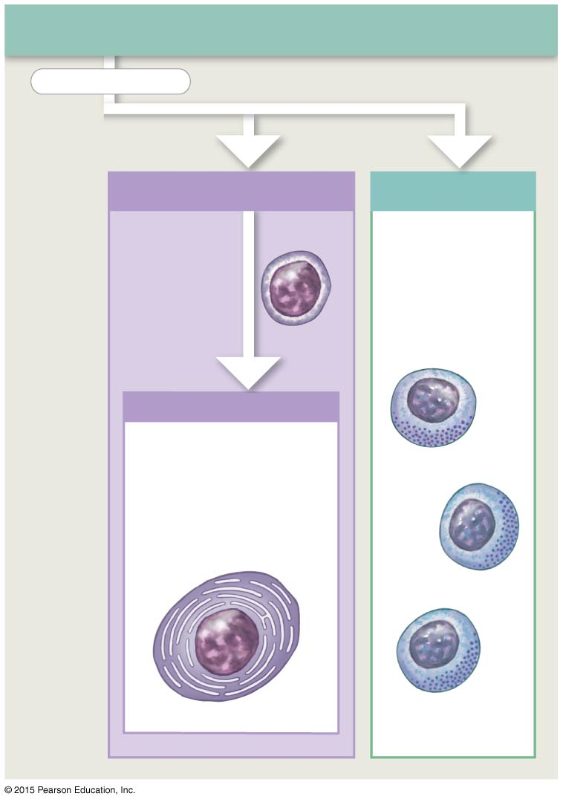
Figure 22-5 Classes of Lymphocytes (Part 2 of 2).
Classes of Lymphocytes
subdivided into
B Cells
NK Cells
B cells make up 10–15% of circulating lymphocytes.
NK cells make up the remaining 5–10% of circulating lymphocytes.
Plasma Cells
When stimulated, B cells can differentiate into plasma cells, which produce and secrete antibodies.

Slide 43
22-2 Structures of Body Defenses
Lymphocyte Distribution
Tissues maintain different T cell and B cell populations
Lymphocytes wander through tissues
Enter blood vessels or lymphatics for transport
Can survive many years

Slide 44
22-2 Structures of Body Defenses
Lymphocyte Production
Also called lymphopoiesis, involves:
Bone marrow
Thymus
Peripheral lymphoid tissues
Hemocytoblasts
In bone marrow, divide into two types of lymphoid stem cells

Slide 45
22-2 Structures of Body Defenses
Lymphoid Stem Cells
Group 1
Remains in bone marrow and develop with help of stromal cells
Produces B cells and natural killer cells
Group 2
Migrates to thymus
Produces T cells in environment isolated by blood–thymus barrier

Slide 46
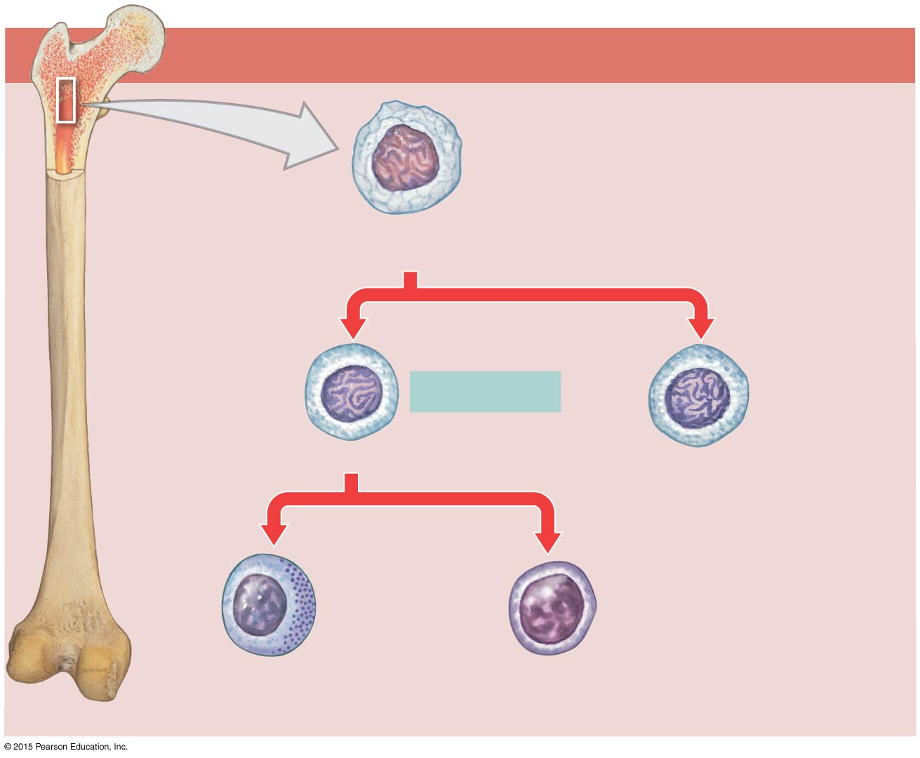
Figure 22-6 The Origin and Distribution of Lymphocytes (Part 1 of 3).
Red Bone Marrow
One group of stem cells remains in the red bone marrow, producing daughter cells that mature into NK cells and B cells.
Multipotent hemopoietic stem cell
Interleukin-7
Lymphoid stem cells
Lymphoid stem cells
NK cells
B cells

Slide 47
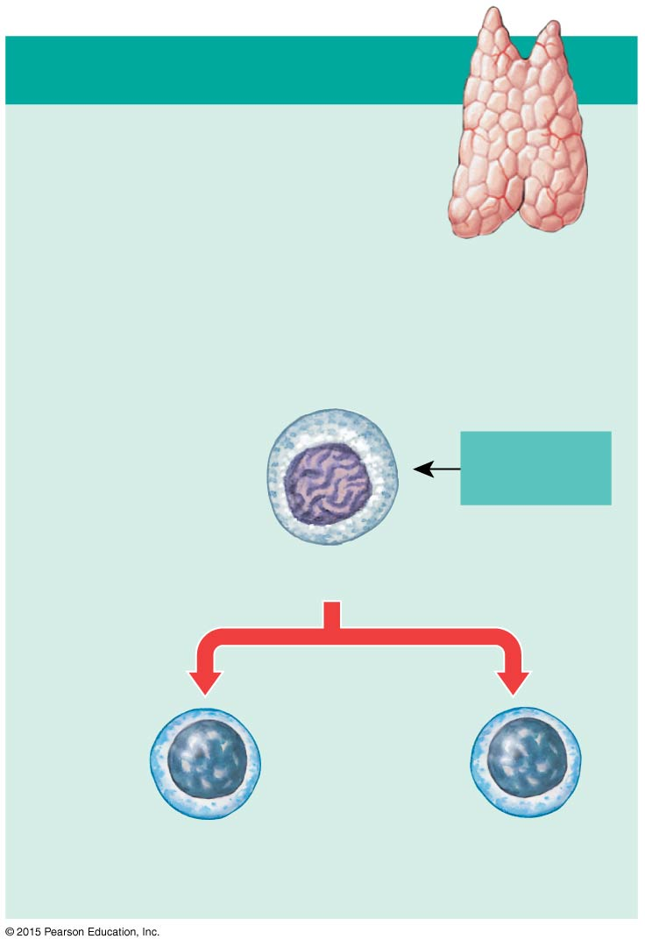
Figure 22-6 The Origin and Distribution of Lymphocytes (Part 2 of 3).
Thymus
The second group of stem cells migrates to the thymus, where subsequent divisions produce daughter cells that mature into T cells.
Thymic hormones
Lymphoid stem cells
Production, selection, and differentiatiion of T cells
Mature T cells
Mature T cells

Slide 48
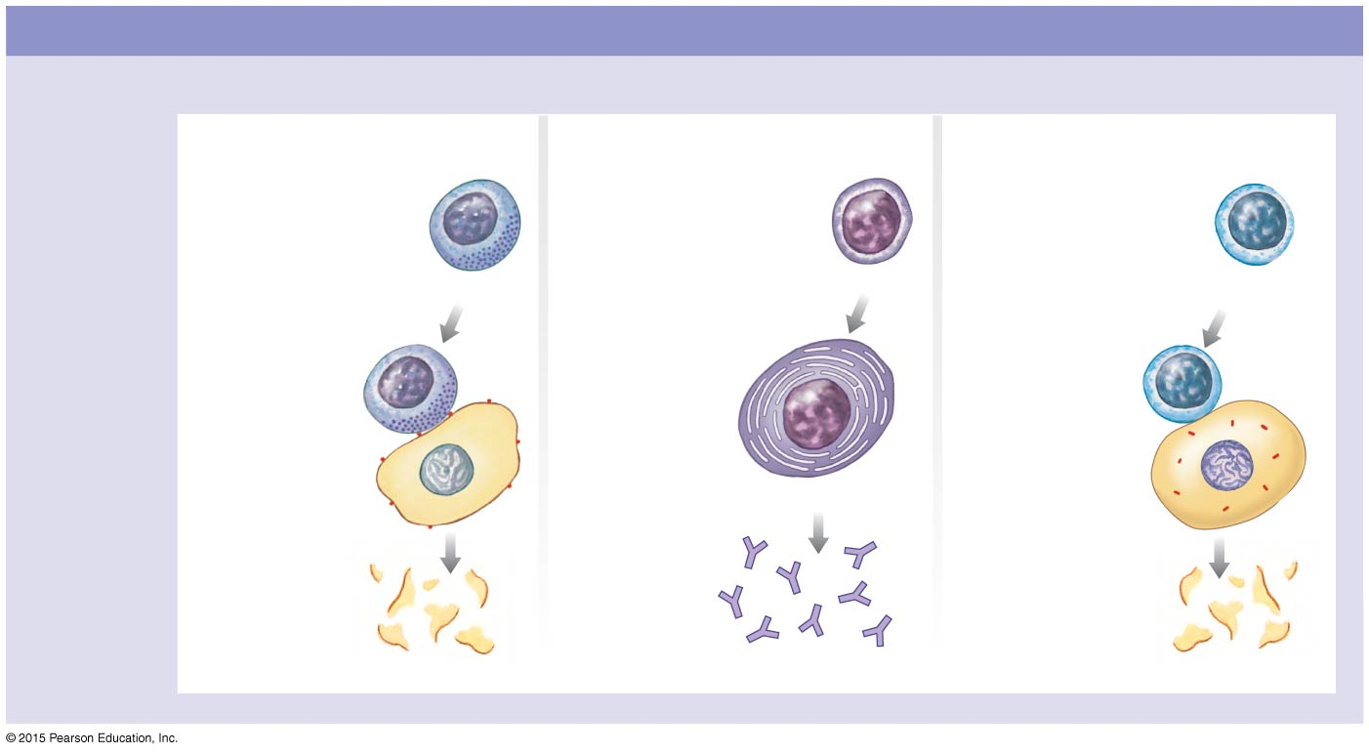
Figure 22-6 The Origin and Distribution of Lymphocytes (Part 3 of 3).
Peripheral Tissues
All three types of lymphocytes
circulate throughout the body in the bloodstream, establishing immunity.
Immune surveillance
Antibody-mediated immunity
Cell-mediated immunity
NK cells attack foreign cells, body cells infected by viruses, and cancer cells. They secrete chemicals that lyse the plasma membrane of the abnormal cells.
When stimulated, B cells can differentiate
into plasma cells, which produce and secrete antibodies. These antibodies attach to pathogens. This starts a chain reaction that leads to the destruction of the pathogen.
One type of mature T cell, called cytotoxic T cells, plays a role in cell-mediated immunity. These cells attack and destroy foreign cells or body cells infected by viruses.
NK cells
B cell
Cytotoxic T cell
Abnormal cell
Abnormal cell
Plasma cell
Cell destroyed
Antibodies
Cell destroyed

Slide 49
22-2 Structures of Body Defenses
T Cells and B Cells
Migrate throughout the body
To defend peripheral tissues
Retaining their ability to divide
Is essential to immune system function

Slide 50
22-2 Structures of Body Defenses
Differentiation
B cells differentiate
With exposure to hormone called cytokine (interleukin-7)
T cells differentiate
With exposure to several thymic hormones

Slide 51
22-2 Structures of Body Defenses
Lymphoid Tissues
Connective tissues dominated by lymphocytes
Lymphoid Nodules
Areolar tissue with densely packed lymphocytes
Germinal center contains dividing lymphocytes

Slide 52
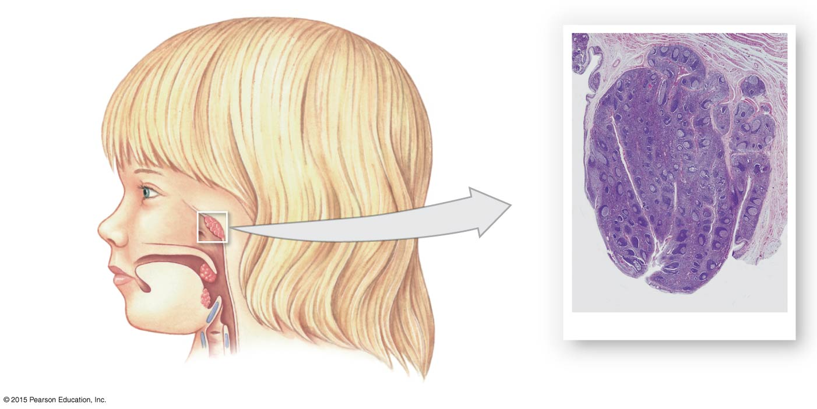
Figure 22-7a Lymphoid Nodules.
Pharyngeal epithelium
Pharyngeal tonsil
Palate
Palatine tonsil
Germinal centers within nodules
Lingual tonsil
Pharyngeal tonsil
LM × 40
a
The locations of the tonsils

Slide 53
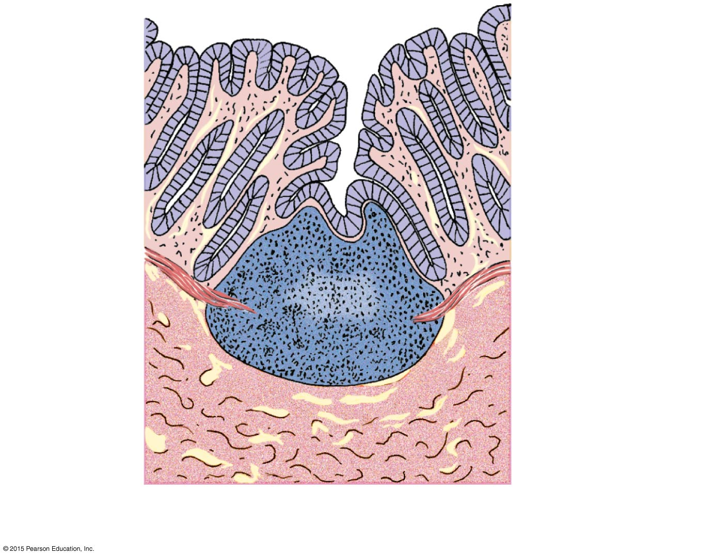
Figure 22-7b Lymphoid Nodules (Part 1 of 2).
Intestinal lumen
Mucous membrane of intestinal wall
Germinal center
Aggregated lymphoid nodule in intestinal mucosa
Underlying connective tissue
b
Diagrammatic view of aggregated lymphoid nodule

Slide 54
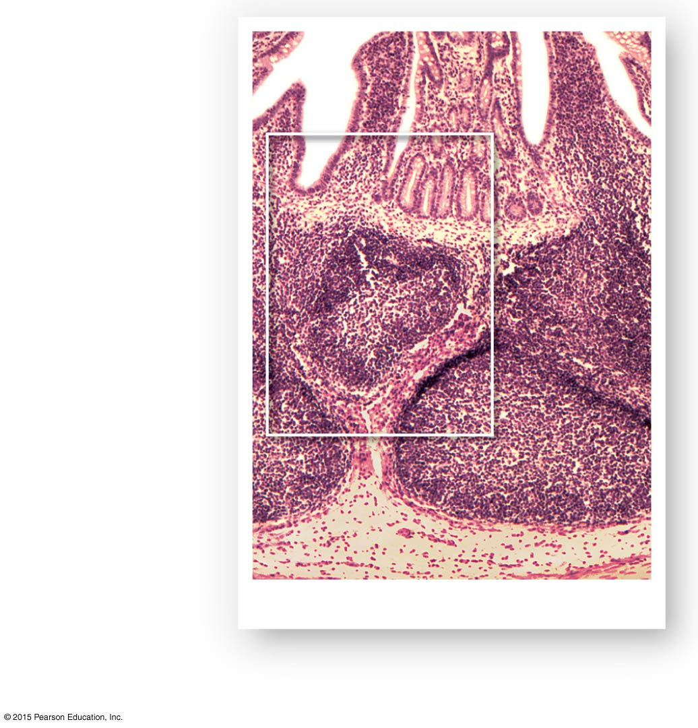
Figure 22-7b Lymphoid Nodules (Part 2 of 2).
Intestinal lumen
Germinal center
Aggregated lymphoid nodule in intestinal mucosa
Underlying connective tissue
Aggretated lymphoid nodules
LM × 20
b
Diagrammatic view of aggregated lymphoid nodule

Slide 55
22-2 Structures of Body Defenses
Distribution of Lymphoid Nodules
Lymph nodes
Spleen
Respiratory tract (tonsils)
Along digestive, urinary, and reproductive tracts

Slide 56
22-2 Structures of Body Defenses
Mucosa-Associated Lymphoid Tissue (MALT)
Lymphoid tissues associated with the digestive system
Aggregated Lymphoid Nodules
Clustered deep to intestinal epithelial lining
Appendix (Vermiform Appendix)
Contains a mass of fused lymphoid nodules

Slide 57
22-2 Structures of Body Defenses
The Five Tonsils
In wall of pharynx
Left and right palatine tonsils
Pharyngeal tonsil (adenoid)
Two lingual tonsils

Slide 58
22-2 Structures of Body Defenses
Lymphoid Organs
Lymph nodes
Thymus
Spleen
Are separated from surrounding tissues by a fibrous connective tissue capsule

Slide 59
22-2 Structures of Body Defenses
Lymph Nodes
Trabeculae
Bundles of collagen fibers
Extend from capsule into interior of lymph node
Hilum
A shallow indentation where blood vessels and nerves reach the lymph node

Slide 60
22-2 Structures of Body Defenses
Lymph Nodes
Afferent lymphatics
Carry lymph
From peripheral tissues to lymph node
Efferent lymphatics
Leave lymph node at hilum
Carry lymph to venous circulation

Slide 61
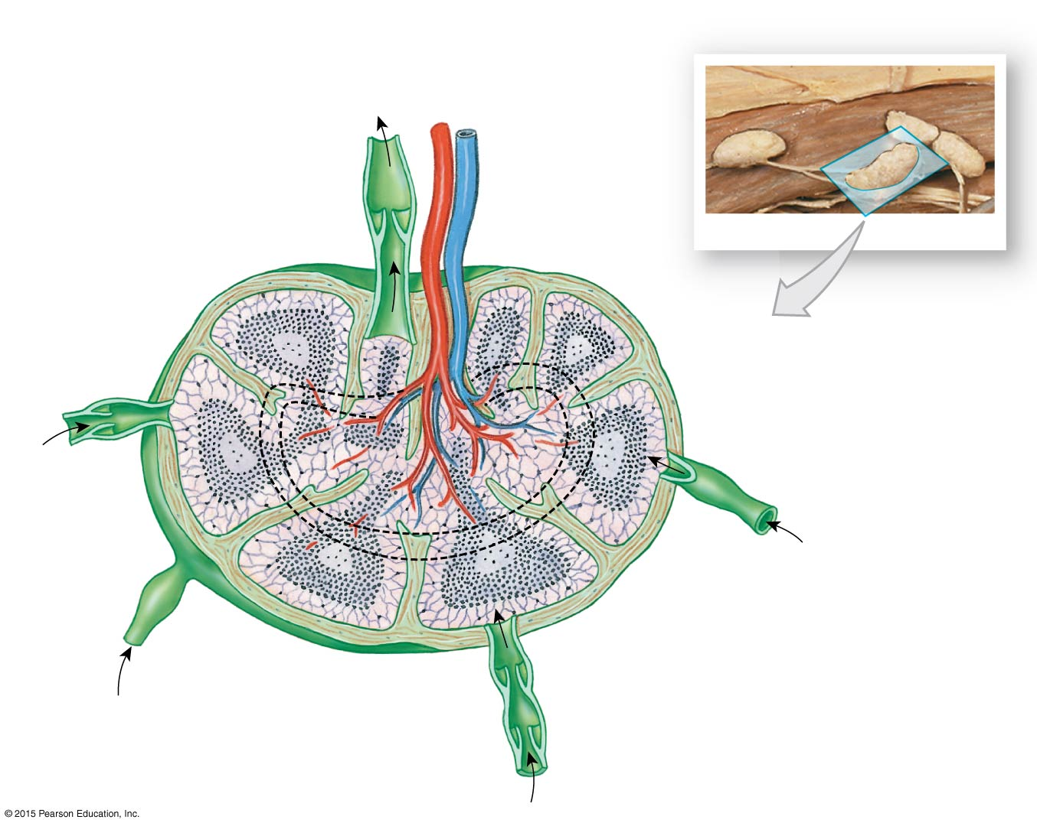
Figure 22-8 The Structure of a Lymph Node (Part 1 of 2).
Lymphatic vessel
Lymph nodes
Efferent vessel
Lymph node artery and vein
Hilum
Lymph nodes
Trabeculae
Medulla
Cortex
Medullary sinus
Outer cortex (B cells)
Subcapsular space
Deep cortex (T cells)
Capsule
Medullary cord (B cells and plasma cells)
Afferent vessel

Slide 62
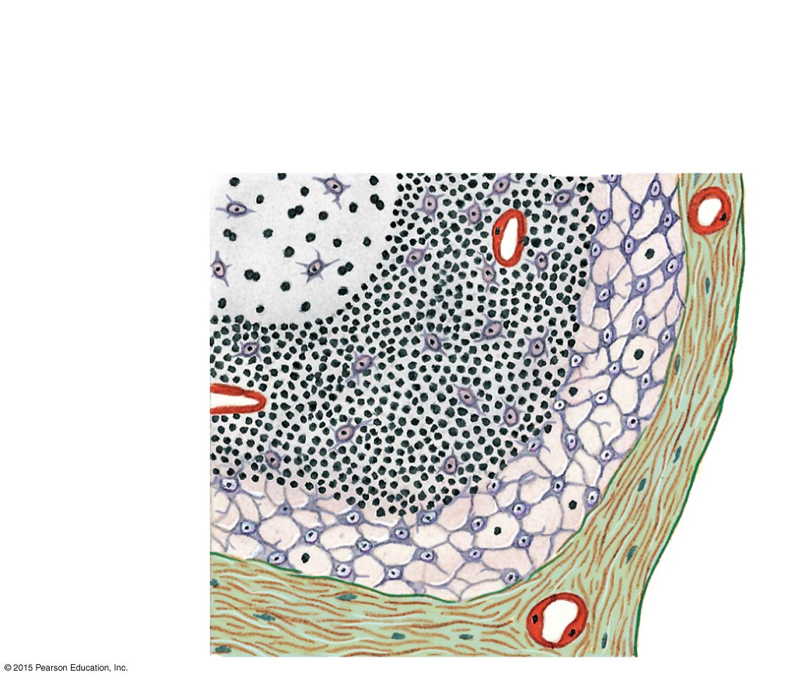
Figure 22-8 The Structure of a Lymph Node (Part 2 of 2).
Subcapsular space
Germinal center
Outer cortex
Capsule
Dividing B cell
Dendritic cells
Nuclei of B cells
Capillary

Slide 63
22-2 Structures of Body Defenses
Lymph Flow
Flows through lymph node in a network of sinuses
From subcapsular space
Contains macrophages and dendritic cells
Through outer cortex
Contains B cells within germinal centers
Through deep cortex
Dominated by T cells
Through the core (medulla)
Contains B cells and plasma cells, organized into medullary cords
Finally, into hilum and efferent lymphatics

Slide 64
22-2 Structures of Body Defenses
Lymph Node Function
A filter
Purifies lymph before return to venous circulation
Removes:
Debris
Pathogens
99 percent of antigens

Slide 65
22-2 Structures of Body Defenses
Antigen Presentation
First step in immune response
Extracted antigens are “presented” to lymphocytes
Or attached to dendritic cells to stimulate lymphocytes

Slide 66
22-2 Structures of Body Defenses
Lymphatic Functions
Lymphoid tissues and lymph nodes
Distributed to monitor peripheral infections
Respond before infections reach vital organs of trunk
Lymph nodes of gut, trachea, lungs, and thoracic duct
Protect against pathogens in digestive and respiratory systems

Slide 67
22-2 Structures of Body Defenses
Lymph Nodes (Glands)
Large lymph nodes at groin and base of neck
Swell in response to inflammation
Lymphadenopathy
Chronic or excessive enlargement of lymph nodes
May indicate infections, endocrine disorders, or cancer

Slide 68
22-2 Structures of Body Defenses
The Thymus
Located in mediastinum
Atrophies after puberty
Diminishing effectiveness of immune system
Divisions of the Thymus
Thymus is divided into two thymic lobes
Septa divide lobes into smaller lobules

Slide 69
22-2 Structures of Body Defenses
A Thymic Lobule
Contains a dense outer cortex and a pale central medulla
Lymphocytes
Divide in the cortex
T cells migrate into medulla
Mature T cells leave thymus by medullary blood vessels

Slide 70
22-2 Structures of Body Defenses
Thymic Epithelial Cells in the Cortex
Surround lymphocytes in cortex
Maintain blood–thymus barrier
Secrete thymic hormones that stimulate:
Stem cell divisions
T cell differentiation

Slide 71
22-2 Structures of Body Defenses
Thymic Epithelial Cells in the Medulla
Form concentric layers known as thymic (Hassall’s) corpuscles
The medulla has no blood–thymus barrier
T cells can enter or leave bloodstream
Thymus Hormones
Thymosin – an extract from the thymus that promotes development of lymphocytes

Slide 72
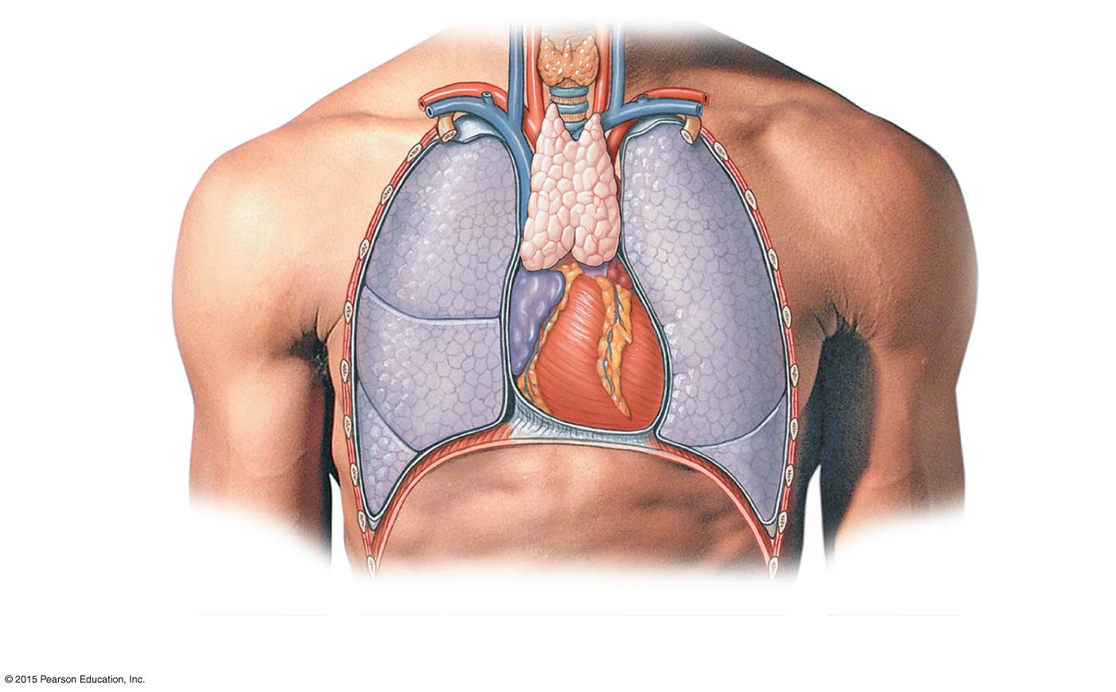
Figure 22-9a The Thymus.
Thyroid gland
Trachea
Thymus
Right lobe
Left lobe
Left lung
Right lung
Heart
Diaphragm
a
The appearance and position of the thymus in relation to other organs in the chest.

Slide 73
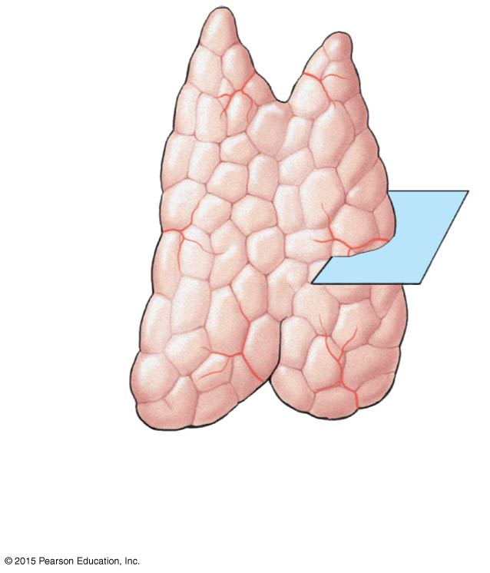
Figure 22-9b The Thymus.
Right lobe
Left lobe
Septa
Lobule
b
Anatomical landmarks on
the thymus.

Slide 74
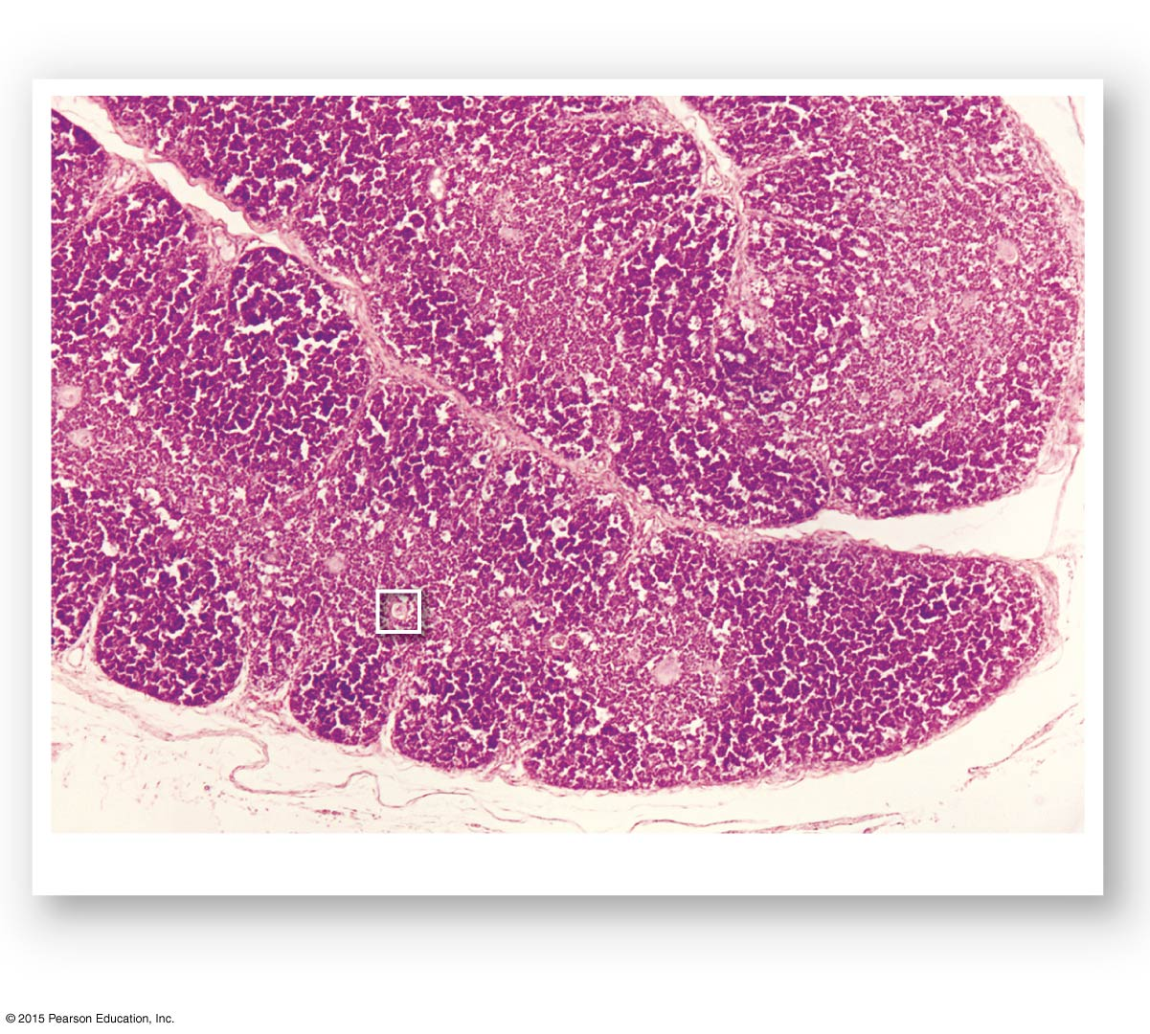
Figure 22-9c The Thymus.
Medulla
Septa
Cortex
Lobule
Lobule
The thymus gland
LM × 50
c
Fibrous septa divide the tissue of the thymus into lobules resembling interconnected lymphoid nodules.

Slide 75
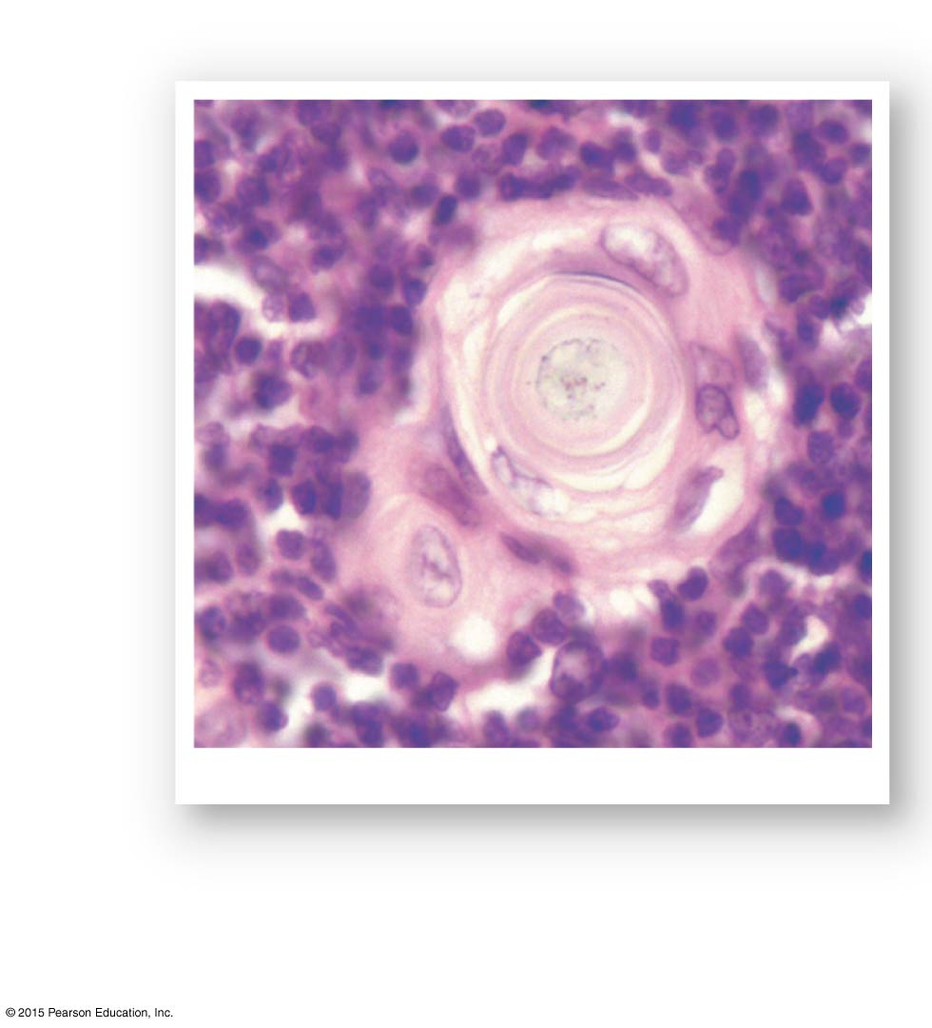
Figure 22-9d The Thymus.
Lymphocytes
Thymic corpuscle
Thymic epithelial cells
A thymic corpuscle
LM × 550
d
Higher magnification reveals the unusual structure of thymic corpuscles. The small cells are lymphocytes in various stages of development.

Slide 76
22-2 Structures of Body Defenses
Three Functions of the Spleen
Removal of abnormal blood cells and other blood components by phagocytosis
Storage of iron recycled from red blood cells
Initiation of immune responses by B cells and T cells
In response to antigens in circulating blood

Slide 77
22-2 Structures of Body Defenses
Anatomy of the Spleen
Attached to stomach by gastrosplenic ligament
Contacts diaphragm and left kidney
Splenic veins, arteries, and lymphatic vessels
Communicate with spleen at hilum

Slide 78
22-2 Structures of Body Defenses
Histology of the Spleen
Inside fibrous capsule
Red pulp contains many red blood cells
White pulp resembles lymphoid nodules

Slide 79
22-2 Structures of Body Defenses
Trabecular Arteries
Branch and radiate toward capsule
Finer branches surrounded by white pulp
Capillaries discharge red blood cells into red pulp
Red Pulp
Contains elements of circulating blood
Plus fixed and free macrophages

Slide 80
22-2 Structures of Body Defenses
Splenic Circulation
Blood passes through:
Network of reticular fibers
Then enters large sinusoids (lined by macrophages)
Which empty into trabecular veins

Slide 81
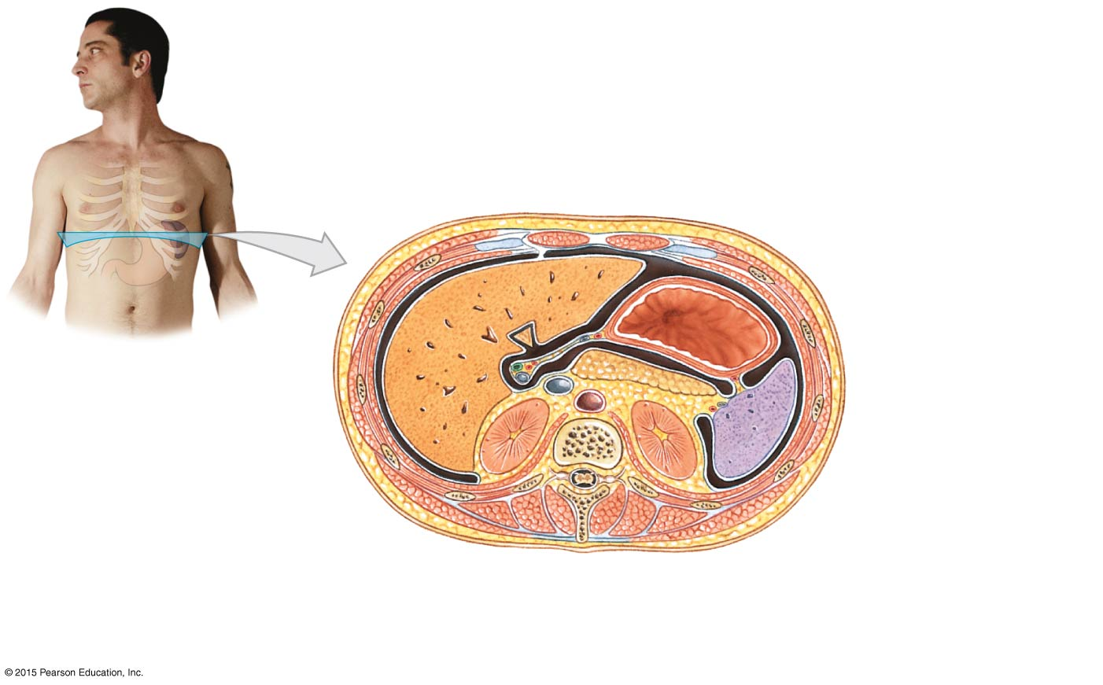
Figure 22-10a The Spleen.
Spleen
Parietal peritoneum
Visceral peritoneum
Stomach
Diaphragm
Rib
Gastrosplenic ligament
Liver
Pancreas
Gastric area
Diaphragmatic surface
Aorta
Spleen
Hilum
Renal area
Kidneys
a
A transverse section through the trunk, showing the typical position of the spleen projecting into the peritoneal cavity. The shape of the spleen roughly conforms to the shapes of adjacent organs.

Slide 82
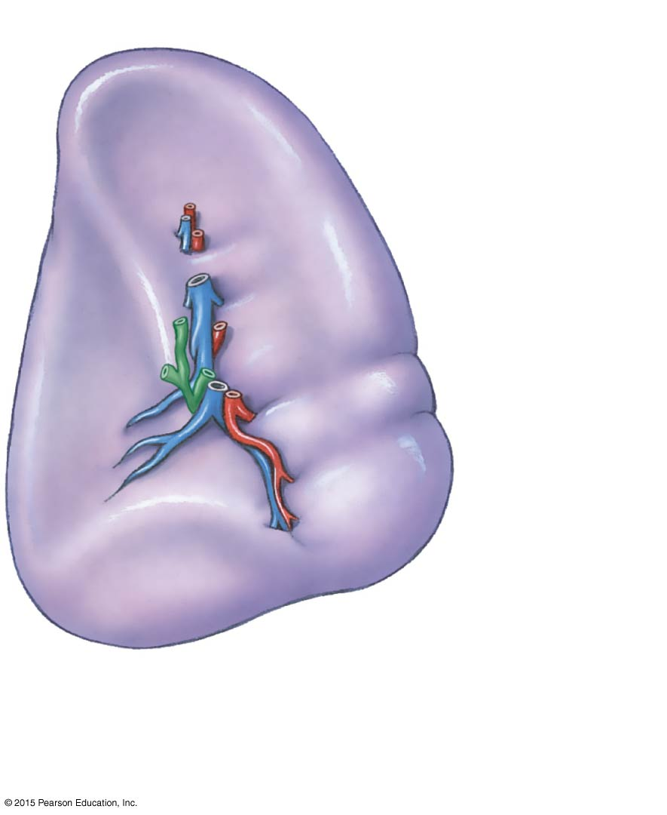
Figure 22-10b The Spleen.
SUPERIOR
Gastric area
Hilum
Splenic vein
Renal area
Splenic artery
Splenic lymphatic vessel
INFERIOR
b
A posterior view of the surface of an intact spleen, showing major anatomical landmarks.

Slide 83
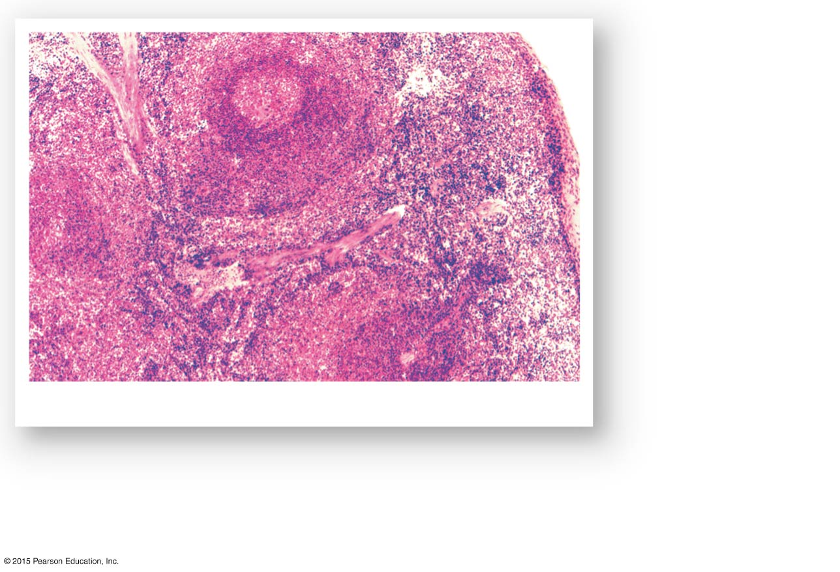
Figure 22-10c The Spleen.
White pulp of
splenic nodule
Capsule
Red pulp
Trabecular artery
Central artery in splenic nodule
The spleen
LM × 50
c
Spleen histology. White pulp is dominated by lymphocytes; it appears purple because the nuclei of lymphocytes stain very darkly. Red pulp contains a large number of red blood cells.

Slide 84
22-2 Structures of Body Defenses
Spleen Function
Phagocytes and other lymphocytes in spleen
Identify and attack damaged and infected cells
In circulating blood

Slide 85
22-2 Structures of Body Defenses
The Lymphatic System and Body Defenses
Body defenses provide resistance to fight infection, illness, and disease
Two categories of defenses
Innate (nonspecific) immunity
Adaptive (specific) immunity

Slide 86
22-2 Structures of Body Defenses
Innate (Nonspecific) Immunity
Always works the same way
Against any type of invading agent
Nonspecific resistance
Adaptive (Specific) Immunity
Protects against specific pathogens
Depends on activities of lymphocytes
Specific resistance (immunity)
Develops after exposure to environmental hazards

Slide 87
22-3 Nonspecific Defenses
Seven Major Categories of Innate (Nonspecific) Immunity
Physical barriers
Phagocytes
Immune surveillance
Interferons
Complement
Inflammatory response
Fever

Slide 88
22-3 Nonspecific Defenses
Physical Barriers
Keep hazardous materials outside the body
Phagocytes
Attack and remove dangerous microorganisms
Immune Surveillance
Constantly monitors normal tissues
With natural killer cells (NK cells)

Slide 89
22-3 Nonspecific Defenses
Interferons
Chemical messengers that trigger production of antiviral proteins in normal cells
Antiviral proteins
Do not kill viruses
Block replication in cell
Complement
System of circulating proteins
Assists antibodies in destruction of pathogens

Slide 90
22-3 Nonspecific Defenses
Inflammatory Response
Localized, tissue-level response that tends to limit spread of injury or infection
Fever
A high body temperature
Increases body metabolism
Accelerates defenses
Inhibits some viruses and bacteria

Slide 91
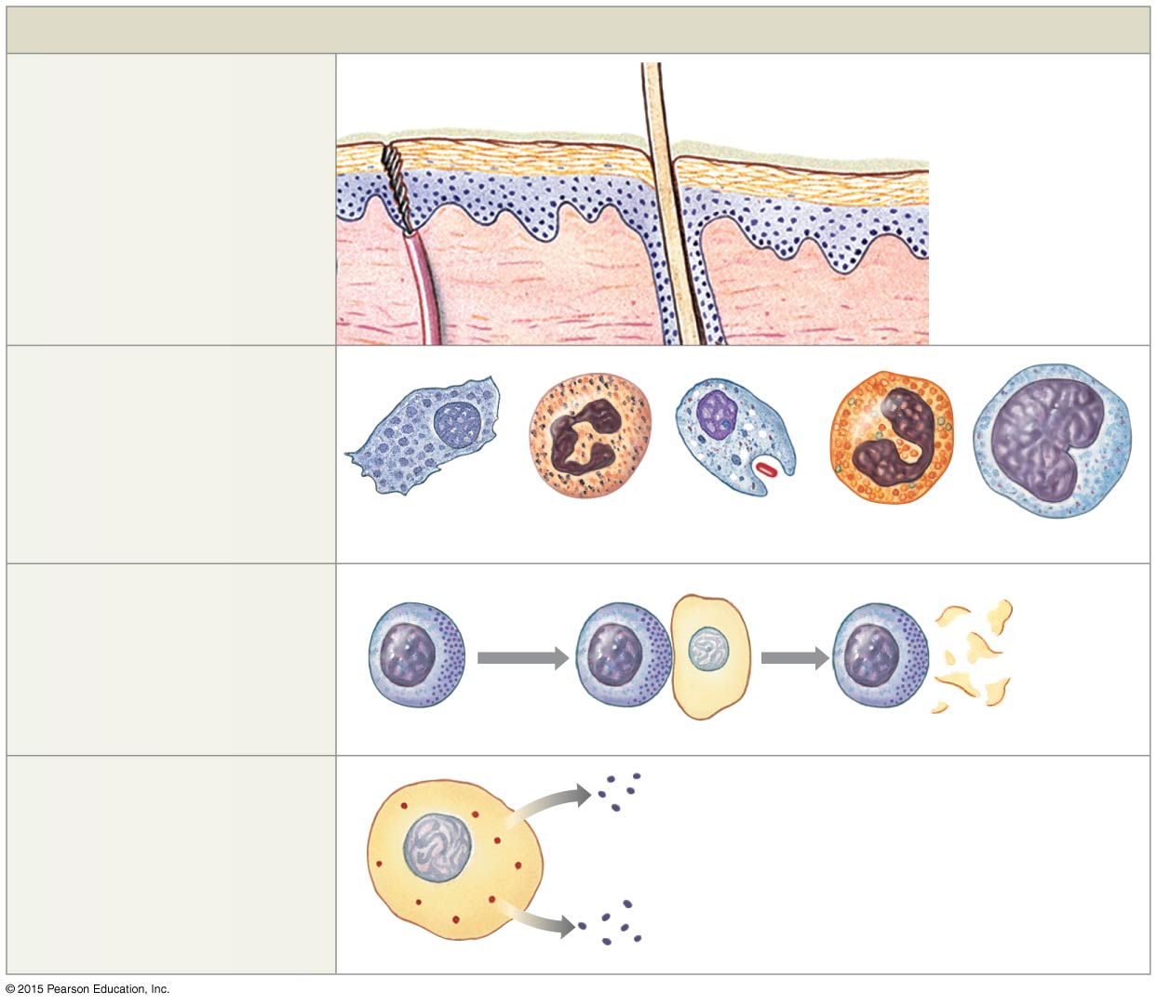
Figure 22-11 Innate Defenses (Part 1 of 2).
Innate Defenses
Physical barriers
Duct of eccrine sweat gland
keep hazardous organisms and materials outside the body.
Hair
Secretions
Epithelium
Phagocytes
engulf pathogens and cell debris.
Fixed macrophage
Free macrophage
Neutrophil
Eosinophil
Monocyte
Immune surveillance
is the destruction of abnormal cells by NK cells in peripheral tissues.
Lysed abnormal cell
Natural killer cell
Interferons
are chemical messengers that coordinate the defenses against viral infections.
Interferons released by activated lymphocytes, macrophages, or virus-infected cells

Slide 92
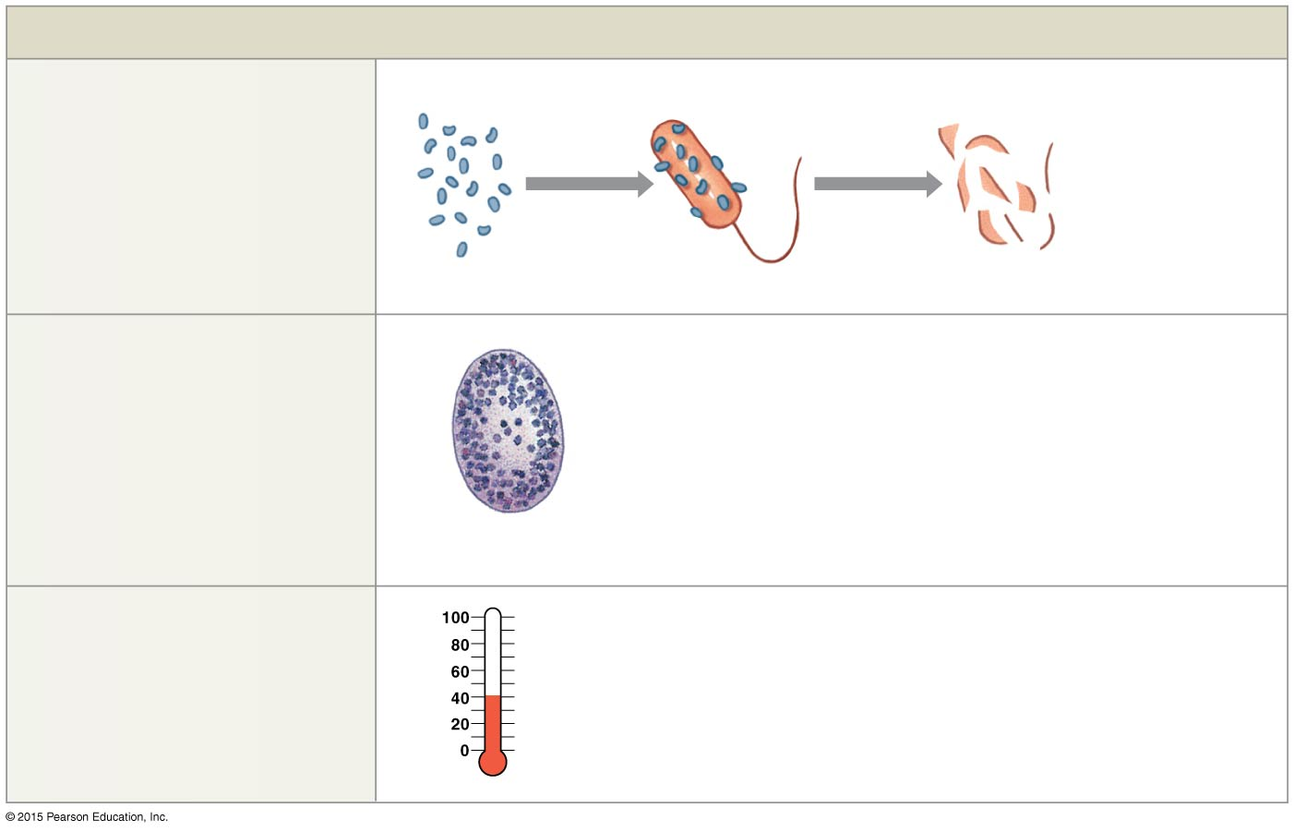
Figure 22-11 Innate Defenses (Part 2 of 2).
Innate Defenses
Complement
is a system of circulating proteins that assist antibodies in the destruction of pathogens.
Lysed pathogen
Complement
Inflammation
Blood flow increased
Phagocytes activated
Capillary permeability increased
Complement activated
Clotting reaction walls off region
Regional temperature increased
Adaptive defenses activated
is a localized, tissue-level response that tends to limit the spread of an injury or infection.
Mast cell
Fever
is an elevation of body temperature that accelerates tissue metabolism and body defenses.
Body temperature rises above 37.2°C in response to pyrogens

Slide 93
22-3 Nonspecific Defenses
Physical Barriers
Outer layer of skin
Hair
Epithelial layers of internal passageways
Secretions that flush away materials
Sweat glands, mucus, and urine
Secretions that kill or inhibit microorganisms
Enzymes, antibodies, and stomach acid

Slide 94
22-3 Nonspecific Defenses
Two Classes of Phagocytes
Microphages
Neutrophils and eosinophils
Leave the bloodstream
Enter peripheral tissues to fight infections

Slide 95
22-3 Nonspecific Defenses
Two Classes of Phagocytes
Macrophages
Large phagocytic cells derived from monocytes
Distributed throughout body
Make up monocyte–macrophage system (reticuloendothelial system)

Slide 96
22-3 Nonspecific Defenses
Activated Macrophages
Respond to pathogens in several ways
Engulf pathogen and destroy it with lysosomal enzymes
Bind to pathogen so other cells can destroy it
Destroy pathogen by releasing toxic chemicals into interstitial fluid

Slide 97
22-3 Nonspecific Defenses
Two Types of Macrophages
Fixed macrophages
Also called histiocytes
Stay in specific tissues or organs
For example, dermis and bone marrow
Free macrophages
Also called wandering macrophages
Travel throughout body

Slide 98
22-3 Nonspecific Defenses
Special Histiocytes
Microglia found in central nervous system
Kupffer cells found in liver sinusoids
Free Macrophages
Special free macrophages
Alveolar macrophages (phagocytic dust cells)

Slide 99
22-3 Nonspecific Defenses
Movement and Phagocytosis
All macrophages:
Move through capillary walls (emigration)
Are attracted or repelled by chemicals in surrounding fluids (chemotaxis)
Phagocytosis begins:
When phagocyte attaches to target (adhesion)
And surrounds it with a vesicle

Slide 100
22-3 Nonspecific Defenses
Immunological Surveillance
Is carried out by natural killer (NK) cells
Activated NK Cells
Identify and attach to abnormal cell (nonselective)
Golgi apparatus in NK cell forms perforin vesicles
Vesicles release proteins called perforins (exocytosis)
Perforins lyse abnormal plasma membrane
Also attack cancer cells and cells infected with viruses

Slide 101
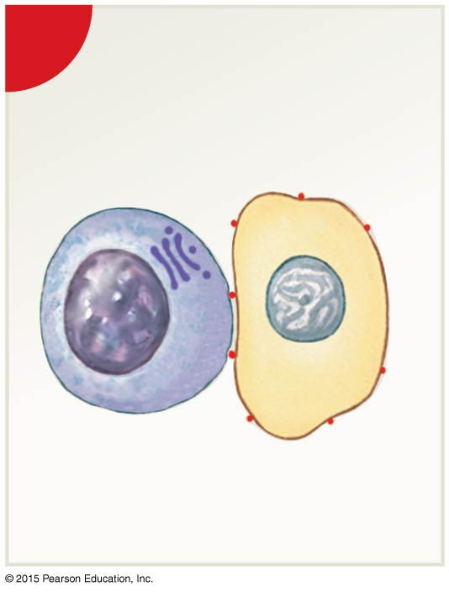
Figure 22-12 How Natural Killer Cells Kill Cellular Targets (Part 1 of 4).
1
Recognition and adhesion
NK cell
Golgi apparatus
Abnormal cell

Slide 102
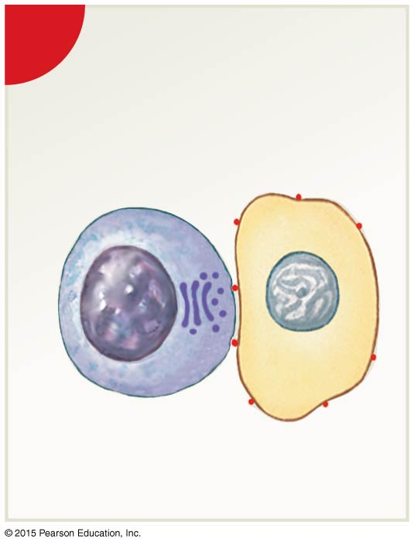
Figure 22-12 How Natural Killer Cells Kill Cellular Targets (Part 2 of 4).
2
Realignment of Golgi apparatus

Slide 103
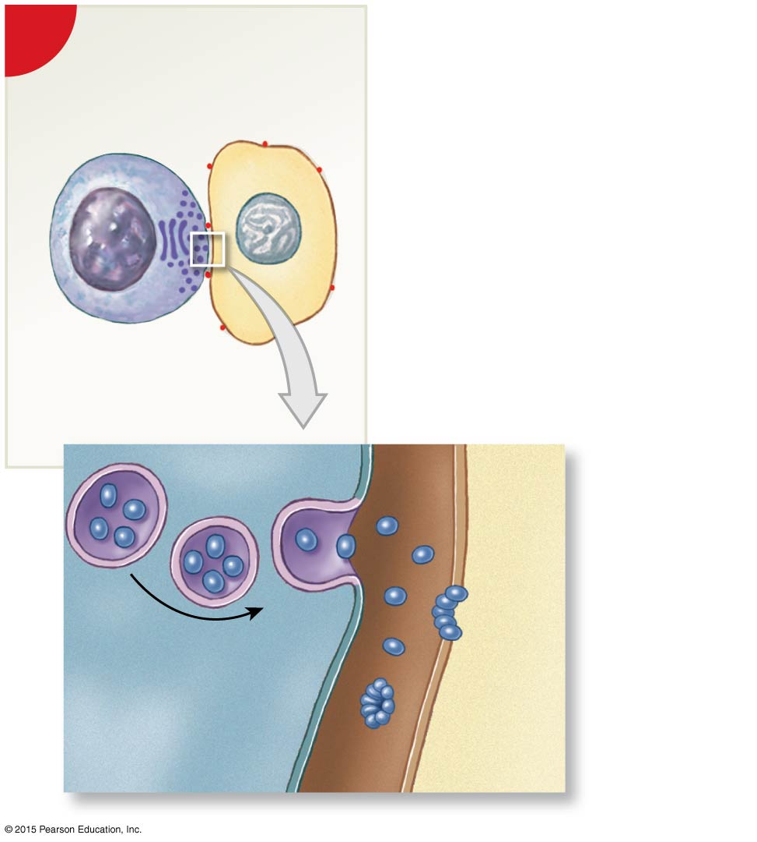
Figure 22-12 How Natural Killer Cells Kill Cellular Targets (Part 3 of 4).
3
Secretion of perforin
Perforin molecules
Pores formed by perforin complex
NK cell
Abnormal cell

Slide 104
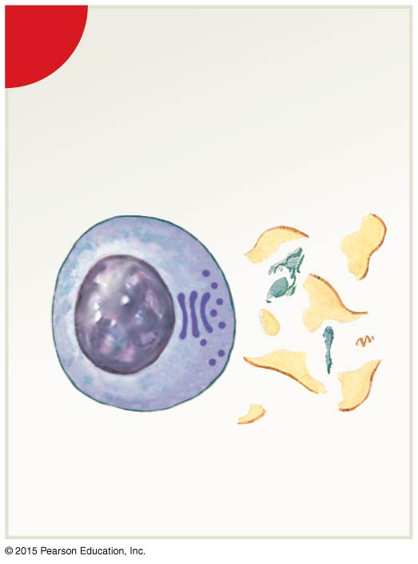
Figure 22-12 How Natural Killer Cells Kill Cellular Targets (Part 4 of 4).
4
Lysis of abnormal cell

Slide 105
22-3 Nonspecific Defenses
Immunological Surveillance
Cancer cells
With tumor-specific antigens
Are identified as abnormal by NK cells
Some cancer cells avoid NK cells (immunological escape)

Slide 106
22-3 Nonspecific Defenses
Immunological Surveillance
Viral infections
Cells infected with viruses
Present abnormal proteins on plasma membranes
Allow NK cells to identify and destroy them

Slide 107
22-3 Nonspecific Defenses
Interferons
Proteins (cytokines) released by activated lymphocytes and macrophages
Cytokines
Chemical messengers released by tissue cells
To coordinate local activities
To act as hormones to affect whole body

Slide 108
22-3 Nonspecific Defenses
Three Types of Interferons
Alpha-interferons
Produced by leukocytes
Stimulate NK cells
Beta-interferons
Secreted by fibroblasts
Slow inflammation
Gamma-interferons
Secreted by T cells and NK cells
Stimulate macrophage activity

Slide 109
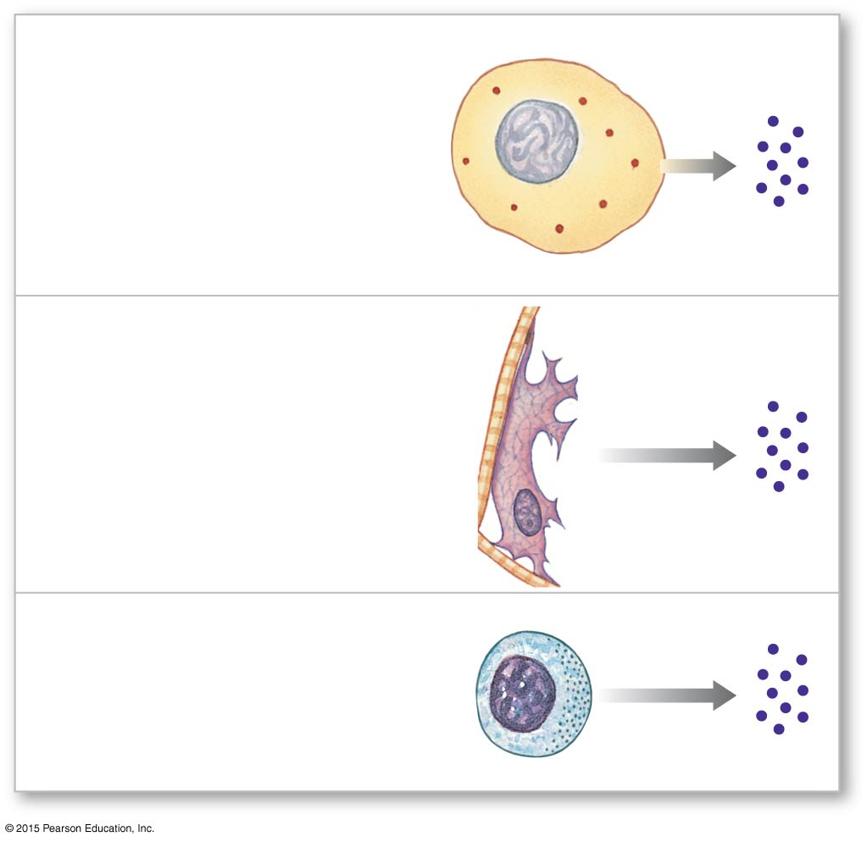
Figure 22-13 Interferons.
Interferon alpha (α) is produced by cells infected with viruses. They attract and stimulate NK cells and enhance resistance to viral infection.
Interferon beta (β) is secreted by fibroblasts and slows inflammation in a damaged area.
Interferon gamma (γ) is secreted by T cells and NK cells and stimulates macrophage activity.

Slide 110
22-3 Nonspecific Defenses
Complement
Plasma contains 30 special complement (C) proteins
That form complement system and complement antibody action
Complement activation
Complements work together in cascades
Two pathways activate the complement system
Classical pathway
Alternative pathway

Slide 111
22-3 Nonspecific Defenses
Complement Activation: The Classical Pathway
Fast method C1 binds to:
Antibody molecule attached to antigen (bacterium)
Bound protein acts as enzyme
Catalyzes chain reaction

Slide 112
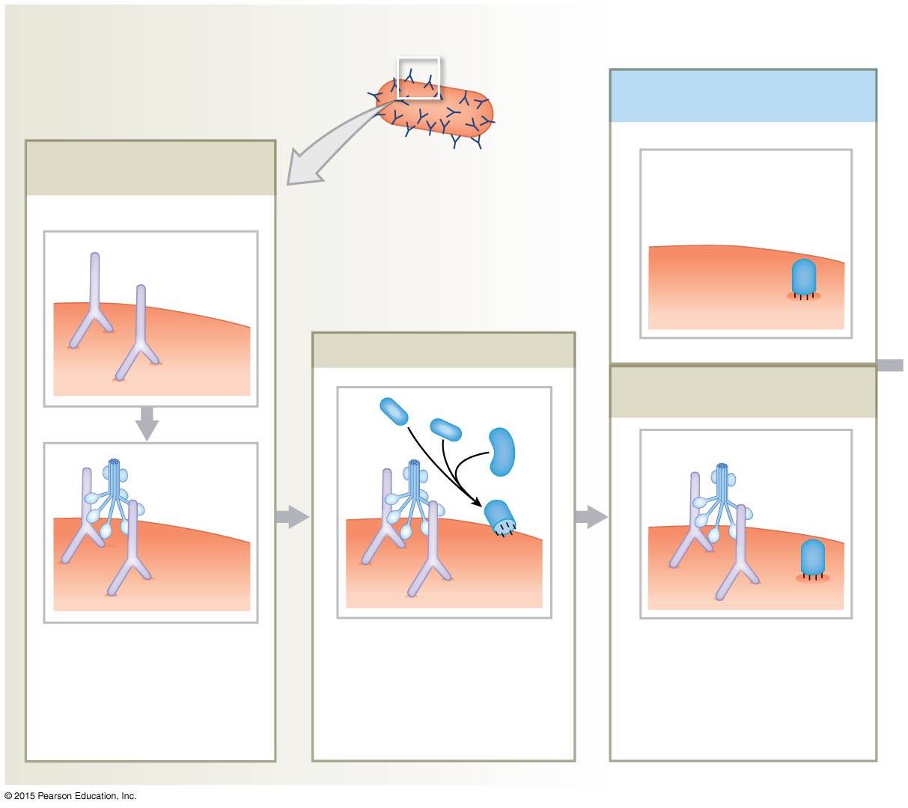
Figure 22-14 Pathways of Complement Activation (Part 2 of 3).
Classical Pathway
The most rapid and effective activation of the complement system occurs through the classical pathway.
C3b Attachment (alternative pathway)
Antibody Binding and C1 Attachment
Antibody binding
C3b
Antibodies
Bacterial cell wall
Activation and Cascade
C3b Attachment (classical pathway)
C2
C4
C3
C1
C3b
C3b
C1 must attach to two antibodies for its activation.
The attached C1 protein then acts as an enzyme, catalyzing a series of reactions involving other complement proteins.
The classical pathway ends with the conversion of an inactive C3 to an
activated C3b that attaches to the cell wall.

Slide 113
22-3 Nonspecific Defenses
Complement Activation: The Alternative Pathway
Slow method exposed to antigen
Factor P (properdin)
Factor B
Factor D
Interact in plasma

Slide 114
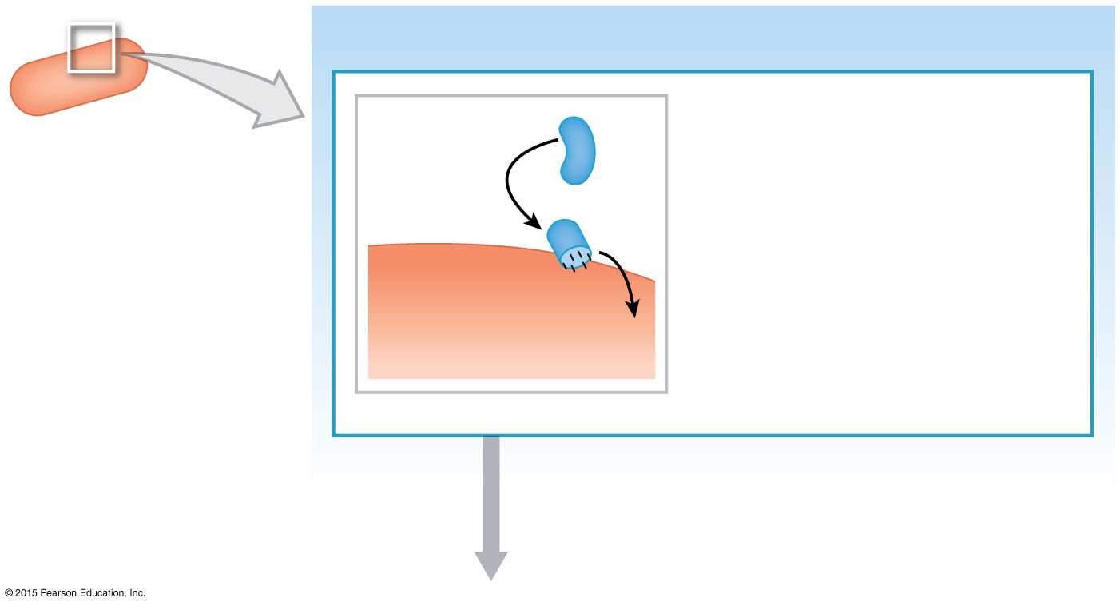
Figure 22-14 Pathways of Complement Activation (Part 1 of 3).
Alternative Pathway
The alternative pathway begins
when several complement
proteins, notably properdin, interact in the plasma. This interaction can be triggered by exposure to foreign materials, such as the capsule of a bacterium. The end result is the attachment of an activated C3b protein to the bacterial cell wall.
The alternative pathway is important in the defense against bacteria, some parasites, and virus-infected cells.
C3
Properdin Factor B Factor D
C3b
Bacterial cell wall

Slide 115
22-3 Nonspecific Defenses
Complement Activation
Both pathways end with:
Conversion of inactive complement protein C3
To active form C3b

Slide 116
22-3 Nonspecific Defenses
Effects of Complement Activation
Pore formation
Destruction of target plasma membranes
Five complement proteins join to form membrane attack complex (MAC)
Enhancement of phagocytosis by opsonization
Complements working with antibodies (opsonins)
Histamine release
Increases the degree of local inflammation and blood flow

Slide 117
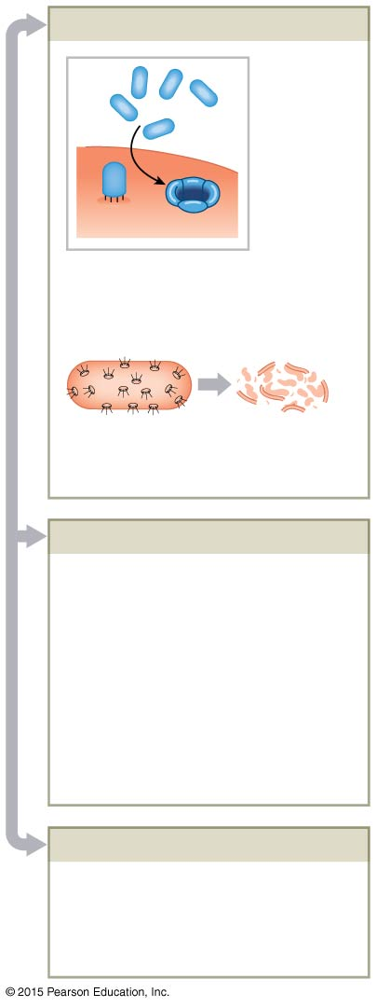
Figure 22-14 Pathways of Complement Activation (Part 3 of 3).
Cell Lysis by Pore Formation
Once an activated C3b protein has attached to the cell wall, additional complement proteins
form a membrane attack complex (MAC) in the membrane that destroys the integrity of the target cell.
C5-C9
MAC
Multiple pores in bacterium
Cell lysis
Enhanced Phagocytosis
A coating of complement proteins and antibodies both attracts phagocytes and makes the target cell easier to engulf. This enhancement of phagocytosis, a process called opsonization, occurs because macrophage membranes contain receptors that detect and bind to complement proteins and bound antibodies.
Histamine Release
Release of histamine by mast cells and basophils increases the degree of local inflammation and accelerates blood flow to the region.

Slide 118
22-3 Nonspecific Defenses
Inflammation
Also called inflammatory response
A localized response
Triggered by any stimulus that kills cells or injures tissue

Slide 119
22-3 Nonspecific Defenses
Cardinal Signs and Symptoms
Swelling (tumor)
Redness (rubor)
Heat (calor)
Pain (dolor)

Slide 120
22-3 Nonspecific Defenses
Three Effects of Inflammation
Temporary repair and barrier against pathogens
Retards spread of pathogens into surrounding areas
Mobilization of local and systemic defenses
And facilitation of repairs (regeneration)

Slide 121
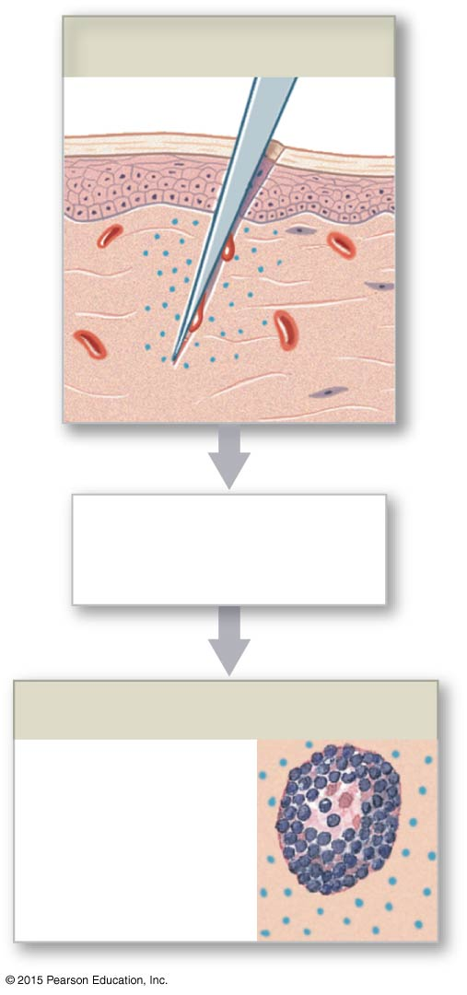
Figure 22-15 Inflammation and the Steps in Tissue Repair (Part 1 of 2).
Tissue Damage
Chemical change
in interstitial fluid
Mast Cell Activation
Release of
histamine and
heparin from
mast cells

Slide 122
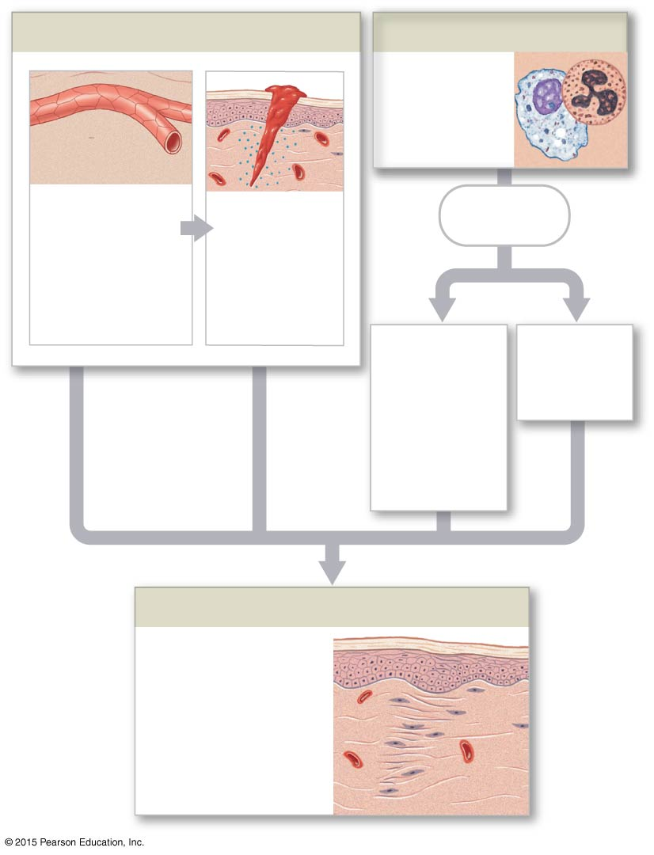
Figure 22-15 Inflammation and the Steps in Tissue Repair (Part 2 of 2).
Redness, Swelling, Heat, and Pain
Phagocyte Attraction
Attraction of
phagocytes,
especially
neutrophils
Dilation of
blood vessels,
Increased
blood flow,
increased vessel
permeability
Clot
formation
(temporary
repair)
Release of
cytokines
Removal of
debris by
neutrophils
and macro-
phages;
stimulation
of fibroblasts
Activation
of specific
defenses
Tissue Repair
Pathogen removal,
clot erosion, scar
tissue formation

Slide 123
22-3 Nonspecific Defenses
Products of Inflammation
Necrosis
Local tissue destruction in area of injury
Pus
Mixture of debris and necrotic tissue
Abscess
Pus accumulated in an enclosed space

Slide 124
22-3 Nonspecific Defenses
Fever
A maintained body temperature above 37.2°C (99°F)
Pyrogens
Any material that causes the hypothalamus to raise body temperature
Circulating pathogens, toxins, or antibody complexes
Endogenous pyrogens or interleukin-1 (IL-1)
Pyrogen released by active macrophages
A cytokine

Slide 125
22-4 Specific Defenses
Adaptive (Specific) Defenses
Specific resistance (immunity)
Responds to specific antigens
With coordinated action of T cells and B cells

Slide 126
22-4 Specific Defenses
Specific Defenses
T Cells
Provide cell-mediated immunity
Defend against abnormal cells and pathogens inside cells
B Cells
Provide antibody-mediated immunity
Defend against antigens and pathogens in body fluids

Slide 127
22-4 Specific Defenses
Forms of Immunity
Innate
Present at birth
Adaptive
After birth
Active
Antibodies develop after exposure to antigen
Passive
Antibodies are transferred from another source

Slide 128
22-4 Specific Defenses
Active Immunity
Naturally acquired
Through environmental exposure to pathogens
Artificially induced
Through vaccines containing pathogens

Slide 129
22-4 Specific Defenses
Passive Immunity
Naturally acquired
Antibodies acquired from the mother
Artificially induced
By an injection of antibodies

Slide 130
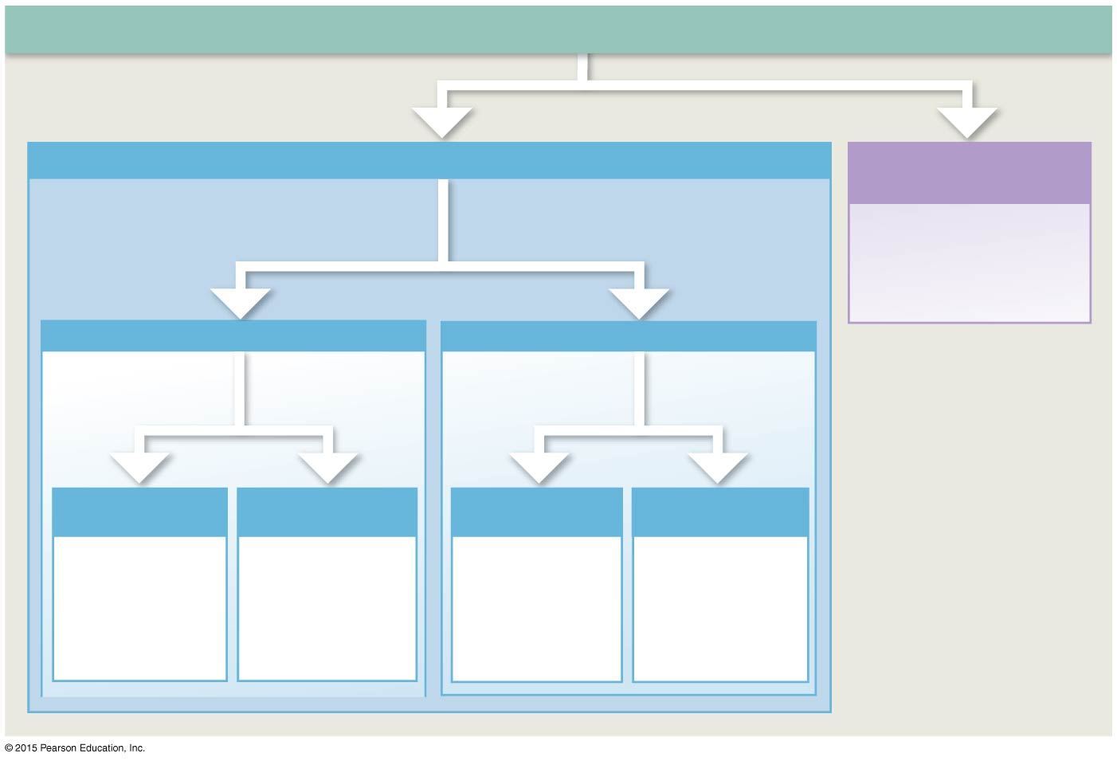
Figure 22-16 Forms of Immunity.
Immunity
Ability to resist
Infection and disease
Adaptive (Specific) Immunity
Innate (Nonspecific)
Immunity
Adaptive immunity is not present at birth. You
acquire immunity to a specific antigen only
When you have been exposed to that antigen
or receive antibodies
from another source.
Genetically determined—
no prior exposure or
antibody production
involved
Active Immunity
Passive Immunity
Develops in
response to antigen
exposure
Produced by transfer
of antibodies from
another source
Naturally acquired
active immunity
Artificially induced
active immunity
Naturally acquired
passive immunity
Artificially induced
passive immunity
Develops after
exposure to
antigens in
environment
Develops after
administration of
an antigen to
prevent disease
Conferred by
transfer of
maternal
antibodies across
placenta or in
breast milk
Conferred by
administration of
antibodies to
combat infection

Slide 131
22-4 Specific Defenses
Four Properties of Immunity
Specificity
Each T or B cell responds only to a specific antigen and ignores all others
Versatility
The body produces many types of lymphocytes
Each fights a different type of antigen
Active lymphocyte clones itself to fight specific antigen

Slide 132
22-4 Specific Defenses
Four Properties of Immunity
Memory
Some active lymphocytes (memory cells):
Stay in circulation
Provide immunity against new exposure
Tolerance
Immune system ignores “normal” antigens (self- antigens)

Slide 133
22-4 Specific Defenses
An Introduction to the Immune Response
Two main divisions
Cell-mediated immunity (T cells)
Antibody-mediated immunity (B cells)

Slide 134
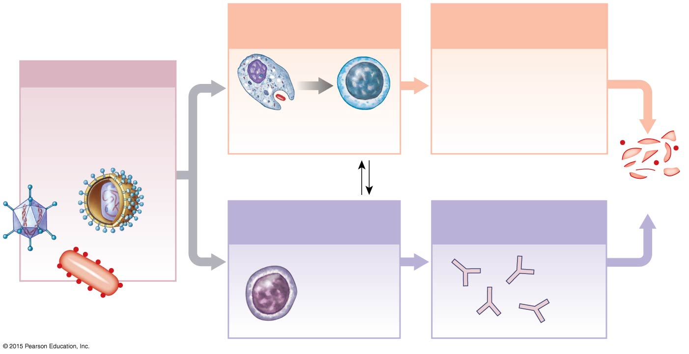
Figure 22-17 An Overview of the Immune Response.
Cell-Mediated
Immunity
Direct Physical and
Chemical Attack
Adaptive Immunity
Activated T cells find
the pathogens and
attack them through
phagocytosis or the
release of chemical
toxins.
Antigen presentation
triggers specific
defenses, or an
immune response.
Phagocytes
activated
T cells
activated
Communication
and feedback
Destruction
of antigens
Antibody-Mediated
Immunity
Attack by Circulating
Antibodies
Activated B
cells give rise
to cells that
produce
antibodies

Slide 135
22-5 T Cells and Immunity
Four Major Types of T Cells
Cytotoxic T cells (also called T_{C} cells)
Attack cells infected by viruses
Responsible for cell-mediated immunity
Memory T cells
Clone more of themselves in response to “remembered” antigen
Helper T cells (also called T_{H} cells)
Stimulate function of T cells and B cells
Suppressor T cells (also called T_{S} cells)
Inhibit function of T cells and B cells

Slide 136
22-5 T Cells and Immunity
Antigen Presentation
T cells only recognize antigens that are bound to glycoproteins in plasma membranes
MHC Proteins
The membrane glycoproteins that bind to antigens
Genetically coded in chromosome 6
The major histocompatibility complex (MHC)
Differs among individuals

Slide 137
22-5 T Cells and Immunity
Two Classes of MHC Proteins
Class I
Found in membranes of all nucleated cells
Class II
Found in membranes of antigen-presenting cells (APCs)
Found in lymphocytes

Slide 138
22-5 T Cells and Immunity
Class I MHC Proteins
Pick up small peptides in cell and carry them to the surface
T cells ignore normal peptides
Abnormal peptides or viral proteins activate T cells to destroy cell

Slide 139
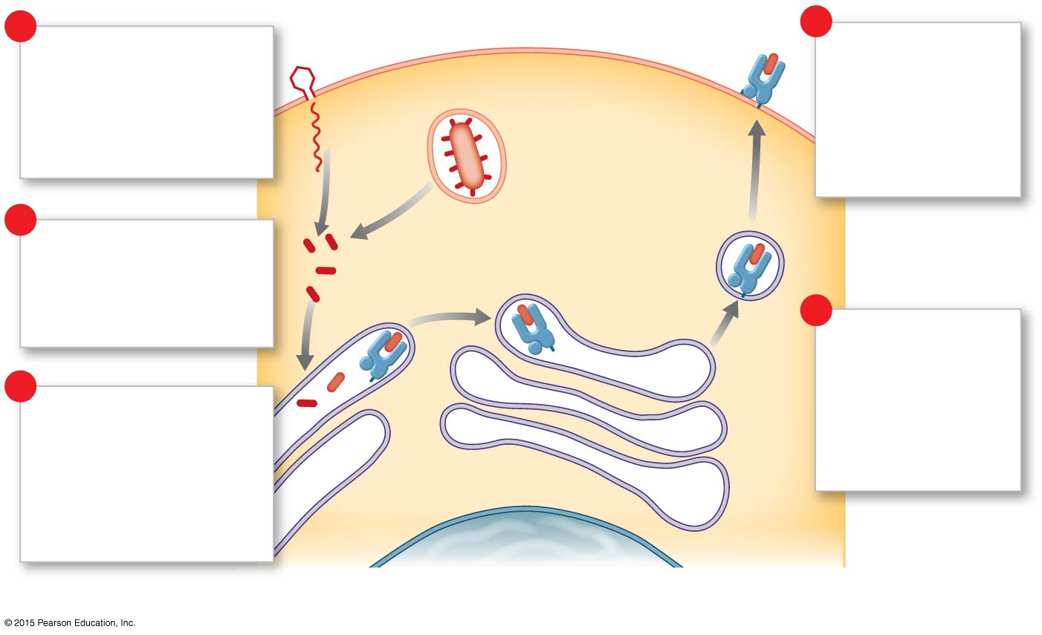
Figure 22-18a Antigens and MHC Proteins.
1
Plasma membrane
5
Antigen presentation
by Class I MHC proteins
is triggered by viral or
bacterial infection of a
body cell.
The abnormal
peptides are
displayed by
Class I MHC
proteins on the
plasma membrane.
Viral or bacterial
pathogen
2
The infection results
in the appearance of
abnormal peptides in
the cytoplasm.
Transport
vesicle
4
After export to the
Golgi apparatus,
the MHC proteins
reach the plasma
membrane within
transport vesicles.
3
The abnormal peptides
are incorporated into
Class I MHC proteins
as they are synthesized
at the endoplasmic
reticulum.
Endoplasmic
reticulum
Nucleus
a
Infected cell.

Slide 140
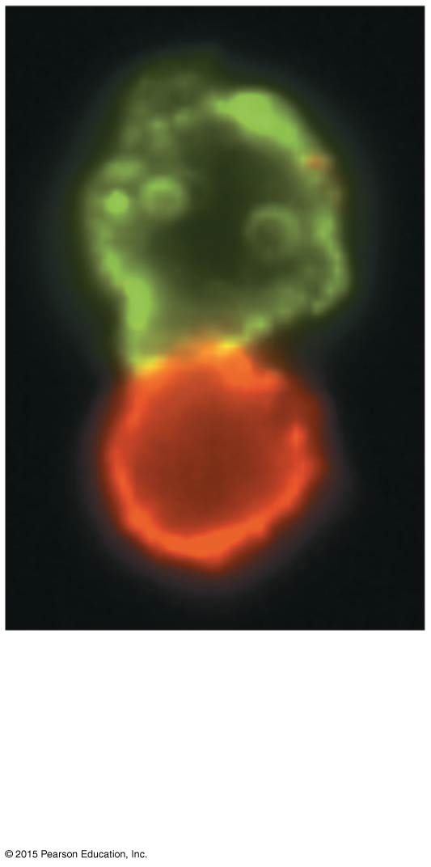
Figure 22-18b Antigens and MHC Proteins.
b
Cells exposed to
fluorescent-tagged
antibodies. The green cell
is an APC and the red cell
is a lymphocyte.

Slide 141
22-5 T Cells and Immunity
Class II MHC Proteins
Antigenic fragments
From antigen processing of pathogens
Bind to Class II proteins
Inserted in plasma membrane to stimulate T cells
Antigen-presenting cells (APCs)
Responsible for activating T cells against foreign cells and proteins

Slide 142
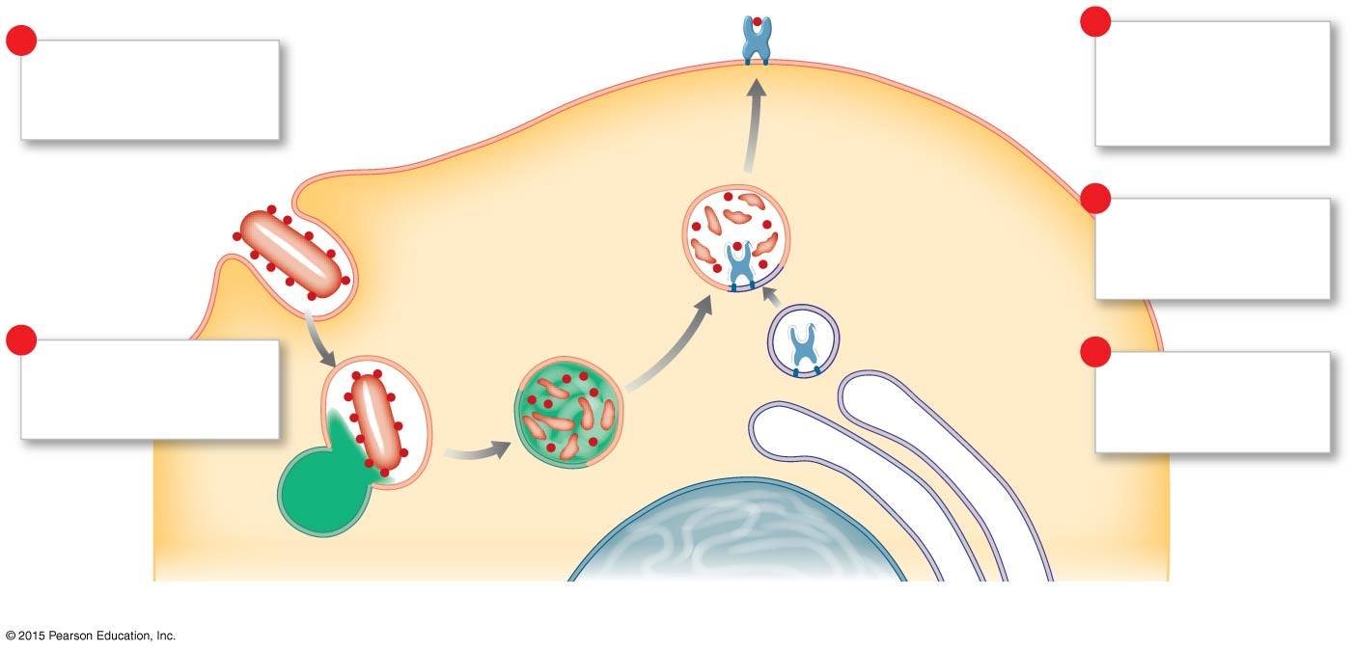
Figure 22-18c Antigens and MHC Proteins.
Plasma
membrane
5
1
Phagocytic APCs
engulf the extracellular
pathogens.
Antigenic fragments
are displayed by Class
II MHC proteins on the
plasma membrane.
4
Antigenic fragments
are bound to Class II
MHC proteins.
2
Lysosomal action
produces antigenic
fragments.
3
The endoplasmic
reticulum produces
Class II MHC proteins.
Lysosome
Nucleus
Endoplasmic
reticulum
c
Phagocytic antigen-presenting cell.

Slide 143
22-5 T Cells and Immunity
Phagocytic APCs
Free and fixed macrophages
In connective tissues
Kupffer cells
Of the liver
Microglia
In the CNS

Slide 144
22-5 T Cells and Immunity
Non-phagocytic APCs
Langerhans cells
In the skin
Dendritic cells
In lymph nodes and spleen

Slide 145
22-5 T Cells and Immunity
Antigen Recognition
Inactive T cell receptors
Recognize Class I or Class II MHC proteins
Recognize a specific antigen
Binding occurs when MHC protein matches antigen

Slide 146
22-5 T Cells and Immunity
CD Markers
Also called cluster of differentiation markers
In T cell membranes
Molecular mechanism of antigen recognition
More than 70 types
Designated by an identifying number
CD3 Receptor Complex
Found in all T cells

Slide 147
22-5 T Cells and Immunity
Two Important CD Markers
CD8 Markers
Found on cytotoxic T cells and suppressor T cells
Respond to antigens on Class I MHC proteins
CD4 Markers
Found on helper T cells
Respond to antigens on Class II MHC proteins
CD8 or CD4 Markers
Bind to CD3 receptor complex
Prepare cell for activation

Slide 148
22-5 T Cells and Immunity
Costimulation
For T cell to be activated, it must be costimulated
By binding to stimulating cell at second site
Which confirms the first signal

Slide 149
22-5 T Cells and Immunity
Activation of CD8 T Cells
Activated by exposure to antigens on MHC proteins
One responds quickly
Producing cytotoxic T cells and memory T cells
The other responds slowly
Producing suppressor T cells

Slide 150
22-5 T Cells and Immunity
Cytotoxic T (T_{C}) Cells
Seek out and immediately destroy target cells
Release perforin
To destroy antigenic plasma membrane
Secrete poisonous lymphotoxin
To destroy target cell
Activate genes in target cell
That cause cell to die

Slide 151
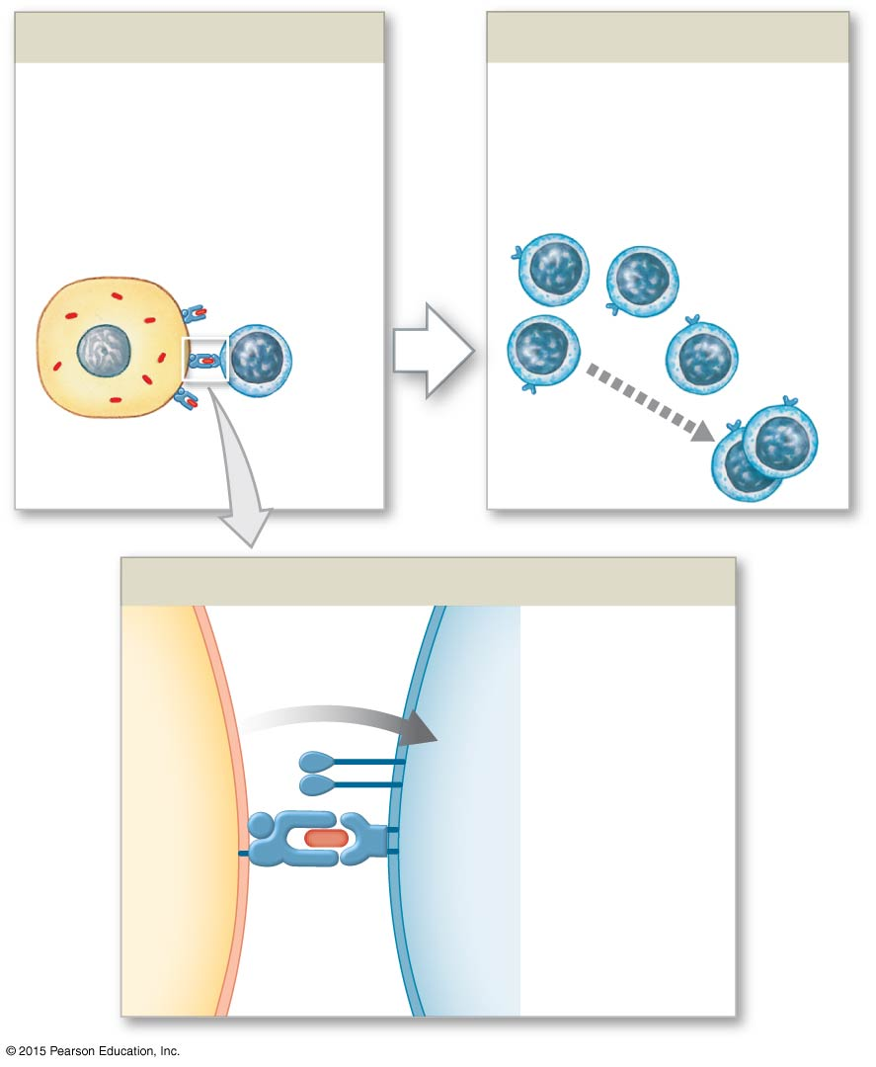
Figure 22-19 Antigen Recognition and Activation of Cytotoxic T Cells (Part 1 of 2).
Antigen Recognition
Activation and Cell Division
Antigen recognition occurs
when a CD8 T cell encounters
an appropriate antigen on
the surface of another cell,
bound to a Class I MHC protein.
Antigen recognition and
costimulation result in T cell
activation and cell division,
producing active T_{C} cells
and memory T_{C} cells.
Infected cell
Active
T_{C} cells
Inactive
CD8
T cell
Viral or
bacterial antigen
Memory T_{C}
cells (inactive)
Costimulation
Costimulation
activates
CD8 T cell
Before activation
can occur, a
T cell must
be chemically
or physically
stimulated by
the abnormal
target cell.
CD8
protein
Class I
MHC
T cell
receptor
Antigen
Infected
cell
CD8
T cell

Slide 152
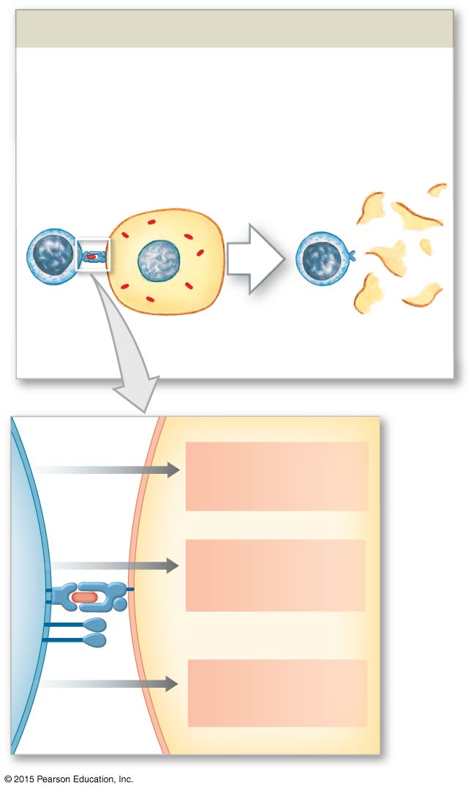
Figure 22-19 Antigen Recognition and Activation of Cytotoxic T Cells (Part 2 of 2).
Destruction of Target Cells
The active T_{C} cell destroys the
antigen-bearing cell. It may use
several different mechanisms to
kill the target cell.
Lysed
cell
Perforin
release
Destruction of
plasma membrane
Cytokine
release
Stimulation of
apoptosis
Disruption of cell
metabolism
Lymphotoxin
release

Slide 153
22-5 T Cells and Immunity
Memory T_{C} Cells
Produced with cytotoxic T cells
Stay in circulation
Immediately form cytotoxic T cells if same antigen appears again

Slide 154
22-5 T Cells and Immunity
Suppressor T Cells
Secrete suppression factors
Inhibit responses of T and B cells
Act after initial immune response
Limit immune reaction to single stimulus

Slide 155
22-5 T Cells and Immunity
Activation of CD4 T cells
Active helper T cells (T_{H} cells)
Secrete cytokines
Memory helper (T_{H}) cells
Remain in reserve

Slide 156
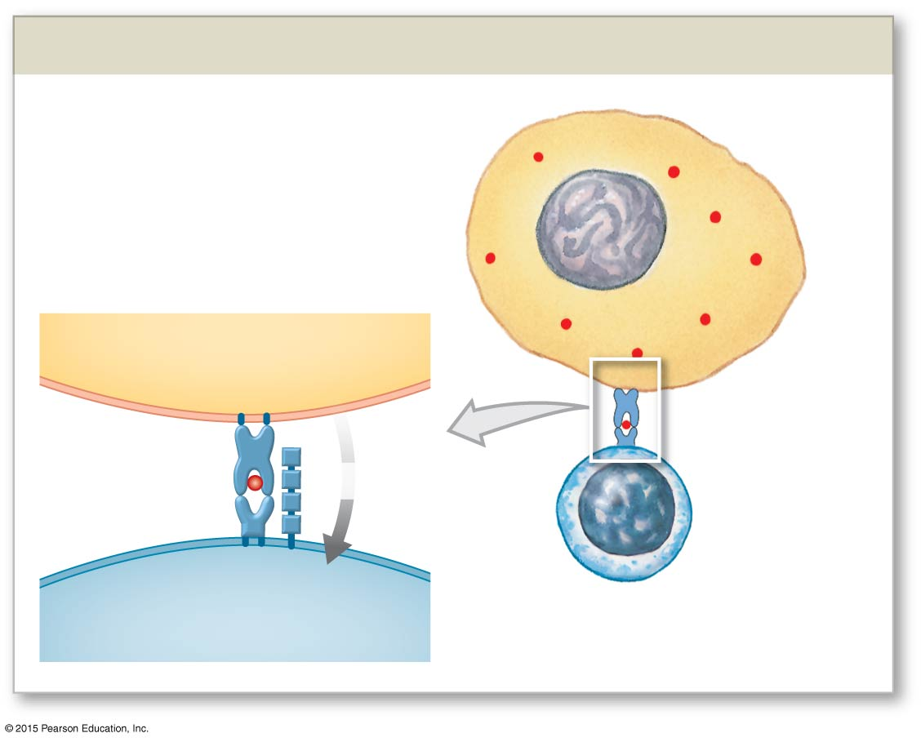
Figure 22-20 Antigen Recognition and Activation of Helper T Cells (Part 1 of 2).
Antigen Recognition by CD4 T Cell
Foreign antigen
Antigen-presenting
cell (APC)
Class II MHC
APC
Antigen
Costimulation
Inactive
CD4 (T_{H})
cell
CD4 protein
T cell receptor
T_{H} cell

Slide 157
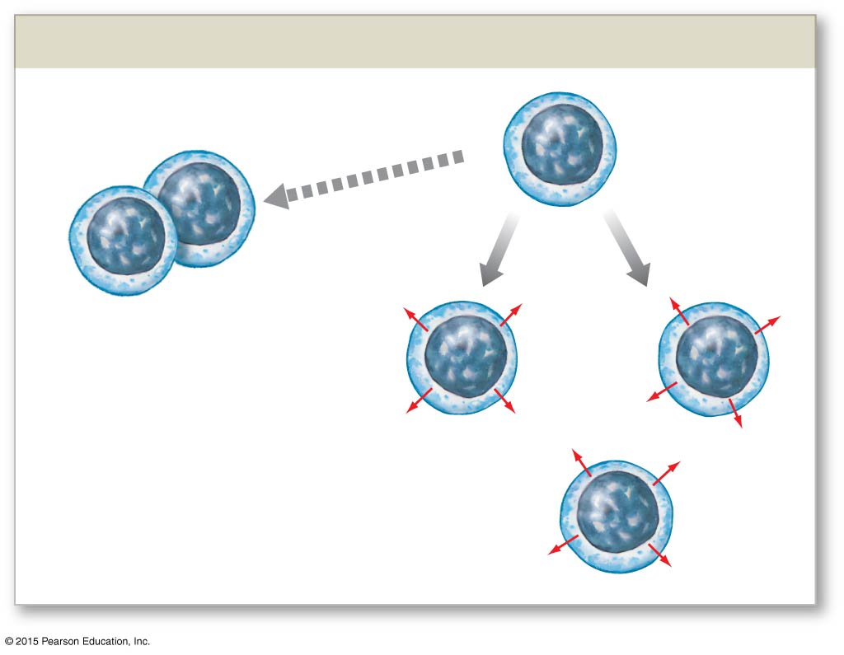
Figure 22-20 Antigen Recognition and Activation of Helper T Cells (Part 2 of 2).
CD4 T Cell Activation and Cell Division
Memory T_{H} cells
(inactive)
Active
T_{H} cells
Cytokines
Cytokines
Active helper T cells secrete
cytokines that stimulate
both cell-mediated and
antibody-mediated immunity.
Cytokines

Slide 158
22-5 T Cells and Immunity
Four Functions of Cytokines
Stimulate T cell divisions
Produce memory T_{H} cells
Accelerate cytotoxic T cell maturation
Attract and stimulate macrophages
Attract and stimulate activity of cytotoxic T cells
Promote activation of B cells

Slide 159
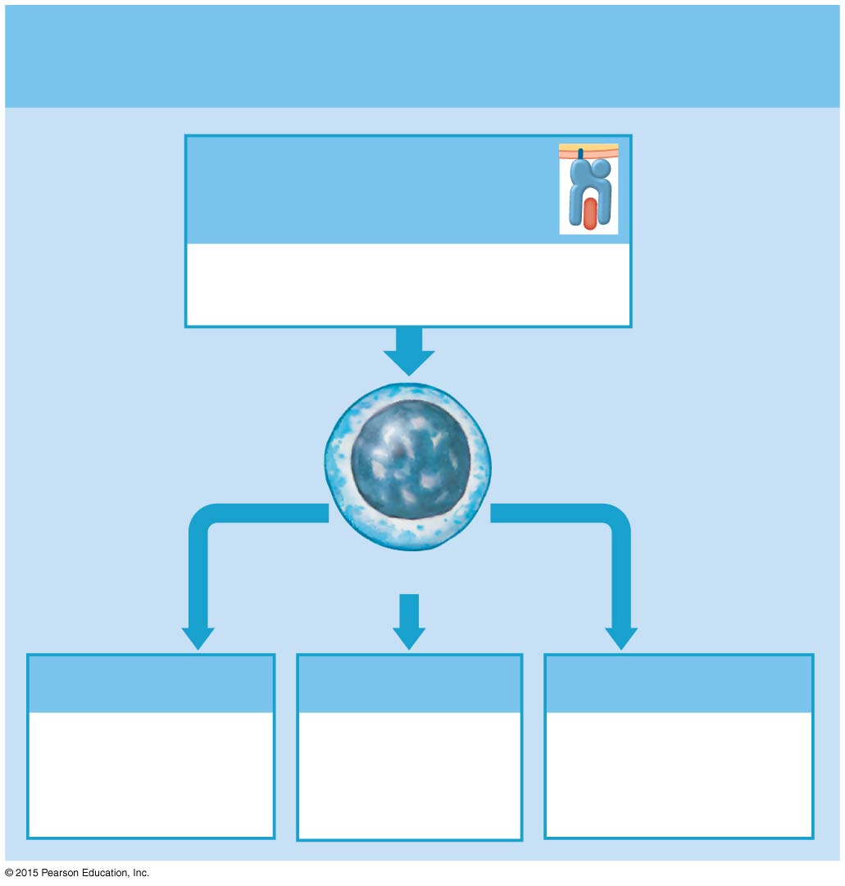
Figure 22-21a A Summary of the Pathways of T Cell Activation.
a
Activation by Class I MHC proteins
Antigen bound to
Class I MHC protein
Indicates that the cell is infected
or otherwise abnormal
CD8 T Cells
Cytotoxic T Cells
Memory T_{C} Cells
Suppressor T Cells
Attack and destroy
infected and
abnormal cells
displaying antigen
Await
reappearance
of the antigen
Control or moderate
immune response by
T cells and B cells

Slide 160
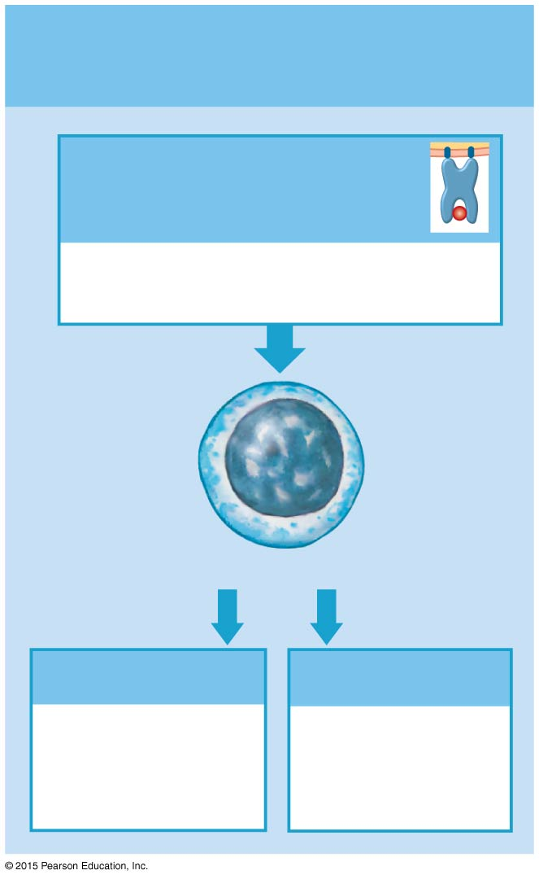
Figure 22-21b A Summary of the Pathways of T Cell Activation.
b
Activation by Class II
MHC proteins
Antigen bound to
Class II MHC protein
Indicates presence of pathogens,
toxins, or foreign proteins
CD4 T Cells
Helper T Cells
Memory T_{H} Cells
Stimulate immune
response by
T cells and B cells
Await
reappearance
of the antigen

Slide 161
22-6 B Cells and Immunity
B Cells
Responsible for antibody-mediated immunity
Attack antigens by producing specific antibodies
Millions of populations, each with different antibody molecules

Slide 162
22-6 B Cells and Immunity
B Cell Sensitization
Corresponding antigens in interstitial fluids bind to B cell receptors
B cell prepares for activation
Preparation process is sensitization
During sensitization, antigens are:
Taken into the B cell
Processed
Reappear on surface, bound to Class II MHC protein

Slide 163
Figure 22-22 The Sensitization and Activation of B Cells (Part 1 of 3).
1
Sensitization
Antigens
Class II MHC
Antibodies
Inactive B cell
Antigens bound to
antibody molecules
Antigen
binding
Sensitized
B cell

Slide 164
22-6 B Cells and Immunity
Helper T Cells
Sensitized B cell is prepared for activation but needs helper T cell activated by same antigen
B Cell Activation
Helper T cell binds to MHC complex
Secretes cytokines that promote B cell activation and division

Slide 165
Figure 22-22 The Sensitization and Activation of B Cells (Part 2 of 3).
2
Activation
Class II MHC
T cell receptor
Antigen
B cell
T cell
Cytokine
costimulation
Helper T cell
Sensitized
B cell

Slide 166
22-6 B Cells and Immunity
B Cell Division
Activated B cell divides into:
Plasma cells
Memory B cells

Slide 167
Figure 22-22 The Sensitization and Activation of B Cells (Part 3 of 3).
3
Division and Differentiation
ANTIBODY
PRODUCTION
Plasma cells
Activated
B cells
Memory B cells
(inactive)

Slide 168
22-6 B Cells and Immunity
Plasma Cells
Synthesize and secrete antibodies into interstitial fluid
Memory B Cells
Like memory T cells, remain in reserve to respond to next infection

Slide 169
22-6 B Cells and Immunity
Antibody Structure
Two parallel pairs of polypeptide chains
One pair of heavy chains
One pair of light chains
Each chain contains:
Constant segments
Variable segments

Slide 170
22-6 B Cells and Immunity
Five Heavy-Chain Constant Segments
Determine five types of antibodies
IgG
IgE
IgD
IgM
IgA

Slide 171
22-6 B Cells and Immunity
Variable Segments of Light and Heavy Chains
Determine specificity of antibody molecule
Binding Sites
Free tips of two variable segments
Form antigen binding sites of antibody molecule
Which bind to antigenic determinant sites of antigen molecule
Antigen–Antibody Complex
An antibody bound to an antigen

Slide 172
22-6 B Cells and Immunity
The Antigen–Antibody Complex
A Complete Antigen
Has at least two antigenic determinant sites
Binds to both antigen-binding sites of variable segments of antibody
B Cell Sensitization
Exposure to a complete antigen leads to:
B cell sensitization
Immune response

Slide 173
22-6 B Cells and Immunity
Hapten (Partial Antigens)
Must attach to a carrier molecule to act as a complete antigen
Dangers of Haptens
Antibodies produced will attack both hapten and carrier molecule
If carrier is “normal”:
Antibody attacks normal cells
For example, penicillin allergy

Slide 174
Figure 22-23a Antibody Structure and Function.
Antigen
binding
site
Heavy
chain
Antigen binding
site
Disulfide
bond
Variable
segment
Light
chain
Complement
binding site
Constant
segments
of light
and heavy
chains
Site of binding
to macrophages
a
A diagrammatic view of the structure of an antibody.

Slide 175
Figure 22-23b Antibody Structure and Function.
Light
chain
Antigen
binding site
Heavy chain
b
A computer-generated image of a typical antibody.

Slide 176
Figure 22-23c Antibody Structure and Function.
Antigenic
determinant
sites
Antigen
Antibodies
c
Antibodies bind to portions of
an antigen called antigenic
determinant sites, or epitopes.

Slide 177
Figure 22-23d Antibody Structure and Function.
Complete
antigen
+
Hapten
Carrier
molecule
d
Antibody molecules can bind a
hapten (partial antigen) once it has
become a complete antigen by
combining with a carrier molecule.

Slide 178
22-6 B Cells and Immunity
Five Classes of Antibodies
Also called immunoglobulins (Igs)
IgG, IgD, IgE, IgM, IgA
Are found in body fluids
Are determined by constant segments
Have no effect on antibody specificity

Slide 179
22-6 B Cells and Immunity
Five Classes of Antibodies
IgG is the largest and most diverse class of antibodies
80 percent of all antibodies
IgG antibodies are responsible for resistance against many viruses, bacteria, and bacterial toxins
Can cross the placenta, and maternal IgG provides passive immunity to fetus during embryological development
Anti-Rh antibodies produced by Rh-negative mothers are also IgG antibodies and produce hemolytic disease of the newborn

Slide 180
22-6 B Cells and Immunity
Five Classes of Antibodies
IgE attaches as an individual molecule to the exposed surfaces of basophils and mast cells
When an antigen is bound by IgE molecules:
The cell is stimulated to release histamine and other chemicals that accelerate inflammation in the immediate area
IgE is also important in the allergic response

Slide 181
22-6 B Cells and Immunity
Five Classes of Antibodies
IgD is an individual molecule on the surfaces of B cells, where it can bind antigens in the extracellular fluid
Binding can play a role in the sensitization of the B cell involved

Slide 182
22-6 B Cells and Immunity
Five Classes of Antibodies
IgM is the first class of antibody secreted after an antigen is encountered
IgM concentration declines as IgG production accelerates
Plasma cells secrete individual IgM molecules, but it polymerizes and circulates as a five-antibody starburst
The anti-A and anti-B antibodies responsible for the agglutination of incompatible blood types are IgM antibodies
IgM antibodies may also attack bacteria that are insensitive to IgG

Slide 183
22-6 B Cells and Immunity
Five Classes of Antibodies
IgA is found primarily in glandular secretions such as mucus, tears, saliva, and semen
Attack pathogens before they gain access to internal tissues
IgA antibodies circulate in blood as individual molecules or in pairs
Epithelial cells absorb them from blood and attach a secretory piece, which confers solubility, before secreting IgA molecules onto the epithelial surface

Slide 184
Table 22-1 Classes of Antibodies (Part 1 of 2).

Slide 185
Table 22-1 Classes of Antibodies (Part 2 of 2).

Slide 186
22-6 B Cells and Immunity
Seven Functions of Antigen–Antibody Complexes
Neutralization of antigen binding sites
Precipitation and agglutination – formation of immune complex
Activation of complement
Attraction of phagocytes
Opsonization increasing phagocyte efficiency
Stimulation of inflammation
Prevention of bacterial and viral adhesion

Slide 187
22-6 B Cells and Immunity
Primary and Secondary Responses to Antigen Exposure
Occur in both cell-mediated and antibody-mediated immunity
First exposure
Produces initial primary response
Next exposure
Triggers secondary response
More extensive and prolonged
Memory cells already primed

Slide 188
22-6 B Cells and Immunity
The Primary Response
Takes time to develop
Antigens activate B cells
Plasma cells differentiate
Antibody titer (level) slowly rises

Slide 189
22-6 B Cells and Immunity
The Primary Response
Peak response
Can take two weeks to develop
Declines rapidly
IgM
Is produced faster than IgG
Is less effective

Slide 190
Figure 22-24a The Primary and Secondary Responses in Antibody-Mediated Immunity.
PRIMARY
RESPONSE
Antibody level
in plasma
IgG
IgM
1
2
3
4
Time (weeks)
a
The primary response takes about two
weeks to develop peak antibody levels
(titers). IgM and IgG antibody levels do
not remain elevated.

Slide 191
22-6 B Cells and Immunity
The Secondary Response
Activates memory B cells
At lower antigen concentrations than original B cells
Secrete antibodies in massive quantities

Slide 192
Figure 22-24b The Primary and Secondary Responses in Antibody-Mediated Immunity.
SECONDARY
RESPONSE
IgG
IgM
1
2
3
4
Time (weeks)
b
The secondary response has a very rapid
increase in IgG antibody concentration
and rises to levels much higher than those
of the primary response. Antibody levels
remain elevated for an extended period
after the second exposure to the antigen.

Slide 193
22-6 B Cells and Immunity
Effects of Memory B Cell Activation
IgG
Rises very high and very quickly
Can remain elevated for extended time
IgM
Production is also quicker
Slightly extended

Slide 194
22-6 B Cells and Immunity
Combined Responses to Bacterial Infection
Neutrophils and NK cells begin killing bacteria
Cytokines draw phagocytes to area
Antigen presentation activates:
Helper T cells
Cytotoxic T cells
B cells activate and differentiate
Plasma cells increase antibody levels

Slide 195
Figure 22-25 The Course of the Body’s Response to a Bacterial Infection.
Neutrophils
Macrophages
Plasma cells
Natural
killer cells
Cytotoxic
T cells
Antibody
level
Number of active immune cells
0
1
2
3
Time (weeks)

Slide 196
22-6 B Cells and Immunity
Combined Responses to Viral Infection
Similar to bacterial infection
But cytotoxic T cells and NK cells are activated by contact with virus-infected cells

Slide 197
Figure 22-27a Defenses against Bacterial and Viral Pathogens.
BACTERIA
Phagocytosis by
macrophages and APCs
Antigen
presentation
Activation of
cytotoxic T cells
Activation of
helper T cells
Activation
of B cells
Antibody
production by
plasma cells
Opsonization
and phagocyte
attraction
Formation of
antigen-antibody
complexes
Destruction of bacteria by
cell lysis or phagocytosis
a
Defenses against bacteria involve phagocytosis
and antigen presentation by APCs.

Slide 198
Figure 22-27b Defenses against Bacterial and Viral Pathogens.
VIRUSES
Infection of
tissue cells
Infection of or uptake
by APCs
Release of
interferons
Appearance of antigen
in plasma membrane
Antigen
presentation
Increased
resistance to
viral infection
and spread
Stimulation
of NK cells
Activation of
cytotoxic T cells
Activation of
helper T cells
Activation
of B cells
Antibody
production by plasma cells
Destruction of
virus-infected cells
Destruction of
viruses or
prevention of
virus entry into cells
b
Defenses against viruses involve direct contact with virus-infected
cells and antigen presentation by APCs.

Slide 199
Table 22-2 Cells That Participate in Tissue Defenses (Part 1 of 2).

Slide 200
Table 22-2 Cells That Participate in Tissue Defenses (Part 2 of 2).

Slide 201
22-7 Immune System Development
Immune System Development
Fetus can produce immune response (has immunocompetence)
After exposure to antigen
At about three to four months

Slide 202
22-7 Immune System Development
Development of Immunocompetence
Fetal thymus cells migrate to tissues that form T cells
Liver and bone marrow produce B cells
Four-month fetus produces IgM antibodies

Slide 203
22-7 Immune System Development
Before Birth
Maternal IgG antibodies
Pass through placenta
Provide passive immunity to fetus
After Birth
Mother’s milk provides IgA antibodies
While passive immunity is lost

Slide 204
22-7 Immune System Development
Normal Resistance
Infant produces IgG antibodies through exposure to antigens
Antibody, B cell, and T cell levels slowly rise to adult levels
About age 12

Slide 205
22-7 Immune System Development
Cytokines of the Immune System
Chemical messengers involved in cellular immunity
Hormones and paracrine-like glycoproteins
Examples of cytokines:
Interferons
Interleukins
Tumor necrosis factors (TNFs)

Slide 206
22-7 Immune System Development
Interleukins
Functions include:
Increasing T cell sensitivity to antigens exposed on macrophage membranes
Stimulating B cell activity, plasma cell formation, and antibody production

Slide 207
22-7 Immune System Development
Interleukins
Functions include:
Enhancing nonspecific defenses
Stimulation of inflammation
Formation of scar tissue by fibroblasts
Elevation of body temperature via the preoptic nucleus of the hypothalamus
Stimulation of mast cell formation
Promotion of adrenocorticotropic hormone (ACTH) secretion by the anterior lobe of the pituitary gland
Moderating the immune response
Some interleukins help suppress immune function and shorten the immune response

Slide 208
22-7 Immune System Development
Interleukins
IL-1 and IL2, are important in stimulating and maintaining the immune response
When released by activated macrophages and lymphocytes, these cytokines stimulate the activities of other immune cells and of the secreting cell
Result is a positive feedback loop that helps to recruit additional immune cells

Slide 209
22-7 Immune System Development
Three Types of Interferons
Alpha-interferons
Produced by leukocytes
Stimulate NK cells
Beta-interferons
Secreted by fibroblasts
Slow inflammation
Gamma-interferons
Secreted by T cells and NK cells
Stimulate macrophage activity

Slide 210
Figure 22-13 Interferons.
Interferon alpha (α) is produced by cells infected with viruses. They attract and stimulate NK cells and enhance resistance to viral infection.
Interferon beta (β) is secreted by fibroblasts and slows inflammation in a damaged area.
Interferon gamma (γ) is secreted by T cells and NK cells and stimulates macrophage activity.

Slide 211
22-7 Immune System Development
Tumor Necrosis Factors (TNFs)
TNFs slow the growth of a tumor and kill sensitive tumor cells
Activated macrophages secrete one type of TNF and carry the molecules in their plasma membranes
Cytotoxic T cells produce a different type of TNF
In addition to their effects on tumor cells:
TNFs stimulate granular leukocyte production, promote eosinophil activity, cause fever, and increase T cell sensitivity to interleukins

Slide 212
22-7 Immune System Development
Phagocyte-Activating Chemicals
Several cytokines coordinate immune defenses by adjusting the activities of phagocytic cells
Include factors that attract free macrophages and microphages and prevent their premature departure from the site of an injury
Colony-Stimulating Factors
Factors are produced by active T cells, cells of the monocyte–macrophage system, endothelial cells, and fibroblasts
CSFs stimulate the production of blood cells in red bone marrow and lymphocytes in lymphoid tissues and organs

Slide 213
22-7 Immune System Development
Cytokines Are Often Classified According to Their Origins
Lymphokines are produced by lymphocytes
Monokines are secreted by active macrophages and other antigen-presenting cells
These terms are misleading, because lymphocytes and macrophages may secrete the same cytokines
Cells involved in adaptive immunity and tissue repair can also secrete cytokines

Slide 214
22-7 Immune System Development
Immune Disorders
Autoimmune disorders
Immunodeficiency disease
Allergies

Slide 215
22-7 Immune System Development
Autoimmune Disorders
A malfunction of system that recognizes and ignores “normal” antigens
Activated B cells make autoantibodies against body cells
Examples:
Thyroiditis
Rheumatoid arthritis
Insulin-dependent diabetes mellitus (IDDM)

Slide 216
22-7 Immune System Development
Immunodeficiency Diseases
Result from:
Problems with embryological development of lymphoid tissues
Can result in severe combined immunodeficiency disease (SCID)
Viral infections such as HIV
Can result in AIDS
Immunosuppressive drugs or radiation treatments
Can lead to complete immunological failure

Slide 217
22-7 Immune System Development
Allergies
Inappropriate or excessive immune responses to antigens
Allergens
Antigens that trigger allergic reactions

Slide 218
22-7 Immune System Development
Four Categories of Allergic Reactions
Immediate hypersensitivity (Type I)
Cytotoxic reactions (Type II)
Immune complex disorders (Type III)
Delayed hypersensitivity (Type IV)

Slide 219
22-7 Immune System Development
Type I Allergy
Also called immediate hypersensitivity
A rapid and severe response to the presence of an antigen
Most commonly recognized type of allergy
Includes allergic rhinitis (environmental allergies)

Slide 220
22-7 Immune System Development
Type I Allergy
Sensitization leads to:
Production of large quantities of IgE antibodies distributed throughout the body
Second exposure leads to:
Massive inflammation of affected tissues

Slide 221
22-7 Immune System Development
Type I Allergy
Severity of reaction depends on:
Individual sensitivity
Locations involved
Allergens (antigens that trigger reaction) in bloodstream may cause anaphylaxis

Slide 222
22-7 Immune System Development
Anaphylaxis
Can be fatal
Affects cells throughout body
Changes capillary permeability
Produces swelling (hives) on skin
Smooth muscles of respiratory system contract
Make breathing difficult
Peripheral vasodilation
Can cause circulatory collapse (anaphylactic shock)

Slide 223
Figure 22-29 The Mechanism of Anaphylaxis (Part 1 of 2).
First
Exposure
Allergen fragment
Allergens
Macrophage
T_{H} cell activation
B cell sensitization
and activation
Plasma cell
IgE antibodies

Slide 224
Figure 22-29 The Mechanism of Anaphylaxis (Part 2 of 2).
Subsequent
Exposure
IgE
Allergen
Granules
Sensitization of
mast cells and
basophils
Massive
stimulation of
mast cells
and basophils
Release of histamines, leukotrienes,
and other chemicals that
cause pain and inflammation
Capillary dilation, increased capillary
permeability, airway constriction,
mucus secretion, pain and itching

Slide 225
22-7 Immune System Development
Antihistamines
Drugs that block histamine released by mast cells
Can relieve mild symptoms of immediate hypersensitivity
Benadryl

Slide 226
22-7 Immune System Development
Stress and the Immune Response
Glucocorticoids
Secreted to limit immune response
Long-term secretion (chronic stress)
Inhibits immune response
Lowers resistance to disease

Slide 227
22-7 Immune System Development
Functions of Glucocorticoids
Depression of the inflammatory response
Reduction in abundance and activity of phagocytes
Inhibition of interleukin secretion

Slide 228
22-8 Effects of Aging on the Immune System
Immune System Diminishes with Age
Increasing vulnerability to infections and cancer
Four Effects of Aging
Thymic hormone production is greatly reduced
T cells become less responsive to antigens
Fewer T cells reduces responsiveness of B cells
Immune surveillance against tumor cells declines

Slide 229
22-9 Immune System Integration
Nervous and Endocrine Systems
Interact with thymic hormones
Adjust sensitivity of immune response

Slide 230
Figure 22-30 diagrams the functional relationships between the lymphatic system and the other body systems we have studied so far.
SYSTEM INTEGRATOR
Body System
Lymphatic System
Lymphatic System
Body System
Provides physical barriers to pathogen entry;
macrophages in dermis resist infection and
present antigens to trigger immune
response; mast cells trigger inflammation,
mobilize cells of lymphatic system
Provides IgA antibodies for secretion
onto integumentary surfaces
Integumentary
Integumentary
Page 174
Lymphocytes and other cells
involved in the immune response are
produced and stored in red bone
marrow
Assists in repair of bone after
injuries; osteoclasts differentiate
from monocyte–macrophage cell line
Skeletal
Skeletal
Page 285
Protects superficial lymph nodes and
the lymphatic vessels in the
abdominopelvic cavity; muscle
contractions help propel lymph along
lymphatic vessels
Assists in repair after injuries
Muscular
Muscular
Page 380
Microglia present antigens that
stimulate adaptive defenses; glial
cells secrete cytokines; innervation
stimulates antigen-presenting cells
Cytokines affect hypothalamic
production of CRH and TRH
Nervous
Nervous
Page 558
Glucocorticoids have
anti-inflammatory effects; thymosins
stimulate development and maturation
of lymphocytes (T cells); many
hormones affect immune function
Thymus secretes thymosins;
cytokines affect cells
throughout the body
Endocrine
Endocrine
Page 647
Cardiovascular
Distributes WBCs; carries antibodies that
attack pathogens; clotting response
helps restrict spread of pathogens;
granulocytes and lymphocytes
produced in red bone marrow
Fights infections of
cardiovascular organs;
returns interstitial fluid to
circulation
Cardiovascular
Page 776
The LYMPHATIC System
For all body systems, the lymphatic system
provides adaptive (specific) immunity
against infection. The lymphatic system
is an anatomically distinct system. In
comparison, the immune system is a
physiological system that includes the
lymphatic system, as well as components of
the integumentary, skeletal, cardiovascular, respiratory, digestive, and other body
systems. through immune surveillance, pathogens are continuously eliminated
throughout the body.
Respiratory
Page 874
Gonads—ovaries in females and testes in
males—are organs that produce gametes
(sex cells). LH and FSH, hormones secreted
by the anterior lobe of the pituitary gland,
affect these organs. The ovaries and testes
are discussed further in Chapter 28.
Digestive
Gonads—ovaries in females and testes in males—are organs that produce gametes (sex cells). LH and FSH, hormones secreted by the anterior lobe of the pituitary gland, affect these organs. The ovaries and testes are discussed further in Chapter 28.
Page 929
Urinary
Page 1010
Reproductive
Page 1090

