Slide 1
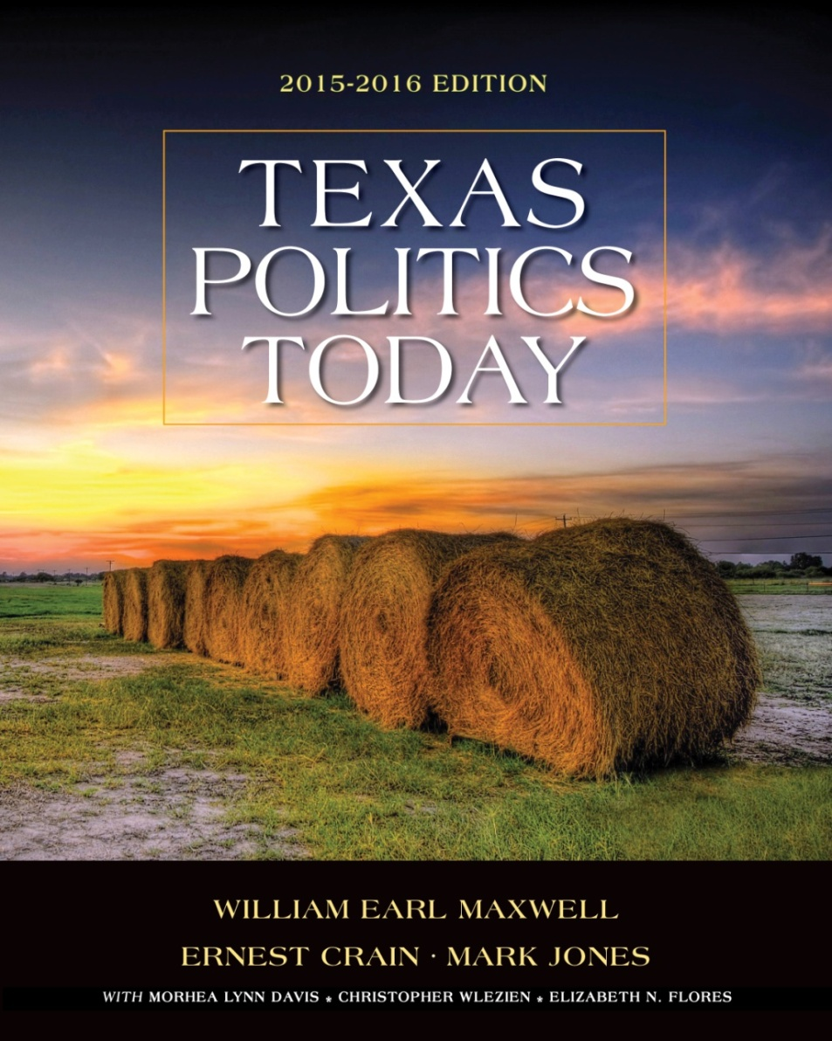
Chapter 11
Local Government

Slide 2
learning objectives
LO 11.1 Describe and evaluate the organization and structure of municipal governments.
LO 11.2 Describe and evaluate the organization and structure of county governments.
LO 11.3 Describe and evaluate the organization and structure of special-district governments.
LO 11.4 Evaluate the role of councils of governments as local government partners.
LO 11.5 Apply what you have learned about local government.

Slide 3
LOCAL GOVERNMENT
Anyone who lives in a metropolitan area is likely to be governed by
Local governments
municipal and county
not considered special districts
Special districts
school, hospital, transit, utility
Notes:
Charter: The organizing document for a municipality.
According to the Texas Municipal League, the vast majority of Texas cities—about 75 percent—are general-law cities.

Slide 4
LOCAL GOVERNMENT
All local governments are bound by federal laws, state laws, and the U.S. Constitution.
Counties, Special Districts, School Districts are creatures of the state and have only as much power as the Texas Constitution and Texas legislature grant them.
Notes:
Charter: The organizing document for a municipality.
According to the Texas Municipal League, the vast majority of Texas cities—about 75 percent—are general-law cities.

Slide 5
LOCAL GOVERNMENT
The relationship between states and local governments follows from the fact that states have a unitary system of government.
Notes:
Charter: The organizing document for a municipality.
According to the Texas Municipal League, the vast majority of Texas cities—about 75 percent—are general-law cities.

Slide 6
Local Governments and Public School Systems, United States And Texas, 2012
How is it possible for ordinary voters to keep track of the numerous elected officials that they elect to local offices? How can government be simplified to best serve citizens?
Notes:
Table 11.1
Source: U.S. Census Bureau, 2012 Census of Governments, Local Governments by Type and State: 2012 at http://factfinder2.census.gov/faces/tableservices/jsf/pages/productview.xhtml?src=bkmk.
How is it possible for ordinary voters to keep track of the numerous elected officials that they elect to local offices?

Slide 7
MUNICIPALITIES
General-Law and Home-Rule Cities
General-law city—a city with a population of 5,000 or fewer that is limited in the subject matter upon which it may legislate
Home-rule city—a city with a population greater than 5,000 that can adopt its own charter using any organizational structure that complies with state law
Notes:
Charter: The organizing document for a municipality.
According to the Texas Municipal League, the vast majority of Texas cities—about 75 percent—are general-law cities.

Slide 8
MUNICIPALITIES
General-Law and Home-Rule Cities (cont.)
Direct democracy at the municipal level
Home rule allows local voters to participate directly through:
Initiative
allows registered voters to force a sometimes reluctant city council to place a proposed ordinance on the ballot?

Slide 9
MUNICIPALITIES
General-Law and Home-Rule Cities (cont.)
Examples of initiative include cities
limiting the sale of beer and wine
freezing property taxes for seniors and people with disabilities
increasing the minimum wage
placing a cap on property tax rates
Referendum
Recall
The limits of home rule

Slide 10
MUNICIPALITIES
General-Law and Home-Rule Cities (cont.)
Referendum
Voters who wish to repel an existing ordinance can petition the council to hold a referendum election.
Recall
The limits of home rule

Slide 11
MUNICIPALITIES
General-Law and Home-Rule Cities (cont.)
Recall
Voters in home-rule cities permitted to remove the mayor or a member of the council.
Recalled members of a city council must step down once the election results are certified.
Not used in general-rule cities.

Slide 12
MUNICIPALITIES
General-Law and Home-Rule Cities (cont.)
The limits of home rule
State law determines the specific dates for municipal elections.
Local government is subject to sunshine laws.
Cities may hold charter elections only every 2 years
State constitution may be amended to invalidate local ordinance

Slide 13
Municipal Governments In Texas, 1952–2012
What factors should mayors and city councils take into consideration when prioritizing the needs of their communities?
Notes:
Table 11.2
Source: U.S. Census Bureau, 2012 Census of Governments, Municipal Governments, General-Purpose Local Governments by State: Census Years 1942 to 2012 at http://factfinder2.census.gov/faces/tableservices/jsf/pages/productview.xhtml?src=bkmk

Slide 14
MUNICIPALITIES
Forms of Municipal Government
Council-Manager system
The two largest Texas cities with council-manager form of government are San Antonio and Dallas.
Council-manager government was initiated as part of a reform movement during the Progressive Era.
The city manager is responsible for both executing council policies and managing the day-to-day operations of city government.
The powers of the city manager come from
the city charter.
Notes:
Mayor-council system: A form of municipal government consisting of a mayor and a city council; this form includes both strong-mayor and weak-mayor variations.
Strong-mayor form of government: A form of municipal government in which the mayor, who is chosen in a citywide election, is both the chief executive and the leader of the city council.
Weak-mayor form of government: A form of municipal government in which the mayor and council share administrative authority.
Commission form of government: A municipal government in which voters elect one set of officials who act as both executives and legislators. The commissioners, sitting together, are the municipal legislature, but individually each administers a city department.

Slide 15
MUNICIPALITIES
Forms of Municipal Government
Mayor-Council system
The two largest Texas cities with a mayor-council form of government are Houston and Pasadena.
Notes:
Mayor-council system: A form of municipal government consisting of a mayor and a city council; this form includes both strong-mayor and weak-mayor variations.
Strong-mayor form of government: A form of municipal government in which the mayor, who is chosen in a citywide election, is both the chief executive and the leader of the city council.
Weak-mayor form of government: A form of municipal government in which the mayor and council share administrative authority.
Commission form of government: A municipal government in which voters elect one set of officials who act as both executives and legislators. The commissioners, sitting together, are the municipal legislature, but individually each administers a city department.

Slide 16
MUNICIPALITIES
Forms of Municipal Government
Mayor-Council system
The strong-mayor form
In the strong-mayor system, the mayor is responsible for administration of city policy.
Restrictions on the powers of the mayor in some strong-mayor council systems of government include nonpartisan elections, ethics, and campaign finance laws.
Notes:
Mayor-council system: A form of municipal government consisting of a mayor and a city council; this form includes both strong-mayor and weak-mayor variations.
Strong-mayor form of government: A form of municipal government in which the mayor, who is chosen in a citywide election, is both the chief executive and the leader of the city council.
Weak-mayor form of government: A form of municipal government in which the mayor and council share administrative authority.
Commission form of government: A municipal government in which voters elect one set of officials who act as both executives and legislators. The commissioners, sitting together, are the municipal legislature, but individually each administers a city department.

Slide 17
MUNICIPALITIES
Forms of Municipal Government
Mayor-Council system
The weak-mayor form
power is decentralized, the mayor and council share administrative authority.
Commission system
Voters elect one set of officials who act as both executives and legislators. The commissioners, sitting together, are the municipal legislature, but individually each administers a city department.
Notes:
Mayor-council system: A form of municipal government consisting of a mayor and a city council; this form includes both strong-mayor and weak-mayor variations.
Strong-mayor form of government: A form of municipal government in which the mayor, who is chosen in a citywide election, is both the chief executive and the leader of the city council.
Weak-mayor form of government: A form of municipal government in which the mayor and council share administrative authority.
Commission form of government: A municipal government in which voters elect one set of officials who act as both executives and legislators. The commissioners, sitting together, are the municipal legislature, but individually each administers a city department.

Slide 18
Common Forms of Municipal Government
Notes:
Figure 11.1 This figure shows the four major forms of city government. Although voters are the ultimate
authority in each type, scholars argue that some types are more efficient and responsive to residents’ needs.
What measures can the public take to make their views known to city officials in a way that makes city hall more accountable to the people?

Slide 19
MUNICIPALITIES
Municipal Election Systems
Nonpartisan elections
In Texas, all city elections are nonpartisan
political parties do not
nominate candidates below the county level.
mention party affiliation on the ballot.
increase voter turnout in the municipal and special district elections.

Slide 20
MUNICIPALITIES
Municipal Election Systems
Cities have choice to use at-large and single-member district systems
A majority of U.S. cities have
council-manager form of government.
at-large elections.
powers of initiative and recall.

Slide 21
MUNICIPALITIES
Municipal Election Systems
Election System Options
At-large elections
Pure at-large system
candidates for city council run citywide and the top vote getters are elected to fill the number of open seats.
At-large place system
candidates for city council run citywide and the top vote getters are elected to fill the number of open seats.
Notes:
Pure at-large system: An election system in which candidates for city council run citywide and the top vote getters are elected to fill the number of open seats.
At-large place system: An election system in which each candidate runs citywide for a specific seat on the council and voters cast one vote for each seat or place.
Single-member districts: An electoral system in which each council member is elected from a particular geographical district by only the voters who live in that district.

Slide 22
MUNICIPALITIES
Municipal Election Systems
Election System Options
Single-member districts
each council member is elected from a particular geographical district by only the voters who live in that district
the primary means of increasing minority representation on city councils
Notes:
Pure at-large system: An election system in which candidates for city council run citywide and the top vote getters are elected to fill the number of open seats.
At-large place system: An election system in which each candidate runs citywide for a specific seat on the council and voters cast one vote for each seat or place.
Single-member districts: An electoral system in which each council member is elected from a particular geographical district by only the voters who live in that district.

Slide 23
MUNICIPALITIES
Municipal Election Systems
Many cities, including Houston, have established term limits for the mayor and city council.
Based on the idea that city hall is best governed by new blood and fresh ideas and that limiting the number of terms for council members is the best way to achieve that goal.
Notes:
Pure at-large system: An election system in which candidates for city council run citywide and the top vote getters are elected to fill the number of open seats.
At-large place system: An election system in which each candidate runs citywide for a specific seat on the council and voters cast one vote for each seat or place.
Single-member districts: An electoral system in which each council member is elected from a particular geographical district by only the voters who live in that district.

Slide 24
MUNICIPALITIES
Revenue Sources and Limitations
Sources and amount of revenue used to meet a city’s budget depend on:
Size of the city’s population
Amount and type of taxes a city is allowed and willing to levy
Total assessed value of taxable property
Needs of the residents

Slide 25
Texas Municipal Finances: General Revenue and Expenditures
What factors determine the budget priorities of municipal governments?
Notes:
Figure 11.2 These charts show where Texas municipalities get their revenues and how they spend them. The largest source of city revenue is the property tax, followed by sales taxes, and various fees. The majority of municipal expenditures are for protective services such as police, fire, and emergency medical services.
Source: Based on http://www.tml.org/HCW/WhereCitiesGetMoney.pdf
What factors determine the budget priorities of municipal governments?

Slide 26
MUNICIPALITIES
Fix The Streets
Catch The Crooks
Fix The Streets
Balance The Budget
Notes:
Rollback election: An election to limit an increase in the property tax rate to no more than 8 percent above that required for increased debt service.
User fees: Fees paid by the individuals who receive a particular government service.
Public debt: Money owed by government, ordinarily through the issuance of bonds. Local governments issue bonds to finance major projects with voter approval.

Slide 27
MUNICIPALITIES
Revenue Sources and Limitations (cont.)
Sales taxes
Property taxes
Property appraisals in all local governments are done by the countywide appraisal authority.
Limits on property taxes
The maximum property tax rate of a general-law city is $1.50 per $100 of the assessed value of a city’s property.
Notes:
Rollback election: An election to limit an increase in the property tax rate to no more than 8 percent above that required for increased debt service.
User fees: Fees paid by the individuals who receive a particular government service.
Public debt: Money owed by government, ordinarily through the issuance of bonds. Local governments issue bonds to finance major projects with voter approval.

Slide 28
MUNICIPALITIES
Revenue Sources and Limitations (cont.)
Home-rule municipalities can set property tax rates as high as $2.50 per $100 of assessed value.
Some Texas cities have taken measures to limit increases in property taxes by issuing a property tax revenue cap and/or freezing property taxes for the disabled and the elderly.
Texas Property Tax Rates
http://www.tax-rates.org/texas/property-tax
Notes:
Rollback election: An election to limit an increase in the property tax rate to no more than 8 percent above that required for increased debt service.
User fees: Fees paid by the individuals who receive a particular government service.
Public debt: Money owed by government, ordinarily through the issuance of bonds. Local governments issue bonds to finance major projects with voter approval.

Slide 29
MUNICIPALITIES
Revenue Sources and Limitations (cont.)
Rollback elections
An election where voters in non-school district jurisdictions limit an increase in the property tax rate to no more than 8 percent above that required for increased debt service.
Notes:
Rollback election: An election to limit an increase in the property tax rate to no more than 8 percent above that required for increased debt service.
User fees: Fees paid by the individuals who receive a particular government service.
Public debt: Money owed by government, ordinarily through the issuance of bonds. Local governments issue bonds to finance major projects with voter approval.

Slide 30
MUNICIPALITIES
Revenue Sources and Limitations (cont.)
User fees
Fees paid by the individuals who receive a particular government service.
Garbage, water, electricity, ambulance service
Notes:
Rollback election: An election to limit an increase in the property tax rate to no more than 8 percent above that required for increased debt service.
User fees: Fees paid by the individuals who receive a particular government service.
Public debt: Money owed by government, ordinarily through the issuance of bonds. Local governments issue bonds to finance major projects with voter approval.

Slide 31
MUNICIPALITIES
Revenue Sources and Limitations (cont.)
Public debt
Money owed by government, ordinarily through the issuance of bonds.
Bonds often issued for major projects
must be approved by the voters in a referendum
City services, public assistance, roads, buildings, public facilities, health care
Notes:
Rollback election: An election to limit an increase in the property tax rate to no more than 8 percent above that required for increased debt service.
User fees: Fees paid by the individuals who receive a particular government service.
Public debt: Money owed by government, ordinarily through the issuance of bonds. Local governments issue bonds to finance major projects with voter approval.

Slide 32
MUNICIPALITIES
Municipalities: Issues, Trends and Controversies
Population growth and demographic change
Economic development
Government mandates
Federal and state
Have increased (particularly federal)

Slide 33
MUNICIPALITIES
Municipalities: Issues, Trends and Controversies
Annexation
A policy that permits a city to bring unincorporated areas into the city’s jurisdiction.
Texas annexation policy has allowed big cities in Texas to suffer less than many other U.S. cities from “white flight,” urban decay, the evacuation of industry, and declining tax bases
Notes:
Annexation: A policy that permits a city to bring unincorporated areas into the city’s jurisdiction.
Extraterritorial jurisdiction (ETJ): A buffer area that extends beyond a city’s limits.
Colonias: Severely impoverished unincorporated areas along the Texas–Mexico border with a multitude of problems, including substandard housing, unsanitary drinking water, and lack of proper sewage disposal.

Slide 34
MUNICIPALITIES
Municipalities: Issues, Trends and Controversies
Extraterritorial jurisdiction
Using this power Texas cities can keep from being boxed in by suburban “bedroom” cities.
Colonias
Most are along the U.S.–Mexico border.
A severely impoverished unincorporated area.
About 1,800 colonias in Texas.
Notes:
Annexation: A policy that permits a city to bring unincorporated areas into the city’s jurisdiction.
Extraterritorial jurisdiction (ETJ): A buffer area that extends beyond a city’s limits.
Colonias: Severely impoverished unincorporated areas along the Texas–Mexico border with a multitude of problems, including substandard housing, unsanitary drinking water, and lack of proper sewage disposal.

Slide 35
MUNICIPALITIES
Municipalities: Issues, Trends and Controversies
City Hall and Social Issues
HERO
Sanctuary City
Notes:
Annexation: A policy that permits a city to bring unincorporated areas into the city’s jurisdiction.
Extraterritorial jurisdiction (ETJ): A buffer area that extends beyond a city’s limits.
Colonias: Severely impoverished unincorporated areas along the Texas–Mexico border with a multitude of problems, including substandard housing, unsanitary drinking water, and lack of proper sewage disposal.

Slide 36
MUNICIPALITIES
Of the ten largest cities in the United States, Texas is home to how many?

Slide 37
MUNICIPALITIES
Houston
San Antonio
Dallas

Slide 38
COUNTIES
Functions of Counties
local government that also serves as an administrative arm of the state.
Counties do not have Home Rule
Structure and Organization of Counties
Commissioner’s court
The commissioners court acts as a legislature
with limited authority to approve the budget for all county operations.
to set the tax rate.
to pass ordinances on a narrow range of policies.
Notes:
County governments: General-purpose local government that also serves as an administrative arm of the state.

Slide 39
COUNTIES
Structure and Organization of Counties
County judge
chief county executive
presides over commissioner’s court
can perform marriage ceremonies
serves as the head of civil defense
conducts hearings for beer and wine permits
Notes:
County governments: General-purpose local government that also serves as an administrative arm of the state.

Slide 40
COUNTIES
Structure and Organization of Counties
Sheriff
law enforcement in the county
hires deputies
operates county jail, but not city jails
delivers and executes court papers
Constables
serve as the process officer of justice of the peace courts and also has general law enforcement powers?
Tax assessor-collector
most important county financial officer
Notes:
County governments: General-purpose local government that also serves as an administrative arm of the state.

Slide 41
Texas County Officials Elected by Voters
Should counties have fewer elected offices and nonpartisan elections, as is the case with Texas municipalities? Or do counties provide greater accountability with a divided executive structure in which voters elect numerous county administrators?
Notes:
Figure 11.3 Each of the 254 Texas counties has several officials, each of whom is independently elected in
partisan elections.
Should counties have fewer elected offices and nonpartisan elections, as is the case with Texas municipalities? Or do counties provide greater accountability with a divided executive structure in which voters elect numerous county
administrators?

Slide 42
counties
Structure and Organization of Counties
County treasurer
County auditor
County clerk
District clerk
County or district attorneys

Slide 43
counties
Counties: Issues, Trends, and Controversies
Long ballot: Reformers recommend a short ballot with fewer elected county officials.
It would simplify structure with a single-county executive, which would allow voter to hold one high-profile officer accountable.
A chief county executive could coordinate county programs.
Would enable long-range planning and eliminate duplication among various county offices.
Notes:
Unit road system: A system that concentrates the day-to-day responsibilities for roads in the hands of a professional engineer rather than individual county commissioners.
Consolidation: The merging of county government with other local governments to form a single local government.

Slide 44
counties
Counties: Issues, Trends, and Controversies
Constitutional rigidity
Long ballot
Unit road system
Spoils system vs. merit system
Elected officials use spoils system to hire county employees
Consolidation
merging or joining of responsibilities by county and other local governments.
Notes:
Unit road system: A system that concentrates the day-to-day responsibilities for roads in the hands of a professional engineer rather than individual county commissioners.
Consolidation: The merging of county government with other local governments to form a single local government.

Slide 45
SPECIAL-DISTRICT GOVERNMENTS
Special-District Governments
Local governments that provide single services not provided by counties or cities
Airport authorities
Hospital authorities
Municipal utility districts
Metropolitan transit authorities

Slide 46
Special Districts In Texas, 1952–2012
What are the benefits of having a specialized approach to providing government services? What are the drawbacks?
Notes:
Table 11.4 Special districts have been on the rise since the mid-twentieth century. Some special districts have their own elected governing boards that have the authority to impose a property tax.
Source: U.S. Census Bureau, List and Structure of Governments: Number of Special Districts , www.census.gov/govs/go/number_of_special_districts_by_county.html .

Slide 47
Cities and Counties Served by Public Transportation Systems
Should Texas cities invest more in public transportation?
Notes:
Figure 11.4
Source: Texas Department of Transportation, http://ftp.dot.state.tx.us/pub/txdot-info/ptn/small_urban_map.pdf.
Should Texas cities invest more in public transportation? What factors are likely to encourage the public to use mass transit?

Slide 48
SPECIAL-DISTRICT GOVERNMENTS
Reasons for Creating Special District Governments
Limited revenue
Reaching state-mandated sales tax ceiling
Only a small area may need the service
Demand for service may extend beyond a single jurisdiction

Slide 49
SPECIAL-DISTRICT GOVERNMENTS
Special Districts: Issues, Trends and Controversies
All of the following are criticisms of special-district governments:
too small to achieve public attention.
too numerous to be held accountable.
too small to be efficient.

Slide 50
COUNCILS OF GOVERNMENTS
Councils of Government (COGs)
Voluntary regional groupings of local governments
Attempt to coordinate government activities
Share information
Notes:
Councils of governments (COGs): Advisory bodies consisting of representatives of various local governments brought together for the purposes of regional planning and cooperation.

Slide 51
Houston taps emergency water
Click picture to view video

Slide 52
video discussion questions
What role do special districts play in delivering water services to residents?
Who determines water priorities when there are conflicting interests?
When the water supply is limited, should it cost more? Why or why not?

