Slide 1


The Media and Politics
Chapter
6

Slide 2
Learning Objectives
6.1 Compare the ways in which Texans get their information today with past patterns.
6.2 Describe the roles of the media in Texas politics.
6.3 Discuss the roles of the media in modern Texas election campaigns.
6.4 Analyze whether there is ideological bias in the Texas media.
6.5 Distinguish how print and electronic media are regulated by government.
6.6 Discuss the positive and negative effects of the changes the media are undergoing in Texas.

Slide 3
Where Do We Get Our Information?
Print Media: Newspapers and Newsmagazines
  Used to be primary information source
  Declining in circulation, size and staff
    Tend to serve small communities or those with common interests
    National dailies lack Texas news
    Little following for newsmagazines

Slide 4

Sources for Campaign News, 2012
Critical Thinking Question: There are many sources of news. Can you rank them in terms of which are better sources? What are the things you consider in the ranking?
Notes:
Table 6.1
Pew Research Center’s Project for Excellence in Journalism, www.journalism.org/2012/10/25/social-media-doubles-remains-limited/.

Slide 5
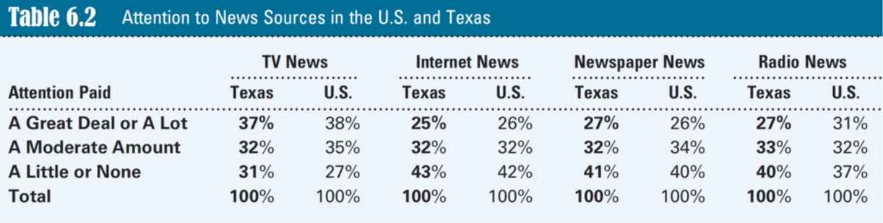

Attention to News Sources in the U.S. and Texas
Critical Thinking Question:
The table shows no major differences in paying attention to the news between the national and Texas samples. Why is this?
Notes:
Table 6.2
2012 National Election Study Time Series, Survey Documentation and Analysis, University of California, Berkeley, http://sda.berkeley.edu, analyzed by author February 6, 2014.

Slide 6
Office of the weekly Menard News and Messenger in Menard, southeast of San Angelo.
Critical Thinking Question:
Will local newspapers survive the Internet challenge? Why?
Notes:
Source: Menard News and Messenger

Slide 7
Where Do We Get Our Information?
Electronic Media: Radio and Television
  950 radio stations in Texas
    Limited value for political news
  Rise of talk radio and all-news radio
    Conservatives dominate
  Television in 97% of households
Notes:
In Texas, nationally syndicated talk show hosts have substantial followings, along with hosts with Texas origins, such as Alex Jones, Michael Berry (husband of Texas Secretary of State Nandita Berry), Neal Boortz, Joe Pagliarulo, and Dan Patrick (who achieved political prominence as a member of the Texas Senate before election as lieutenant governor in 2014).

Slide 8
Symbols of the new media:
Facebook, Twitter, and the Tumblr site for Texas’s online newspaper, The Texas Tribune.
Critical Thinking Question:
How have the Internet and social media influenced the reliability of news?
Notes:
Source: www.facebook.com; www.twitter.com; http://texastribune.tumblr.com/

Slide 9
Where Do We Get Our Information?
Digital Media: The Internet and Social Media
  Explosive growth in last decade
  News websites and political blogs
  Social media
    Used by almost 75% of Americans over age 18
    But not primarily for news – Television is primary
Learning Check
Notes:
Learning Check 6.1:
From which medium do the most people get their news today?
From which medium did most people get their news in the early 20th century?
social media: websites and computer applications that allow users to engage in social networking and create online communities. Social media provide platforms for sharing information and ideas through discussion forums, videos, photos, documents, audio clips, and the like.
news website: An Internet site that provides news. These sites are often affiliated with a newspaper or television station, but many are independent.
blog: A website or web page on which a writer or group of writers record opinions, information, and links to other sites on a regular basis.

Slide 10
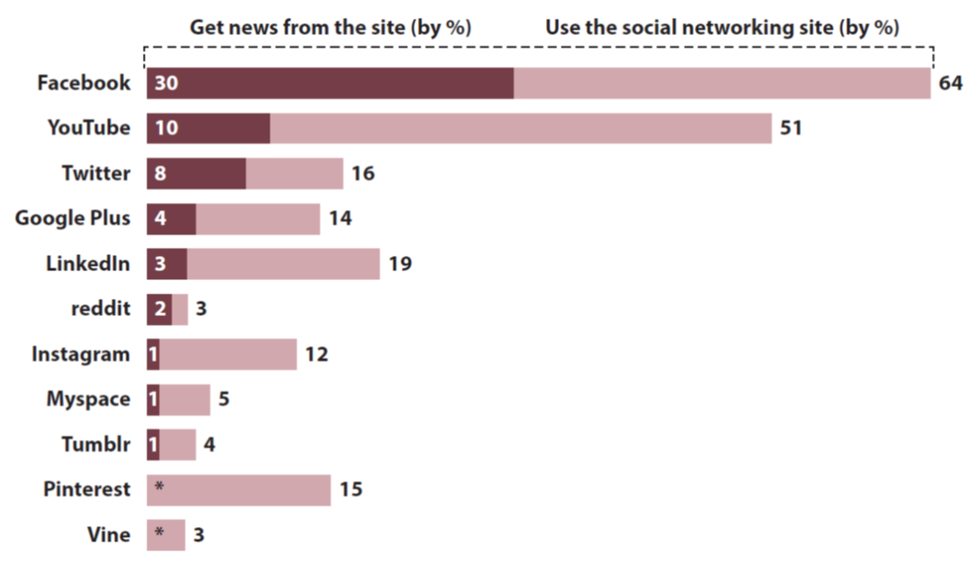
Percent of U.S. Adults Who Use and Get News From Social Networking Sites
Critical Thinking Question:
Is the proportion of those getting news from social media likely to increase or decrease? Why?
Notes:
Figure 6.1
Katerina Eva Matsa and Amy Mitchell, ‘‘8 Key Takeaways about Social Media and News,’’ Pew Research Journalism Project, March 26, 2014, http://www.journalism.org/2014/03/26/8-keytakeaways-about-social-media-and-news/.

Slide 11
Percent of Facebook News Consumers Who Regularly See News on Facebook About…
Critical Thinking Question: How good are the quantity and quality of news people get on social media?
Notes:
Figure 6.2
Source: Katerina Eva Matsa and Amy Mitchell, ‘‘8 Key Takeaways about Social Media and News,’’
Pew Research Journalism Project, March 26, 2014, http://www.journalism.org/2014/03/26/8-keytakeaways-
about-social-media-and-news/.

Slide 12
The Media’s Roles in Politics
Providing Information
  Must be from trusted source
  Political elite pay more attention to news
  Soft news vs. hard news
Notes:
soft news: News that is more entertaining, sensationalized, covers only the surface, and has little connection to public policy.
hard news: News that focuses on the facts, provides more depth, and commonly has implications for public policy.

Slide 13
The Media’s Roles in Politics
Maintaining Democracy
  The partisan past
    Yellow journalism
  Professionalism and democracy
    Must be objective, neutral, and accurate; not based on partisanship, ideology or money interests
    Advocacy: Texas Observer
    Adversarial
Notes:
yellow journalism: Journalism that is based on sensationalism and exaggeration.
professionalism: Reporting that is objective, neutral, and accurate.
adversarial: Reporting featuring opposition and a combative style. Also called attack journalism.

Slide 14
The Media’s Roles in Politics
Maintaining Democracy
  Investigative journalism
    Declining
    Open meetings and open records important
  Scandals and the media
    Sharpstown stock fraud scandal
    Defrauding of veterans
    Texas Supreme Court investigations
Notes:
open meetings: Meetings of public entities that are required by law to be open to the public.
open records: Government documents and records that are required by law to be available to the public.

Slide 15
The Media’s Roles in Politics
Setting the Public Agenda
  Influencing issues dealt with by government
    But limited by resources
Notes:
agenda setting: Affecting the importance given issues by government and public leaders.

Slide 16
The Media’s Roles in Politics
Shaping Our Views?
  Affected by personal knowledge and connections
  Selective perception and retention
  Attack ads
  Priming and framing
  What research finds
Learning Check
Notes:
Learning Check 6.2
Are the media today becoming more or less able to investigate government wrongdoing?
What does media framing mean?
attack ad: An advertisement meant as a personal attack on an opposing candidate or organization.
priming: The news media indicating how important an issue is or which part of a situation is most important.
framing: The news media providing meaning or defining the central theme of an issue.

Slide 17
Campaigns and Citizen Participation
Campaigns and the Traditional Media
  Candidates rely on media to get message out
    Want to control costs and coverage

Slide 18
Campaigns and Citizen Participation
Digital Campaigning
  Horserace coverage
  2008 and 2012 presidential campaigns
  Rick Perry’s 2010 gubernatorial campaign
  Ted Cruz’s 2012 U.S. Senate campaign
  Not always successful
    Senator Dan Patrick
Notes:
horserace journalism: News that focuses on who is ahead in the race (poll results and public perceptions) rather than policy differences.

Slide 19
Campaigns and Citizen Participation
Citizen Participation in the Digital Age
  Pew Research Internet Project – lower education & income – less civic participation
  Texas below average in political engagement
  Tea Party – grassroots success - digital
  Senator Wendy Davis (democrat) – helped nomination for governor
Learning Check
Notes:
Learning Check 6.3
1. Why are statewide election campaigns so expensive in Texas?
2. Are campaigns learning to use the Internet and social media?
Civil engagement: Actions by citizens to address issues of public concern.

Slide 20
Bias?
Media Bias and the News
  Traditional journalism standards changing
    Partisanship encouraged on cable news
    Talk radio dominated by conservatives
    Humorous political talk shows liberal
  Major networks, public networks and major newspapers strive for objectivity
Notes:
It is well established by research that over the last 30 years reporters have been more liberal and aligned with the Democratic Party than the general population, while newspaper management has long tended to be more conservative and Republican.

Slide 21
Bias?
What Research Finds
  Little evidence of systemic ideological or partisan bias in mainstream media
    But more interpretation and analysis
    Biased coverage on both sides tends to balance out
  Bias toward entertainment
  Commercial bias
Learning Check
Notes:
Learning Check 6.4
1. Do studies find that there is a net bias in the media to the left or right?
2. In which area of the media is there becoming more partisanship?

Slide 22
Regulation
Regulation of Print and Broadcast Media
  New York Times Co. v. United States
  Federal Communications Commission
    Broadcast television
    Radio and cable deregulated (1996)
Notes:
The Internet has not experienced the degree of regulation faced by the broadcast media and cable but has had to deal with a number of legal issues over time: copyright protection, pornography, cybersecurity, the harvesting of personal information from the Net, and now government spying.
Prior restraint: suppression of material before it is published, commonly called censorship.

Slide 23
Regulation
Internet Regulation
  Net neutrality
State and Local Regulation
  Shield law
    Free Flow of Information Act
Learning Check
Notes:
Learning Check 6.5
1. Which medium is most regulated today?
2. Which level of government has traditionally done the most regulating of media?
net neutrality: A legal principle that Internet service providers and governments should treat all data on the Internet equally, not discriminating or charging differentially and not blocking content they do not like.
shield law: A law protecting journalists from having to reveal confidential sources to police or in court.

Slide 24

Texas Tribune director
of technology, Higinio
Maycotte (left), and
software engineer, Niran Babalola, work in their Austin newsroom. Samples of other national news websites are posted on the walls. The major online nonprofit newspaper, The Texas Tribune, was founded in 2009.
Critical Thinking Question:
As traditional newspapers decline in Texas, will the digital media gather enough news to keep us well informed?
Notes:
Source: Erich Schlegel/Corbis News/Corbis

Slide 25
Change in the Media: More Participation, More Sources, but Less News?
Major Sources:
  19th century: newspapers
  20th century: television
  21st century: Internet and social media
Niche journalism increasing
Notes:
Newspapers are still the major gatherers of news. Television news and the Internet depend heavily on the major newspapers for originating stories.
niche journalism (narrowcasting): A news medium focusing on a narrow audience defined by concern about a particular topic or area.

Slide 26
Change in the Media: More Participation, More Sources, but Less News?
Concentration of Ownership
  Six corporations own most national media
    Mostly conglomerates
  Local ownership declining in Texas
    Illusion of choice

Slide 27
Change in the Media: More Participation, More Sources, but Less News?
Concentration of Ownership
  Homogenization
  Soft news
  Less state and local news
  Commercial bias
Notes:
homogenization of news: Making news uniform regardless of differing locations and cultures.
Hard news focuses on the facts, provides more depth, and commonly has implications for public policy.
Soft news: is more entertaining (often sensationalized by focusing on scandal and tragedy), covers only the surface of serious issues, and has little connection to public policy.
Capitol press corps: reporters assigned to cover state-level news, commonly working in the state capital.

Slide 28
Change in the Media: More Participation, More Sources, but Less News?
For Good and for Bad: The Rise of the Internet and Social Media
  Age
  News on Internet free or subscription?
  Quality issues

Slide 29
Change in the Media: More Participation, More Sources, but Less News?
The Future?
  Can digital media take up the slack from the decline of traditional media and provide the quantity of hard news necessary to keep leaders and the public adequately informed?
  Will the news provided by the digital media continue journalistic standards of professionalism?
Learning Check
Notes:
Learning Check 6.6
1. Are the changes in the news media trending toward more or less news gathering?
2. Are people getting news from social media?

Slide 30
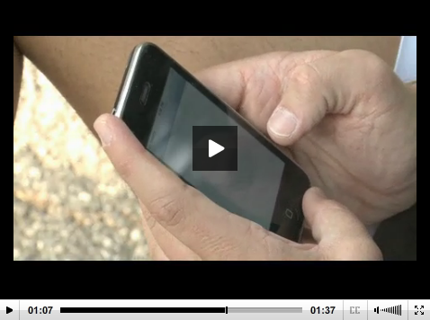

Social Media and Congress
Click picture to view video

Slide 31
Video Discussion Questions
Much like politicians in Texas, members of Congress use social media to communicate directly with voters. What are its advantages and disadvantages in politics?
Do you predict politicians will soon bypass traditional media in favor of social media? Why or why not?

