Slide 1
©2013 Cengage Learning. All Rights Reserved. May not be scanned, copied or duplicated, or posted to a publicly accessible website, in whole or in part.

Slide 2
The World Marketplace:
LO1 What opportunities exist in the world economy for businesses?
LO2 Why do nations trade?
LO3 How do we measure trade?
LO4 How do companies reach global markets?
LO5 What are the barriers to international trade?
LO6 What are the benefits and criticisms of the free trade movement?
Business Without Borders

Slide 3
An Unprecedented Opportunity….
“
“A company that keeps its eye on Tom, Dick and Harry is going to miss Pierre, Hans, and Yoshio.”
-- Al Ries, marketing strategist and author
“

Slide 4
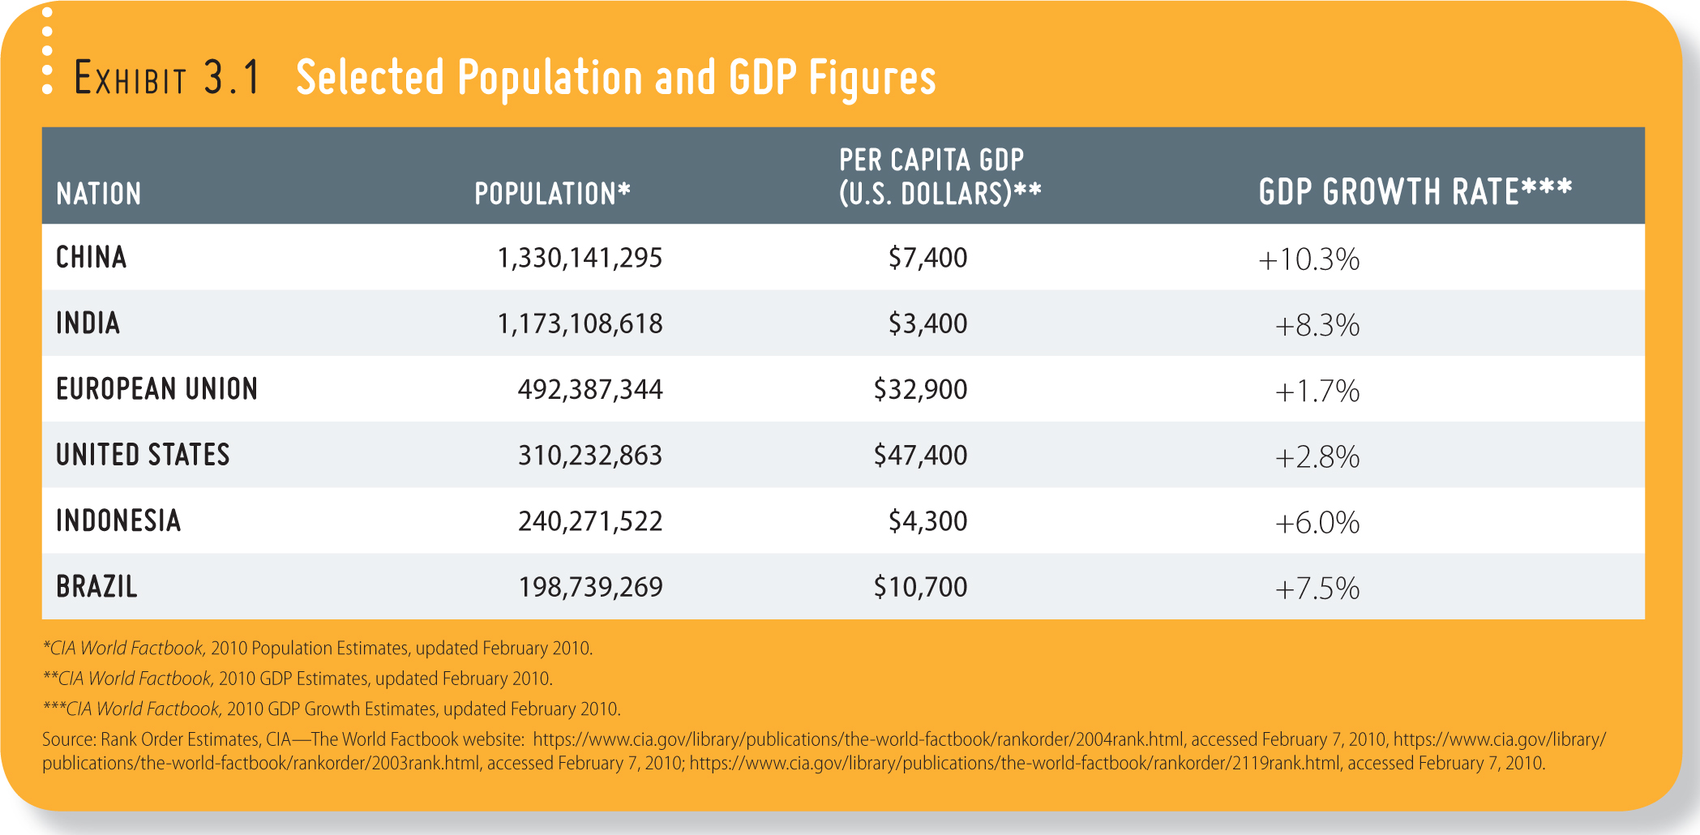
Growing World Population
Source: https://www.cia.gov/library/publications/the-world-factbook/rankorder/2004rank.html, accessed February 7, 2010, https://www.cia.gov/library/publications/the-world-factbook/rankorder/2003rank.html, accessed February 7, 2010; https://www.cia.gov/library/publications/the-world-factbook/rankorder/2119rank.html, accessed February 7, 2010.

Slide 5
Global Trade Recovery
The long-term global potential for U.S. business is enormous
The global economy contracted in 2009
But, world GDP turned back around in 2010
U.S. consumers have money but China and India represent a bigger opportunity

Slide 6
Unimpressive Scores
U.S. students ranked 25th among peers from 34 countries on a math test, and scored average in science and reading
China, Singapore, and South Korea led the pack, outpacing American students
The South Korean government set a curfew for online games in 2010 because public school students exhibited signs of addiction
The U.S. addiction level are equally high as American students need to increase their academic “game” to compete globally
©iStockphoto.com/Jesus Jauregui
Source: Singapore Study finds video game addiction exists globally, The Medical News website, January 20, 2011, http://www.news-medical.net/news/20110120/Singapore-study-finds-video-game-addiction-exists-globally.aspx accessed February 14, 2011; What they’re restricting in South Korea, Time magazine briefing, April 26, 2010; U.S. Teens Lag as China Soars on International Test by John Hechinger, December 7, 2010, Bloomberg website, http://www.bloomberg.com/news/2010-12-07/teens-in-u-s-rank-25th-on-math-test-trail-in-science-reading.html, accessed February 14, 2010; South Korea Cracks Down on Gaming Addiction by Geoffrey Cain, Time magazine website, April 20, 2010, http://www.time.com/time/world/article/0,8599,1983234,00.html, accessed February 1, 2010

Slide 7
Key Reasons for International Trade
Access to Factors of Production
Reduced Economic Risk
Inflow of Innovation

Slide 8
Key Reasons for International Trade: Competitive Advantage
Opportunity cost –The cost of giving up the second-best choice when making a decision
A country has an
absolute advantage when
it can produce more of a
good than other nations,
using the same amount
of resources.
Comparative
advantage is the
benefit a country
has in a given industry if
it can make products at a
lower opportunity
cost.

Slide 9
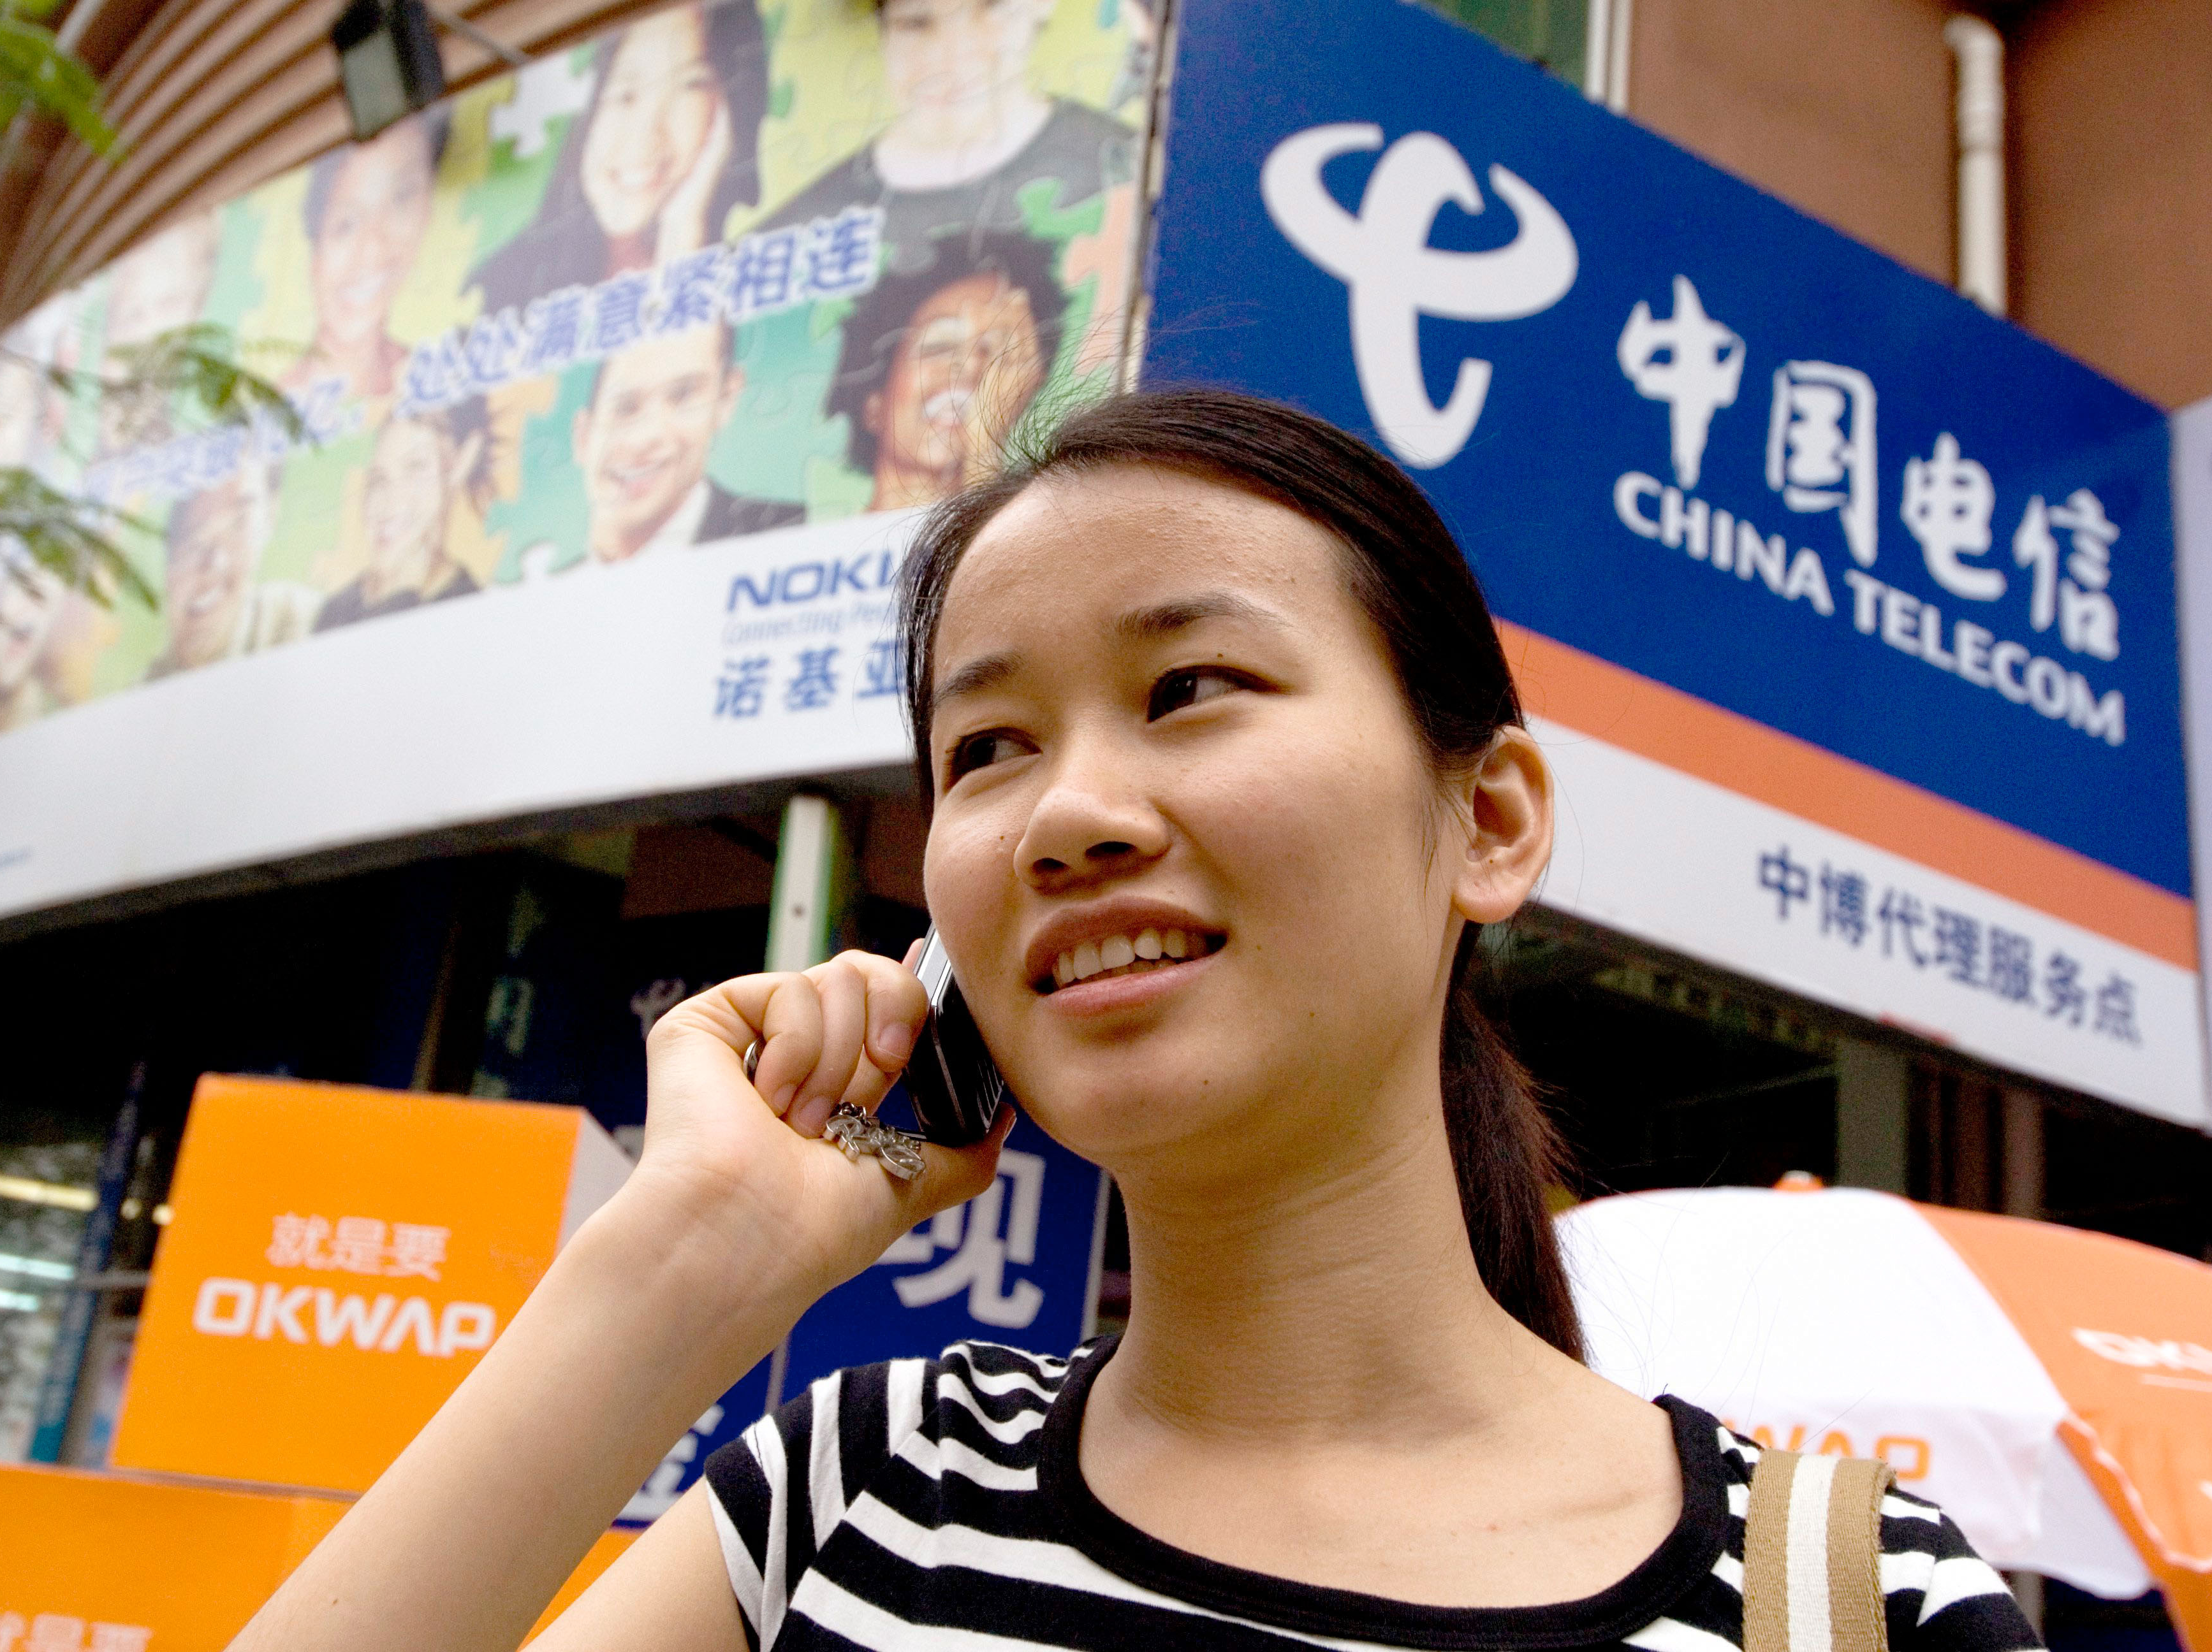
Cell Phone Subscriptions Around the World
In the U.S., Europe, and Japan, cell phones followed landlines, but many developing nations “can leapfrog technology.”
China currently boasts the world’s largest base of cell phone users—766 million
India’s current subscriber base is more than 584 million; it has grown explosively in 5 years
In Africa, cell phone penetration rates in 2009 were approximately 21% versus 9% for land lines
In Zimbabwe, cell phone penetration grew from 4% in 2008 to about 30% in 2009.
© vario images GmbH & Co.KG / Alamy
Source: Zimbabwe: Mobile phone penetration linked to GDP growth, October 28, 2010, AllAfrica Global Media website, http://allafrica.com/stories/201011011088.html, accessed February 7, 2010; Mobile Phone Adoption in Developing Countries, WikiInvest website, http://www.wikinvest.com/concept/Mobile_Phone_Adoption_in_Developing_Countries, accessed February 8, 2011; Cell phones vital in developing world by Malcolm Foster, January 27, 2007, Washington Post website, http://www .washingtonpost.com/wp-dyn/content/article/2007/01/27/AR2007012700662.html, accessed January 28, 2009; China’s mobile users top 600 million: govt, July 24, 2008

Slide 10
Global Trade: Taking Measure
Balance of Trade
Trade Deficit
Trade Surplus
Balance of Payments
Balance of Payments Deficit
Balance of Payments Surplus
Exchange Rates
Countertrade

Slide 11
Global Trade: Exchange Rates
STRONG DOLLAR VS EURO: (Example: $1.00 = 1.20 euros) | WEAK DOLLAR VS. EURO: (Example: $1.00 = .60 euros)
U.S. travelers to Europe | European travelers to U.S.
American firms with European operations | European firms with American operations
European exporters | American exporters
Source: What is countertrade? By Neha Gupta, Barter News Weekly website, March 11, 2010, http://www.barternewsweekly.com/2010/03/11/what-is-counter-trade-1851/, accessed February 10, 2010

Slide 12
The Many Names of Money
China
Yuan
England
Pound
European Union
Euro
India
Rupee
Iran
Rial
Israel
Shekel
Japan
Yen
Mexico
Peso
South Africa
Rand
South Korea
Won

Slide 13
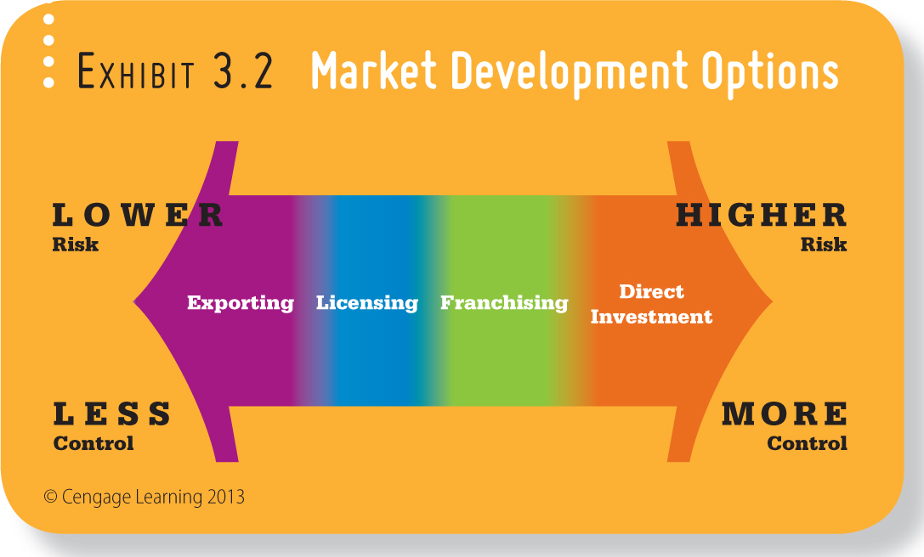
Market Development Options

Slide 14
Strategies for Reaching Global Markets
Foreign Outsourcing/Contract Manufacturing
Contracting with foreign suppliers to produce products
Importing
Buying products that have been produced in foreign nations

Slide 15
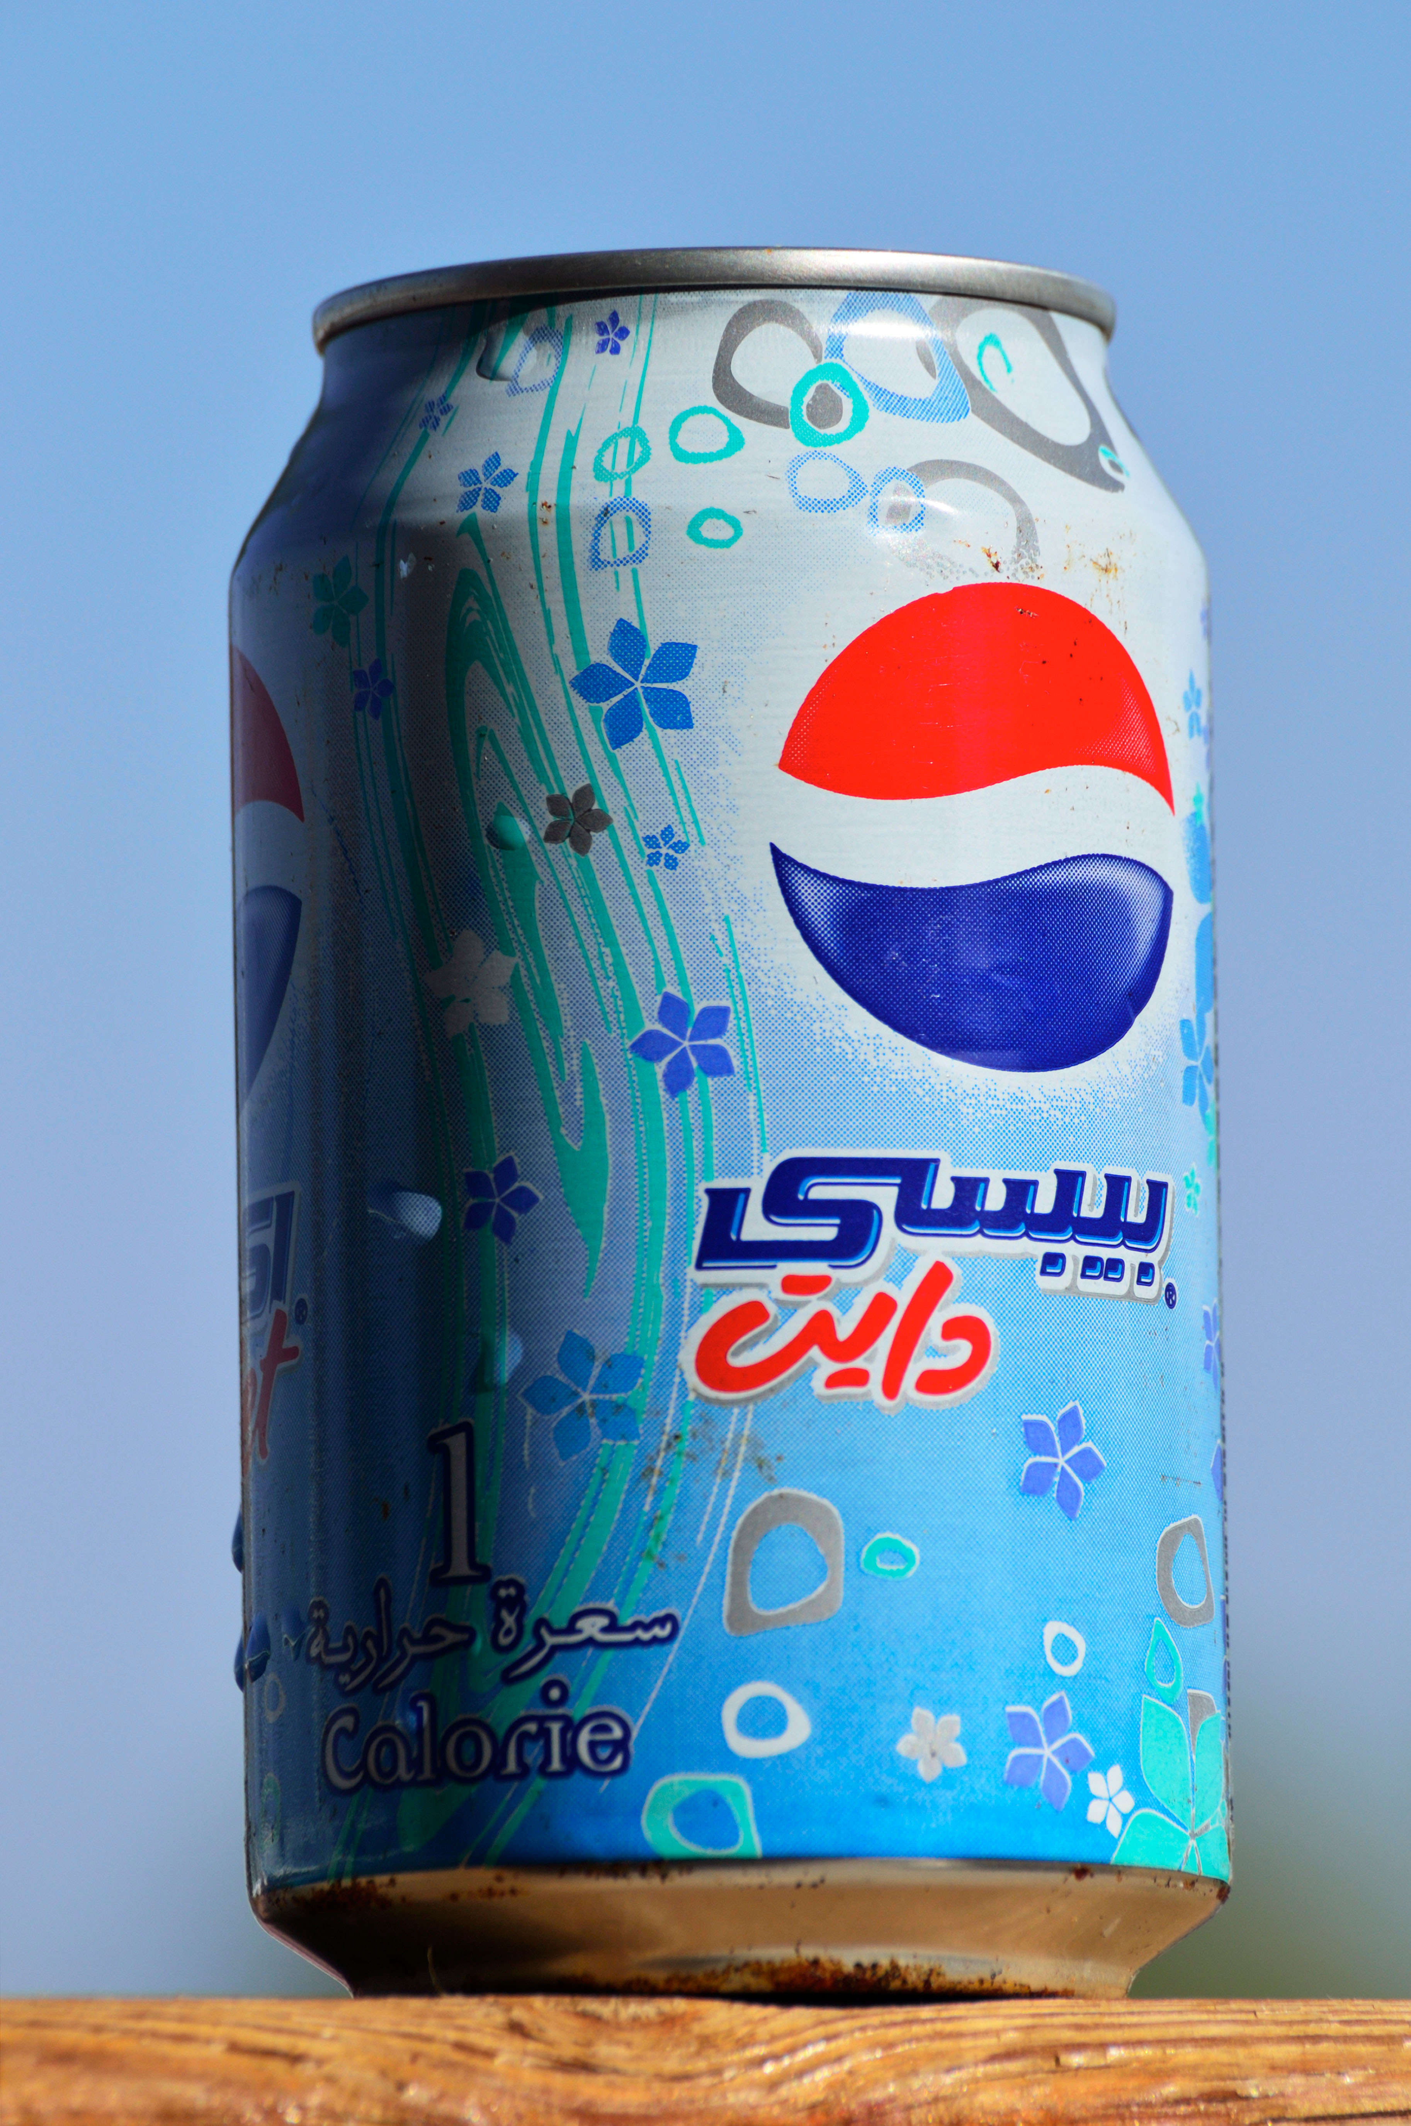
Seizing the Opportunity: Strategies for Reaching Global Markets
© The Studio Dog/Photodisc/Getty Images
Exporting
Selling domestic products abroad
Licensing
Authority given for rights to produce/market product and use trademarks/patents
Franchising
Providing the right to produce and market products under its operating requirements
Direct Investment
Firms acquire businesses or develop new facilities in foreign countries
Joint Ventures
Two or more companies joining forces
© Mystic Arabia / Alamy

Slide 16
Chrysler and Fiat
Foreign acquisition
allows companies to gain quick access into new markets
In the wake of the Great Recession…
Italian carmaker Fiat acquired struggling U.S. auto giant, Chrysler to leverage the American market

Slide 17
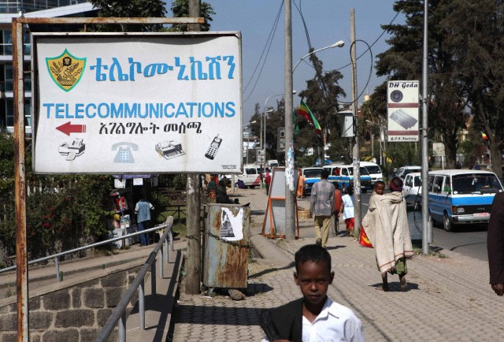
Barriers to International Trade
Sociocultural Differences
Economic Differences
Political & Legal Differences
© MAO SIQIAN/ XINHUA/XINHUA PRESS/ CORBIS

Slide 18
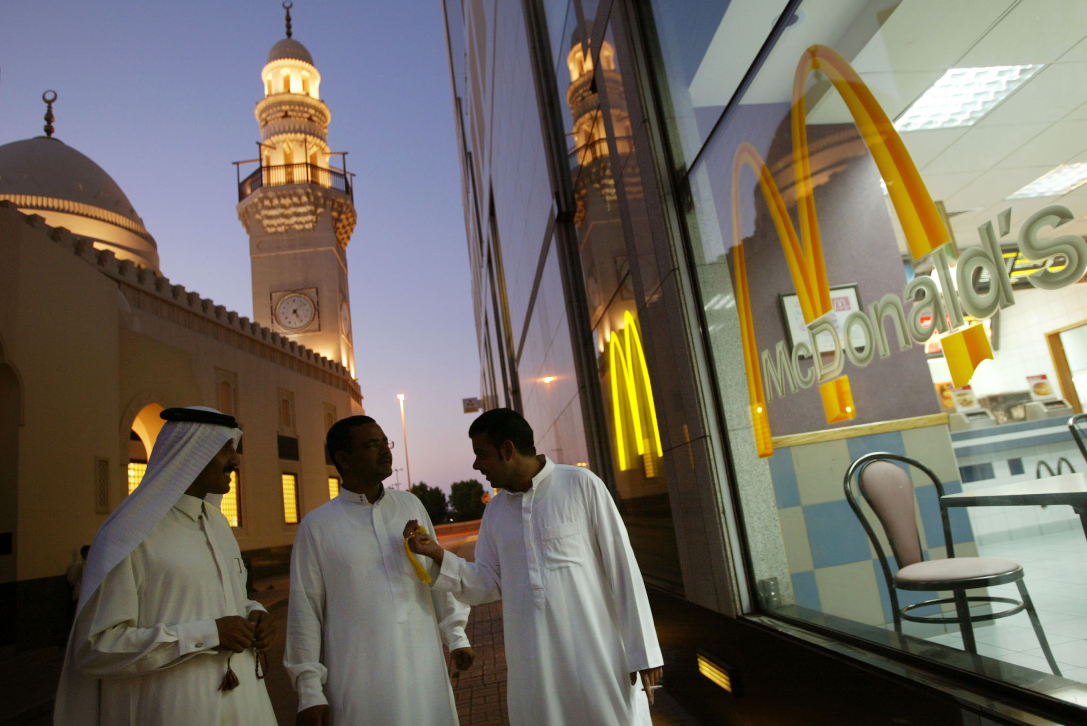
Veggie Surprise, Anyone?
McDonald’s
India: Paneer Salsa Wrap: Cottage cheese with Mexican-Cajun coating
Australia: Bacon and Egg Roll: “rashers of quality bacon and fried egg”
Kumati: Veggie Surprise Burger
United Kingdom: Five “Toasted Deli” sandwich options
Pizza Hut
Japan: Crust stuffed with shrimp nuggets and mayonnaise
South Korea: Crust filled with sweet potato mousse
©Joe Raedle/Getty Images
Source: McDonald’s country/market sites, http://www.mcdonalds .com./countries.html, accessed February 10, 2011 . <http://www.dominos.com/Public-EN/Site+Content/Secondary/Inside+Dominos/Pizza+Particulars/International+Speciality+Toppings/; http://slice.seriouseats.com/archives/2008/02/crazy-weird-asian-pizza-crusts-japanese-korean-hong kong.html; http://recipes.howstuffworks.com/fresh-ideas/dinner-food-facts/favorite-pizza-toppings-in-10-countries .htm; http://slice.seriouseats.com/archives/2008/02/crazy weird-asian-pizza-crusts-japanese-korean-hong-kong.htm>

Slide 19
Barriers to International Trade: Economic Differences
Exchange Rates
Population
Per Capita Income
Infrastructure
Transportation
Communication
Energy
Finance
Can you profitably provide your product or service to meet the needs of the market?

Slide 20
Barriers to International Trade: Sociocultural Differences
Social/cultural differences can rapidly undermine business relationships
Nonverbal Communication
Forms of Address
Attitudes toward punctuality
Religious Celebrations
Business Practice/Gifts

Slide 21
Barriers to International Trade: Political and Legal Differences
© The Studio Dog/Photodisc/Getty Images
Political regimes differ around the world
Legal Differences
Lack of Enforcement
Bribery
Political Climate
Stability
Violence
Piracy and intellectual property is a problem in several foreign nations.

Slide 22
Global Greening?
The world community must take dramatic steps to combat global warming.
Change won’t be easy and coordination is vital
The United Nations is sponsoring an international Climate Change Conference in Copenhagen.
Consider these questions about the conference:
Did a treaty emerge? How many nations signed? Did any of the participants surprise you? How?
Do you think the conferences and treaties will yield results? Why or why not?
What role did the United States play? Do you believe that the role was appropriate? Why or why not?

Slide 23
Protectionism
Reasons to Create Trade Restrictions | Reasons to Eliminate Trade Restrictions
Protect domestic industry | Reduce prices and increase choices for consumers
Protect domestic jobs in key industries | Increase domestic jobs
Retaliate against countries who have engaged in unfair trade practices | Build exporting opportunities
Pressure other countries | Use world resources more efficiently

Slide 24
International Trade Restrictions
Tariffs
Quotas
Voluntary Export Restrictions
Embargo

Slide 25
Free Trade: The Movement Gains Momentum
There has been a global move toward free trade – the unrestricted movement of good and services across borders.

Slide 26
GATT and the World Trade Organization (WTO)
General Agreement on Tariffs & Trade (GATT)
Established in 1948
125 Nations
Slashed tariffs by about 30%
World Trade Organization (WTO)
Promote International Trade
Settle Trade Disputes

Slide 27
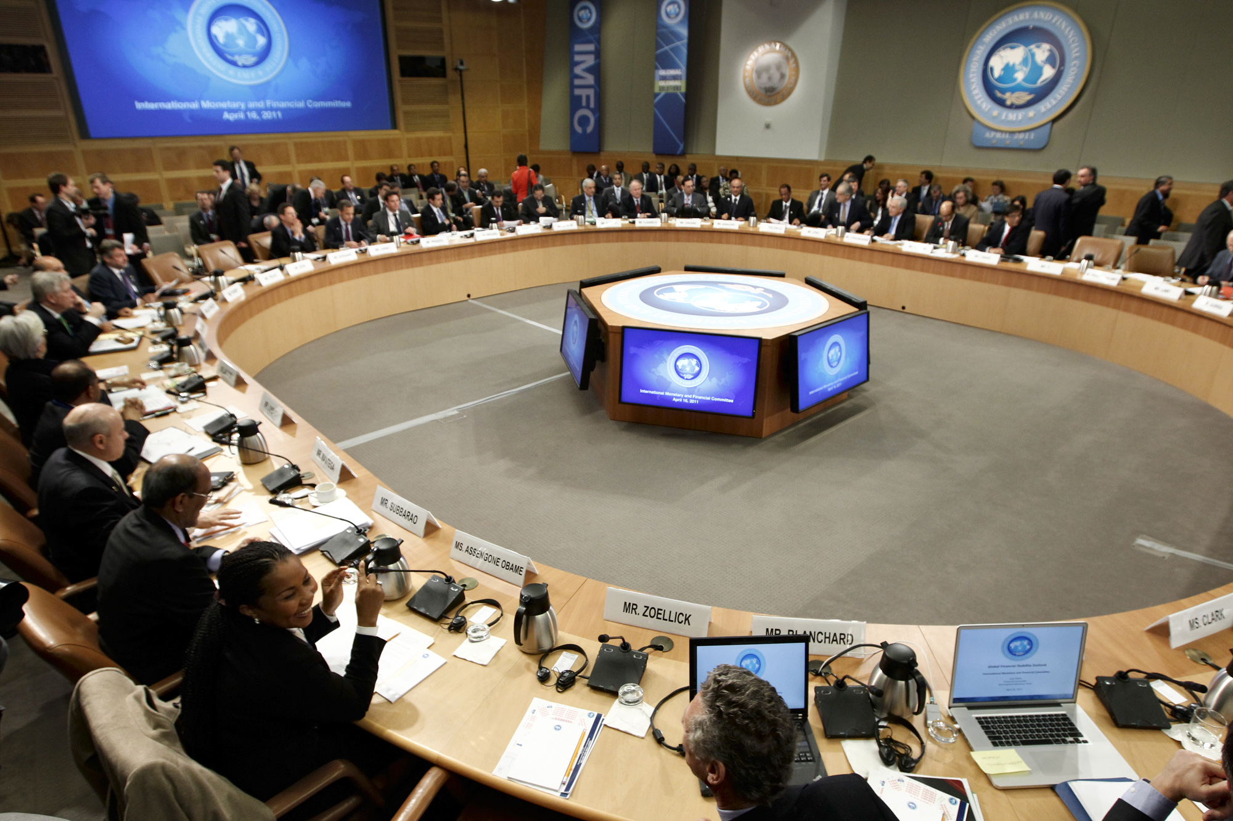
GATT and the World Trade Organization (WTO)
The World Bank
187 Member Countries
Reduce World Poverty in Developing World
Influence Global Economy
Provide Financial Assistance
The International Monetary Fund
Support Stable Exchange Rates
Facilitate International Payments
Adopt Economic Policies
Promote Trade
Lends money to member nations
AP Images/J. Scott Applewhite

Slide 28
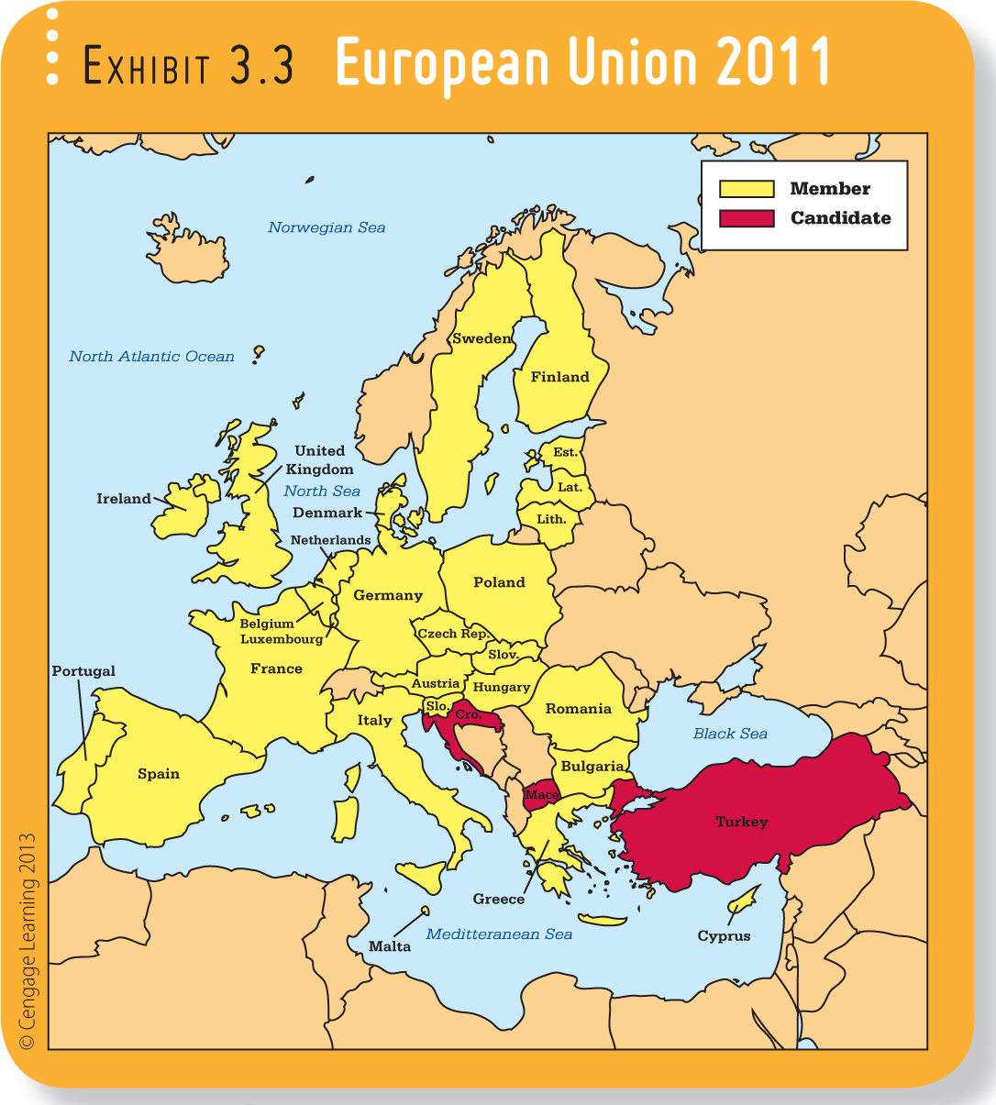
Trading Blocs and Common Markets
Groups of countries promoting the free flow of goods and services
The North American Free Trade Agreement (NAFTA)
The largest trading bloc
United States, Canada and Mexico
Critics for job loss
European Union (EU)
The largest common market
27 nations; combined GDP of $15 Trillion
Goal is to bolster Europe’s trade position

Slide 29
Foreigners Flocking to America for Bargains
The weak dollar is enticing global shoppers
The down dollar is a discount to tourists
Foreign travelers are lured to the U.S. where they get a bigger bang for their euro, franc, yen….
Demand for U.S. hotels is up
Tourism has been an economic boost representing 10% of jobs added in the first part of 2011
http://www.alaskadispatch.com/article/foreigners-flocking-america-bargains

Slide 30
Looking Back
What opportunities exist in the world economy for businesses?
Why do nations trade?
How do we measure trade?
How do companies reach global markets?
What are the barriers to international trade?
What are the benefits and criticisms of the free trade movement?

