Slide 1
The Trump Phenomenon
How the Trump Candidacy and Presidency Defies the Norms of Presidential Politics

Slide 2
The Trump Phenomenon How Trump Defies the Norms of Presidential Politics
How we evaluate presidential politics
Based on what has happened in the past, we make predictions about the future, such as who is most likely to win the next presidential election, e.g., Candidate A has an 80% likelihood of winning
This methodology has not worked well with Trump because what we have learned from the past has not been a good predictor of the future
How has Trump defied the rules of presidential politics?
Trump won the Republican Nomination
Trump won evangelicals despite his un-Christian-like past, even against more religious Republican competitors
Trump won with no endorsements of Republican office-holders in the pre-primary season
Trump won despite having raised very little money in the pre-primary season
Trump won the Presidential Election
Trump won despite having problems with the Republican “base,” the more intellectual conservatives in open rebellion against Trump
Trump won despite raising far less money than Hillary
Trump won despite not having won a significantly higher % of minority voters, particularly Hispanics, than his Republican counterparts in previous election cycles
Trump won despite having no previous political experience
Notes:
Front-loading occurs when most states hold their primaries early in the election year, usually before the end of March, rather than spacing the primaries evenly between January and June. In order for a candidate to win the Democratic or Republican nomination for president, a candidate has to win a certain number of votes (called delegates), and in order to win the votes necessary, they have to compete and win in a lot of different states across America. No one state can give a candidate enough votes to win the nomination.
The pre-primary season begins a year or two before any primary election is even held. Candidates engage in fund-raising and cater to party leaders during the pre-primary season. In a front-loaded process, the candidate who has the most money and who has the most party insiders on his or her side will likely win the Democratic or Republican nomination.
In theory, for an “outsider” to win the nomination (either Republican or Democratic), he or she needs time to build momentum, so it helps for the various states to spread their primary elections over a longer period of time, say over 6 or 7 months rather than over 2 months. Front-loading hurts an outsider candidate’s chances of winning.
2016 Primaries
In 2016, the primary season is not as front-loaded as in 2000 or 2008. 14 states, including Texas, held primaries on Mar 1st (13 states for the Democrats), which is more than the 12 states that held that many on one day in 2012. In 2000, there were 20+ primaries on one day, and in 2008, there were 20+ primaries in early February. Still, 14 (or 13 for Democrats) is a lot. Candidates who have a lot of money can advertise on TV in multiple-states, whereas other candidates who are not as well funded cannot extensively advertise, thus they are at a disadvantage. In the modern era, the most effective way to reach the voters is via TV ads.
Still, in 2016, the Iowa Caucus was on Feb. 1st, whereas in 2008 and 2012, it was held on Jan. 3rd. So the voting started later in 2016, which in theory is designed to give “outsider” candidates more time to campaign than in the previous elections cycles of 2008 and 2012.
http://www.uspresidentialelectionnews.com/2016-presidential-primary-schedule-calendar/ -- The 2016 primary calendar
2012 Primaries
In 2012, the advent of “Super PACs” allowed “outsiders” like Newt Gingrich and Rick Santorum to stay in the race longer, even long enough to survive Super Tuesday. Mitt Romney was the front-runner on the Republican side—he was the “insider,” given that he had raised so much more money and had secured many high-level endorsements (e.g., governors like Chris Christie (R-NJ) and Nikki Haley (R-SC) and Donald Trump).
The “Super PACs” allow one wealthy individual to give as much money as he or she wants to support a candidate (the money is not given directly to the candidate’s campaign but instead to an independent group that supports the candidate). A casino owner (Sheldon Adelson) in Las Vegas bankrolled most of the “Super PAC” that supported Newt Gingrich. This “Super PAC” allowed Gingrich to stay in the race longer than he would have otherwise. A billionaire investor (Foster Friess) bankrolled most of the “Super PAC” that supported Rick Santorum’s primary run, and like Gingrich, Santorum was able to stay in the race longer because of this financial support.
In 2012, the effect of front-loading was offset by the “Super PACs.” In addition, the primary season was less front-loaded than usual. 10 states held their primaries on “Super Tuesday” (March 6 2012), down from the usual ~20 states. Still, Mitt Romney won the Republican nomination, so the “insider candidate” prevailed in a less front-loaded process that included “Super PACs.” (President Obama had no competitors in the 2012 Democratic primaries, so there was no news on the Democratic side.)
Some History
2000: Party leaders courted George W Bush, starting in 1998 after he won a landslide victory for Governor of Texas. “Super Tuesday” and other regional primaries, where ~20 states held their primary elections on the same day, were devastating to McCain in 2000.
2008: Front-loading was in play in 2008. 20+ states held their primary elections on the same day early in the year (Feb 5th 2008). At the end of 2007, most political experts believed that the two front-runners, Hillary Clinton and Rudy Giuliani, would wrap up the Democratic and Republican nominations, respectively, on Super Tuesday (Feb. 5th 2008). That did not happen. Barack Obama (D-IL) proved to be a much more competitive opponent to Hillary Clinton. He even gained momentum after Super Tuesday, winning 11 election contests in a row between February 5th and March 4th (Texas and Ohio held primaries on March 4th). On the Republican side, John McCain emerged as the front-runner one-week before Super Tuesday, and then wrapped up the Republican nomination one month after Super Tuesday. This just goes to show that “the rules” don’t always apply. Barack Obama was able to overcome a front-loaded primary process to win the Democratic nomination.

Slide 3
Presidential Elections
The Primaries

Slide 4
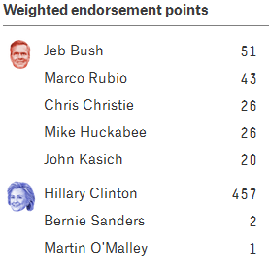
Presidential Primaries The Pre-Primary – Endorsements of Party Leaders
The “Conventional Wisdom”
Typically, during the pre-primary phase of the campaign, the candidate who receives the most endorsements from elected party leaders wins the nomination…but not always
Pre-primary endorsements don’t always predict the eventual party nominee. For instance, Hillary Clinton had more endorsements from party leaders than Barack Obama, pre-Iowa caucus in 2008
Pre-Iowa Caucus, Michael Dukakis was 3rd in party Democratic endorsements in 1988 and John Kerry was 4th in party endorsements in 2004
Republican Frontrunners in Iowa
Notes:
Source: http://projects.fivethirtyeight.com/2016-endorsement-primary/
What is the pre-primary? It is the year before any votes are cast in a presidential cycle. During the pre-primary season, candidates raise money and seek endorsements of big name party leaders. Typically, the candidate with the most endorsements and money raised wins the nomination. This did not happen in 2016. Trump won with no pre-primary endorsements and with very little fund-raising.
How Fivethirtyeight.com weights pre-primary endorsements: A gubernatorial endorsement for a candidate counts 10 points; an endorsement from a U.S. Senator is worth 5 points, and an endorsement from a U.S. representative is 1 point. If the endorsements of elected leaders is a predictor of which candidate will win the nomination, then Hillary Clinton should be a shoe-in in 2016 for the Democratic nomination, and Jeb Bush and Marco Rubio should have the inside track for the Republican nomination.
What is the Conventional Wisdom?? In the context of a presidential election, the conventional wisdom is a consensus belief among political experts regarding which factors decide a presidential election. The consensus belief is that the candidate who secures the most endorsements and campaign money (including money raised by outside groups or “Super PACs”) is most likely to win the nomination.
Since 1980, the Republican candidate with the most pre-Iowa Caucus endorsements of Republican party leaders has won the nomination. This trend was broken in 2016 by Donald Trump, who even after becoming the presumptive nominee in May 2016, only had 46 points of endorsements (according to the weighting used by 538.com)
Follow-up from points made on the PowerPoint slide above: Interestingly, on the eve of the Iowa Caucus, Donald Trump had no endorsements, and Ted Cruz had 16 endorsements of Republican Party leaders. Cruz went on to win the Iowa Caucus; Trump was second.
Follow-up from points made on the PowerPoint slide above: In 1988, Michael Dukakis was the eventual Democratic nominee, as was John Kerry in 2004 and Barack Obama in 2008.
See the endorsements to date (1/18/2016): http://projects.fivethirtyeight.com/2016-endorsement-primary/#endorsements

Slide 5
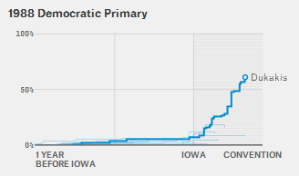
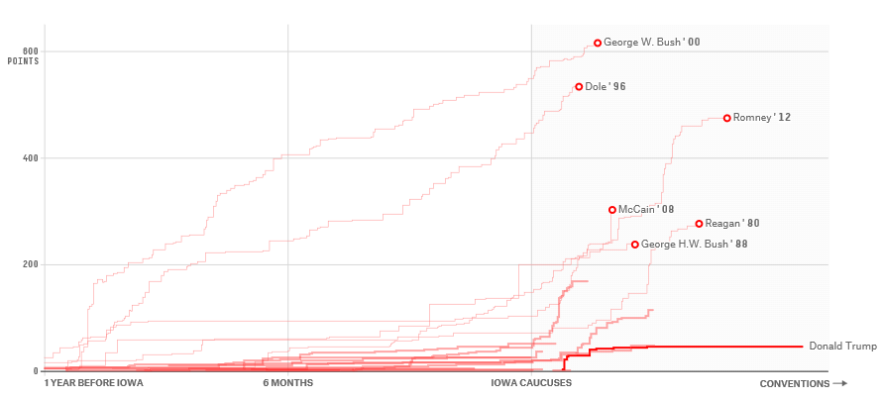
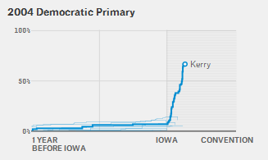
Presidential Primaries The Pre-Primary – Endorsements of Party Leaders
Pre-Iowa Endorsements in Past Republican Election Cycles
2016 Republican Primary
After taking a “wait and see” approach prior to the Iowa Caucus, Democratic Party leaders rallied behind one candidate in 1988 and 2004
Republican Party leaders took this same “wait and see” approach in 2016, but they never rallied behind Donald Trump even after it became clear that Trump would win the nomination. This is unlike Republican presidential nominees in the past, who eventually won the support of their party leaders
Notes:
Source: http://projects.fivethirtyeight.com/2016-endorsement-primary/
See the endorsements to date (1/18/2016): http://projects.fivethirtyeight.com/2016-endorsement-primary/#endorsements
Cut and pasted from Fivethirtyeight.com: “While each election cycle is different, nomination races since 1980 have fallen into two broad categories. In some — like the Republican contest of 1996 and both the Democratic and Republican races of 2000 — party elites rallied around a candidate well before the Iowa caucuses, and these candidates went on to win their nominations with relative ease. In others, like the Democratic contests of 1988 and 2004 , there was less of an endorsement consensus, with party officials taking more of a wait-and-see approach until voters weighed in. Party elites coalesced around a candidate only after the Iowa caucuses and the New Hampshire primary.”

Slide 6
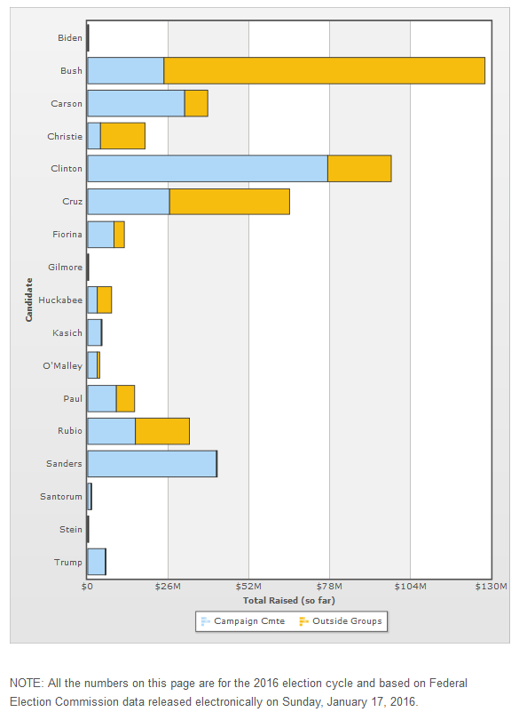
Presidential Primaries The Pre-Primary – Fund Raising (Money)
The “Conventional Wisdom”
Typically, during the pre-primary phase of the campaign, the candidate who raises the most campaign money—and who has the most “Super PAC” money (i.e., outside groups)—wins the nomination…but not always
During the pre-primary, Jeb Bush and Hillary Clinton raised the most money (including outside groups raising money for these respective candidates)
Pre-Iowa Caucus, Donald Trump and Ted Cruz led Bush in the polls, and Clinton and Sanders were in a dead-heat
Notes:
Source: http://www.opensecrets.org/pres16/
http://www.opensecrets.org/pres16/outsidegroups.php – a list of all Super PACs to date.
What is the Conventional Wisdom?? In the context of a presidential election, the conventional wisdom is a consensus belief among political experts regarding which factors decide a presidential election. The consensus belief is that the candidate who secures the most endorsements and campaign money (including money raised by outside groups or “Super PACs”) is most likely to win the nomination.
Fund-raising is not always the deciding factor in an election. In 1998, Jesse Ventura (a movie actor) won the Governor’s race in Minnesota. He ran as an Independent and raised only $250,000, and he still beat the Democrat and Republican in the race, both of whom had raised millions of dollars.

Slide 7
Presidential Elections
The General Election

Slide 8
Party Divisions
A Divided Republican/Conservative Base

Slide 9
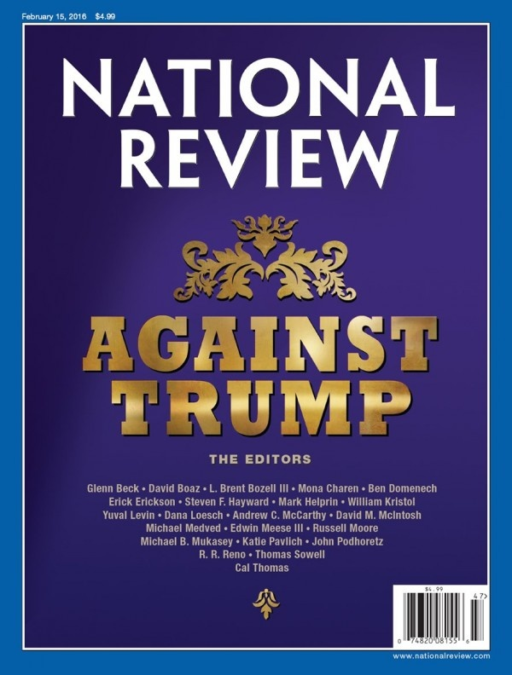
A Divided Republican Party
Conservative Ideologues Opposed Trump
The National Review is the longest running conservative publication in America. It represents the views of conservative ideologues
The editors of the National Review have positioned themselves strongly against Donald Trump, because Trump has some liberal ideas and they fear he will advance the Democratic agenda as president
In the 2016 presidential race, this created divisions within the Republican Party, which is typically bad news for the party’s nominee (Trump). A unified party is necessary to communicate a clear and positive message to independent and moderate voters, who usually make the difference in a presidential election.
Notes:
It is bad news for a political party when it is internally divided. The “message stream” (from TV, internet, newspapers, social media, etc.) is mixed, some positive and some negative. Moderates and Independents receive these messages and conclude there may be something wrong with the candidate (i.e., in this case, Trump)—thus they are more likely to vote for the other candidate (i.e., Hillary Clinton) because the message stream about the other candidate is more unified and positive, given that there is more unity in the other party.

Slide 10
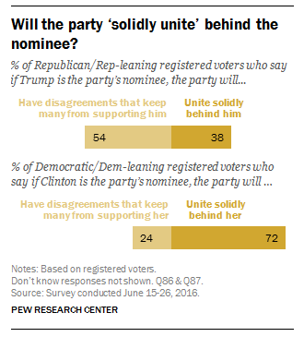
A Divided Republican Party
Public Perception
In June 2016, the perception among the public was that Trump would be much less likely to unite the Republican Party than Hillary Clinton would be to unite the Democratic Party
On Election Day (2016), Exit Polls showed that Trump won 88% of Republican voters, slightly down from the typical 90% or better, but Hillary Clinton only won 89% of Democratic voters, also down from the normal 90% or better

Slide 11
The Importance of the Party Base History’s Judgment
Losing the party base has ruined past presidents
11 of 45 presidents have lost their own party’s support throughout American history…each was ruined politically (lost the presidency)
Trump is vulnerable to a similar fate…or is he, given that “the rules” don’t always apply to him??
Past Presidents Ruined by Losing their Party Base
John Adams – Quasi-war with France a compromise that satisfied no one
James K Polk – Mexican-American War controversial, expanding slavery?
Millard Fillmore – Pro-slavery provisions in Compromise of 1850
Franklin Pierce – Desire to expand slavery to Cuba?
James Buchanan – Did nothing to resolve the slave issue
Chester Arthur – Not re-nominated, divided support between other candidates
Grover Cleveland – Position on Gold Standard aligned with other party
LBJ – Party opposed to Vietnam War, which LBJ was fighting
Richard Nixon – Concerned about intelligence leaks, led to Watergate
Jimmy Carter – Too conservative for the Democratic Party
George H.W. Bush (the father) – Raised taxes (“read my lips, no new taxes”)
Notes:
President’s who lost support of their own parties:
1. John Adams – Quasi-War…Adams’ party wanted all-out war with France, while the opposing party opposed war with France. Adams split the difference, but party leaders turned to Hamilton for leadership. Adams ran for reelection but lost to Jefferson.
2. James K Polk – Mexican-American War controversial at the time, thought to be unconstitutional…Western Democrats turned against Polk when he failed to go to war with GB over Northwest Territory…Polk was not re-nominated by party leaders to run for reelection; he served only one term as president
3. Fillmore – the pro-slavery provisions of the compromise of 1850 was too controversial, and Fillmore supported the compromise…he too was not re-nominated by party leaders
Pierce – desire to purchase Cuba, viewed as an attempt to spread slavery…violence in the Kansas Territory over the slave issue hurt Pierce…again, party leaders did not re-nominate Pierce
Buchanan – LeCompton Compromise for Kansas a disaster…Buchanan did nothing to resolve the slave issue
Chester Arthur – not re-nominated by party leaders
Grover Cleveland – took a stand on the Gold Standard, split the Democratic Party in two…Cleveland supported a 3rd Party candidate in 1896
LBJ – destroyed by the Vietnam War…invited 3 challenges in the primaries…LBJ decided not to run for reelection
Nixon – Watergate, Republicans could not support him…Nixon resigned over the controversy
Carter – invited a challenge from his left flank (Ted Kennedy); Carter was too conservative for the Democratic Party
Bush41 – invited a challenge from his right flank (Pat Buchanan); he compromised on the tax issue (raised taxes)

Slide 12
Demographics
Demographic Voting Behavior

Slide 13
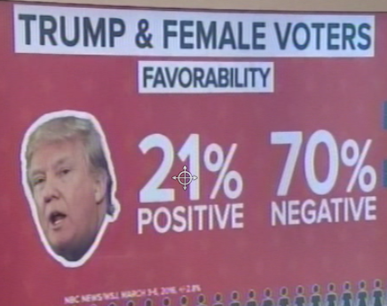
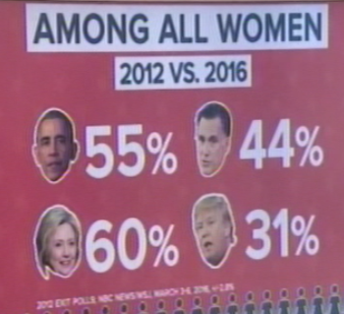
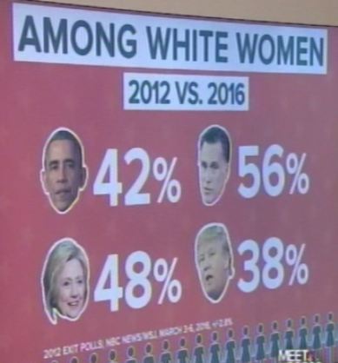
The 2016 Presidential Race Trump’s Problems with Female Voters (March 2016)
During the 2016 primaries, Trump was polling very badly among white women, much worse than Mitt Romney polled in 2012 on Election Day, and some predicted that he could not win the presidency unless he won more white female voters
Notes:
Source: Meet the Press, 3-27-2016

Slide 14
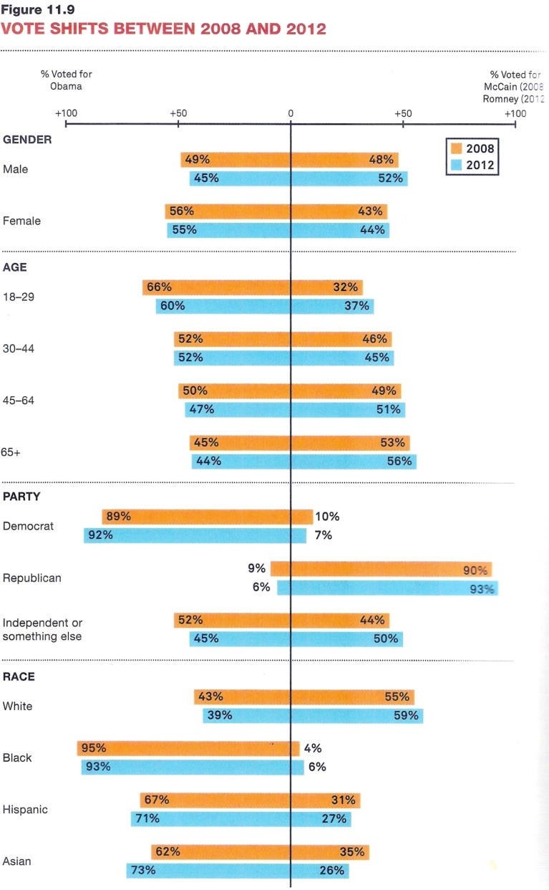
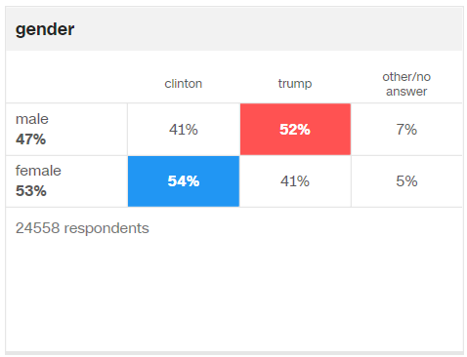
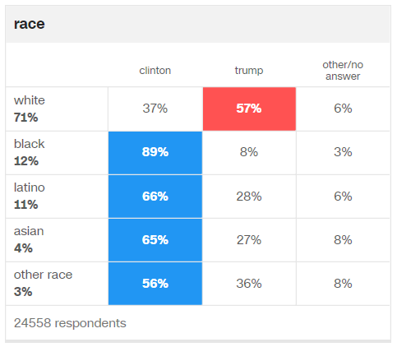
Vote Choice in Presidential Elections Demographics
2016 Presidential Election
The Conventional Wisdom coming out of 2012 was that the Republican needed to win a higher % of female and Hispanic voters to win in 2016
This turned out not to be the case. Trump won more disaffected voters (mostly white) in Wisconsin, Michigan, Ohio, and Pennsylvania, which turned out to be the difference in his victory in 2016
Notes:
Source (2016 Exit Polls): cnn.com/elections
2008 & 2012: Some demographics are strong predictors of vote choice in a presidential election. Typically, blacks vote ~90% for the Democratic candidate, and roughly 2/3rds of Hispanics tend to vote for the Democratic candidate. About 55% to 60% of whites vote for the Republican candidate. In the aftermath of the 2012 election, the conventional wisdom was that Republicans needed to do better with hispanic voters—Romney only won 27% of the hispanic vote.
2012: The Republican base is very strongly against illegal immigration, and Romney appealed to that sentiment in 2012. Some concluded that Romney won so few hispanic votes because of that strong stance. In the 2016 cycle, Donald Trump vowed to win the hispanic vote, but he took an even harsher line on illegal immigration than Romney. Trump pledged to build a wall along the U.S.-Mexico border and somehow compel Mexico to pay for the wall. Much of his appeal is valence (character) related, and perhaps some Hispanics are attracted to his most appealing traits (e.g., Trump speaks his mind, and he can’t be corrupted with campaign donations because he is rich enough to self-finance his own campaign), but in the end,

Slide 15
The Trump Presidency

Slide 16
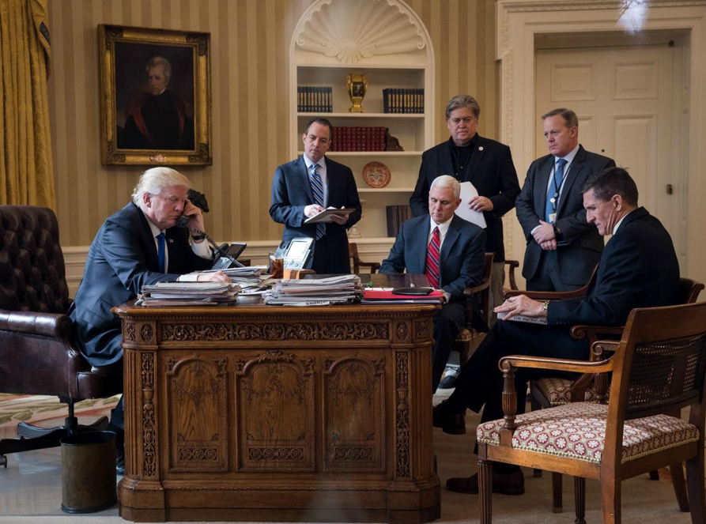
The Trump Presidency A Chaotic Start to the Trump Presidency
Only VP Mike Pence is still left from Trump’s original circle of advisors. All others pictured either resigned or were fired in the early months of the Trump presidency
Notes:
In the picture above, those with X’s from left to right are: Chief of Staff, Reince Previus, policy advisor, Steve Bannon, White House spokesman, Sean Spicer, and National Security Advisor, Michael Flynn.
In addition to his inner circle, Trump has feuded with his cabinet secretaries. He has openly attack his Attorney General (Jeff Sessions) for recusing himself from the Russia investigation. He has feuded with his Secretary of State (Rex Tillerson) over dealing with North Korea, tweeting that it is a waste of time to negotiate with “little Rocket man.” Tillerson reportedly called Trump a “blanking moron” in response.

Slide 17
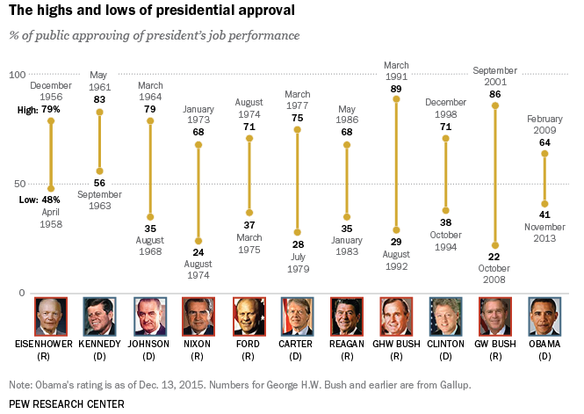
Public Opinion The Importance of Presidential Approval
Presidents want their job approval numbers to be above 50%
Why? 1) The president is more likely to get his agenda through Congress
2) The president’s opposition is less likely to attack the president
Trump has averaged 39% approval in his first 9 months in office
Notes:
Source: http://www.pewresearch.org/fact-tank/2016/01/12/presidential-job-approval-ratings-from-ike-to-obama/
It matters if the American people are supportive of their president, or not.
When a president has job approval numbers in the 60s and 70s, they can be very effective. Their supporters are more loyal and their opponents back off, fearing that if they challenge the president, they may be defeated in the next election.
When a president has job approval numbers in the 20s or 30s, the president is unlikely to get any proposal through Congress, and the president’s opposition feels confident to attack the president relentlessly, hoping to discredit him even further in the eyes of the public.

Slide 18
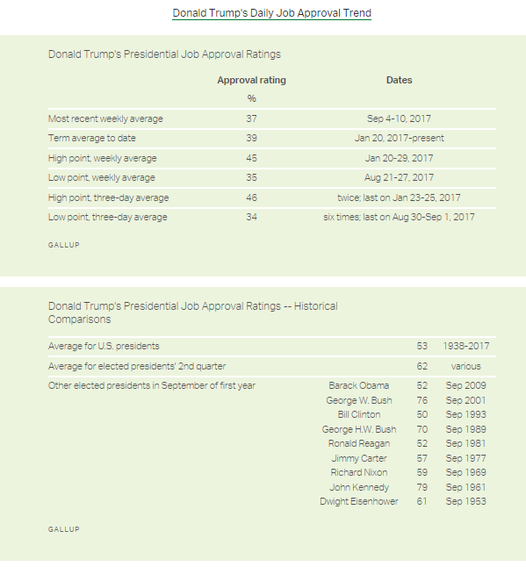
The Honeymoon Donald Trump (2017 - Present)
Unlike most past presidents, Trump has not enjoyed a “honeymoon,” averaging only 39% approval of the public in his first 9 months in office
Typically, presidents enjoy a “honeymoon” period when they first take office, meaning that the American people want the new president to get off to a good start and the president’s political opposition usually stands down for a while
Notes:
Source: http://news.gallup.com/poll/203198/presidential-approval-ratings-donald-trump.aspx
Bill Clinton did not enjoy a great honeymoon period in 1993; still, his approval numbers were better than Trump’s.

Slide 19
Accomplishments
Trump’s 1st Year Accomplishments

