Slide 1
SLIP Orientation
Successful Learning Intervention Program

Slide 2
Welcome to a new path!!
Why are you here?
ACADEMIC suspension
or
ACADEMIC probation
What are you expected to do?
  Participate in SLIP program this semester
  Get better grades
Notes:
Group Rules
Definition of Terms
Calculating your Grade Point Average (GPA)
Barriers to Success
SLIP Agreement
Counseling Services
Counselor Contact Information

Slide 3
What Will Happen Next:
After the completion of the SLIP Orientation session, your hold will be removed within the next 24 hours.
You will be notified if you are required to file an Appeal. Please allow 5-7 business days for appeals to be reviewed once they have been submitted.
Your hold will not be removed if you are not Term Activated.

Slide 4
Academic Standing
Good Standing | Cumulative GPA of 2.0 or higher
Probation | Cumulative GPA below 2.0
Continued Probation | Cumulative GPA below 2.0 and a Term GPA of 2.0 or higher
Suspension | Previous term status of probation or continued probation and term GPA falls below 2.0
Notes:
At this point, have students open their student center and list their grades (if in a lab with computer stations).

Slide 5
Academic Suspension
All students who are suspended from the previous semester must complete the following prior to your ability to enroll.
  Attend SLIP Orientation
  Complete an Academic Suspension Appeal or sit out for one long semester
    Submit a typed academic appeal to your designated counselor.
    Provide supporting documentation . An appeal will not be reviewed without sufficient supporting documentation.
    You will be notified of the committee’s decision by e-mail or via phone.
    Make sure that your e-mail on the SLIP Orientation sign-in sheet is one that you read on a regular basis and that you write it legibly.
    If your appeal is approved, your hold will be released and you can enroll in a maximum of 7 hours for the semester.

Slide 6
What is SLIP?
Successful Learning Intervention Program
  The program lasts all semester
  Students on Academic Probation/Suspension are allowed to enroll up to 7 SCH only; Online courses aren’t recommended
  Enroll in 16-wk or 12-wk (Fall/Spring semester);
  You’re expected to seek/attend tutorial services
  http://www.hccs.edu/district/students/tutoring/
  You meet 3 times with this counselor (MANDATORY)
    Once today (SLIP Orientation)
    Twice individually (1-on-1) (Must be scheduled after classes start)
    First appointment – may be scheduled before classes start or 3 weeks after classes begin
    Second appointment – schedule around mid terms/workshop

Slide 7
What am I supposed to get from the SLIP program?
Methods to improve your grades.
Knowledge of your “barriers to success”.
How to choose the correct classes.
How to improve your ability to concentrate in class.
How to improve your motivation for school.
How to improve your ability to comprehend material.
Knowledge that HCC really wants you to do well and complete your degree and/or certificate.
  And have a face and name to go with that concern!

Slide 8
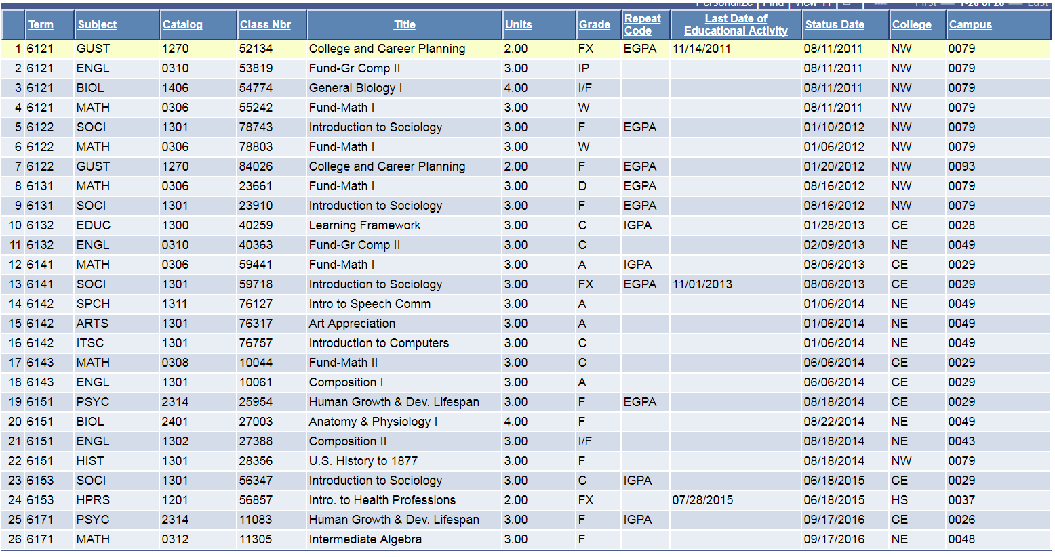
Group Activity 1

Slide 9
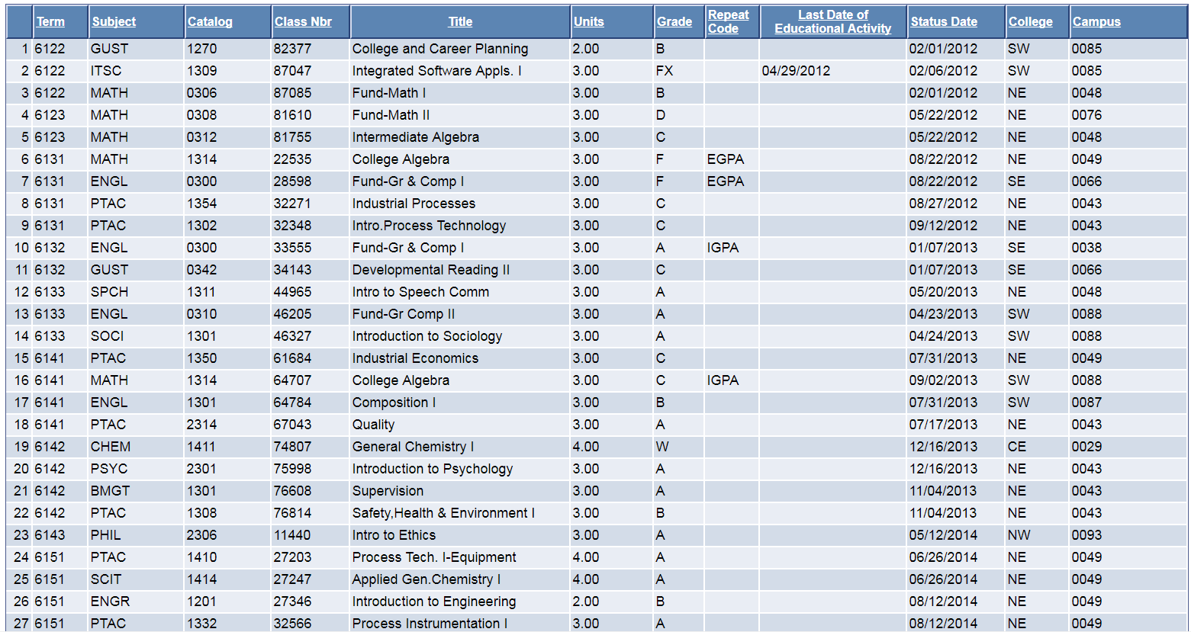
Group Activity 2

Slide 10
Grades Explained
FX(Failing)-Student failed because he/she stopped attending.
I/F (Incomplete/F)-Student was given extra time to complete the class and failed to do so. (No need to re-enroll; 6-months to complete Incomplete grade)
IP (In Progress)-Given only for developmental classes. Student must retake the course for credit.
W (Withdrawn)-Student withdrawn from class.
Notes:
IP, COM and I do not affect the GPA-per 2011-2013 catalog, pg. 43.
Instructors are allowed to withdraw a student after missing too many classes. Period!

Slide 11
EVERYTHING THAT YOU NEED TO KNOW as an HCC student, may be found at:
INFO FOR STUDENTS:
https://www.hccs.edu/resources-for/current-students/
CATALOG:
https://www.hccs.edu/programs/catalog/
STUDENT HANDBOOK:
https://www.hccs.edu/resources-for/current-students/student-handbook/

Slide 12
Calculating your GPA
Each grade you receive for your class is worth a specific number of points:
  A = 4.0
  B = 3.0
  C = 2.0
  D = 1.0
  F = 0
A Grade Point Average (GPA) starts at zero and can be as high as 4.0
Falling below a 2.0 GPA can lead to:
  academic probation
  continued probation
  suspension
A GPA of 4.0 equals an A average.
FAST FACTS:
The higher your GPA, the more options you have.
(programs, jobs, pay, etc.)
The lower your GPA, the fewer options you have.
(programs, jobs, pay, etc.)

Slide 13
Calculating your GPA
Each course is worth a specific number of semester credit hours..
Example:
  Student takes HIST 1301 and BIOL 1406
  This student is taking a TOTAL of 7 semester credit hours.
  Note: BIOL 1406 equals 3 hours of lecture plus 1 hour of lab time.

Slide 14
Calculating your GPA
Divide the total number of points by the total number of credit hours.
Example:
  Class & Credit hrs. Grades Credit Hrs. x Grades
  A = 4.0
  B = 3.0
  C = 2.0
  D = 1.0
  F = 0.0
27/9 = 3.0
The student’s GPA is 3.0
  HIST 1301 B = 3.0 3x3 = 9
  MATH 1314 C = 2.0 3x2 = 6
  PSYC 2301 A = 4.0 3x4 = 12
9 credit hours
27 total points

Slide 15
ON-LINE GPA CALCULATOR
UHD On-line GPA Calculator
https://www.uhd.edu/academics/advising/Pages/academic-advising-aac-gpa.aspx

Slide 16
How do I improve my GPA?
The fastest way to improve your GPA is to retake courses you failed.
Notes:
The “new” grade replaces the “old” grade and improves your GPA.
Note: ALL grades (both old and new) will remain on your HCC transcript.
Example: Student fails ENGL 1301. Student retakes ENGL 1301 and earns a grade of a, “B”. The grade of, “B” replaces the original “F” and improves student’s GPA. Both grades remain on student’s HCC record.

Slide 17
Financial Aid Issues
Student must successfully meet the minimum cumulative GPA of 2.0
Student must meet Ratio requirements and progress toward graduation by successfully completing 67% of the cumulative units attempted
    Ratio=Cumulative number of credit hours successfully completed
    Cumulative number of credit hours attempted.
    Attempted: not dependent on whether the student received financial aid.
Financial Aid Call Center # 713-718-2000, Option #2
OR 713/718-8490

Slide 18
SQ4R Method of Study
Scan the chapter – Read the introduction, read the subtitles, notice pictures, graphs, bold words, and read the questions at the end of the chapter.
Question – Turn the first subtitle into a question
Read – Read from the first subtitle to the next one
Respond – Answer your question
Write – Using Cornell notes, write your question on the 1/3 portion of your note paper and the answer on the 2/3 section of the page. Continue in this manner through the remainder of the chapter.

Slide 19
SQ4R Continued
6. Review – Answer the questions at the end of the chapter. When you study for your test, cover the right side of the paper and try to answer the questions you responded to.
Cornell Notes –
Keep your work organized by subject and date
Use page numbers and identify the chapter
Keep papers from class with your notes
Read the entire syllabus on the first day
Write a SMART goal for each of your classes
Use backwards planning to assure assignments are completed on time
Make use of online assistance and tools
1/3
Questions
Key Words
2/3
Answers to questions
Definitions

Slide 20

SMART Goals
Specific
Measurable
Attainable
Realistic
Time
Example: “I will earn a grade of a B in ENGL 1301 in Spring 2019.”
What is missing from the goal and how do you find the answer?
(Missing is how the student will earn a grade of B. Where do you find the answer – look at the teacher’s syllabus)
To learn more about goals, go to:
http://play.simpletruths.com/movie/10-rules-for-success/

Slide 21
IN-DEPTH CAREER COUNSELING
(To help find your career path/match)
TYPEFOCUS:
https://www.typefocus.com/
TypeFocus Access Code: hccs55
To make an appointment for career counseling, call your counseling center.
OTHER ONLINE CAREER INVENTORIES [Self-Directed Search (SDS)]
Career Coach at HCC
https://hccs.emsicareercoach.com/
Texas Reality Check
http://www.texasrealitycheck.com/
O*NET ONLINE
https://www.onetonline.org/
HCC-Career Planning and Resources (CPR): Virtual Career Center (VCC)
http://www.hccs.edu/district/students/career-planning/

Slide 22

HCC Library Mission
HCC Libraries, faculty librarians, and staff provide transformative instruction and friendly and expert learning support in inviting learning spaces and online environments, with the most relevant and accessible physical and digital information resources, accessible technology, and quality programs that promote student learning and success.

Slide 23
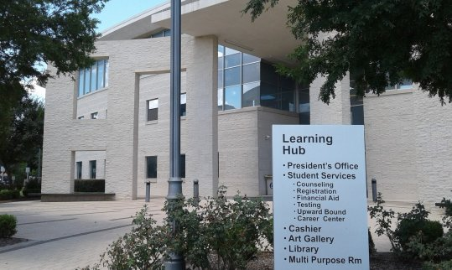
Prof. Richard Conn Public Librarian–SE 713/718-7334 richard.conn@hccs.edu http://library.hccs.edu/
Library Hours
Monday 7:30 am - 9 pm
Tuesday 7:30 am - 9 pm
Wednesday 7:30 am – 9 pm
Thursday 7:30 am – 9 pm
Friday 7:30 am – 4 pm
Saturday 9 am – 3 pm
Sunday 12 pm – 6 pm

Slide 24
Our staff is here to provide energetic and enthusiastic faculty librarians and support staff sufficient to meet the needs of student learners and faculty.
We work closely with students individually and in groups as coaches, facilitators, mentors, and professors to support engagement, learning, and success.
We provide reference and information services based on the best information currently available.
We provide information use, library, and research instruction in a variety of forms and media to empower students for immediate success and for lifelong engagement as citizens, employees, entrepreneurs, and learners.

Slide 25
Barriers to Success
Interpersonal Problems
Learning Challenges
Problems with Motivation and Goal-Setting
Distractions
Time Management
Notes:
No student says to himself/herself, “I want to go to school and not get good grades!”
“Things” can interfere or become barriers to success.
Interpersonal Problems with:
Family
Romantic Relationships
Peer
Intrapersonal Problems such as:
Depression
Anxiety
Health Issues
Financial Problems
Job related issues or joblessness
Job Search
WorkSource Solutions
On campus resources
Residential issues
Homelessness/Couch surfing
Learning Challenges
Test Anxiety.
Math class difficulties.
Poor study skills/habits.
Distractions from studying.
Problems with Motivation and Goal-Setting
Setting short-term and long-term goals.
Poor time-management skills.
Procrastination.

Slide 26
Barriers to success:
Dealing with distractions
Some things to consider:
  Television
  Too many study breaks.
  Facebook, Twitter, YouTube, Pinterest, Snapchat, etc…
  Texting
  Uncomfortable when studying.
Notes:
Do you try to study with the television on?
Do you take too many breaks from studying? Or take really long breaks?
Do you give in to online distractions like Facebook, Twitter, YouTube, etc….?
Do I waste time texting friends and relatives when I should be studying?
Am I comfortable when studying? Room too cold or warm?

Slide 27
Barriers to success:
Time Management Skills
Many students have difficulty managing their time wisely.
What can you do to make the best use of your time?
Notes:
Set aside time after each class to review class material.
Set aside time just for studying.
Select a specific place to study (library, home, etc…)
Pick the best times to study (when you are most likely to make use of that time).
Study in small periods of time. Don’t cram too much material in a short amount of time.
Be aware of how long you can pay attention to the material.
Don’t take too many classes. Limit your class load.
Allow time for emergencies (traffic, daycare, working late, etc…)
Relax!

Slide 28
Time Management Tips
Get Organized - Use a planner or calendar to write down assignments that are due for the semester. Refer to your class syllabus so you know what to pencil in on your planner.
Scheduling Study Time – Rule of Thumb: For every hour you spend in class, you should spend a minimum of 2 hours outside of class studying.
Prioritize your Time – study the hardest subject first.
Avoid procrastination - You retain more information if you study more often for shorter periods of time. For example, study for 45 minutes then take a 15 minute break.
Combine Activities – Study during your lunch break.
Social Interruptions – Put you phone on silent and turn off the television while studying or doing homework.

Slide 29
Time Management (continued)
168 hrs total in a week
  21 hrs/week (3 hrs out of class for every 1 hr in (7 sch = 21 hrs studying)
  34 hrs of TV
  40 hrs = Full-time, 20 hrs = Part-time, 60 hrs = REALITY (pay bills, etc.)
  42 hrs a week for sleep = (6 hrs a night for 7 days of the week)
______________________________________________________________________________________________________________________________________
Total time left? 168-21-34-40-42 = 31 hrs.
Anyone want to eat, have fun, or take a shower?
BOTTOM LINE: Time needs to be managed in order to do all the things you want in a week.

Slide 30
Weekly Calendar
 |  |  | Weekly Calendar
 | Sunday | Monday | Tuesday | Wednesday | Thursday | Friday | Saturday
12:00am
1:00am
2:00am
3:00am
4:00am
5:00am
6:00am
7:00am
8:00am
9:00am
10:00am
11:00am
12:00pm
1:00pm
2:00pm
3:00pm
4:00pm
5:00pm
6:00pm
7:00pm
8:00pm
9:00pm
10:00pm
11:00pm

Slide 31
What am I studying?
Certificate
Associate of Applied Science Degree (AAS degree)
Associate of Arts Degree
Associate of Science Degree
HCC PROGRAMS:
http://www.hccs.edu/programs/

Slide 32
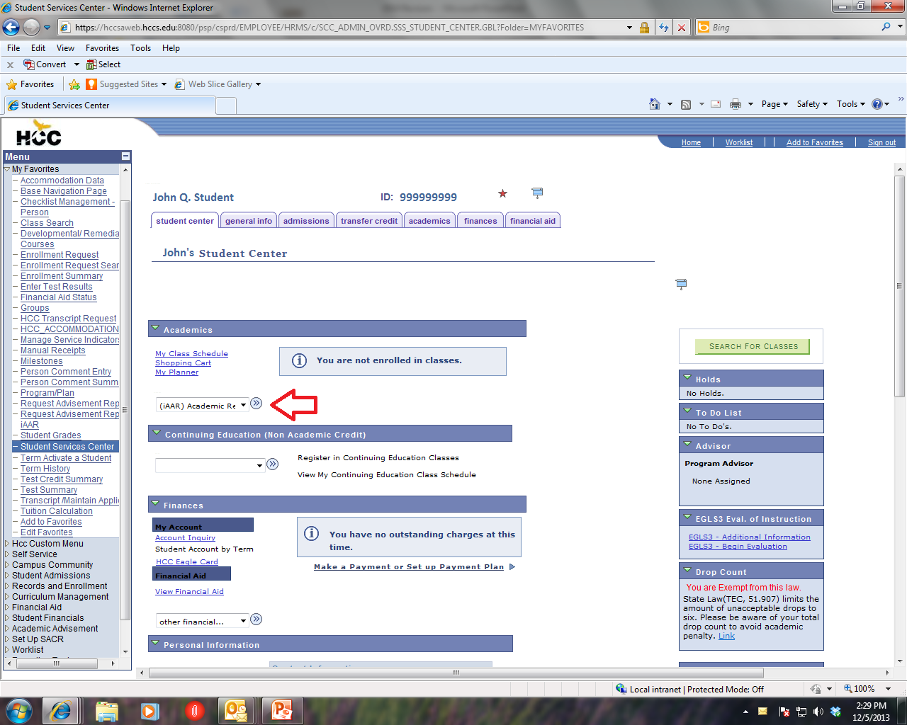
What classes do I sign-up for?
Notes:
Complete an IAAR report on your Student Center web page.
Speak to an Academic Advisor about a degree plan.

Slide 33
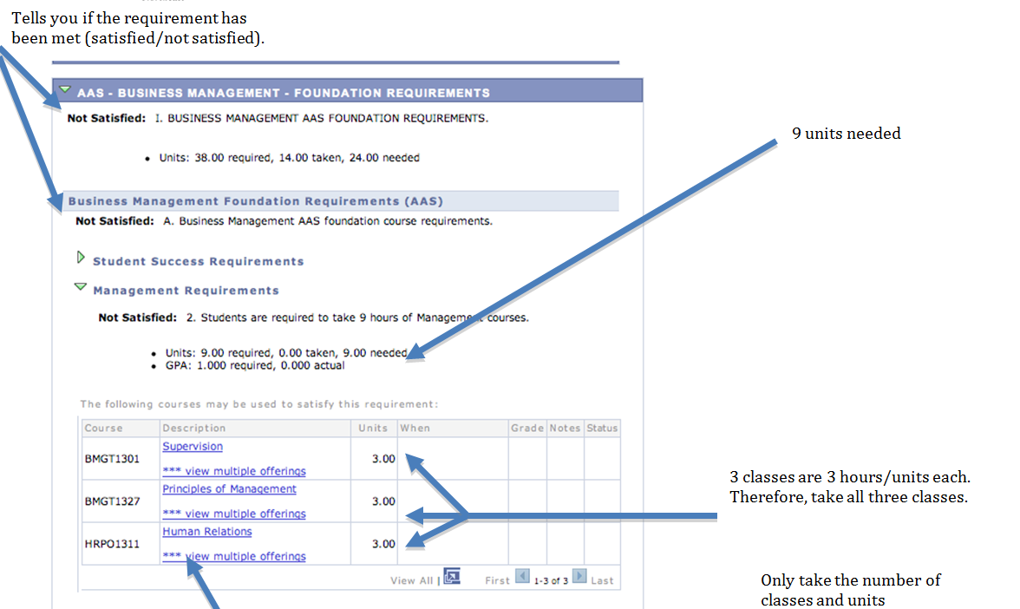
Individualized Academic Advisement Report (iAAR)

Slide 34
Counselor or Advisor?
Who do I talk to?
Counselors see students on academic probation or academic suspension.
Counselors meet with student with personal problems.
  (Note: Due to state licensure restrictions, personal counseling is available for Texas students only)
Counselors see students by appointment.
_________________________________________
Advisors answer questions about grades, degree plans, graduation, etc…..

Slide 35
HCC Counselors Webpage
DISTRICT | COLEMAN | SOUTHEAST | SOUTHWEST | NORTHWEST | NORTHEAST | CENTRAL
Director-Counseling and Ability Support Services Mahnaz Kolaini, MEd, NCC, LPC-S 713-718-7449 |  | Lead Counselor Roman Alvarez, EdD, LPC-S, LMFT-S 713-718-7144 | Lead Counselor DeShantra Moore, MSW, LCSW 713-718-7729 | Lead Counselor Kevin Fuller, MA, LPC 713-718-2838 | Lead Counselor Ayesha Farr, MA, NCC, LPC 713-718-8420 | Lead Counselor Hope Pamplin, PhD, LPC-S 713-718-6174
HCC Online Counselor Pat Jensvold MEd, LPC-S, NCC, 713-718-7281 | ADA Counselor Brandy Lerman, MEd, LPC 713-718-7082 | ADA Counselor E.J. Sit, EdD, LPC-S 713-718-7144 | ADA Counselor Becky Hauri, PhD, Lic Psyc 713-718-7909 | ADA Counselor LaRonda Ashford, EdD. LPC 713-718-5408 | ADA Counselor Cynthia De Los Santos, MA, LMFT 713-718-8322 | ADA Counselor Jette (Yetta) Lott, EdS, MA, LPC, CRC, NCC 713-718-6164
Counselor Veterans Ana Canek, MA, LPC 713-718-7544 |  | Counselor Cynthia Castellanos, MS, LPC 713-718-7144 | ADA Counselor Greta Brooks, MS, M.Ed., LPC, CRC 713- 718-7448 | ADA Counselor Lisa Parkinson, MEd, LPC 713-718-5667 | Counselor Patrick Nguyen, MS, LPC 713-718-6855 | ADA Counselor Senta Eastern, MEd, LPC-S, NCC 713-718-6164
 |  |  | Counselor Sara Shideler, MSW, LCSW 713- 718-7799 | Tamara Petty, MA, LPC-S, NCC 713-718-7518 |  | Counselor Cassandra Mack, MA, LCSW 713-718-6174
 |  |  | Counselor (Vacant), | Counselor Kevin Fuller, MA, LPC 713-718-2838 |  | Counselor Nicole Loving, MA, LPC 713-718-6174

Slide 36
HCC – Counselor Contacts
  https://www.hccs.edu/support-services/drug--alcohol-abuse-prevention/hcc-counselors/

Slide 37
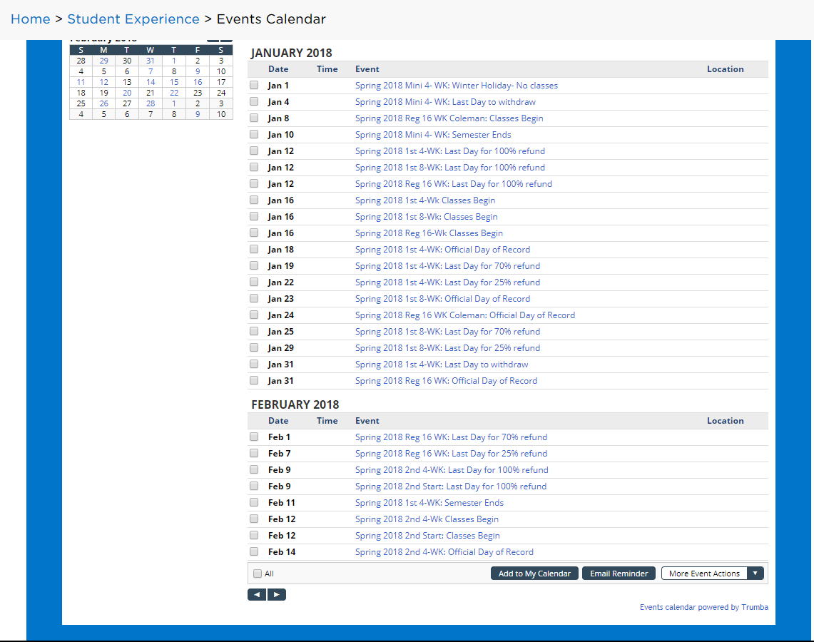
Academic Calendars
http://www.hccs.edu/student-experience/events-calendar/#/?i=2

Slide 38
Veterans
Ana Canek, MA, LPC
  Counselor, Veterans Affairs
  Telephone: 713-718-7544
  Email: ana.canek@hccs.edu
Location: 3200 Main Street
Houston, TX 77002
VA Call Center: 713-718-8522
  713-718-8522
Notes:
http://www.hccs.edu/portal/site/hccs/menuitem.a12520d901466b1f3227a2ced07401ca/?vgnextoid=0e0ed65bcc807310VgnVCM100000864710acRCRD&vgnextchannel=3f7df8a147b6f110VgnVCM100000054710acRCRD&appInstanceName=default

Slide 39
International Students
Office of International Student Services (OISS)
Houston Community College
3200 Main Street
Houston, Texas 77002
(corner of Elgin and Main St.)
Telephone: 713.718.8521
fax: 713.718.2112
email: https://www.hccs.edu/support-services/international-students/
Office Hours
Monday - Thursday: 8am - 5pm
Friday: 8am - 1pm
https://www.hccs.edu/support-services/international-students/international-advisors-/

Slide 40
HCC – Southeast Counselors
Contact Information
Dr. Roman Alvarez, LPC, LMFT
  Lead Counselor
  713-718-7144
  Email: roman.alvarez@hccs.edu roman.alvarez@hccs.edu
Ms. Cynthia Castellanos, LPC, NCC
  General Counselor
  713-718-7144
  Email: c.castellanso1@hccs.edu c.castellanos1@hccs.edu
Dr. EJ Sit, LPC-S
  ADA Counselor
  713-718-7144
  Email: estelle.sit@hccs.edu estelle.sit@hccs.edu

