Slide 1
HCC OER and Z-Degree Primer
Nathan Smith, PhD
Interim OER Coordinator

Slide 2
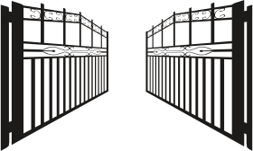
Welcome!

Slide 3
What are OER?
Open Educational Resources are teaching, learning, and research resources that reside in the public domain or have been released under an intellectual property license that permits their free use and re-purposing by others. (William and Flora Hewlett Foundation)

Slide 4
What is the Z-Degree?
Any degree plan composed entirely of Z Courses at HCC – i.e., courses that require only Open Access and OER materials. Courses developed as part of HCC’s Z degree initiative will be given the CC-BY intellectual property license and will be shared through an open platform.

Slide 5
What is an “open license”?
Items found in the “public domain”: Public domain material refers to published documents whose copyright term have expired or which have been intentionally released from all copyright claims.
Variable licensing: Some permissions are granted by the author while withholding other permissions, for example, the Creative Commons Licenses.

Slide 6
Creative Commons Licensing
The best known legal framework for openly licensing your work is Creative Commons (CC).
This is a legal license that preserves some of your intellectual property rights.
Whereas traditional copyright asserts “all rights reserved,” CC licenses assert “some rights reserved.”
The CC-BY license “lets others distribute, remix, tweak, and build upon your work, even commercially, as long as they credit you for the original creation. This is the most accommodating of licenses offered. Recommended for maximum dissemination and use of licensed materials.”
(https://creativecommons.org/licenses/)

Slide 7
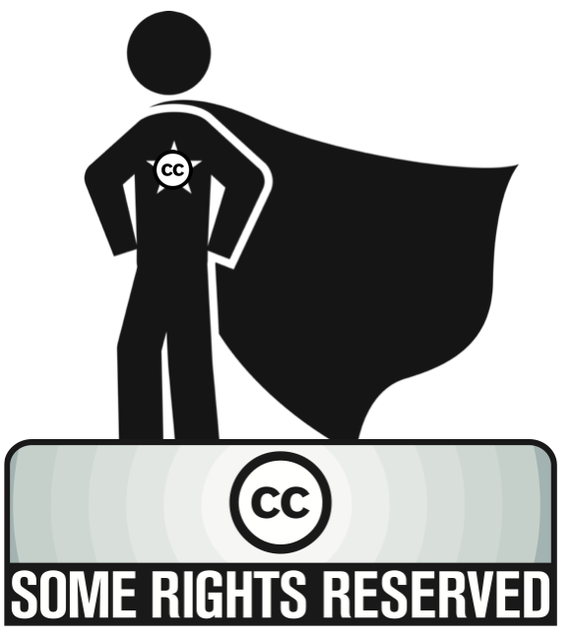

Slide 8
The 5 R’s of OER
Importantly OER materials attempt to preserve these capacities (Wiley 2014):
Retain: the right to make, own , and control copies of the content.
Reuse: the right to use the content in a wide range of ways.
Revise: the right to adapt, adjust, modify, or alter the content itself.
Remix: the right to combine the original or revised content with other open content to create something new.
Redistribute: the right to share copies of the original content, your revisions, or your remixes with others.

Slide 9
Perceptions of OER
A large, meta-study examining 4,510 student and faculty members found that “In no instance did a majority of students or teachers report a perception that the OER were less likely to help students learn. In only one study did faculty state that traditional resources had a higher ‘trusted quality’ than OER (however nearly two-thirds said they were the same).” (Hilton, 2016)
HCC’s internal survey (over the years 2014-2016) found that 51% of faculty who have used OER rate their quality as “about the same” as traditional textbooks, while 34% rate their quality as somewhat or much better and only 14% rate them as somewhat or much worse than traditional textbooks.

Slide 10
Benefits of OER and the Z-Degree

Slide 11
Academic Freedom
The primary benefit of using OER in your courses is that they return control of the course design and content to the instructor.
Too often, courses structured around traditional textbooks (and ancillary materials) are wedded to the structure, design, and content of the textbook.
Textbooks, requiring approval by the program committee, are frequently imperfectly aligned with a particular instructor’s teaching preferences.
Publishers typically make small revisions to their textbooks with their cycle of new editions that force faculty to redesign courses with little pedagogical benefit.

Slide 12
Cost Savings to Students
HCC internal surveys (2015-16) indicate that 77% of students spend over $150 per semester on textbooks, with 47% spending over $300 per semester.
HCC surveys (2014-16) also show that faculty are quite concerned with textbook costs (26% moderately concerned, 52% extremely concerned)
OER courses promise to drastically reduce the cost of instructional materials to students since (at least in digital forms), these materials should be freely accessible to students.

Slide 13
Cost Savings cont.
Hilton and Laman (2012) estimate that adopting OER saves each student between $64.30 and $81.60 per course. This could translate to as much as $1,650 savings over the course of an associates degree, or roughly the tuition for 8 classes!
Hilton et al (2014) shows a cost savings across 6 colleges as averaging between $60.03 to $154.21 per course.
This money can be used for additional courses (decreasing time to completion) or for life needs (freeing students to focus on education). (see Hilton et al, 2016 and Wiley et al, 2016)

Slide 14
Student Success
OER appear not only to positively impact students financially, but also to improve their success, retention, and progress to degree.
Fischer et al (2015), in a multi-institutional study found that a marginally larger share of students achieved a C or better and completed courses with OER as compared to traditional textbooks.
Fischer et al (2015) and Hilton (2016) also found significant improvement in enrollment intensity (the number of courses taken in the subsequent semester) among students who take courses using OER than those who take courses using traditional textbooks.

Slide 15
Open Learning / Open Pedagogy
OER open up a range of possible new pedagogical methods.
Open Learning and Open Pedagogy refer to an approach to teaching and learning that aims to remove all unnecessary barriers to learning:
Encourage students to participate in the learning process.
Provide opportunities for extension of learning beyond the classroom.
Increase flexibility and access for learning according to the needs and desires of students.
Education that emphasizes competencies and demonstrated abilities rather than test scores or seat time.

Slide 16
References
Butcher, Neil. (2015). A Basic Guide to Open Educational Resources (OER). Vancouver, BC: UNESCO.
Hilton, J. (2016). Open educational resources and college textbook choices: a review of research on efficacy and perceptions. Educational Technology Research and Development, 64(4). pp 573–590. 10.1007/s11423-016-9434-9
Hilton, J., Robinson T. J., Wiley, D. A., & Ackerman, J. (2014). Cost-Savings Achieved in Two Semesters Through the Adoption of Open Educational Resources. International Review of Research on Distance and Open Learning.

Slide 17
Hilton, J., Fischer, L., Wiley, D., & Williams, L. (2016). Maintaining Momentum Toward Graduation: OER and the Course Throughput Rate. International Review of Research in Open and Distance Learning, 17(6). http://dx.doi.org/10.19173/irrodl.v17i6.2686
The Noun Project. Creative Commons: About the Licenses. Retrieved from: https://creativecommons.org/licenses/
Wiley, David. (2014). The Access Compromise and the 5th R. Retrieved from: https://opencontent.org/blog/archives/3221
Wiley, D., Hilton, J., Williams, L., & DeMarte, D. (2016). The Tidewater Z-Degree and the INTRO Model for Sustaining OER Adoption. Education Policy Analysis Archives, 23(41). http://dx.doi.org/10.14507/epaa.v23.1828

